Slide 1


ETP2
Coding Style Guideline for Android Apps
Android Apps Documentation

Slide 2
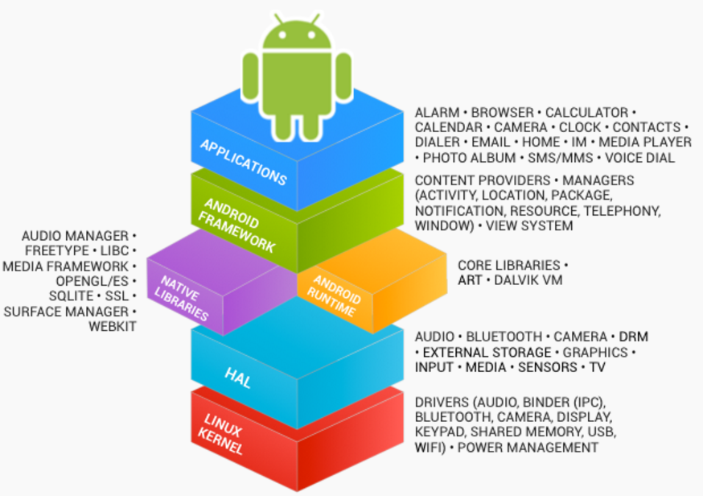
General Recommendation
Follow the
coding style rules for contributors
defined by the Android
community http://source.android.com/source/code-style.html
or
https://github.com/ribot/android-guidelines/blob/master/project_and_code_guidelines.md

Slide 3
Android Code Style Rules
Follow standard Java Coding conventions http://www.oracle.com/technetwork/java/codeconvtoc-136057.html
and some additional rules:
Never ignore exceptions
Do not use wildcards in imports import android.content.*; import android.content.Intent;
Some more … (details see http://source.android.com/source/code-style.html#java-language-rules )
Use Javadoc standard comments http://www.oracle.com/technetwork/articles/java/index-137868.html

Slide 4
Standard Java Coding Conventions
Source Files:
One file contains only one top-level class
Filename is the name of the top-level class followed by the .java extension.
Naming conventions:
Class names: UpperCamelCase Typically nouns or noun phrases: MainActivity
Method names: lowerCamelCase Typically verbs or verb phrases: sendMessage, stop
Constants: ALL_UPPER_CASE with words separated by underscore characters. Typically nouns or noun phrases: MAX_LENGTH, RED

Slide 5
Standard Java Coding Conventions
Naming conventions (continued):
Fields: lowerCamelCase Typically nouns or noun phrases: firstName, index
Local variables: lowerCamelCase May be abbreviated more liberally. E.g. one char. names may be used for temp. or looping variables: i,j,k,n
Apply camel case rules also on abbreviations: customerId, HttpRequest
Use English language
Names for items with a large scope may be longer but names with a small should be kept short
Don’t repeat the class name in fields and methods Line.length, Line.lineLength

Slide 6
Standard Java Coding Conventions
Other coding conventions:
Don’t use “magic numbers” (literals) in your code. Exceptions are: 1 and 0 for (int i = 0; i < 255; i++) for (int i = 0; i < MAX_LENGTH; i++)
Declare variables in the smallest scope possible
for (int i = 0; i < MAX_LENGTH; i++)

Slide 7
Standard Java Coding Conventions
Other coding conventions …:
Don’t declare public fields. Use setter and getter methods to access the fields. private int length; public int getLength(){ return length; } public void setLength(int length){ this.length = length; }

Slide 8

Javadoc
is used to automatically generate a documentation from comments in the Java code. (similar to Doxygen)
generates a HTML documentation
Javadoc comment blocks start with ” /** ” and ends with ” */ ”
Other Java comment /* ...*/ or //... is ignored by the Javadoc tool.
Javadoc comments are always placed directly before the statement to be documented.

Slide 9
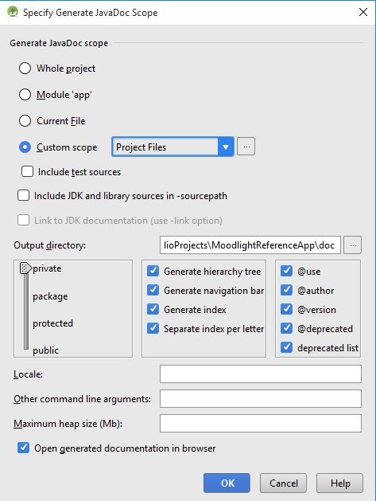
Javadoc with Android Studio
Tools → Generate JavaDoc …
Choose these settings ->
Define the output directory. You may choose a subfolder “doc” in the App root folder.

Slide 10
Javadoc with Android Studio
In Android Studio, /** followed by <enter> creates a Javadoc snippet.
Android Studio: Tools -> Generate JavaDoc … starts the Javadoc tool

Slide 11
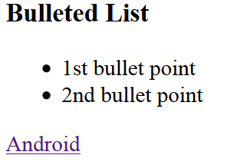
Javadoc General Rules
First sentence should summarize the description.
Remaining text is the detailed in depth description.
HTML tags may be included * <h3>Bulleted List</h3> * <ul> * <li>1st bullet point</li> * <li>2nd bullet point</li> * </ul> * <a href="http://developer.android.com" >Android</a>
generates:

Slide 12
Common Javadoc Tags
@author: author(s) of a class
@version: software version
@params: parameters passed to a method
@return values returned by a method
@throws exceptions thrown by a method
@see reference entry
{@code } literal code example

Slide 13
Javadoc Example
Full stop closes first sentence.
/**
* <h1>Here comes the brief description.</h1>
* Here comes the in depth class description. * * @author eand * @version V1.0 */
public class Example {
...

Slide 14
Javadoc Example
/**
* Method brief description.
* <br>
* Detailed description of method addNumbers() *
* @param a first value to be added
* @param b second value to be added
* @return the sum a + b * @author eand * @version V1.0 */
public double addNumbers(double a, double b)
{ ...

