Slide 1

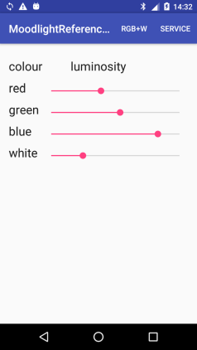
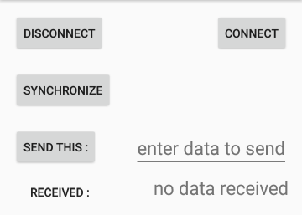
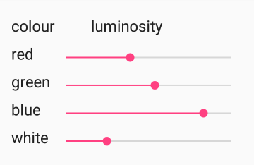
Moodlight Reference App
The Moodlight Reference App is based on ONE Activity and …
a Toolbar with the menu items which (on click) …
load the associated Fragments with the views (text, slider, …)

Slide 2
Classes of the Moodlight App
MainActivity Command center of the app. Manage the fragments of the user interface and the connection with the Moodlight.
RgbwFragment Red-Green-Blue+White view (fragment) of the app. Standard user interface where the brightness of each colour can be adjusted by changing the position of a SeekBar.
ServiceFragment Service view (fragment) of the app. User interface where the communication to the Moodlight can be controlled manually.
Connection Handles connection and data transfer with the Moodlight. Runs in the background and does not block the MainActivity.

Slide 3
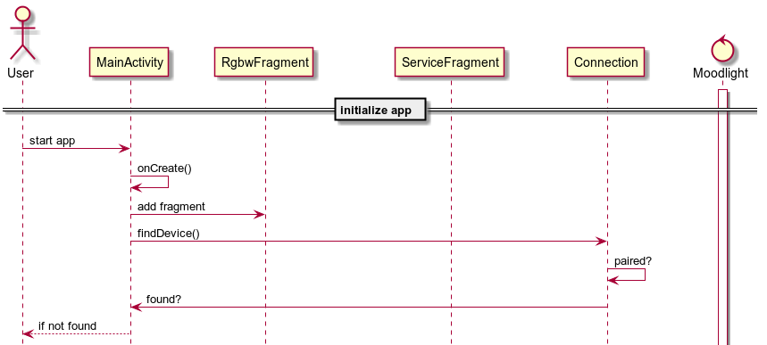
Sequence diagram

Slide 4
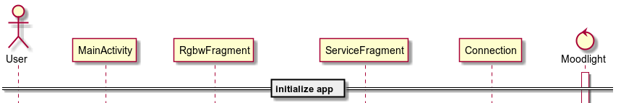
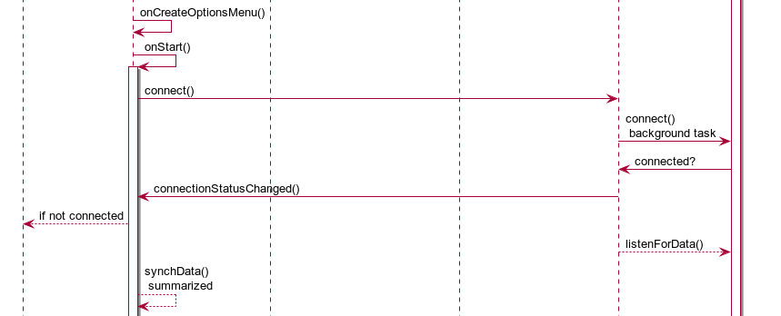
Sequence diagram (continued)

Slide 5

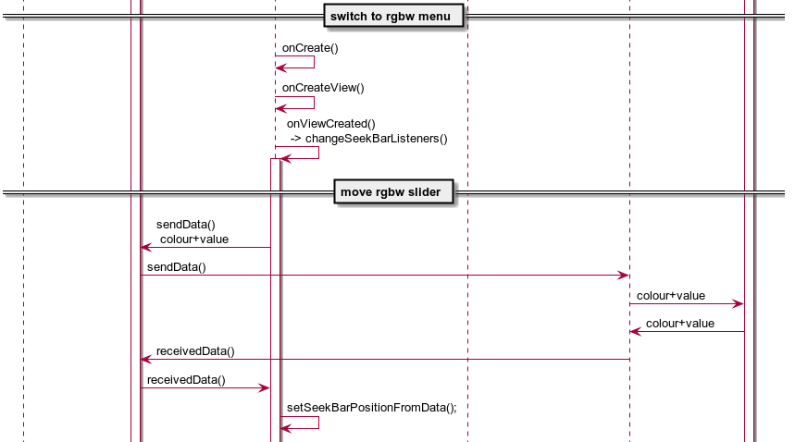
Sequence diagram (continued)

Slide 6
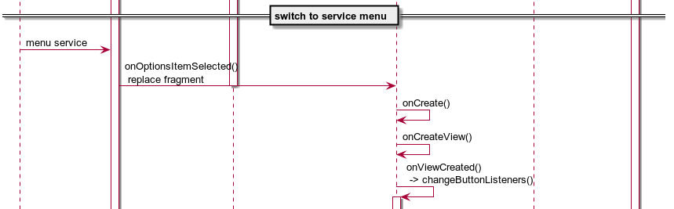
Sequence diagram (continued)

Slide 7
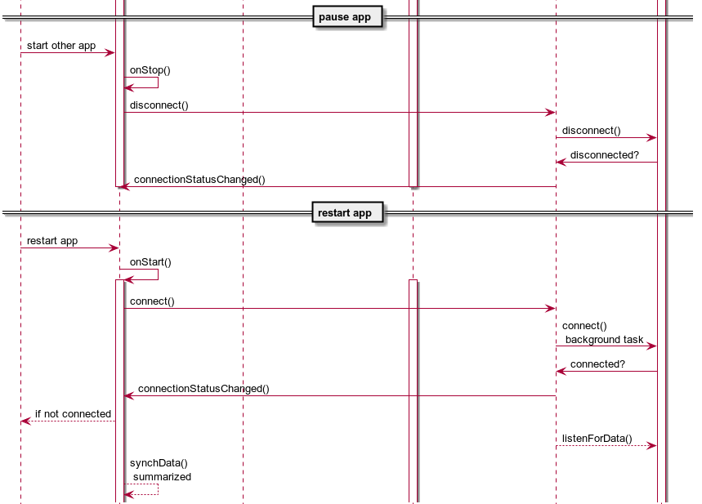
Sequence diagram (continued)

Slide 8
Activity-Fragment-Communication
There are a lot of ways to implement communication between the MainActivity and its Fragments.
The easiest way is to pass the data as parameters to a method and get the result as its return value.
Call a method in the MainActivity from within a fragment: ((MainActivity) getActivity()).methodInMainActivity();
Call a method in a fragment from within the MainActivity: fragmentInstanceName.methodInFragment();

Slide 9
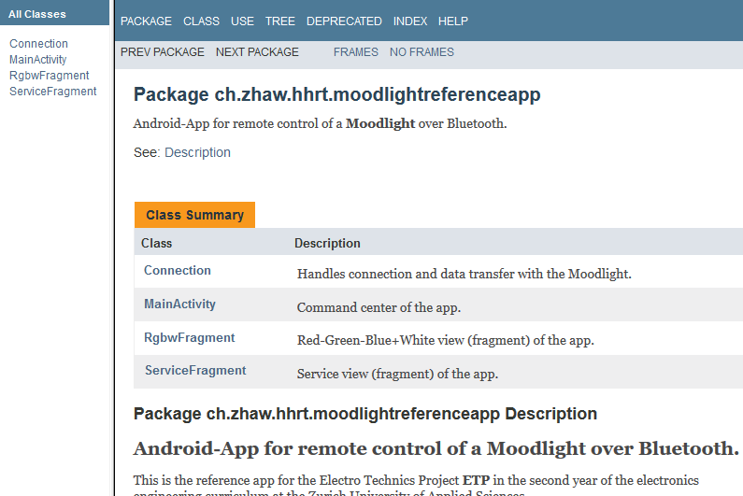
Javadoc of the Moodlight

Slide 10
Javadoc: Tips
Short description ends with ". x" where x stands for any uppercase letter or end of line.
Use <p> to start a new paragraph and <br> to start a new line.
To include an image use: <img src="{@docRoot}/images/image.jpg" alt="screenshot">
In other words: HTML tags can be used for formatting the documentation.
Use the examples in the Moodlight Reference App.

Slide 11
Moodlight Reference App: Files
Import the Android project (zip-file) from: \\shared.zhaw.ch\pools\t\T-ZSN-ETP\Android_App
Javadoc documentation …/MoodlightReferenceApp/doc/index.html
The Java code …/MoodlightReferenceApp/app/src/main/java/
The XML layout …/MoodlightReferenceApp/app/src/main/res/layout/

