Slide 1
Problem Statement :
Detect pixelated image and correct it

Slide 2
Unique Idea Brief:
Detects and Corrects Pixelated Images: This model identifies images that are pixelated and automatically enhances their quality by smoothing out the pixelation, restoring them to a clearer, more detailed state.
Real-Time Pixelated Video Correction Using OpenCV: Utilizing OpenCV, this model can process and enhance pixelated video streams in real-time, ensuring smooth, high-quality video playback without any noticeable pixelation issues.

Slide 3
Features offered:
1. Detection of pixeleted images
2. Correction of Pixeleted images
3. Single and recursive corrections
4. Video corrections

Slide 4
Process Flow:
1. Image preprocessing
2. Divide in 256x256 blocks
3. For each block, check if the block is pixeleted or not.
4. If pixeleted:
a. Correct the block once (inference.py)
b. Correct the block repeatedly until detection model marks it as
non-pixeleted (repeated-inference.py)
5. If not pixeleted, keep the block as it is
6. Assemble all the blocks in a single image
7. Save the image
In case of video-inference, every frame from the camera feed is processed and
played side by side using open-cv.

Slide 5
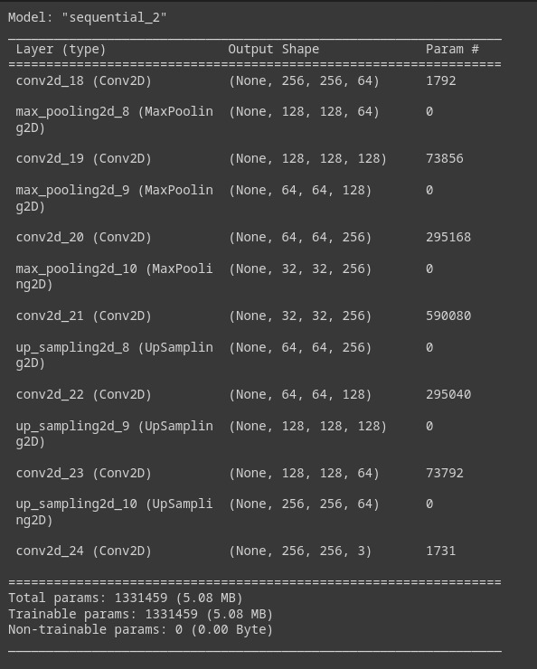
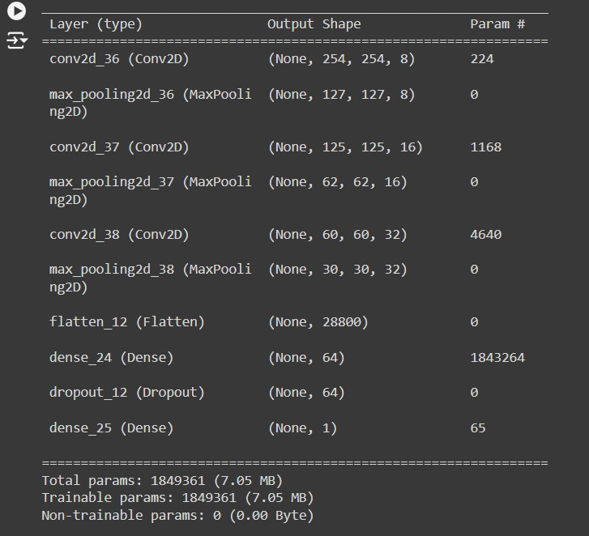
Model Architecture:
CORRECTION MODEL
DETECTION MODEL

Slide 6

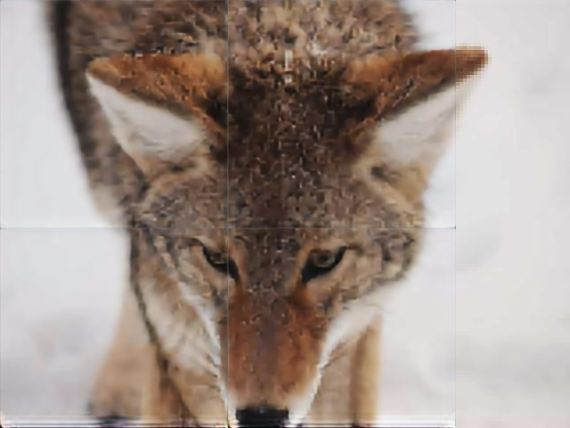
Output:
PIXELATED IMAGE
CORRECTED IMAGE

Slide 7

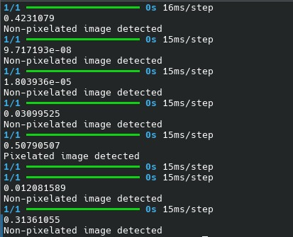
Output:
NON PIXELATED IMAGE
DETECTION

Slide 8
Technologies Used:
1. opencv-python
2. tensorflow
3. pillow
4. numpy

Slide 9
Team Members and Contributions:​
Om Mane - Correction Model
Mehul Kohad - Detection Model
Vedant Raut - Data Collection and Research

Slide 10
Conclusion:
The Pixelated Image Detection and Correction Model successfully addresses the common issue of image pixelation by leveraging deep learning techniques. With its ability to detect and correct pixelated regions, this model significantly enhances image quality. This project demonstrates the potential of AI in improving visual data and offers a robust solution for applications requiring high-quality image restoration. Future improvements could further refine the model's accuracy and efficiency, making it even more effective in various real-world scenarios.

