Slide 1






$$loss of immunity$$
$$ω$$
Susceptible
$$transmission$$
Infectious
$$recovery$$
Removed
$λ$(t)
$$γ$$

Slide 2
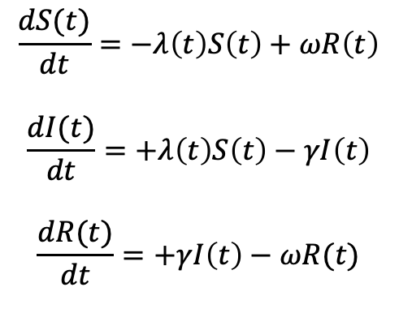
$$\frac{dS(t)}{dt}=−λ\left(t\right)S\left(t\right)+ωR\left(t\right)$$
$$\frac{dI(t)}{dt}=+λ\left(t\right)S\left(t\right)−γI\left(t\right)$$
$$\frac{dR(t)}{dt}=+γI\left(t\right)−ωR(t)$$

