Slide 1
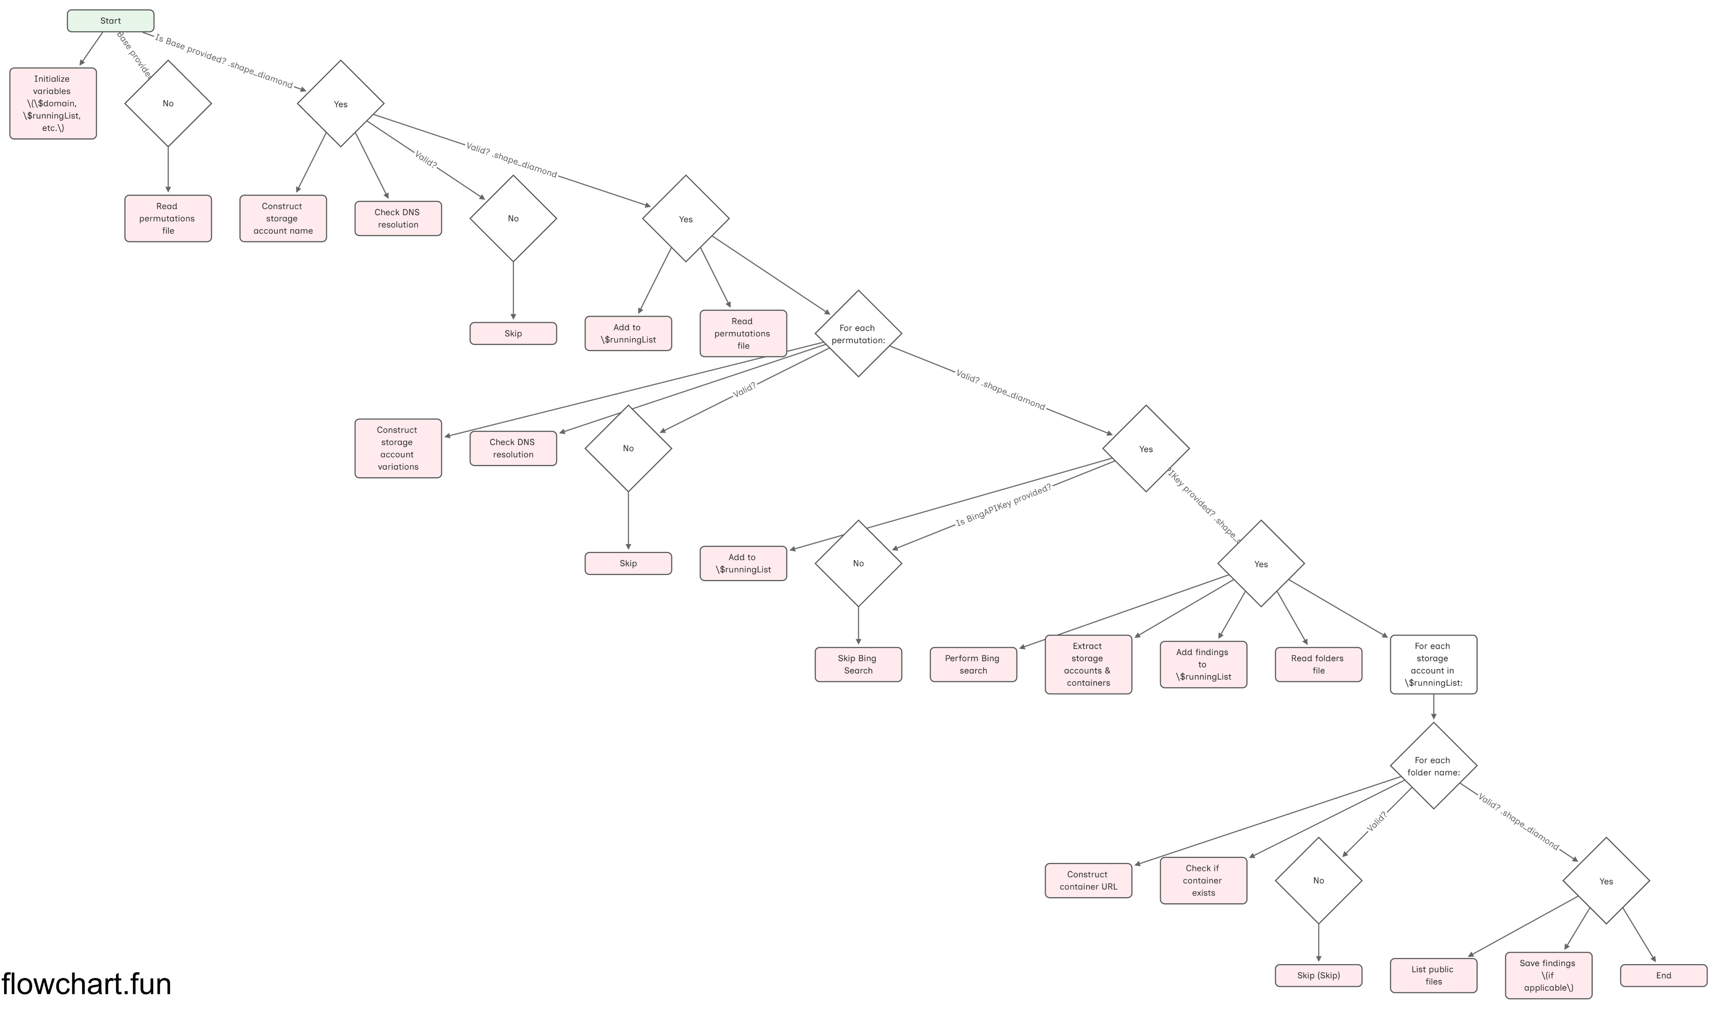
Storage Account Enumeration - NetSPI

Slide 2
L3 SOC Analyst
L2 SOC Analyst
Evaluates the case and escalates further for analysis
L1 SOC Analyst
(SOP)
Security Tools – Alerts/Incidents
Microsoft Defender for Cloud,
Microsoft Defender for Endpoint
Azure Monitor
Logs and Events from IT and Cloud Resources

Slide 3
Windows Authentication
Executables initiated by Userinit.exe
Explorer.exe: Desktop, Taskbar, Explorer, Start menu
cmd.exe: Executes logon scripts (batch files)
Powershell.exe: Runs PowerShell scripts
Wscript.exe/Cscript.exe: Executes VBScript or JavaScript-based logon scripts.
Gpupdate.exe: Ensures that Group Policy settings are applied.
Net.exe: Used for mapping network drives (e.g., net use X: \\server\share).
Rundll32.exe: Can be used to load DLLs for specific startup tasks.
Taskhost.exe: Loads DLL-based services from the registry (similar to svchost.exe).
Msiexec.exe: Handles installation of startup applications via .msi installers.
cmd.exe
cmd.exe
Handles user authentication UI before passing control to userinit.exe
Service control manager
‘services.exe’
Local session manager
‘lsm.exe’
Local security authority
‘lsass.exe’
Local session manager
‘LogonUI.exe’
‘UserInit.exe’
LogonUI.exe takes credentials and passes them to lsass.exe
Starts login process
Winlogon.exe calls Userinit.exe after successful authentication
Client Server Runtime Subsystem
‘cssrss.exe’
Windows Initialization Process
‘wininit.exe’
Windows logon process
‘winlogon.exe’
Client Server Runtime Subsystem
‘cssrss.exe’
Session 0
for system processes
It starts system services
Session 1
for User processes
After handling system processes Session manager again starts CSRSS
Boot initialization
Session manager
‘smss.exe’

Slide 4
Kerberos Authentication
Kerberos is the default authentication method used for Windows 11, Windows Server 2022, and Windows Server 2019.

Slide 5
Security Posture
A
B
C
D

Slide 6
Security Posture
Credentials
Unpatched software
Password issues
Misconfigurations
Encryption issues
Network segmentation
IAM
Denial of service attack
Phishing, Web and Ransomware
Zero days
Malicious insiders
Trust relationships

Slide 7
Defense in Depth Architecture
Policies
Perimeter
Network
Physical
Endpoint
Application
Data
Network Firewall
Identity and Access Management
DDoS Protection
Secure File Transfer
Network Security Group
Secure Remote Access
Antimalware
Patching
Patching
Secure Coding
DAST and SAST
Secure DevOps
Data Classification
Data loss prevention
Data Encryption

Slide 8
Project Risk
Application security
Information security
Disaster security
Network security
End user security
Operational security
Authentication
Authorization
Encryption
Logging
Application Security testing
Scope & Objective
Requirement definition
Technology employed
Technical processes
User interfaces
Technology scaling
Overall technical performance
Safety, security and reliability
Testing
Project management
Project resources
Communication
Interdependencies
Culture
Sponsorship
Business processes
Acceptance
Support
General contract
Financing
Vendor Stability
Subcontracts
Legal
Contractor experience
Legislative
Regulatory
Political
Pressure from outside groups
Weather
Unforeseeable circumstances

Slide 9



Cloud Access Security Broker
IaaS
SaaS
PaaS
Redirected traffic
API Access
CASB
Visibility
Threat protection
Data Security
Enterprise integration
Compliance
Enterprise integration
Redirected end user and Administrator traffic to cloud service traffic
Corporate Device
BYOD

Slide 10
RACI Matrix
Responsible
Individuals responsible for actually performing a task.
Accountable
Individuals ultimately answerable for the completion of the task or deliverable.
Consulted
Individuals who provide input and are consulted before a task is executed.
Informed
Individuals kept in the loop but are not directly involved in the task.
You as the IT auditor are responsible for conducting the audit.
You will review the policies, perform testing, document deficiencies and generate a report.
The Lead Auditor / Chief Audit Executive (CAE) will be accountable for ensuring the overall audit completion and issuing the audit report.
The Cyber & Risk Management team will be consulted because they have valuable insights into the technical aspects
The Audit Committee needs to be informed about the audit progress and the results, as they have a vested interest in the organization's audit practice.

Slide 11
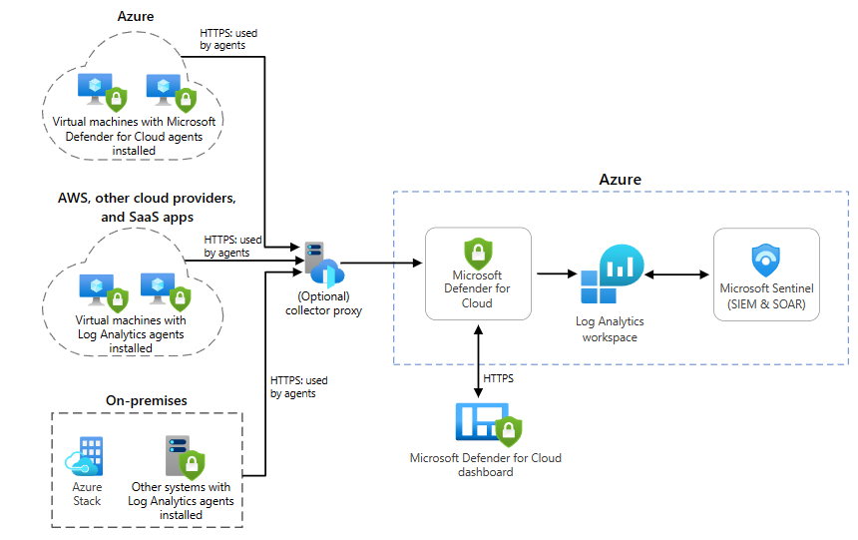
Here is a diagram that shows how to implement Sentinel in a hybrid environment:
https://learn.microsoft.com/en-us/azure/architecture/hybrid/hybrid-security-monitoring

Slide 12
Access control in Azure and Microsoft Entra
Different objects at different scopes are controlled in different ways.
Microsoft Entra Tenant
Entra Roles
Graph API Permissions
Object scoped roles
Explicit Ownership
Root Management Group
App
Service
principal
Device
Group
User
Management Group
Azure Admin Roles
Attribute based access controls
Keys, Secrets, and Certificates
Management Group
Certain objects like key vaults have their own permission model specific to that object
How much fun is that? ☺
Subscriptions
There is no one click in Azure where you can see all effective permissions of these objects
Resource Groups
VMs
Key Vault
DB
Blobs

