Slide 1
Kusto Query Language
Threat Hunting and Detection

Slide 2
Content
Let
Search
Where
Extend
Order by
Summarize
Render
Union
Join

Slide 3
Introduction
Kusto Query Language (KQL) is the query language used to perform analysis on data to create Analytics, Workbooks, and perform Hunting in Microsoft Sentinel.

Slide 4
Let
Let statements bind names to expressions, same like creating variables in scripting.
Used to break a potentially complex expression into multiple parts.
Let statements allow for the creation of user-defined functions and views
Declare and reuse variables:
"ago()" is a function that will take the current Date/Time and subtract it with value provided.
Declare dynamic tables or lists:
let timeOffset = 7d;
let discardEventId = 4688;
SecurityEvent
| where TimeGenerated > ago(timeOffset*2) and TimeGenerated < ago(timeOffset)
| where EventID != discardEventId
let suspiciousAccounts = datatable(account: string) [
@"\administrator",
@"NT AUTHORITY\SYSTEM"
];
SecurityEvent | where Account in (suspiciousAccounts)
let LowActivityAccounts = SecurityEvent
| summarize cnt = count() by Account | where cnt < 1000;
LowActivityAccounts | where Account contains "SQL"

Slide 5
Search
The search operator provides a multi-table/multi-column search experience.
Although the search operator is easy to use, when compared to the where operator it's inefficient
Even with this inefficiency, you can use search to find data when unsure which table or column to filter.
The first statement will search for "err" across all tables.
The second statement will search for "err" in tables SecurityEvent, SecurityAlert, and tables starting with A.
Try each of these queries separately to see the results.
search "err"
search in (SecurityEvent,SecurityAlert,A*) "err"

Slide 6
Where
The where operator filters a table to the subset of rows that satisfy a predicate.
SecurityEvent | where TimeGenerated > ago(1d)
SecurityEvent | where TimeGenerated > ago(1h) and EventID == "4624"
SecurityEvent | where TimeGenerated > ago(1h) | where EventID == 4624 | where AccountType =~ "user"
SecurityEvent | where EventID in (4624, 4625)

Slide 7
Extend
The extend operator will create calculated columns and append the new columns to the result set.
The KQL example below uses the extend operator to create a new column, StartDir containing the directory a process was started in.
The StartDir column is a calculated column containing the results of a substring function.
SecurityEvent
| where ProcessName != "" and Process != ""
| extend StartDir = substring(ProcessName,0, string_size(ProcessName)-string_size(Process))

Slide 8
Order operator
Sort the rows of the input table by one or more columns.
The order by operator can utilize any column or multiple columns by using a comma separator.
Each column can be ascending or descending. The default order for a column is descending.

Slide 9
Summarize operator
The count operator with its variations will create a new column with the calculated result for the specified fields.
The first statement below will return one column that is a unique list of Activity column values.
The second statement will return a count of SecurityEvent rows where EventID equals 4688, and the count is grouped by Process and Computer. Because of the by clause, the result set will contain three columns: Process, Computer, Count.
Run each Query separately to see the results.

Slide 10
Project
The project operators control what columns to include, add, remove, or rename in the result set of a statement.
There are multiple types of project operators.
The following table is a list of the variations.
Operator | Description
project | Select the columns to add, rename or drop, and insert new computed columns.
project-away | Select what columns from the input to exclude from the output.
project-keep | Select what columns from the input to keep in the output.
project-rename | Select the columns to rename in the resulting output.
project-reorder | Set the column order in the resulting output.

Slide 11
Render
The render operator generates a visualization of the query results.
The supported visualizations are:
areachart
barchart
columnchart
piechart
scatterchart
timechart
Use the summarize operator to create time series
The bin() function rounds values down to an integer multiple of the given bin size.
Used frequently in combination with summarize by ....
If you have a scattered set of values, the values are grouped into a smaller set of specific values.
Combining the generated time series and pipe to a render operator with a type of timechart provides a time-series visualization.
SecurityEvent | summarize count() by Account | render barchart
SecurityEvent | summarize count() by bin(TimeGenerated, 1d) | render timechart

Slide 12
Union
It takes 2 or more tables and returns rows of all of them.
The union operator supports wildcards to union multiple tables. The following KQL will create a count for the rows in all tables with names that start with Security.
// Query 1 return all rows of SecurityEvent and all rows of SigninLogs
SecurityEvent | union SigninLogs
// Query 2 return one row and column, which is the count of all rows of SecurityEvent and all rows of SigninLogs
SecurityEvent | union SigninLogs | summarize count() | project count_
// Query 3 return all rows of SecurityEvent and one row for SigninLogs.
SecurityEvent | union (SigninLogs | summarize count()| project count_)
// Query 1 return all rows of SecurityEvent and all rows of SigninLogs
union Security* | summarize count() by Type

Slide 13
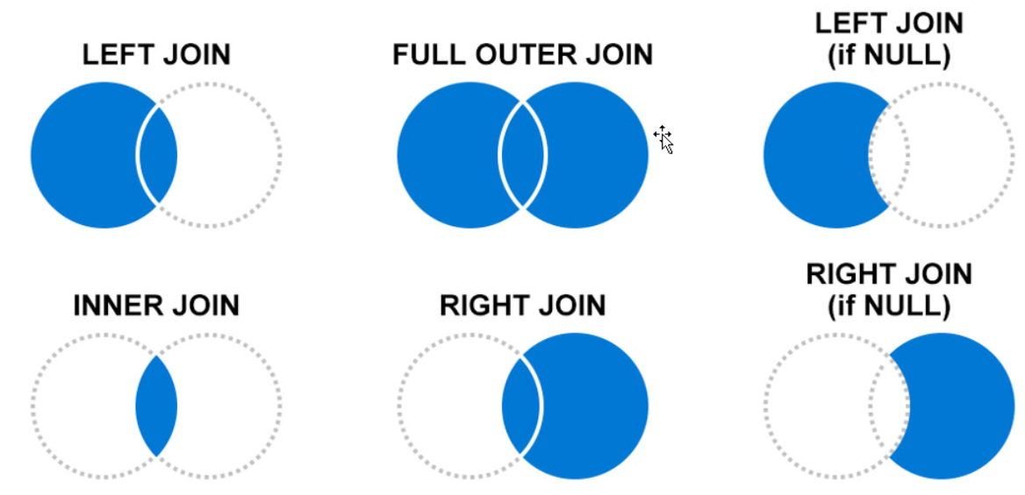
Join
The join operator merges the rows of two tables to form a new table by matching the specified columns' values from each table.
SecurityEvent
| where EventID == "4624"
| summarize LogOnCount=count() by EventID, Account
| project LogOnCount, Account
| join kind = inner (
SecurityEvent
| where EventID == "4634"
| summarize LogOffCount=count() by EventID, Account
| project LogOffCount, Account
) on Account

Slide 14
Extract data from unstructured string fields
Security log data is often contained in unstructured string fields and requires parsing to extract data.
There are multiple ways of pulling information from string fields in KQL.
The two primary operators used are extract and parse.
extract
Extract gets a match for a regular expression from a text string.
You may optionally convert the extracted substring to the indicated type.
The union operator supports wildcards to union multiple tables. The following KQL will create a count for the rows in all tables with names that start with Security.
// Query 1 return all rows of SecurityEvent and all rows of SigninLogs
union Security* | summarize count() by Type

Slide 15
Parse
Parse evaluates a string expression and parses its value into one or more calculated columns. The computed columns will have nulls for unsuccessfully parsed strings.
The union operator supports wildcards to union multiple tables. The following KQL will create a count for the rows in all tables with names that start with Security.
// Query 1 return all rows of SecurityEvent and all rows of SigninLogs
union Security* | summarize count() by Type

Slide 16
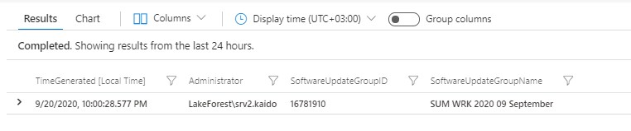
New Software Update Group
Event
| where EventID == 30219 and EventLog == "ConfigurationManager"
| extend MyData = tostring(parse_xml(EventData))
| extend Administrator = extractjson("$['DataItem']['EventData']['Data'][1]", MyData)
| extend SoftwareUpdateGroupID = extractjson("$['DataItem']['EventData']['Data'][2]", MyData)
| extend SoftwareUpdateGroupName = extractjson("$['DataItem']['EventData']['Data'][3]", MyData)
| project Administrator, SoftwareUpdateGroupID, SoftwareUpdateGroupName, TimeGenerated

Slide 17
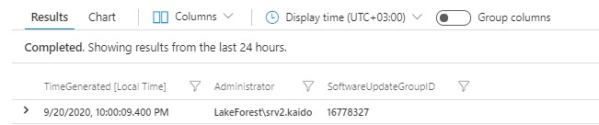
Someone removed the Software Update Group
Event
| where EventID == 30221 and EventLog == "ConfigurationManager"
| extend MyData = tostring(parse_xml(EventData))
| extend Administrator = extractjson("$['DataItem']['EventData']['Data'][1]", MyData)
| extend SoftwareUpdateGroupID = extractjson("$['DataItem']['EventData']['Data'][2]", MyData)
| project Administrator, SoftwareUpdateGroupID, TimeGenerated

Slide 18
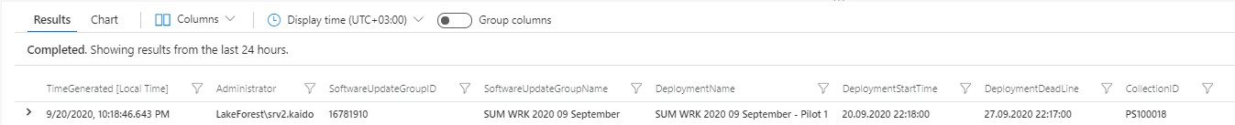
Software Updates deployment
Event
| where EventID == 30196 and EventLog == "ConfigurationManager"
| extend MyData = tostring(parse_xml(EventData))
| extend Administrator = extractjson("$['DataItem']['EventData']['Data'][1]", MyData)
| extend SoftwareUpdateGroupID = extractjson("$['DataItem']['EventData']['Data'][2]", MyData)
| extend SoftwareUpdateGroupName = extractjson("$['DataItem']['EventData']['Data'][3]", MyData)
| extend DeploymentName = extractjson("$['DataItem']['EventData']['Data'][4]", MyData)
| extend DeploymentStartTime = extractjson("$['DataItem']['EventData']['Data'][5]", MyData)
| extend DeploymentDeadLine = extractjson("$['DataItem']['EventData']['Data'][6]", MyData)
| extend CollectionID = extractjson("$['DataItem']['EventData']['Data'][7]", MyData)
| extend Featuretype = extractjson("$['DataItem']['EventData']['Data'][8]", MyData)
| where Featuretype == "Software Update"
| project Administrator, SoftwareUpdateGroupID, SoftwareUpdateGroupName, DeploymentName, DeploymentStartTime, DeploymentDeadLine, CollectionID, TimeGenerated

Slide 19
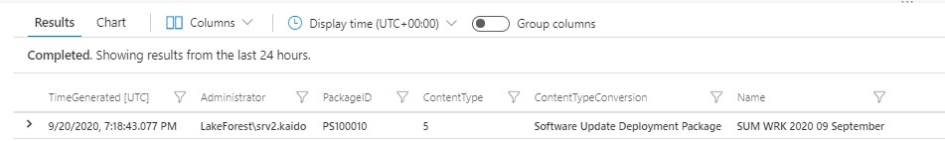
Packages
//New package creation - generic ID for different package types // Package IDs
// 0 - classic software package, 5 - Software Update Deployment Package, 4 - Task Sequence
Event
| where EventID == 30000 and EventLog == "ConfigurationManager"
| extend MyData = tostring(parse_xml(EventData))
| extend Administrator = extractjson("$['DataItem']['EventData']['Data'][1]", MyData)
| extend PackageID = extractjson("$['DataItem']['EventData']['Data'][2]", MyData)
| extend ContentType = extractjson("$['DataItem']['EventData']['Data'][3]", MyData)
| extend ContentTypeConversion = case(ContentType == 0, "Package",ContentType == 5,
"Software Update Deployment Package",ContentType == 4, "Task Sequence","unknown")
| extend Name = extractjson("$['DataItem']['EventData']['Data'][4]", MyData)
| project Administrator, PackageID, ContentType, ContentTypeConversion, Name, TimeGenerated

Slide 20
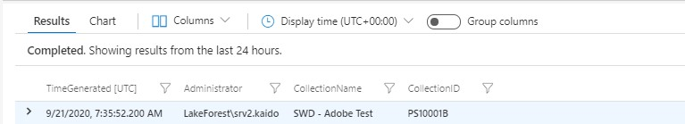
Collections →Collection creation
//New Collection in Configuration Manager
Event
| where EventID == 30015 and EventLog == "ConfigurationManager"
| extend MyData = tostring(parse_xml(EventData))
| extend Administrator = extractjson("$['DataItem']['EventData']['Data'][1]", MyData)
| extend CollectionName = extractjson("$['DataItem']['EventData']['Data'][3]", MyData)
| extend CollectionID = extractjson("$['DataItem']['EventData']['Data'][2]", MyData)
| project Administrator, CollectionName, CollectionID, TimeGenerated

Slide 21
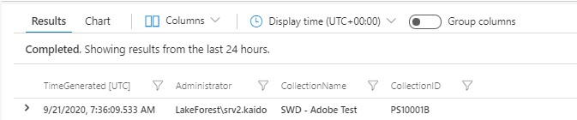
Collections →Collection removal
//Collection removed
Event
| where EventID == 30017 and EventLog == "ConfigurationManager"
| extend MyData = tostring(parse_xml(EventData))
| extend Administrator = extractjson("$['DataItem']['EventData']['Data'][1]", MyData)
| extend CollectionName = extractjson("$['DataItem']['EventData']['Data'][3]", MyData)
| extend CollectionID = extractjson("$['DataItem']['EventData']['Data'][2]", MyData)
| project Administrator, CollectionName, CollectionID, TimeGenerated

Slide 22
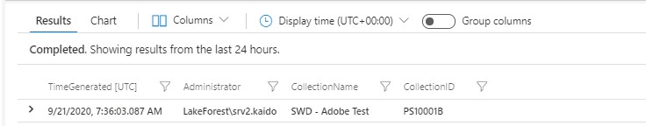
Collections →Collection change
//Collection Change in Configuration Manager
Event
| where EventID == 30016 and EventLog == "ConfigurationManager"
| extend MyData = tostring(parse_xml(EventData))
| extend Administrator = extractjson("$['DataItem']['EventData']['Data'][1]", MyData)
| extend CollectionName = extractjson("$['DataItem']['EventData']['Data'][3]", MyData)
| extend CollectionID = extractjson("$['DataItem']['EventData']['Data'][2]", MyData)
| project Administrator, CollectionName, CollectionID, TimeGenerated

Slide 23
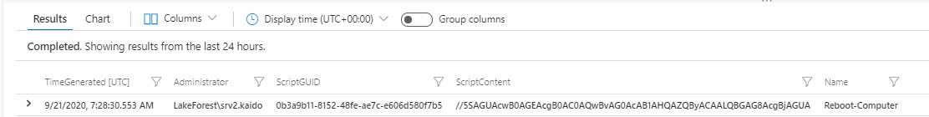
Scripts →New Script
//New Script in Configuration Manager
// ScriptContent holds the actual script from the Configuration Manager. You can decode the script.
Event
| where EventID == 52500 and EventLog == "ConfigurationManager"
| extend MyData = tostring(parse_xml(EventData))
| extend Administrator = extractjson("$['DataItem']['EventData']['Data'][1]", MyData)
| extend ScriptGUID = extractjson("$['DataItem']['EventData']['Data'][2]", MyData)
| extend ScriptContent = extractjson("$['DataItem']['EventData']['Data'][4]", MyData)
| extend Name = extractjson("$['DataItem']['EventData']['Data'][5]", MyData)
| project Administrator, ScriptGUID, ScriptContent, Name, TimeGenerated

Slide 24
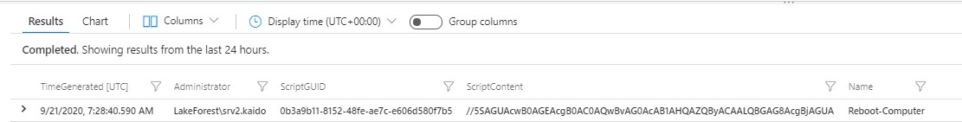
Scripts →Script approved
//Script approved in Configuration Manager
Event
| where EventID == 52501 and EventLog == "ConfigurationManager"
| extend MyData = tostring(parse_xml(EventData))
| extend Administrator = extractjson("$['DataItem']['EventData']['Data'][1]", MyData)
| extend ScriptGUID = extractjson("$['DataItem']['EventData']['Data'][2]", MyData)
| extend ScriptContent = extractjson("$['DataItem']['EventData']['Data'][4]", MyData)
| extend Name = extractjson("$['DataItem']['EventData']['Data'][5]", MyData)
| project Administrator, ScriptGUID, ScriptContent, Name, TimeGenerated

Slide 25
Scripts →Script execution against devices
//Script execution against devices
Event
| where EventID == 40806 and EventLog == "ConfigurationManager"
| extend MyData = tostring(parse_xml(EventData))
| extend Administrator = extractjson("$['DataItem']['EventData']['Data'][1]", MyData)
| extend ScriptGUID = extractjson("$['DataItem']['EventData']['Data'][2]", MyData)
| extend ScriptContent = extractjson("$['DataItem']['EventData']['Data'][4]", MyData)
| extend Name = extractjson("$['DataItem']['EventData']['Data'][5]", MyData)
| extend DeviceCount = extractjson("$['DataItem']['EventData']['Data'][6]", MyData)
| project Administrator, ScriptGUID, ScriptContent, Name, DeviceCount, TimeGenerated

Slide 26
Scripts →Script execution against Collection
//Script execution against Collection
Event
| where EventID == 40805 and EventLog == "ConfigurationManager"
| extend MyData = tostring(parse_xml(EventData))
| extend Administrator = extractjson("$['DataItem']['EventData']['Data'][1]", MyData)
| extend ScriptGUID = extractjson("$['DataItem']['EventData']['Data'][2]", MyData)
| extend ScriptContent = extractjson("$['DataItem']['EventData']['Data'][4]", MyData)
| extend Name = extractjson("$['DataItem']['EventData']['Data'][5]", MyData)
| extend Collection = extractjson("$['DataItem']['EventData']['Data'][6]", MyData)
| extend CollectionID = extractjson("$['DataItem']['EventData']['Data'][7]", MyData)
| project Administrator, ScriptGUID, ScriptContent, Name, Collection, CollectionID, TimeGenerated

Slide 27
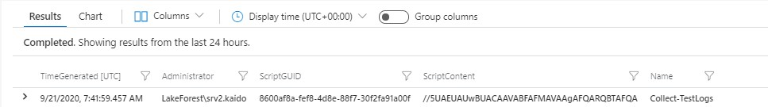
Scripts →Script change
//Edit Script in Configuration Manager
Event
| where EventID == 52506 and EventLog == "ConfigurationManager"
| extend MyData = tostring(parse_xml(EventData))
| extend Administrator = extractjson("$['DataItem']['EventData']['Data'][1]", MyData)
| extend ScriptGUID = extractjson("$['DataItem']['EventData']['Data'][2]", MyData)
| extend ScriptContent = extractjson("$['DataItem']['EventData']['Data'][4]", MyData)
| extend Name = extractjson("$['DataItem']['EventData']['Data'][5]", MyData)
| project Administrator, ScriptGUID, ScriptContent, Name, TimeGenerated

Slide 28
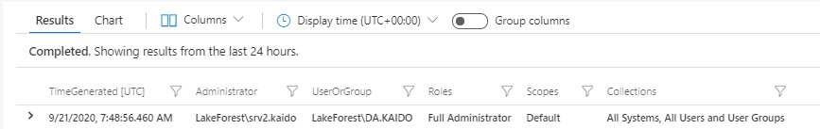
Security →New Administrator
//Somebody added a new user / group - EventID 31240
Event
| where EventID == 31240 and EventLog == "ConfigurationManager"
| extend MyData = tostring(parse_xml(EventData))
| extend Administrator = extractjson("$['DataItem']['EventData']['Data'][1]", MyData)
| extend UserOrGroup = extractjson("$['DataItem']['EventData']['Data'][2]", MyData)
| extend Roles = extractjson("$['DataItem']['EventData']['Data'][3]", MyData)
| extend Scopes = extractjson("$['DataItem']['EventData']['Data'][4]", MyData)
| extend Collections = extractjson("$['DataItem']['EventData']['Data'][5]", MyData)
| project Administrator, UserOrGroup, Roles, Scopes, Collections, TimeGenerated

Slide 29
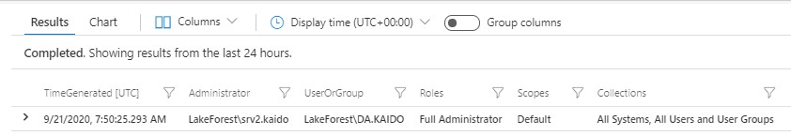
Security →Administrator removed
//Somebody removed a user or security group
Event
| where EventID == 31242 and EventLog == "ConfigurationManager"
| extend MyData = tostring(parse_xml(EventData))
| extend Administrator = extractjson("$['DataItem']['EventData']['Data'][1]", MyData)
| extend UserOrGroup = extractjson("$['DataItem']['EventData']['Data'][2]", MyData)
| extend Roles = extractjson("$['DataItem']['EventData']['Data'][3]", MyData)
| extend Scopes = extractjson("$['DataItem']['EventData']['Data'][4]", MyData)
| extend Collections = extractjson("$['DataItem']['EventData']['Data'][5]", MyData)
| project Administrator, UserOrGroup, Roles, Scopes, Collections, TimeGenerated

Slide 30
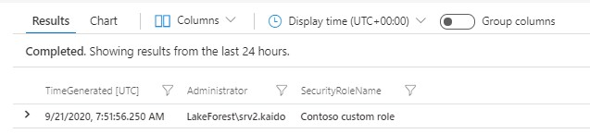
Security → New security role
//New Security Role
Event
| where EventID == 31200 and EventLog == "ConfigurationManager"
| extend MyData = tostring(parse_xml(EventData))
| extend Administrator = extractjson("$['DataItem']['EventData']['Data'][1]", MyData)
| extend SecurityRoleName = extractjson("$['DataItem']['EventData']['Data'][2]", MyData)
| project Administrator, SecurityRoleName, TimeGenerated

Slide 31
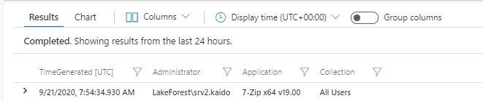
Applications → New Application deployment
//New Application deployment - EventID 30226
Event
| where EventID == 30226 and EventLog == "ConfigurationManager"
| extend MyData = tostring(parse_xml(EventData))
| extend Administrator = extractjson("$['DataItem']['EventData']['Data'][1]", MyData)
| extend Application = extractjson("$['DataItem']['EventData']['Data'][2]", MyData)
| extend Collection = extractjson("$['DataItem']['EventData']['Data'][3]", MyData)
| project Administrator, Application, Collection, TimeGenerated

Slide 32
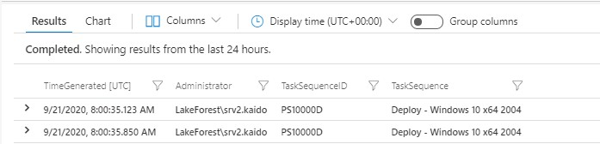
Applications → OS deployment → Change in Task Sequence
//Change in Task Sequence
Event
| where EventID == 30001 and EventLog == "ConfigurationManager"
| extend MyData = tostring(parse_xml(EventData))
| extend Administrator = extractjson("$['DataItem']['EventData']['Data'][1]", MyData)
| extend TaskSequenceID = extractjson("$['DataItem']['EventData']['Data'][2]", MyData)
| extend TaskSequence = extractjson("$['DataItem']['EventData']['Data'][3]", MyData)
| project Administrator, TaskSequenceID, TaskSequence, TimeGenerated

Slide 33
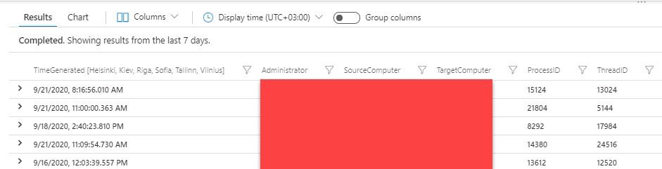
Applications → Remote Control → Session start
//Remote Control Start session
Event
| where EventID == 30076 and EventLog == "ConfigurationManager"
| extend MyData = tostring(parse_xml(EventData))
| extend Administrator = extractjson("$['DataItem']['EventData']['Data'][1]", MyData)
| extend SourceComputer = extractjson("$['DataItem']['EventData']['Data'][2]", MyData)
| extend TargetComputer = extractjson("$['DataItem']['EventData']['Data'][3]", MyData)
| extend ProcessID = extractjson("$['DataItem']['EventData']['Data'][4]", MyData)
| extend ThreadID = extractjson("$['DataItem']['EventData']['Data'][5]", MyData)
| project Administrator, SourceComputer, TargetComputer, ProcessID, ThreadID, TimeGenerated

Slide 34
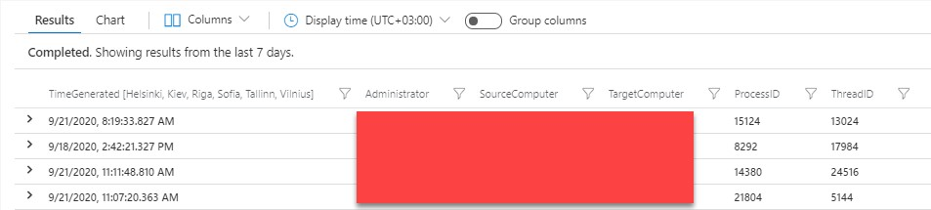
Applications → Remote Control → Session End
//Remote Control end session
Event
| where EventID == 30077 and EventLog == "ConfigurationManager"
| extend MyData = tostring(parse_xml(EventData))
| extend Administrator = extractjson("$['DataItem']['EventData']['Data'][1]", MyData)
| extend SourceComputer = extractjson("$['DataItem']['EventData']['Data'][2]", MyData)
| extend TargetComputer = extractjson("$['DataItem']['EventData']['Data'][3]", MyData)
| extend ProcessID = extractjson("$['DataItem']['EventData']['Data'][4]", MyData)
| extend ThreadID = extractjson("$['DataItem']['EventData']['Data'][5]", MyData)
| project Administrator, SourceComputer, TargetComputer, ProcessID, ThreadID, TimeGenerated

Slide 35
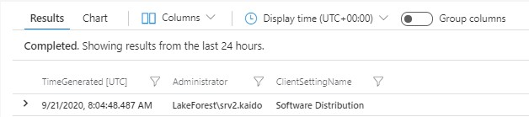
Site Configuration → Client Settings change
//Somebody changed the Client Settings
Event
| where EventID == 30043 and EventLog == "ConfigurationManager"
| extend MyData = tostring(parse_xml(EventData))
| extend Administrator = extractjson("$['DataItem']['EventData']['Data'][1]", MyData)
| extend ClientSettingName = extractjson("$['DataItem']['EventData']['Data'][2]", MyData)
| project Administrator, ClientSettingName, TimeGenerated

Slide 36
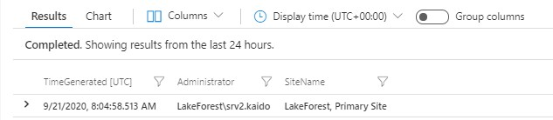
Site Configuration → Hierarchy changes
//Change in Primary Site Settings
Event
| where EventID == 30031 and EventLog == "ConfigurationManager"
| extend MyData = tostring(parse_xml(EventData))
| extend Administrator = extractjson("$['DataItem']['EventData']['Data'][1]", MyData)
| extend SiteName = extractjson("$['DataItem']['EventData']['Data'][2]", MyData)
| project Administrator, SiteName, TimeGenerated

Slide 37
New Software Update Group

