Slide 1
Benefits of Microsoft Sentinel
Empowering Security Operations for Business Success

Slide 2
What is Microsoft Sentinel?
Microsoft Sentinel is a scalable, cloud-native security information and event management (SIEM) solution that delivers intelligent security analytics and threat intelligence.

Slide 3
Key Benefits for Your Business
- Enhanced Threat Detection: Leverages AI to identify and mitigate risks proactively.
- Cost Efficiency: Reduces infrastructure costs with its cloud-native design.
- Scalability: Easily adapts to your business growth and evolving security needs.
- Integrated Insights: Combines security analytics with Microsoft 365 and Azure data.
- Rapid Response: Enables automated responses to security incidents.

Slide 4
Diagram: Cloud-native SIEM with integrations for log data, threat intelligence, AI analytics, and automated responses.

Slide 5
Why CEOs Should Invest in Microsoft Sentinel
- Risk Mitigation: Strengthens organizational resilience against cyber threats.
- Strategic Alignment: Supports compliance with ISO 27001, PCI DSS, and other standards.
- Operational Efficiency: Allows IT teams to focus on strategic initiatives.
- Brand Reputation: Protects against data breaches and ensures trust.
- Data-Driven Decisions: Provides actionable security insights for leadership.

Slide 6
Take the Next Step
Partner with us to implement Microsoft Sentinel and secure your organization. Let's proactively safeguard your business operations.

Slide 7
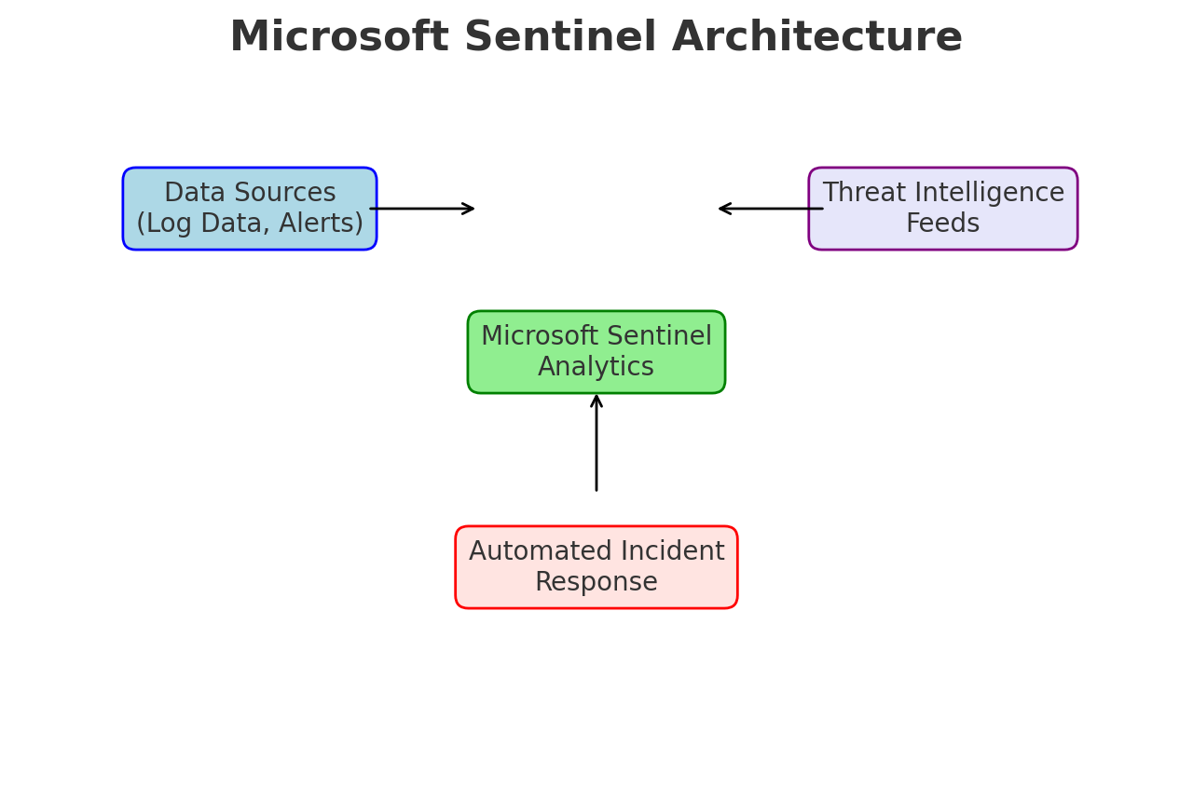
Microsoft Sentinel Architecture Diagram

