Slide 1
GitHub

Slide 2
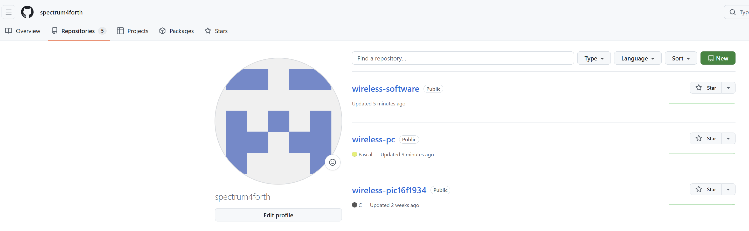
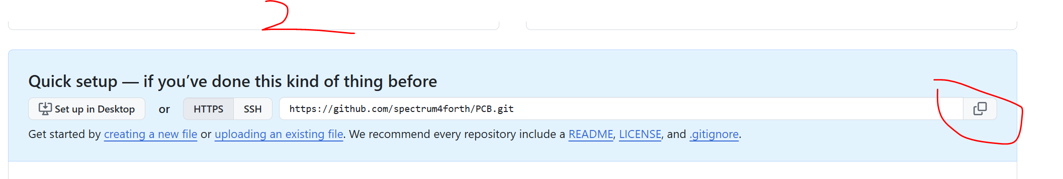
Web Site
https://github.com/spectrum4forth?tab=repositories
NEW
Folder Name

Slide 3
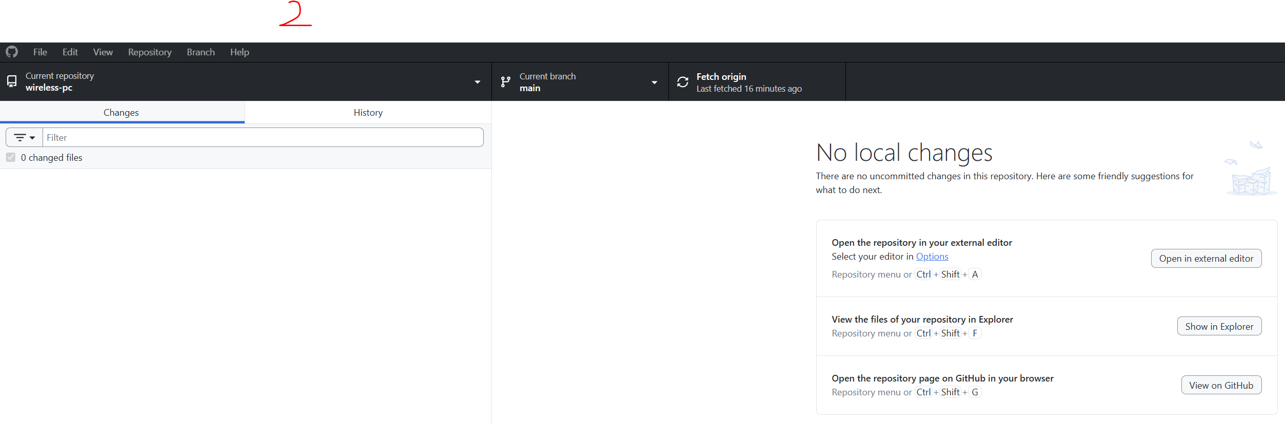
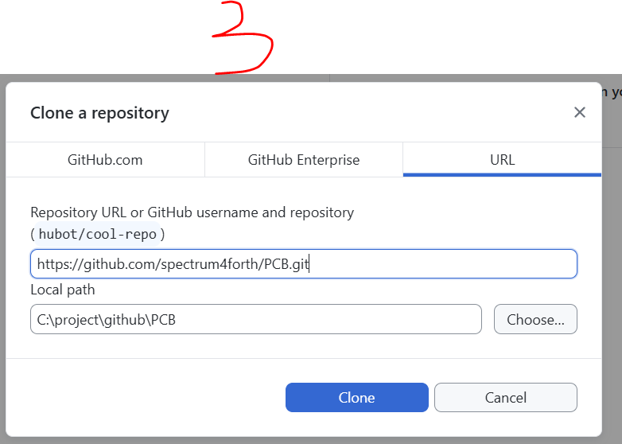
GitHub Desktop
Download Github Desktop and Install: https://desktop.github.com/download/
Run Github desktop
File -> Clone Repository
Copy the files to the PCB

Slide 4
GitHub Desktop
Download Github Desktop and Install: https://desktop.github.com/download/
Run Github desktop
File -> Clone Repository
Copy the files to the PCB
Select file to commit.
Publish branch

