Slide 1

Science Software – v6.0 Tutorial

Slide 2
Tutorial
Overview
Instruments and Data Sets
System
Installation
IDL Configuration
Loading Data
Plotting Data
Analysis Routines
Wavelet Transforms
Coordinate Transforms
Angular Spectra
Graphical User Interface
Appendices - Additional Functionality
Load routines
Crib Sheets
Position/Velocity Plots
Trace/Orbit Plots
Ion Electron Velocity Slices
Map/Orbit Plots

Slide 3
Software Objectives
THEMIS Data Analysis Software (TDAS) Objectives
Powerful, Flexible Command Line Interface
GUI provides easy access to data, analysis tools, and graphics
Crib sheets are available for all data sets and common analysis functions
IDL based (library of routines –but no main program!)
Code is free and available to everyone
The software operates on Level 1 and Level 2 data
- It is not required to analyze level 2 data.
Functionally separates the tasks into:
Reading
Manipulating
Plotting
Platform independent. Works on:
Solaris
Linux
Windows, Vista
Mac OS X

Slide 4
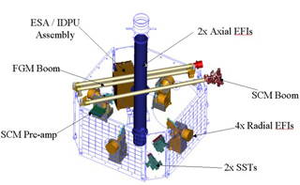
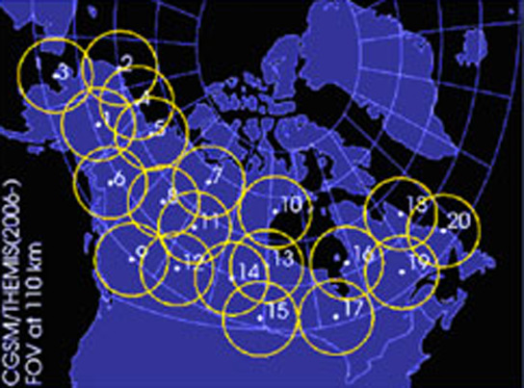
Instruments
FIELDS INSTRUMENTS:
EFI - Electric Field Instruments FGM - Flux Gate Magnetometer
SCM - Search Coil Magnetometers
PARTICLE INSTRUMENTS:
ESA - Electrostatic Analyzer SST - Solid State Telescope
GROUND BASED:
ASI – All-Sky Imager Array GMAG – Magnetometer Array
PROCESSED DATA:
FBK – Filter Bank FIT – Onboard Spin-Fit
FFT – Fast Fourier Transform
MOM – Onboard Moments
STATE – Spacecraft state vectors

Slide 5
Installation
To Download the TDAS software:
Download the latest TDAS release .zip file go to by going to the
THEMIS web page at http://themis.ssl.berkeley.edu/software.shtml
Create a new directory called TDAS into which you will copy the
latest software.
Move the unzipped folder (tdas_x_xx) into the TDAS directory.
The tdas_x_xx directory contains 3 main sub-directories
THEMIS (idl/themis/) – routines specific to THEMIS
ssl_general (idl/ssl_general/) – general routines
external (idl/external/) – external libraries

Slide 6
IDL Configuration
To Configure IDL:
Add the TDAS directory to the IDLPATH.
To Configure IDL 6.4 or older:
Start IDL (Windows) or IDLDE (UNIX, Linux, Mac).
Go to File->Preferences.
Select the “Path” tab.
If <IDL_DEFAULT> is not present, press ‘Insert Standard Libraries’.
Press “Insert”.
Browse to find the TDAS directory.
Check the box to indicate “search subdirectories”.
To Configure IDL 7.0 or newer:
Start IDL (Windows) or IDLDE (UNIX, Linux, Mac).
Go to Window->Preferences.
Expand the menu to access the IDL->Paths section.
Press “Insert”.
Browse to find the TDAS directory. (See section 5.3 above: Installation and Configuration.)
Check the box next to the path to indicate “search subdirectories”.
Select “Apply”
Select “Ok”
Type .full_reset_session at the IDL command prompt or restart IDL.

Slide 7
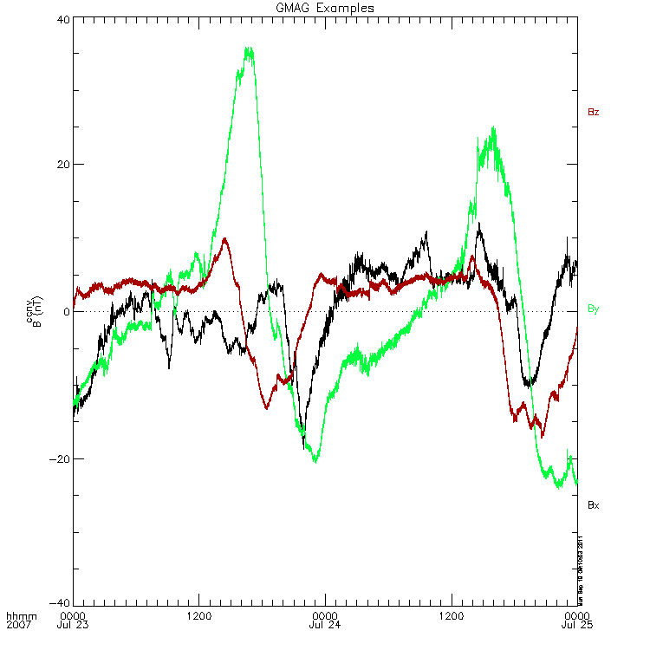
Loading Data
To load THEMIS data type the following at the IDL command prompt:
idl > timespan,‘7-7-23',2,/days
idl > thm_load_gmag, site=‘ccnv’, /subtract_average
idl > tplot, ‘thg_mag_ccnv’
timespan - sets the time frame (start and stop) of the data to be loaded.
thm_load_gmag - loads the data into memory and stores the CDF file on your disk drive.
tplot - displays the data
To add more features to the plot:
idl > options,‘thg_mag_ccnv’, labels=[‘Bx’,’By’,’Bz’]
idl > tplot_options, ‘title’, ‘GMAG Examples’
idl > tplot, ‘thg_mag_ccnv’
NOTE: Load routines are available for all THEMIS science data sets. See appendix slides.

Slide 8
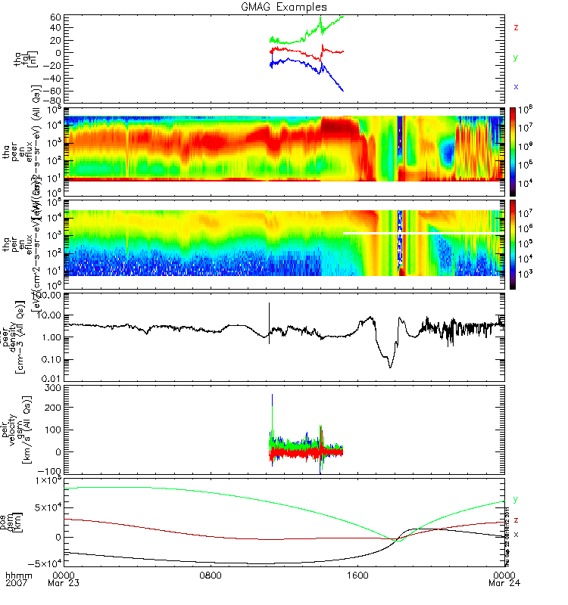
Loading Data (Cont’d)
idl > timespan,‘2007-07-23',1
idl > thm_load_state, probe=‘a’, /get_support_data
idl > thm_load_fgm, probe=‘a’, coord=‘gsm’, datatype=‘fgl’, level=1
idl > thm_load_esa, probe=[‘a’,’b’], datatype=[‘peer_*’,’peir_*’], level=2
idl > thm_load_efi, datatype=‘vaw’
idl > tplot_names
tplot_names - prints names of all tplot variables
currently in memory
idl > tplot, [‘tha_fgl’, $
‘tha_peer_en_eflux’, $
‘tha_peir_en_eflux’, $
‘tha_peer_density’, $
‘tha_peir_velocity_gsm’, $
‘tha_state_pos_gsm’]
.

Slide 9
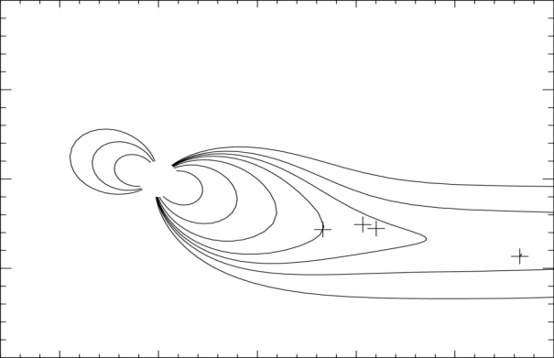
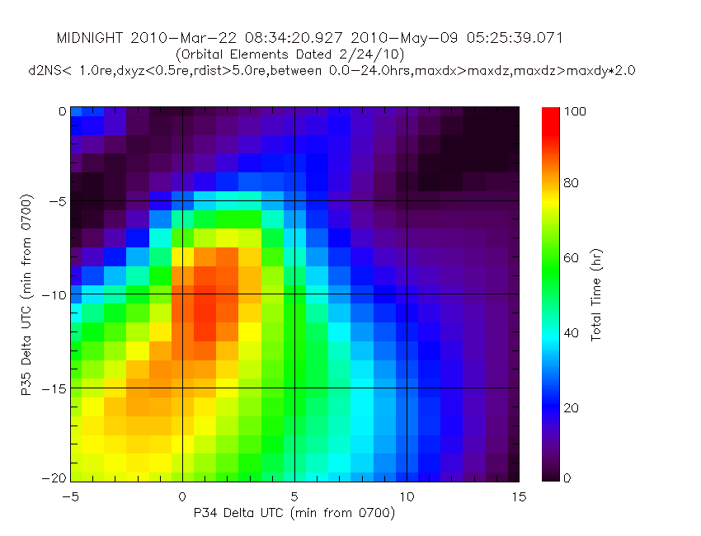
Plotting Routines
Plotting routines using tplot variables
tplot
tplotxy
plotxy
plotxyz
tplot_names
tlimit
get_data
store_data‏
tplotxy can be used to plot isotropic position plots. Like plots of magnetic field models and spacecraft position
NOTE 1: Crib sheets are available for tplot
and other plotting and analysis tools
NOTE 2: Functionality of TDAS routines are
controlled by the use of keywords. The keywords
available for each routine can be found in the
header of the source code.
plotxyz can be used to plot 3 dimensional isotropic data, with any axis. (Not restricted to time-series.)‏

Slide 10
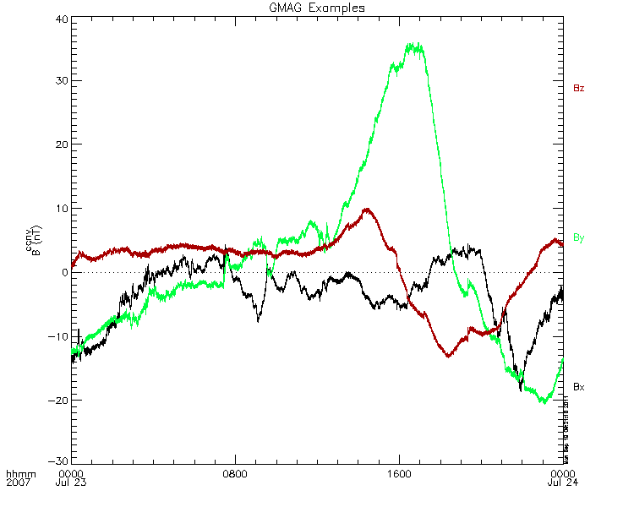
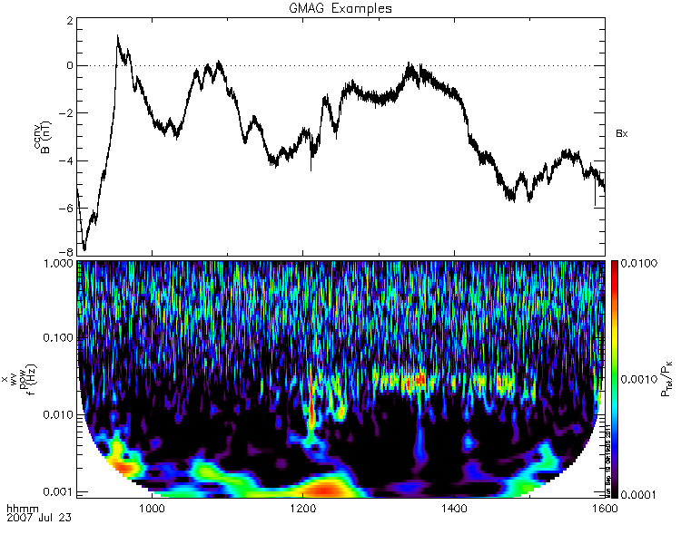
Wavelet Transform
To perform a wavelet transform on an area of interest
; define area of interest
idl > tr = ['2007-07-23/09:00','2007-07-23/16']
; split the 3d vector into components
idl > split_vec, ‘ thg_mag_ccnv‘
; compute transform of one component
idl > wav_data, 'thg_mag_ccnv_x', /kol, $ trange=tr, maxpoints = 24l*3600*2
; set color limits (log scale)
idl > zlim, '*pow', .0001, .01, 1
; and plot it.
idl > tplot, '*ccnv_x*‘ , trange=tr

Slide 11
Analysis Routines
Analytic Coordinate Transformations
tvector_rotate
fac_matrix_make
thm_fac_matrix_make
minvar_matrix_make
enp_matrix_make
rxy_matrix_make
sse_matrix_make
gsm2lmn
Tsyganenko Model
(t)trace2iono
(t)trace2equator
(t)t89
(t)t96
(t)t01
(t)t04s
Example:
idl > tt89, 'tha_state_pos_gsm', newname='model_field'
idl > fac_matrix_make, 'model_field' , other_dim= 'xgse', newname = 'fac_mat'
idl > tvector_rotate, 'fac_mat', 'thc_peir_velocity', newname = 'ion_velocity_model_fa'

Slide 12
Coordinate Transforms
Geophysical Coordinate Systems supported by TDAS
SPG Spinning Probe Geometric
SSL Spinning SunSensor L-vectorZ
DSL Despun SunSensor L-vectorZ
GEI Geocentric Equatorial Inertial
GSE Geocentric Solar Ecliptic
GSM Geocentric Solar Magnetospheric
SM Solar Magnetic
GEO Geographic Coordinate System
SSE Selenocentric Coordinate System
SEL Selenographic Coordinate System
thm_cotrans
transforms to/from any of the following coordinate systems
updates metadata in output.
knows coordinate system of input from metadata
Example (previously loaded FGM and STATE data)‏
idl > thm_cotrans, 'th?_fg?', out_coord='geo‘, ouf_suffix = ‘geo’

Slide 13
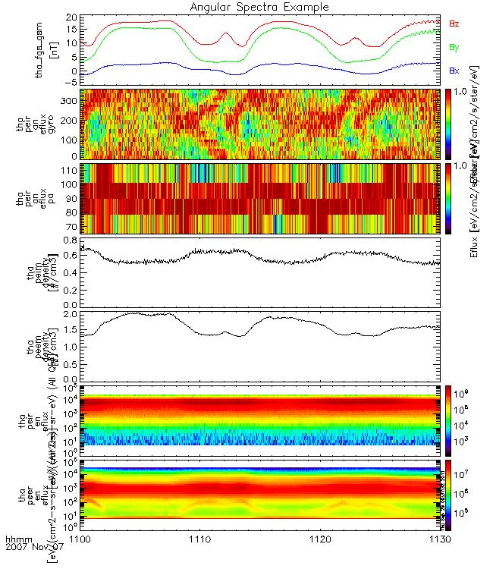
Plotting Angular Spectra
idl > timespan,'7 11 07/10',2,/hours
idl > sc=‘a’
idl > thm_load_state, probe=sc, /get_supp idl > thm_load_fit, probe=sc, data='fgs', $
coord='gsm', suff='_gsm'
idl > thm_load_mom, probe=sc
idl > thm_load_esa,probe=sc idl > tplot, ['tha_fgs_gsm tha_pxxm_pot’, $
‘tha_pe?m_density’, $
’tha_pe?r_en_eflux‘] idl > trange = ['07-11-07/11:00',‘ 07-11-07/11:30'] idl > thm_part_getspec, probe=['a'], $
erange=[2000,10000], trange=trange,$
angle='gyro', pitch=[45,135], $
other_dim='mPhism', /normalize, $ data_type=['peir'], regrid=[32,16]
idl > thm_part_getspec, probe=['a'],
trange=trange, angle=‘pa’
erange=[2000,10000], pitch=[65,115], $
other_dim='mPhism', /normalize, $ data_type=['peir'], regrid=[32,16] idl > tplot, ['tha_fgs_gsm’, $
'tha_peir_an_eflux_gyro’, $
'tha_peir_an_eflux_pa, $
‘tha_pe?m_density’, $
‘tha_pe?r_en_eflux‘], $
title=‘Angular Spectra Example’
full
reduced
full
reduced

Slide 14
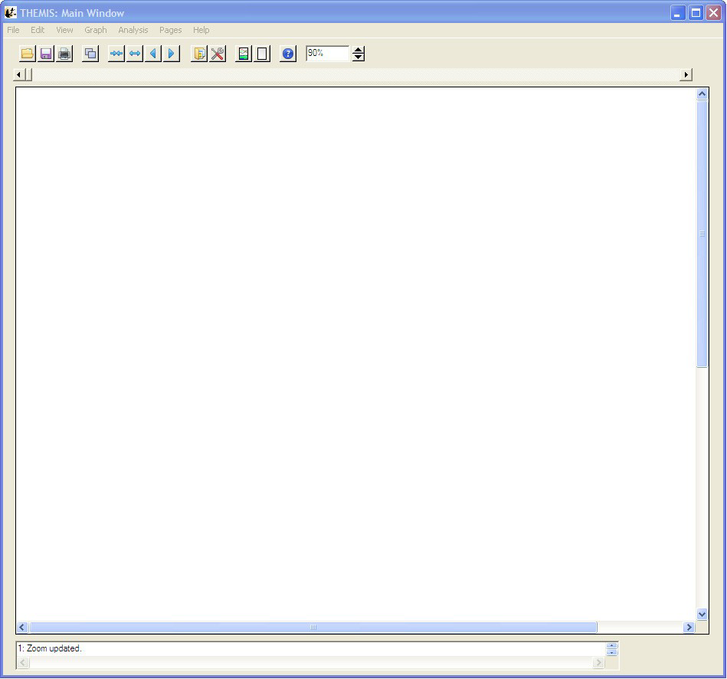
Graphical User Interface
The GUI is the quickest and easiest way to learn TDAS functionality
To run the gui type: idl > thm_gui
Menu Bar
Window Resize
Tool Bar
Main graph
area
Status Bar

Slide 15
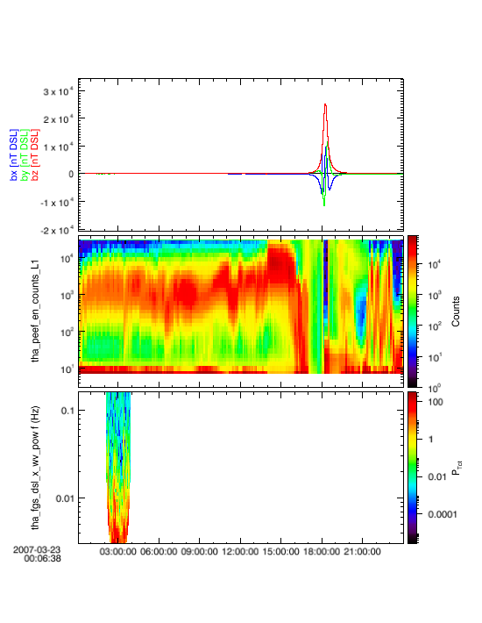
Graphical User Interface
With a few clicks of the button the user can load, analyze and plot data
For Example:
To Load Data:
Select Load Data under the File menu
Select Instrument Type: fgm, Level2: fgs_dsl, Click Right arrow button
Select Instrument Type: esa, Level1: peef, Click Right arrow button
Click Done button
To Perform Analysis:
Select Data Processing… under the Analysis menu
Select tha_fgs_dsl data, Click right Arrow button
Click Power Spectrum button, Select a 1 hour interval of time, Click OK
Click Done button
To Plot Data:
Select Plot/Layout Options… under the Graph menu
Select tha_fgs_dsl, Click Line button
Click Panels Add button, Select tha_peef_en_counts_L1, Click Spec button
Click Panels Add button, Select tha_fgl_dsl_x_wv_pow, Click Spec button
Click OK button

Slide 16
Appendix
Load Routines
Crib Sheets
Position/Velocity Plots
Trace Orbit Plots
Ion Electron Velocity Slices
Map/Orbit Plots

Slide 17
A. Load Routines
There are load routines for every THEMIS science data set and follow a naming convention:
thm_load_xxx where xxx = instrument name
Each load routine contains keywords that are specific to each instrument or data type.
The table below contains only a partial listing of routines available to retrieve and load data.
Name | Description | Level 1 |  | Level 2
 |  | Raw | Calibrated
thm_load_esa | ElectoStatic Analyzer |  |  | *
thm_load_efi | Electric Fields Instrument | * | * | *
thm_load_fgm | Flux Gate Magnetometer Waveforms | * | * | *
thm_load_gmag | Ground Magnetometer |  |  | *
thm_load_scm | Search Coil Magnetometer Waveforms | * | * | *
thm_load_sst | Solid State Telescope | * | (-) | *
thm_load_state | Orbit and Attitude | V3
(-) data reduction and analysis routines available
Additional Examples:
idl > thm_load_state, probe=‘b’, /get_support_data
idl > thm_load_fgm, probe=[‘a’,’b’, ‘c’], coord=‘gei’, datatype=‘fgl’, level=1, suffix=‘gei’
idl > thm_load_esa, probe=‘a’
idl > thm_load_efi, datatype=‘vaf’, trange=[‘2007-03-23’, ‘2007-03-24’]

Slide 18
A. Common Load Keywords
probe = Probe name. The default is 'all', i.e., load all available probes. This can be an array of strings, e.g., ['a',
'b'] or a single string delimited by spaces, e.g., 'a b'
datatype = The type of data to be loaded, 'fge', 'fgh', or 'fgl'. 'all' can be passed in also, to get all variables.
trange = Time range of interest (2 element array), if this is not set, the default is to prompt the user. Note that if
the input time range is not a full day, a full day's data is loaded
level = the level of the data to read, the default is 'l1', or level-1 data. A string (e.g., 'l2') or an integer can be
used. 'all‘ can be passed in also, to get all levels.
type = 'raw' or 'calibrated'. default is calibrated.
coord = coordinate system of output. default is 'dsl'
suffix = suffix to add to output data quantity (not added to support data)
cdf_data = named variable in which to return cdf data structure: only works for a single spacecraft and datafile
name.
varnames = names of variables to load from cdf: default is all.
/get_support_data = load support_data variables as well as data variables into tplot variables.
/download_only = download file but don't read it.
/no_download = use only files which are online locally.
relpathnames_all = named variable in which to return all files that are required for specified timespan, probe,
datatype, and level. If present, no files will be downloaded, and no data will be loaded.
/valid_names = if set, then this routine will return the valid probe, datatype and/or level options in named
variables supplied as arguments to the corresponding keywords.
files = named varible for output of pathnames of local files.
/verbose = set to output some useful info, set to 0 to or 1 to reduce output.
/no_time_clip = Disables time clipping, which is the default

Slide 19
B. Crib Sheets
Crib sheets are the easiest way to learn how to load, analyze and plot data.
Crib sheets can be found in the examples directory under themis.
The following is only a partial list of the crib sheets available.
thm_crib_efi
thm_crib_esa
thm_crib_fgm
thm_crib_gmag
thm_crib_part_getspec
thm_crib_scm
thm_crib_sst
thm_crib_state
thm_crib_tplot
thm_crib_tplotxy
thm_crib_part_slice2d
thm_crib_dproc
Examples:
idl > .run thm_crib_fgm
(or cut and paste, or copy and modify)
idl > .compile thm_crib_plotxyz
idl > .go
(run it by compiling in idl and then typing ".go“, or cut and paste)
idl > thm_crib_part_slice2d
(this is a procedure and can be just typed at the IDL command prompt)

Slide 20
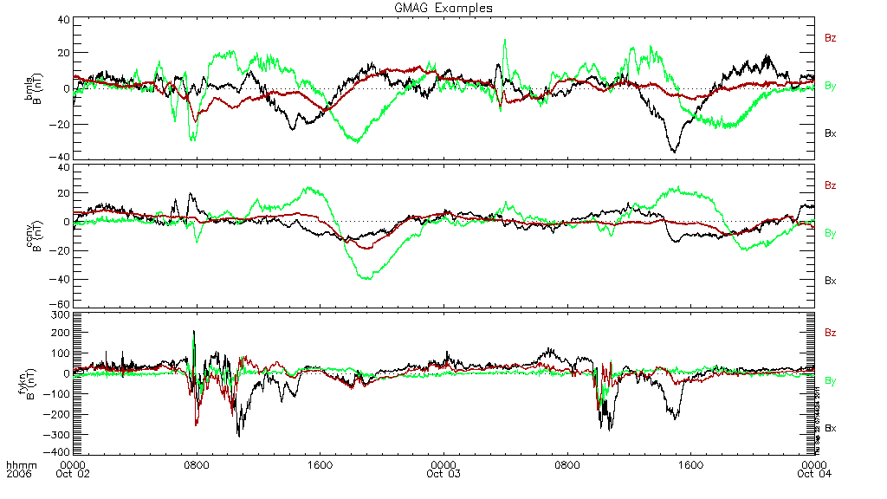
B. Crib Sheet Example
;pro thm_crib_gmag
; This is an example crib sheet that will load ground mag data.
; Open this file in a text editor and then use copy and paste to copy
; selected lines into an idl window. Or alternatively compile and run
; using the command: .RUN THM_CRIB_GMAG
pos=ptrace(option=1) ; Set program trace to display line #.
timespan,'6-10-2',2,/days ; Define the time span of interest.
thm_load_gmag,site='bmls ccnv fykn',/subtract_average ;Load data
options,'thg_mag_????',labels=['Bx','By','Bz']
tplot_options, 'title', 'GMAG Examples'
print,'Defined TPLOT Variables;'
tplot_names ,/time ; Display all stored variables
print,ptrace(),'Loaded GMAG Data, and Displayed tplot names'
print,ptrace(),'Note that 3 sites were loaded each with 2 days of data.'
print,ptrace(),'All files are downloaded automatically if not found.'
stop
tplot,"thg_mag_????" ; tplot accepts wildcard characters
:
etc…
reduced

Slide 21
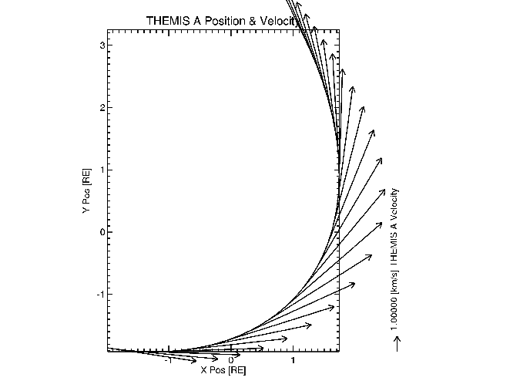
C. Position/Velocity Plots
Plotxyvec – Position/Velocity Plot
To plot something similar, type the following:
idl > get_data, 'tha_state_pos', data=d
idl > d_thm_a = d.y/6374.
idl > plotxy, d_thm_a, xsize=600, ysize=600, $
title="XY orbital plot w/change arrows", $
charsize=1.5, xrange=[-5, 15], yrange=[-15,5]
idl > plotxyvec, [[x[1:n-1]], [y[1:n-1]]],[[u],[v]],/over, $
charsize=1.5
Note: See thm_crib_plotxy.pro and thm_crib_ploxyvec.pro
reduced

Slide 22
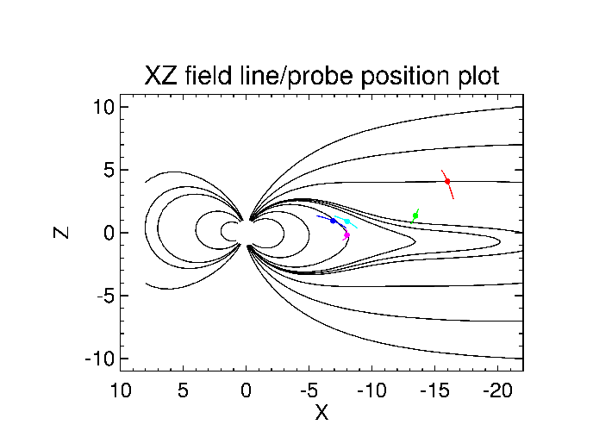
D. Trace / Orbit Plot
Trace / Orbit Plots – XZ Plot
reduced

Slide 23
D. Trace Plot Source Code
Source Code for Trace Plots – XZ Plot
; code to plot trace field lines
thm_init
date = '2008-03-27/02:00:00' ;date to be plotted
hrs = 3
sdate = time_double(date)-3600*hrs/2
edate = time_double(date)+3600*hrs/2
timespan,sdate,hrs,/hour
x = [-22,-22,-22,-22,-17,-12,-8,-5,-3,2,4,7,8,8]
y = replicate(0,14)
z = [10,7,4,0,replicate(0,9),4]
times = replicate(time_double(date),14)
trace_pts_north = [[x],[y],[z]]
trace_pts_south = [[x],[y],[-1*z]]
store_data,'trace_pts_north',data={x:times,y:trace_pts_north}
store_data,'trace_pts_south',data={x:times,y:trace_pts_south}
ttrace2iono,'trace_pts_north',trace_var_name = 'trace_n', in_coord='gsm',out_coord='gsm';trace field lines
ttrace2iono,'trace_pts_south',trace_var_name = 'trace_s', in_coord='gsm',out_coord='gsm', /south
window,xsize=800,ysize=600
xrange = [-22,10] ;x range of the xz plot
zrange = [-11,11] ;z range of the xz plot
tplotxy,'trace_n',versus='xrz',xrange=xrange,yrange=zrange,charsize=charsize, $
title="XZ field line/probe position plot", xthick=axisthick, ythick=axisthick, $
thick=linethick,charthick=charthick,ymargin=[.15,.1]
tplotxy,'trace_s',versus='xrz',xrange=xrange,yrange=zrange,/over, xthick=axisthick, $
ythick=axisthick,thick=linethick,charthick=charthick
reduced

Slide 24
D. Orbit Source Code
Source Code for Trace / Orbit Plots – Spacecraft Position
;code to overplot the probe positions
colors=['m','r','g','c','b'] ;colors for probes
probes = ['a','b','c','d','e'] ;the probes to be marked
A = FINDGEN(17) * (!PI*2/16.) ;makes a circle to mark spacecraft position
USERSYM, COS(A), SIN(A), /FILL
thm_load_state,probe=probes,coord='gsm'
tkm2re,'th'+probes+'_state_pos',/replace
;plot the probe positions
for i = 0,n_elements(probes) - 1 do begin
probe = probes[i]
color = colors[i]
varname = 'th'+probe+'_state_pos'
get_data,varname,data=d ;plot position in KM
if ~is_struct(d) then continue ;skip if no valid data on day
tmp = min(abs(d.x - time_double(date)),probe_pos) ;find midpoint
tplotxy,varname,versus='xrz',/over,color=color,xthick=axisthick,ythick=axisthick, $
thick=linethick,charthick=charthick plotxy,reform(d.y[probe_pos,*],1,3),psym=8, $
color=color,symsize=symsize,versus='xrz',/over,xthick=axisthick,ythick=axisthick, $
thick=linethick,charthick=charthick
endfor
reduced

Slide 25
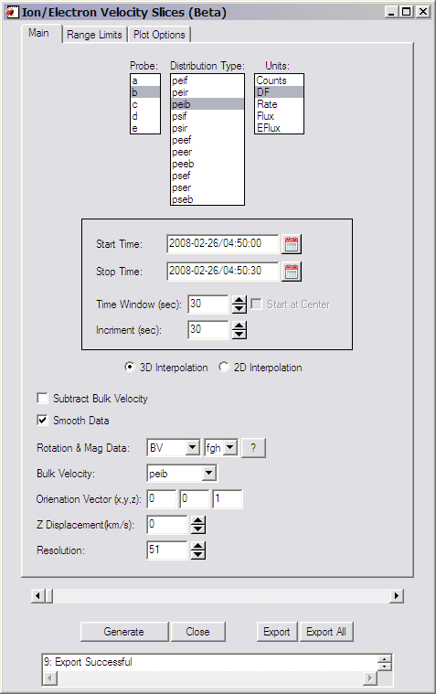
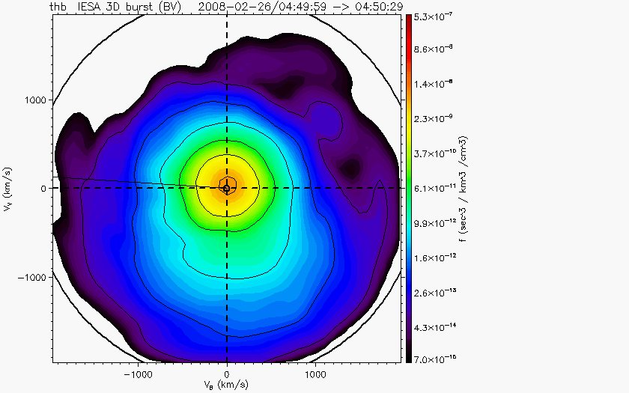
E. Ion Electron Velocity Slices(Beta)‏
Beta support for Slices of 3d particle Velocity distributions are supported in the bleeding edge.
Code can be started by typing: thm_ui_slice2d or can be accessed from the GUI by selecting
Analysis->Velocity Slices

Slide 26
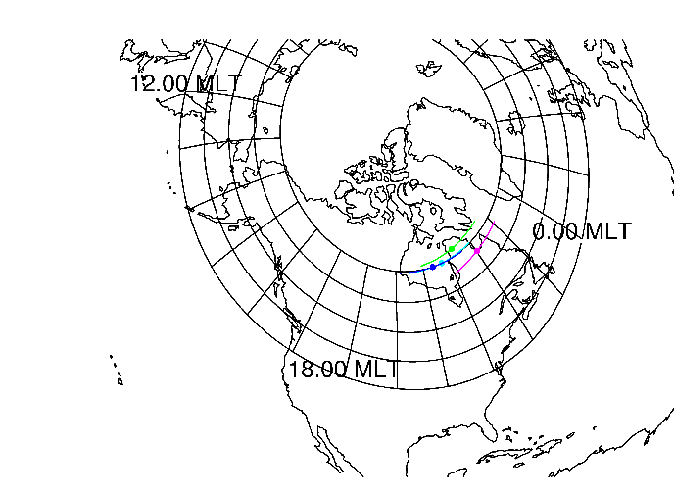
F. Map/Orbits Example
Trace/Orbit Plots - AACGM/Iono Trace Plot
reduced

