Slide 1
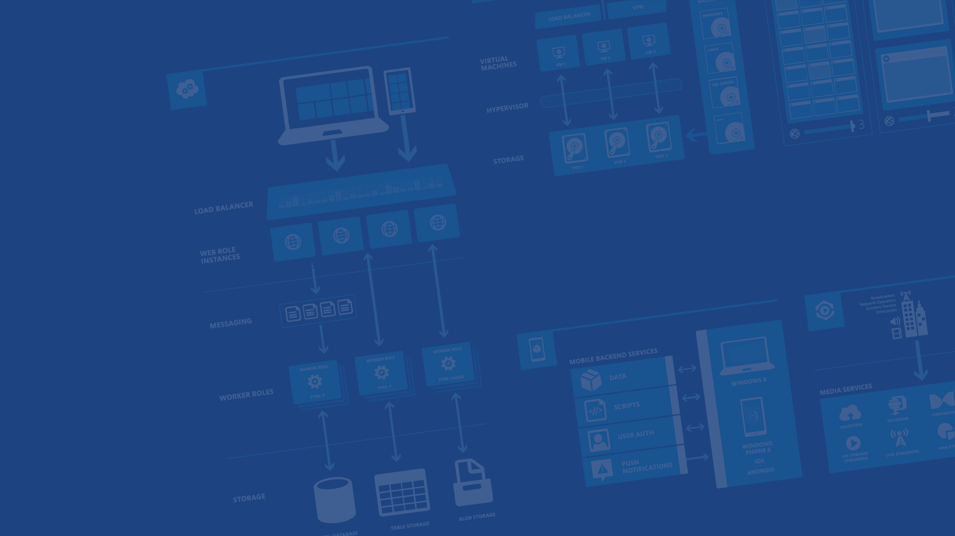
Windows Azure Service Bus
Azure OSS Accelerator
Notes:
1. Microsoft Azure Storage is a Microsoft-managed service that provides durable, scalable, and redundant storage.
2. Microsoft takes care of all backups and maintenance for you.

Slide 2

Service Bus
Connectivity
Service Relay
Protocol Tunnel Eventing
Messaging
Queuing Pub/Sub
Reliable Transfer
Rich options for interconnecting apps across network boundaries
Reliable, transaction-aware cloud messaging infrastructure for business apps.
Svc Management
Naming, Discovery
Monitoring
?
Notification
Multiplatform
Easily Scale out
Consistent management surface and service observation capabilities
Integration Routing
Coordination Transformation
Push notifications to large number of mobile devices.
Content-based routing, document transformation, and process coordination.
Notes:
Whether an application or service runs in the cloud or on premises, it often needs to interact with other applications or services. To provide a broadly useful way to do this, Azure offers Service Bus

Slide 3
Why Service Bus?
Notes:
Because the connection/Firewall
Using HTTP
Architecture

Slide 4
Cloud/On-Premise Integration
Cloud-Hosted, reliable asynchronous Messaging Infrastructure with Publish/Subscribe
Cloud-Based Relay enabling NAT/Firewall Traversal for reach into on-premise assets
Cloud App
On-Prem assets

Slide 5
Cross-Site Federation (SaaS)
Endpoint Federation instead of Network Federation (VPN)
Non-intrusive, does not require network reconfiguration
Enables integration scenarios with:
Multi-Tenancy
Minimal mutual trust
Minimal or no control over the on-premise networking environment
SaaS
Branch On-Prem Assets
Branch On-Prem Assets

Slide 6
Mobile Workforce/Customer Integration
Mobile Devices
Mobile devices are largely not “behind the firewall”
VPN solutions are largely impractical due to setup and management complexity
Application Client Services
Platform Client Services
Branch On-Prem Assets

Slide 7
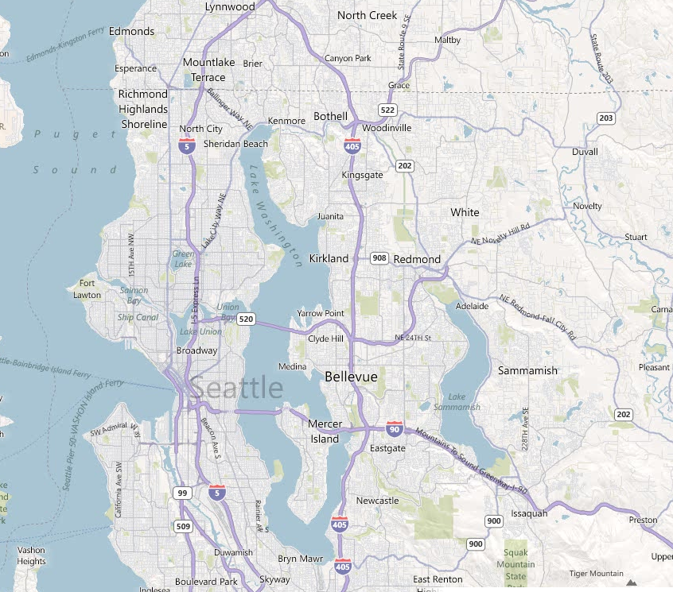
Large Scale Eventing / Command-Control
“Last Mile” problem of reaching into the consumer household
Reach consumer or industrial devices at scale
Broadcast event data at “utility scale”
Send targeted notifications based on geography or demographics
Large scale notifications and broadcast will become part of Service Bus in CY12
Smart Grid System
Smart Grid System
Smart Grid System

Slide 8
Service Bus Namespace https://yourapp.servicebus.windows.net/foo/bar/baz
Naming tree
ATOM Feed at the root for discovery
Management via REST on the ATOM feed hierarchy
All names that can exist do exist
“Infinite” depth
Factually: 32 segments, 450 character path limit
Entities own the namespace tree leaves
Any branch can be differently secured with ACS
/
foo
bar
baz
abc
boo
bee
pqr
def
ghi

Slide 9
Access Control – Conceptual Model
Each name/branch in the namespace can have a set of associated mappings from ‘claims’ to ‘rights’
‘Claims’ are issued by identity providers federated with Access Control
‘Rights’ define permissions on Service Bus entities: ‘Send’, ‘Listen’, ‘Manage’
owner: Send owner: Listen owner: Manage
/
foo
bar
baz
John: Manage
abc
boo
bee
pqr
def
Fred: Send Alice: Send Peter: Listen
ghi

Slide 10
Access Control – Implementation https://yourapp-sb.accesscontrol.windows.net
http://yourapp.sbwn/
/
owner: Send owner: Listen owner: Manage

abc
http://yourapp.sbwn/abc

John: Manage
pqr

Fred: Send Alice: Send Peter: Listen
http://yourapp.sbwn/abc/ghi

ghi


Relying Party/Realm
Rule Group

Slide 11
Service Bus Relay

Slide 12
“Expose Web Services from anywhere to anywhere”
Relayed One-Way Unicast and Multicast
Relayed WCF NET.TCP with Direct Connect Option
Relayed WCF HTTP with support for REST and SOAP 1.1/1.2
Endpoint protection with Access Control
Key Capabilities
Outbound TCP (Ports 9350-9353)
9350 Unsecured TCP One-way (client)
9351 Secured TCP One-way (all listeners, secured clients)
9352 Secured TCP Rendezvous (all listeners except one-way)
9353 Direct Connect Probing Protocol (TCP listeners with direct connect)
Outbound HTTP (Port 80, Listeners)
TCP equivalent tunnel with overlaid TLS/SSL formed over pair of HTTP requests
Alternate connectivity path if outbound TCP is blocked
Outbound HTTPS (Port 443, Senders)
Connectivity Options
Notes:
Relays, which provide bi-directional communication.
Doesn't store in-flight messages.
it just passes them on to the destination application.

Slide 13
Service Bus Messaging

Slide 14
Relay vs. Message Broker
S
AuthN/Z
Relay
Backpressure Feedback
R
Route
The Relay routes messages ‘straight through’ with feedback path and network backpressure into sender
S
Broker
R
AuthN/Z
Query Filter
Pull
Brokers hold messages for retrieval and querying
Notes:
Slide Objectives:
Explain main differences between Relay and Broker
Speaking Points:
Main difference between Relay messaging and Broker messaging
Relay messaging goes through direct, TPC-like connection
Broker manipulate messages (such as stamping) while relay is pass-through
Broker has storage, allowing loose-coupling between the sender and the receiver

Slide 15
Messages
Broker Message
Properties
Brokered messaging properties are not SOAP headers
Properties are key/value pairs that may very well carry payloads
It’s not uncommon to have messages with empty message bodies
Message bodies are useful for a single opaque payload not exposed to the broker (e.g. encrypted content)
Key
Value
Key
Value
Key
Value
Key
Value
Body
Body
Notes:
Slide Objectives:
Overview of brokered message structure
Speaking Points:
The structure is more like a HTTP message instead of a SOAP message.

Slide 16
Queues
S
R
Queue
Load Leveling
Receiver receives and processes at its own pace. Can never be overloaded. Can add receivers as queue length grows, reduce receiver if queue length is low or zero. Gracefully handles traffic spikes by never stressing out the backend.
Offline/Batch
Allows taking the receiver offline for servicing or other reasons. Requests are buffered up until the receiver is available again.
Notes:
Slide Objectives:
This slide and the next slide list some of integration patterns enabled by queues – load leveling, offline/batch, load balancing (competing consumers)

Slide 17
Topics
R
R
S
Topic
Sub
R
Sub
Sub
R
R
Message Distribution
Each receiver gets its own copy of each message. Subscriptions are independent. Allows for many independent ‘taps’ into a message stream. Subscriber can filter down by interest.
Constrained Message Distribution (Partitioning)
Receiver get mutually exclusive slices of the message stream by creating appropriate filter expressions.
Notes:
Slide Objectives:
This slide introduces some integration patterns enabled by topics and subscriptions

Slide 18
Subscription Filters
Filter conditions operate on message properties and are expressed in SQL’92 syntax
InvoiceTotal > 10000.00 OR ClientRating <3
ShipDestCtry = ‘USA’ AND ShipDestState=‘WA’
LastName LIKE ‘V%’
Filters actions may modify/add/remove properties as message is selected
SET AuditRequired = 1
Notes:
Slide Objectives:
Additional integration patterns enabled by subscription filters
Notes:
One pattern can be easily called out is message router, where messages are routed to different recipients based on message attributes. Note that will subscription filters the messages are actually routed to ALL recipients and they are only filtered by subscriptions.

Slide 19
Service Bus Notification Hub
(preview)

Slide 20

How Push Notifications Work
1
Retrieve device handle
4
Device notified (even when app is inactive)
PNS
(APNS, WNS, GCM)
2
Store handle in app back-end
3
Send notification to handle
Notes:
Slide Objectives:
Explains how notifications work without Service Bus Notification Hub
Speaker Notes:
Main challenges
Platform dependency – code multiple interfaces in the backend
Scale – PNS handle needs to be refreshed when app is launched; Most PNSs don’t support multicasting
Routing – not able to filter messages by custom criteria
http://msdn.microsoft.com/en-us/library/windowsazure/jj927170.aspx

