Slide 1
Windows Azure Service Bus
Name
Title
Organization

Slide 2
Agenda
Why Service Bus?
Service Bus Namespace and Access Control
Service Bus Relay
Service Bus Messaging

Slide 3

Service Bus
Connectivity
Service Relay
Protocol Tunnel Eventing
Messaging
Queuing Pub/Sub
Reliable Transfer
Rich options for interconnecting apps across network boundaries
Reliable, transaction-aware cloud messaging infrastructure for business apps.
Svc Management
Naming, Discovery
Monitoring
?
Notification
Multiplatform
Easily Scale out
Consistent management surface and service observation capabilities
Integration Routing
Coordination Transformation
Push notifications to large number of mobile devices.
Content-based routing, document transformation, and process coordination.
Notes:
Slide Objectives:
Overview of Service Bus capabilities
Speaking Points:
Think Service Bus as a federation infrastructure for building loosely-coupled hybrid applications.
Infrastructure for connectivity, for messaging, for integration.

Slide 4
Why Service Bus?

Slide 5
Cloud/On-Premise Integration
Cloud-Hosted, reliable asynchronous Messaging Infrastructure with Publish/Subscribe
Cloud-Based Relay enabling NAT/Firewall Traversal for reach into on-prem assets
Cloud App
On-Prem assets

Slide 6
Cloud/On-Premise Integration
Service Registry that allows organizing endpoints into a common, discovery enabled network surface for services spread across different network environments
Integration with Access Control providing security gate with Federated Identity support
Cloud App
On-Prem assets

Slide 7
Cross-Site Federation (SaaS)
Endpoint Federation instead of Network Federation (VPN)
Non-intrusive, does not require network reconfiguration
Enables integration scenarios with:
Multi-Tenancy
Minimal mutual trust
Minimal or no control over the on-premise networking environment
SaaS
Branch On-Prem Assets
Branch On-Prem Assets

Slide 8
Trade Franchise Partner Integration
Enables integration across partners and franchise environments
Low trust
Limited control
Diverse sites with varying connectivity
Direct peer access and cloud access
Commerce Site
Central Assets
Partner
Partner
Partner
Partner
Partner

Slide 9
Mobile Workforce/Customer Integration
Mobile devices are largely not “behind the firewall”
VPN solutions are largely impractical due to setup and management complexity
Mobile Devices
Application Client Services
Platform Client Services
Branch On-Prem Assets

Slide 10
Mobile Workforce/Customer Integration
Yet, mobile devices need access to on-premise assets
In reach for larger enterprises, not so much for smaller ones without static or at least public IPs
Mobile Devices
Application Client Services
Platform Client Services
Branch On-Prem Assets

Slide 11
Mobile Workforce/Customer Integration
Direct access, access via the cloud using ISV supplied services
In the future also support for Azure inherent mobile services such as Service Bus Push support for mobile
Mobile Devices
Application Client Services
Platform Client Services
Branch On-Prem Assets

Slide 12
Federated Cloud/On-Prem Solutions
Federated solutions provide the same functionality in the cloud and on-premise
Cloud enhances the on-premise solution by providing reach and scale
On-premise solution provides no-compromise availability even in case of a full network outage
Ticketing Site
Venue
Venue
Venue
Venue
Venue

Slide 13
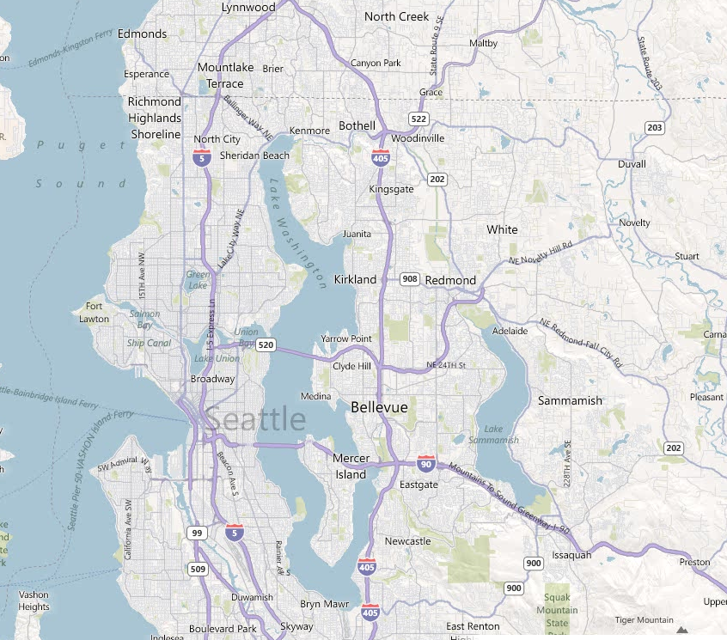
Large Scale Eventing / Command-Control
“Last Mile” problem of reaching into the consumer household
Reach consumer or industrial devices at scale
Broadcast event data at “utility scale”
Send targeted notifications based on geography or demographics
Large scale notifications and broadcast will become part of Service Bus in CY12
Smart Grid System
Smart Grid System
Smart Grid System

Slide 14
Service Bus Namespace and Access Control

Slide 15
Service Bus Namespace https://yourapp.servicebus.windows.net/foo/bar/baz
Naming tree
ATOM Feed at the root for discovery
Management via REST on the ATOM feed hierarchy
All names that can exist do exist
“Infinite” depth
Factually: 32 segments, 450 character path limit
Entities own the namespace tree leaves
Any branch can be differently secured with ACS
/
foo
bar
baz
abc
boo
bee
pqr
def
ghi

Slide 16
Service Bus and Access Control
Special relationship between Service Bus and ACS
Each SB namespace has a ‘buddy’ namespace in ACS
‘yourapp.servicebus.windows.net’
‘yourapp-sb.accesscontrol.windows.net’
‘-sb’ namespaces
Preconfigured relying party for Service Bus namespace root
Can‘t be deleted, system-managed signing key, uses default rule group
Preconfigured service identity ‘owner’
Can’t be deleted, configured as superuser via default rule group
Tokens issued for ‘owner’ assigned ‘Listen’, ‘Send’, and ‘Manage’

Slide 17
Service Bus Rights and Claims
Service Bus defines one authorization claim type with three possible values that indicate the authorized operation(s)
‘net.windows.servicebus.action’
‘Send’ – Permit ‘send’ operations on a Service Bus entity
‘Listen’ – Permit ‘send’ or ‘receive’ operations on a Service Bus entity
‘Manage’ – Permit management operations like creating, inspecting, or deleting Service Bus entities.

Slide 18
Access Control – Conceptual Model
Each name/branch in the namespace can have a set of associated mappings from ‘claims’ to ‘rights’
‘Claims’ are issued by identity providers federated with Access Control
‘Rights’ define permissions on Service Bus entities: ‘Send’, ‘Listen’, ‘Manage’
owner: Send owner: Listen owner: Manage
/
foo
bar
baz
John: Manage
abc
boo
bee
pqr
def
Fred: Send Alice: Send Peter: Listen
ghi

Slide 19
Access Control – Implementation https://yourapp-sb.accesscontrol.windows.net
http://yourapp.sbwn/
/
owner: Send owner: Listen owner: Manage

abc
http://yourapp.sbwn/abc

John: Manage
pqr

Fred: Send Alice: Send Peter: Listen
http://yourapp.sbwn/abc/ghi

ghi


Relying Party/Realm
Rule Group

Slide 20
Namespace and Access Control
demo
Notes:
http://haishibai.blogspot.com/2012/05/window-azure-service-bus-give-read-only.html

Slide 21
Service Bus Relay

Slide 22
“Expose Web Services from anywhere to anywhere”
Relayed One-Way Unicast and Multicast
Relayed WCF NET.TCP with Direct Connect Option
Relayed WCF HTTP with support for REST and SOAP 1.1/1.2
Endpoint protection with Access Control
Key Capabilities
Outbound TCP (Ports 9350-9353)
9350 Unsecured TCP One-way (client)
9351 Secured TCP One-way (all listeners, secured clients)
9352 Secured TCP Rendezvous (all listeners except one-way)
9353 Direct Connect Probing Protocol (TCP listeners with direct connect)
Outbound HTTP (Port 80, Listeners)
TCP equivalent tunnel with overlaid TLS/SSL formed over pair of HTTP requests
Alternate connectivity path if outbound TCP is blocked
Outbound HTTPS (Port 443, Senders)
Connectivity Options

Slide 23
Relay Programming Model
Full WCF Programming Model
Bindings functionally symmetric with WCF
WebHttpRelayBinding (HTTP/REST)
BasicHttpRelayBinding (SOAP 1.1)
WS2007HttpRelayBinding (SOAP 1.2)
NetTcpRelayBinding (Binary transport)
Special Service Bus Bindings
NetOnewayRelayBinding (Multicast one-way)
NetEventRelayBinding (Multicast one-way)
Transport binding elements for custom binding stacks
WebHttpRelayBinding provides full interoperability with any HTTP/REST client, BasicHttpRelayBinding with any SOAP client

Slide 24
Oneway
Backend Naming
Routing Fabric
sb://solution.servicebus.windows.net/a/b/
NetOnewayRelayBinding
All TCP and HTTP listeners use one-way as internal control channel
60KB message-size limit
One-way only
No rendezvous overhead
Subscribe
Route
Service Bus
Frontend Nodes
TCP/SSL HTTP(S)
NLB
TCP/SSL HTTP(S)
outbound connect one-way net.tcp
outbound connect bidi socket
Msg
Msg
Sender
NAT Firewall Dynamic IP
Receiver

Slide 25
Event
Backend Naming
Routing Fabric
sb://solution.servicebus.windows.net/a/b/
NetEventRelayBinding
Small-Scale Synchronous Multicast
60KB message-size limit
One-way only
No rendezvous overhead
Subscribe
Route
Service Bus
Frontend Nodes
TCP/SSL HTTP(S)
TCP/SSL HTTP(S)
outbound connect one-way net.tcp
outbound connect bidi socket
outbound connect bidi socket
Msg
Msg
Msg
Sender
Receiver
Receiver

Slide 26
Rendezvous (TCP & HTTP)
Backend Naming
Routing Fabric
sb://solution.servicebus.windows.net/a/b/
NetTcpRelayBinding
WebHttpRelayBinding
BasicHttpRelayBinding
WS2007RelayBinding
Rendezvous Handshake
Bi-Directional
Net.Tcp Full Duplex
No message size limit
Service Bus
Oneway Rendezvous Ctrl Msg
Frontend Nodes
Ctrl
NLB
2
HTTP/Socket Forwarder
3
TCP/SSL or HTTP
1
Ctrl
outbound socket connect
outbound socket rendezvous
Sender
Receiver
4

Slide 27
Hybrid Connect
Backend Naming
Routing Fabric
sb://solution.servicebus.windows.net/a/b/
Special Mode of NetTcpRelayBinding
TcpRelayConnection-Mode.Hybrid
Starts as relayed connection
Performs NAT probing and behavior prediction
Establishes direct connection and upgrades if possible
Upgrade driven by traffic
Takes large transfers off the Relay
No transfer charges, lower latency
Oneway Rendezvous Ctrl Msg
Service Bus
Frontend Nodes
TCP/SSL HTTP(S)
NAT Probing
Ctrl
NAT Probing
relayed connect
Upgrade
Upgrade
Sender
relayed rendezvous
Receiver
NAT Traversal Connection

Slide 28
Service Bus Relay Samples
demo
Notes:
https://github.com/Azure-Samples/NorthwindMobileServiceBus

Slide 29
Service Bus Messaging

Slide 30
Relay vs. Message Broker
S
AuthN/Z
Relay
Backpressure Feedback
R
Route
The Relay routes messages ‘straight through’ with feedback path and network backpressure into sender
S
Broker
R
AuthN/Z
Query Filter
Pull
Brokers hold messages for retrieval and querying
Notes:
Slide Objectives:
Explain main differences between Relay and Broker
Speaking Points:
Main difference between Relay messaging and Broker messaging
Relay messaging goes through direct, TPC-like connection
Broker manipulate messages (such as stamping) while relay is pass-through
Broker has storage, allowing loose-coupling between the sender and the receiver

Slide 31
Push vs. Pull
S
Intermediary
R
‘Push’ is a sender initiated activity that results in delivery of a message to a receiver without the receiver explicitly asking for one or a particular message
S
Broker
R
‘Pull’ is a receiver initiated activity that delivers stored messages to the receiver in a context that the receiver controls. The context is decoupled from the ‘Push’ style send operation
Notes:
Slide Objectives:
Explain differences between Push and Pull
Transition:
This is a continuation of Relay vs. Broker discussion

Slide 32
Ways to Pull
Receive and Delete
Fastest. Message lost if receiver crashes or transmission fails.
Peek Lock
Message is locked when retrieved. Reappears on broker when not deleted within lock timeout.
Transactional
Local model
Broker
R
Broker
R
Broker
R
Notes:
Slide Objectives:
Up and downs of different ways of polling
Speaking Points:
Receive and Delete may cause message lost
Peek and lock makes sure the message is processed at least once (but doesn’t guarantee if the same message is processed multiple times).

Slide 33
Messages
Broker Message
Properties
Brokered messaging properties are not SOAP headers
Properties are key/value pairs that may very well carry payloads
It’s not uncommon to have messages with empty message bodies
Message bodies are useful for a single opaque payload not exposed to the broker (e.g. encrypted content)
Key
Value
Key
Value
Key
Value
Key
Value
Body
Body
Notes:
Slide Objectives:
Overview of brokered message structure
Speaking Points:
The structure is more like a HTTP message instead of a SOAP message.

Slide 34
Queues
S
R
Queue
Load Leveling
Receiver receives and processes at its own pace. Can never be overloaded. Can add receivers as queue length grows, reduce receiver if queue length is low or zero. Gracefully handles traffic spikes by never stressing out the backend.
Offline/Batch
Allows taking the receiver offline for servicing or other reasons. Requests are buffered up until the receiver is available again.
Notes:
Slide Objectives:
This slide and the next slide list some of integration patterns enabled by queues – load leveling, offline/batch, load balancing (competing consumers)

Slide 35
Queues
R
S
R
Queue
R
Load Balancing
Multiple receivers compete for messages on the same queue (or subscription). Provides automatic load balancing of work to receivers volunteering for jobs.
Observing the queue length allows to determine whether more receivers are required.

Slide 36
Topics
R
R
S
Topic
Sub
R
Sub
Sub
R
R
Message Distribution
Each receiver gets its own copy of each message. Subscriptions are independent. Allows for many independent ‘taps’ into a message stream. Subscriber can filter down by interest.
Constrained Message Distribution (Partitioning)
Receiver get mutually exclusive slices of the message stream by creating appropriate filter expressions.
Notes:
Slide Objectives:
This slide introduces some integration patterns enabled by topics and subscriptions

Slide 37
Subscription Filters
Filter conditions operate on message properties and are expressed in SQL’92 syntax
InvoiceTotal > 10000.00 OR ClientRating <3
ShipDestCtry = ‘USA’ AND ShipDestState=‘WA’
LastName LIKE ‘V%’
Filters actions may modify/add/remove properties as message is selected
SET AuditRequired = 1
Notes:
Slide Objectives:
Additional integration patterns enabled by subscription filters
Notes:
One pattern can be easily called out is message router, where messages are routed to different recipients based on message attributes. Note that will subscription filters the messages are actually routed to ALL recipients and they are only filtered by subscriptions.

Slide 38
Runtime API Choices
Apps
HTTP REST
SOAP WS-* (Relay Clients)
WCF Service Model
Messaging API
NetMessagingBinding
Service Bus Relay Protocol Implementation (private)
Service Bus

Slide 39
Messaging API Hello World!
var nsm = NamespaceManager.Create();
nsm.CreateQueue("newQueue");
var client = QueueClient.Create("newQueue");
client.Send(new BrokeredMessage { Properties = {{ "Greeting", "Hello World!" }}});
var m = client.Receive();
Console.WriteLine(m.Properties["Greeting"]);
1
2
3
<appSettings>
<add key="Microsoft.ServiceBus.ConnectionString"
value="Endpoint=sb://[your namespace].servicebus.windows.net;
SharedSecretIssuer=owner;SharedSecretValue=[your secret]" />
</appSettings>

Slide 40
Service Bus Messaging Samples
demo
Notes:
https://github.com/WindowsAzure-Samples/MessageMe

Slide 41
Tooling improvements
Server explorer
Create queues/topics
Examine queue/topic properties
Send test message
Receive message
Role template
Notes:
Notes:
Role template refers to the “Worker role with Service Bus queue” template you can use when adding a new worker role to a Cloud Service.

Slide 42
Service Bus Best Practices
Client object lifecycle management
Cache QueueClient, SubscriptionClient, TopicClient
Close clients when no longer needed. Close() method may throw an exception. Wrap it with try/catch.
Handling transient errors
Implement consistent retry pattern
Consider Transient Fault Handling Framework
Reliable message handling (Peeklock)
Always finalize successfully processed message by calling Complete()
Always abandon unprocessed message by calling Abandon()
Ensure message is processed within designated lock period
Notes:
Notes: http://msdn.microsoft.com/en-us/library/windowsazure/hh528527.aspx
http://windowsazurecat.com/2011/09/best-practices-leveraging-windows-azure-service-bus-brokered-messaging-api/

Slide 43
Service Bus Best Practices (cont.)
Improve Performance
Reuse client objects
Choose Service Bus client protocol over HTTP
Use asynchronous send/receive
Use ReceiveAndDelete when appropriate
Client-side batching (asynchronous methods only)
Batching internal store access (EnableBatchedOperations = true)
Prefetching
Use multiple queues
Notes:
Notes: http://msdn.microsoft.com/en-us/library/windowsazure/hh528527.aspx
http://windowsazurecat.com/2011/09/best-practices-leveraging-windows-azure-service-bus-brokered-messaging-api/

Slide 44
Service Bus Notification Hub
(preview)

Slide 45

How Push Notifications Work
1
Retrieve device handle
4
Device notified (even when app is inactive)
PNS
(APNS, WNS, GCM)
2
Store handle in app back-end
3
Send notification to handle
Notes:
Slide Objectives:
Explains how notifications work without Service Bus Notification Hub
Speaker Notes:
Main challenges
Platform dependency – code multiple interfaces in the backend
Scale – PNS handle needs to be refreshed when app is launched; Most PNSs don’t support multicasting
Routing – not able to filter messages by custom criteria
http://msdn.microsoft.com/en-us/library/windowsazure/jj927170.aspx

Slide 46

How Service Bus Notification Hub Works
1
Retrieve device handle
PNS
4
Push notification
2
Registration with tags
3
Send notification to handle
Notes:
Slide Objectives:
Explains how notifications work with Service Bus Notification Hub
Speaker Notes:
Main benefits
Multiple-platforms – common interface to send notifications to all supported platforms
Pub/Sub routing – devices specify tags when register with notification hub
Scale – notification hubs scale to millions of devices without the need of architecting or sharding
http://msdn.microsoft.com/en-us/library/windowsazure/jj927170.aspx

