Slide 1
Deep Speaker Recognition: Modular or Monolithic?
Gautam Bhattacharya, Jahangir Alam, Patrick Kenny
Abstract Version

Slide 2
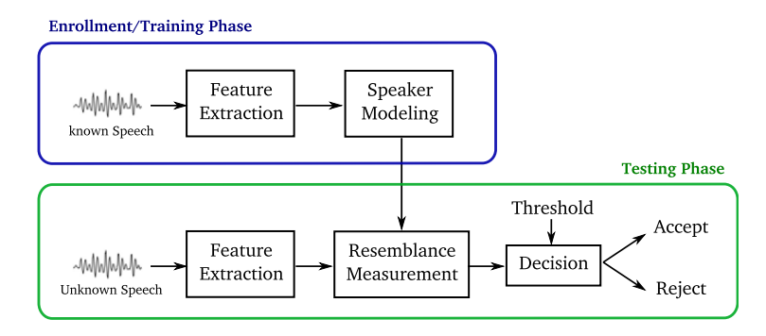
1. Introduction
Goal
In this work, they analyze the performance of end-to-end deep speaker recognizers on two popular text-independent tasks: NIST-SRE 2016 and VoxCeleb.
NIST-SRE 2016 → https://www.nist.gov/itl/iad/mig/speaker-recognition-evaluation-2016
VoxCeleb → https://www.robots.ox.ac.uk/~vgg/data/voxceleb/

Slide 3
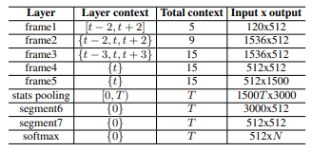
2. Related Works
Two tasks and approaches
X-vector [Snyder et al, 2018] model has established as the state-of-the-art in recent NIST evaluations.
Speaker embeddings are used to train a probabilistic linear discriminant analysis (PLDA) classifier.
→ Modular
ResNet models have been widely adopted for learning speaker embedding models, especially for the VoxCeleb task [Chung et al, 2016] [Cai et al, 2018]
→ Monolithic

Slide 4
3. Proposed Methods
Modular framework
They propose a modular approach that draws inspiration from the x-vector/PLDA recipe.
Unlike the x-vector model, their approach uses a second neural network instead of PLDA.
Procedures
Step 1: Train a speaker embedding model by minimizing the softmax loss. → extract speaker embeddings from entire training dataset.
Step 2: Train a small classifier using the embeddings extracted in step 1 as input. → extract speaker embeddings from this second model to perform speaker verification.

Slide 5
3. Proposed Methods
Main factors
Deep residual neural network feature extractor (step 1)
Self-attention (step 1)
Large margin loss function (step 2)
Feature normalization (step 2)
The Technical details and result → in the paper !

