Slide 1



Spoken Term Discovery for Language Documentation using Translations
Antonios Anastasopoulos, Sameer Bansal,
Sharon Goldwater, Adam Lopez, and David Chiang
Funding: JS McDonnell Foundation,

Slide 2
Steps in documentation
Data collection
Manual annotation
Automatic annotation/analysis

Slide 3
Target scenario
+
Gila aburun ferma hamišaluǧ güǧüna amuqʼdač
Now their farm will not stay behind forever.
Notes:
About ½ of 137 languages in Archive of Indigenous Languages of Latin America don’t have transcriptions

Slide 4
Beyond just alignments
Previous approaches:
Here:
Anastasopoulos et al. (2016), Duong et al. (2016)
now
their
farm
will
not
stay
behind
forever
+

Slide 5
Realistic scenario
Predictions on natural speech data
Not phones or lattices (Adams et al., 2016; Godard et al., 2016)
Not synthetic speech (Bérard et al., 2016)
Using real endangered language recordings
Ainu (~2.5hrs) and Arapaho (~1hr)
Plus Spanish (~20hrs)
Can predict a few terms with ok precision, better than (the only) previous approach.

Slide 6
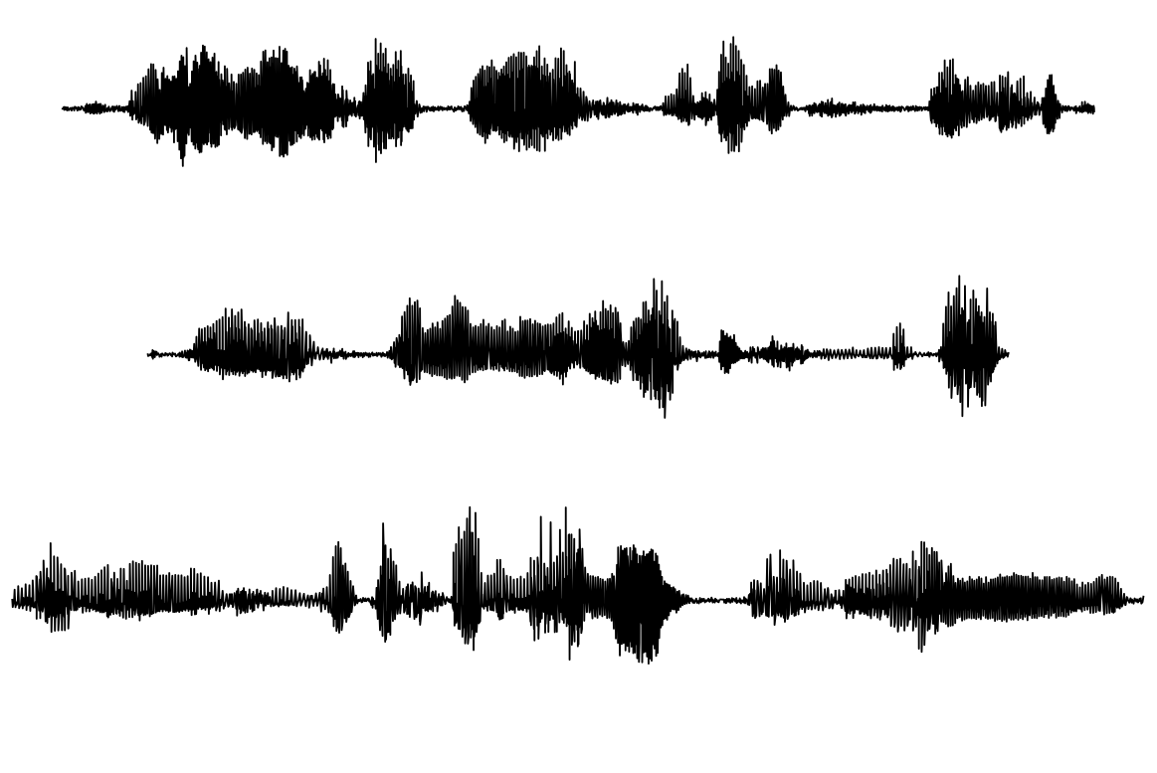
Baseline system (utd-align)
Input data:
Bansal et al. (2017)
the man saw a dog near the tall tree
With translations
the dog ran to the man riding a horse
Speech only

Slide 7
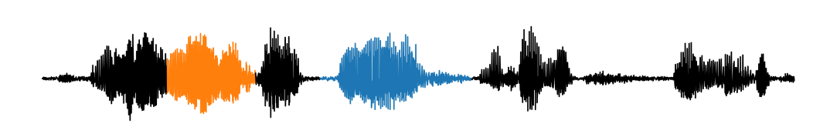
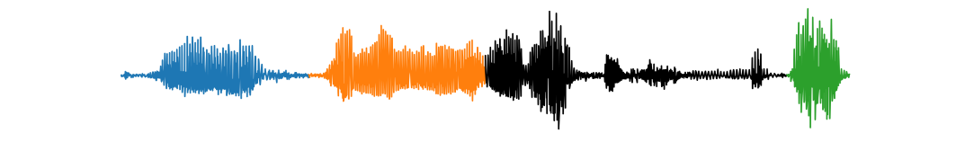
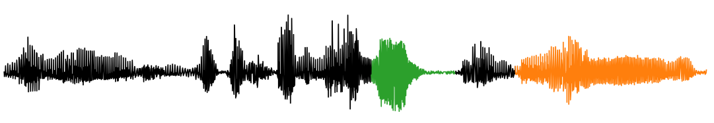
Baseline system (utd-align)
Bansal et al. (2017)
1-2. Segment and cluster (UTD)
3. Align clusters to words
f₁₂ f₇
man saw dog tall tree
f₇ f₁₂ f₃₄
dog ran man riding horse
f₃₄ f₁₂
horse dog
4. Predict translations for unaligned clusters

Slide 8
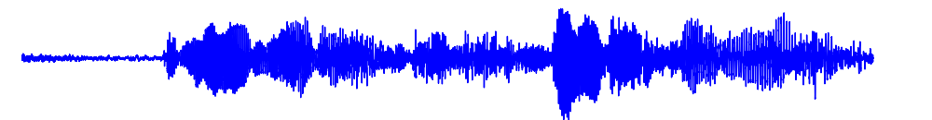


Here: joint system plus predictions
Builds on previous work that jointly learns to segment, cluster, and align (Anastasopoulos et al., 2016)
f8 :
f13 :
f8 :
go dog go

Slide 9
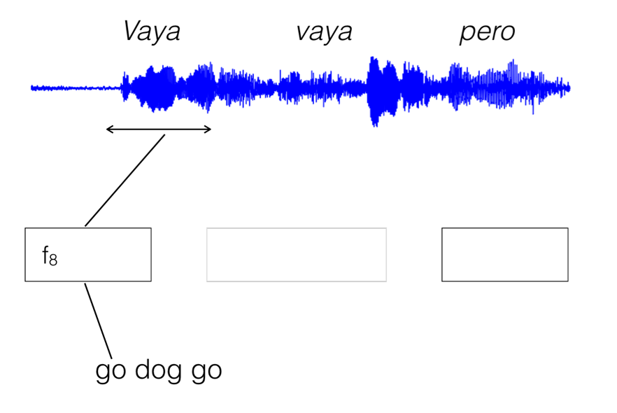
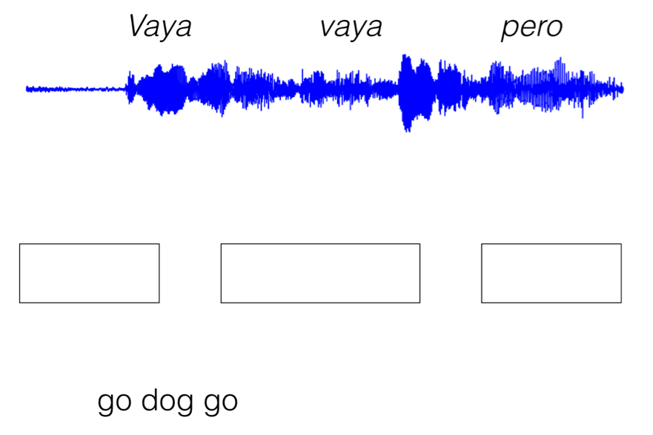
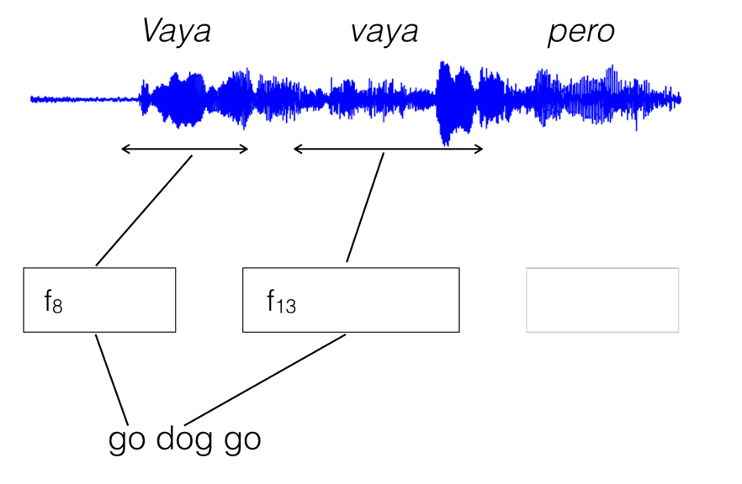
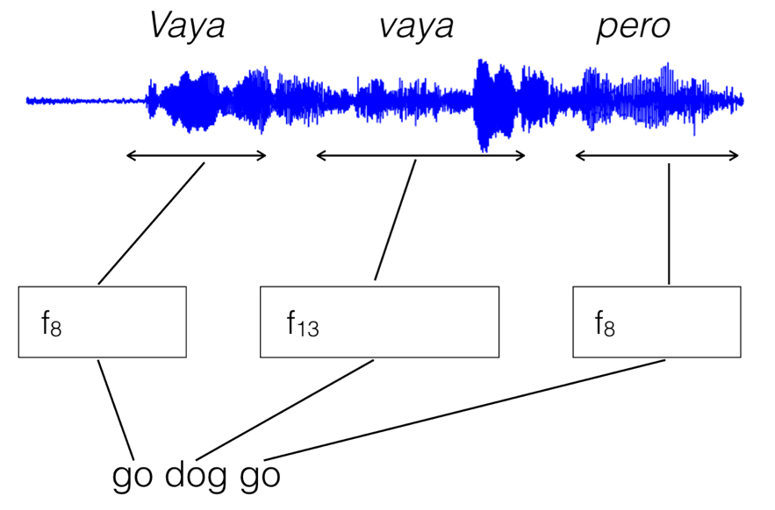
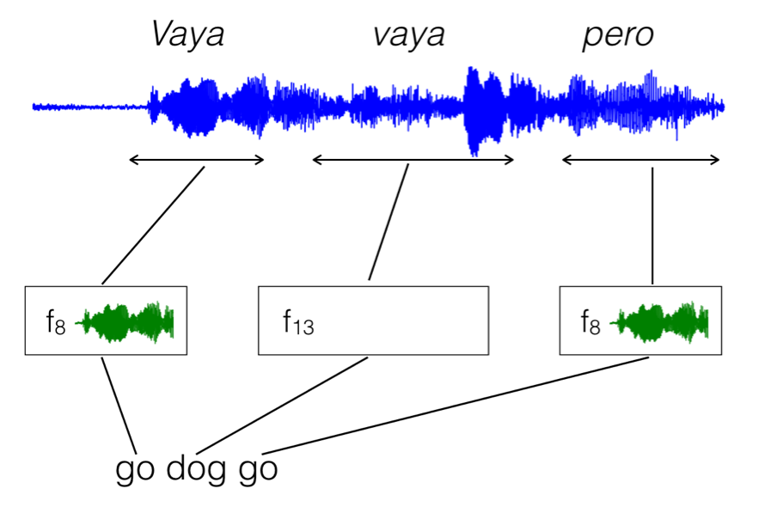
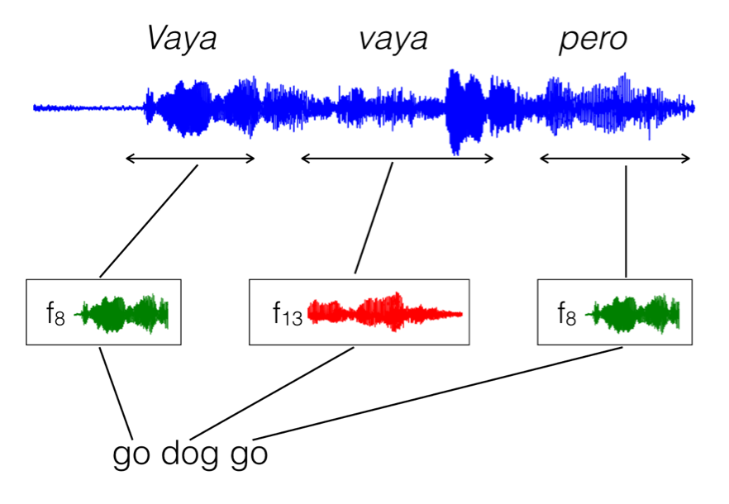
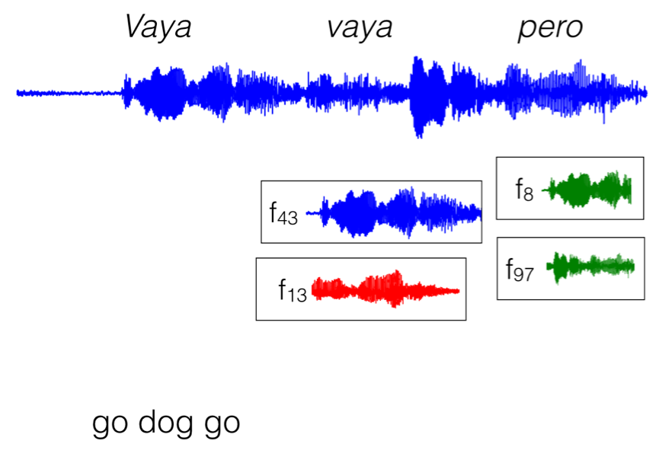
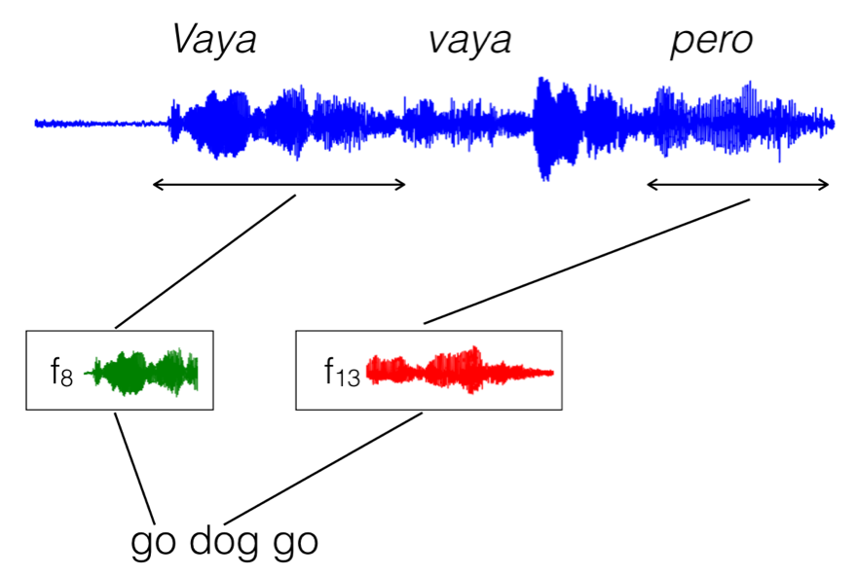
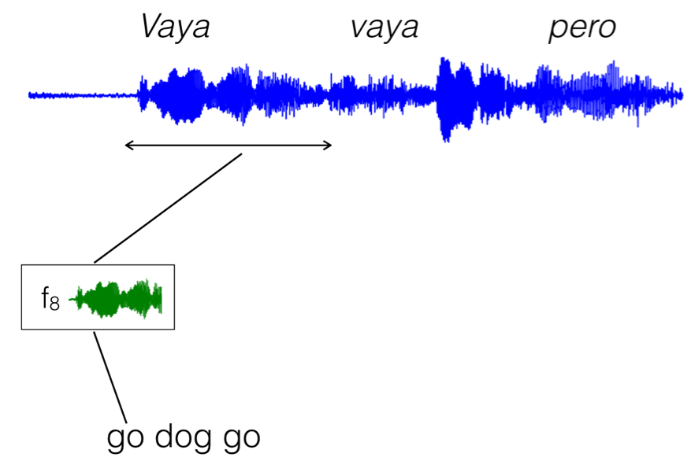
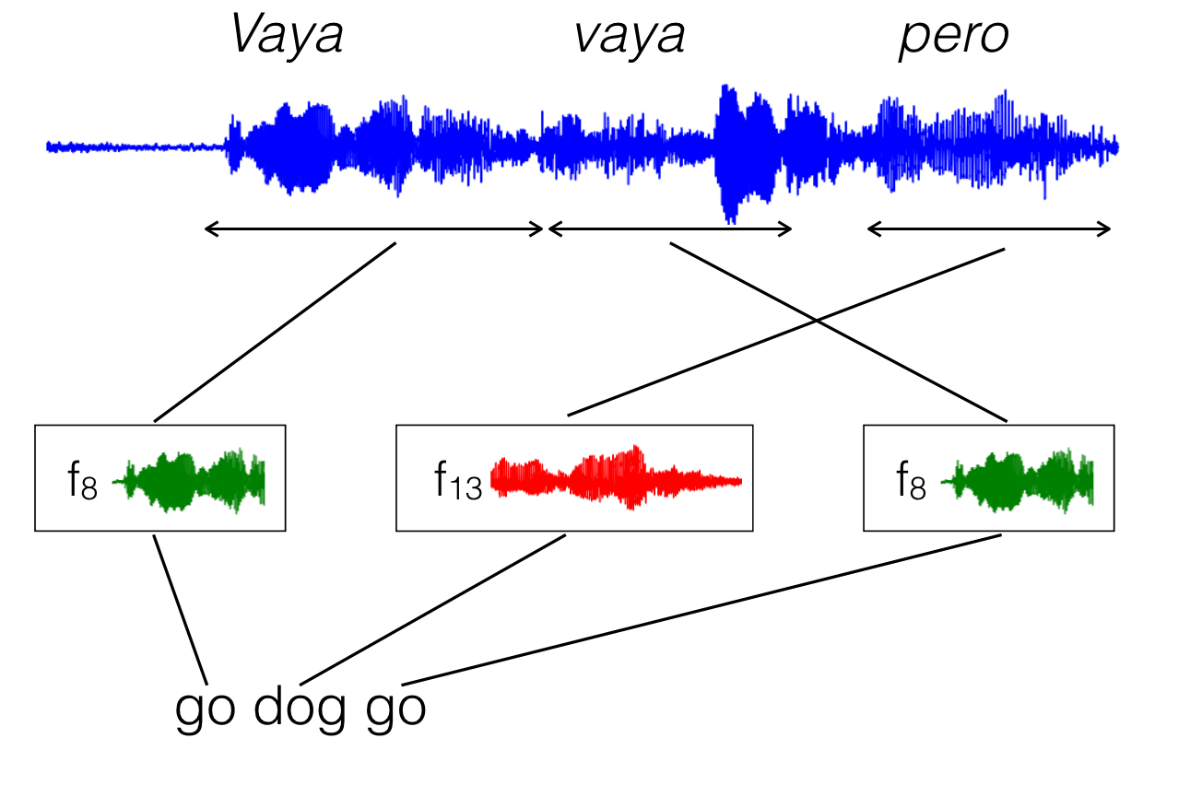
Training using EM
Initialize spans and clusters
M step:
Re-estimate prototypes
E step:
Assign cluster and align

Slide 10
Extension 1: variable # of prototypes
Before re-estimating prototypes, cluster speech segments aligned to each word using a similarity threshold.
f8 :
f13 :
f8 :
go dog go

Slide 11
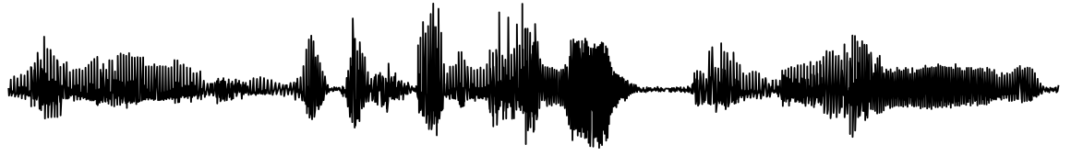
Extension 2: use prototypes to predict
Modify UTD system (Jansen et al., 2010) to search for prototypes in unlabelled speech.
Similarity threshold s: trades off precision/recall.
go
f8 :
dog
f13 :
dog

Slide 12
Experiments: Spanish
CALLHOME: 20hr Spanish speech with English translations (Post et al., 2013)
Random 70% utts training, 10% dev, 20% test
Tune hyperparameters on dev:
Min len of segments used to compute prototypes
Sim threshold for creating prototype subclusters
% length of prototype to match for predictions

Slide 13
Results: Spanish
Notes:
Recall computed using stopwords even though removed

Slide 14

Experiments: endangered languages
Hokkaido Ainu (10 speakers in 2007)
10 narratives, single speaker (150min)
2 for training: 24min, 490 English word types
Arapaho (~1000 speakers)
8 narratives, several speakers (40min)
1 for training: 18min, 233 English word types
No re-tuning of hyperparameters, except threshold for returning matches.
National Institute for Japanese Language and Linguistics (2016). A Glossed Audio Corpus of Ainu Folklore [Software]. http://ainucorpus.ninjal.ac.jp
Arapaho Language Project. http://www.colorado.edu/csilw/alp/index.html

Slide 15
Results: Arapaho / Ainu
Compute token accuracies over full narratives.
On average per narrative,
UTD-align finds only 2 / 4 tokens (0.4% / 0.1% recall).
Our system finds 65 / 122 tokens.

Slide 16
Results: Arapaho / Ainu
Oracle recall is 48% / 64%
Notes:
One reason for low recall: lots of OOV words in test narratives (1/3 – ½)

Slide 17
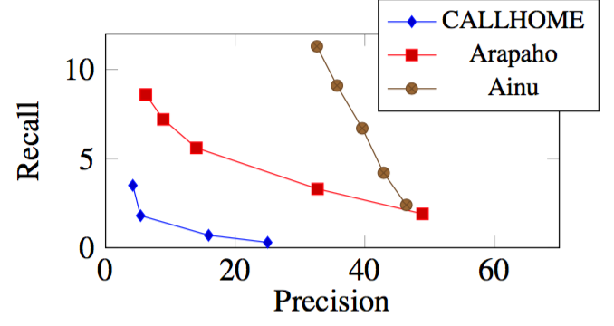
Precision/Recall tradeoff
Varying similarity threshold for matching prototypes:
Notes:
Circles around the points plotted before – prob not the best for these datasets

Slide 18
Examples
Ainu #2: The Young Lad Raised by the Cat God
Notes:
Play audio?

Slide 19
Conclusions
First test of cross-lingual keyword labelling of speech data from endangered languages, using very small translated portions.
Joint alignment/clustering outperforms pipelined system.
Identifies a handful of terms, but speech matching problem is really hard!
Future: consider NN approaches, improve speech feature extraction using multilingual data.

