Slide 1
MasterQuad 2015 A Raspberry Pi based Quadrocopter Platform Project Work
29.06.2015
Oliver Breuning
Jürgen Schmidt

Slide 2
Agenda
Reached project goals
Development Environment
Raspberry Pi based platform
Software structure
UDP-based network connection to MATLAB
Sensor fusion of Inertial Measurement Unit
Outlook

Slide 3
Reached project goals
Setting up a flexible development environment
Hardware selection
Positioning and Wiring of Hardware
Setting up RTOS including Custom Kernel
PPM Decoding
Driver development
LLD – Low-Level Driver
HAL – Hardware Abstraction Layer
SIG – Signal Processing Layer
UDP/Matlab Connection
Sensor Fusion for orientation
Matrix Library
Complementary Filter
Kalman Filter

Slide 4
Development environment
Virtual machine
No specific Operating system on Host Computer needed
Ubuntu
Ubuntu 14.10
More rights to Hardware access
Eclipse
Eclipse Luna
Cross-Compile enabled to ensure faster compilation
Debugging enabled via Network -> faster Software development

Slide 5
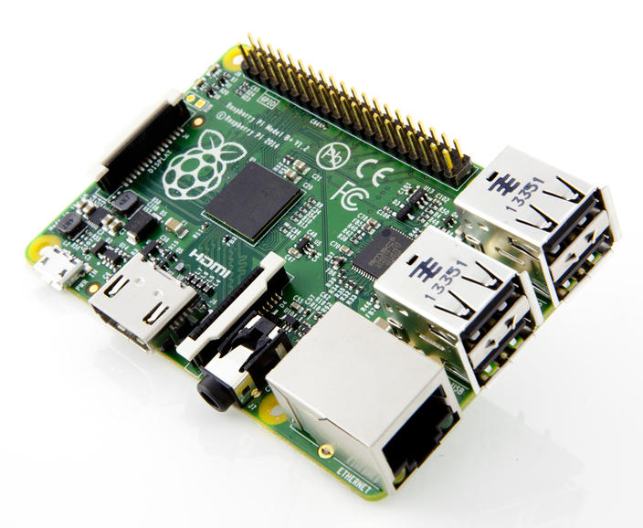
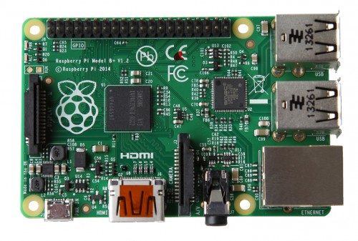
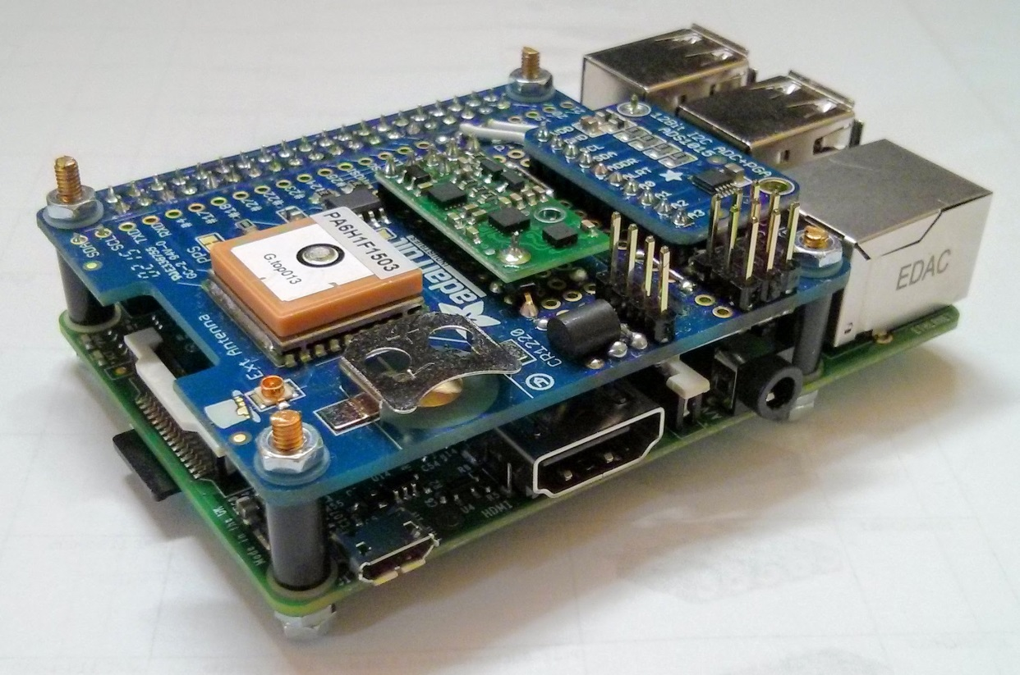
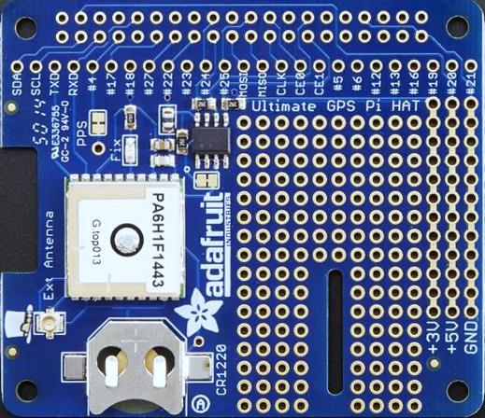
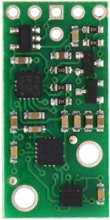
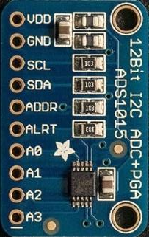
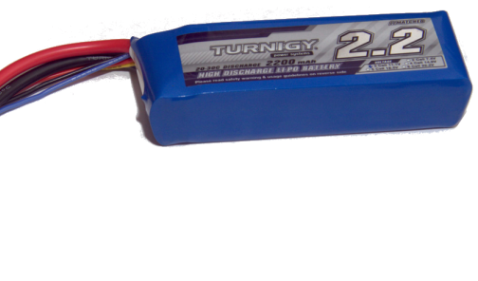
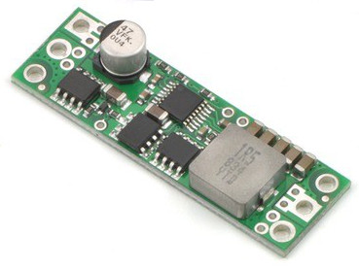
Raspberry Pi based platform Hardware
Raspberry Pi B+
GPS Hat board
IMU Board
Acceleration sensor
eCompass
Gyrosensor
Barometer
A/D Converter
DC/DC Converter
https://www.raspberrypi.org/wp-content/uploads/2014/07/rsz_b--500x337.jpg
http://www.cnet.com/products/raspberry-pi-model-b-plus/
https://blog.adafruit.com/2013/01/04/powering-the-raspberry-pi-from-standard-rc-batteries-piday-raspberrypi-raspberry_pi/

Slide 6
Raspberry Pi based platform Real-Time Linux
Standard Linux distribution (Raspbian)
Patched Kernel with Preempt_RT extension
Goal: Deterministic behavior of system (latency jitter)
Effect: - Interrupts during kernel code - Complete Linux responsive - Low latency at cost of throughput
Pre-configured Firmware Image for ease of use

Slide 7
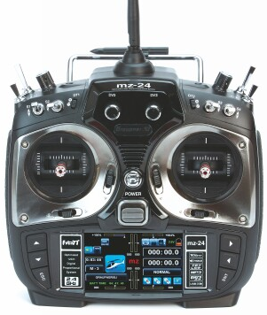
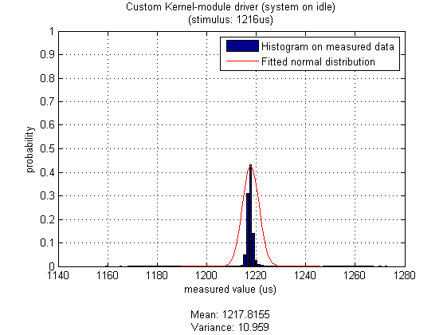
Raspberry Pi based platform Custom Kernel drivers
Isochronous time-trigger required for control loops
Hardware timer interrupt every 10ms → triggers control loop
Remark: Not stable yet!
Graupner sum signal (Remote radio control)
Time between two PPM pulses
Proof-of-concept version stable
http://shop.graupner.de/webuerp/servlet/AI?ARTN=S1006.16

Slide 8
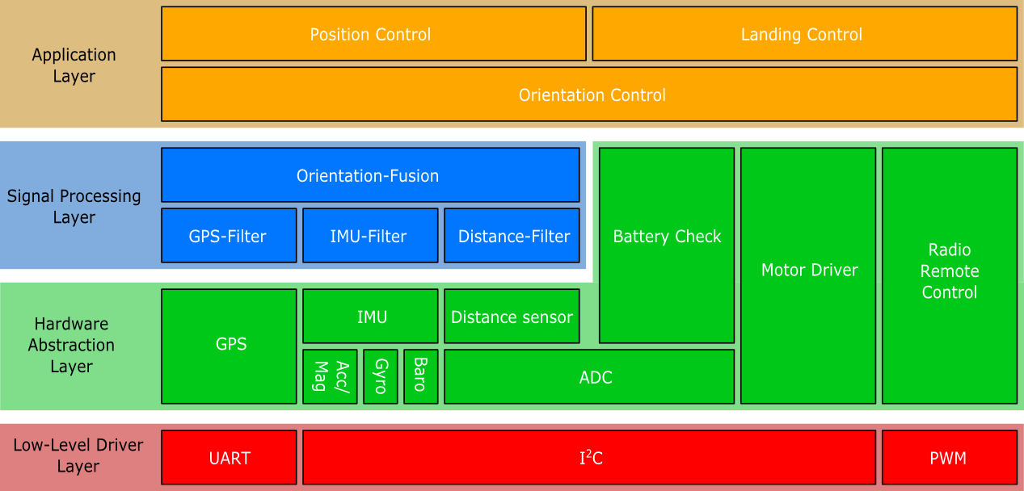
Software structure Layers and Modules
Four software layers reflect modularity of hardware

Slide 9
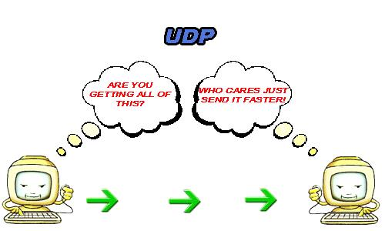
Network connection to MATLAB UDP in a nutshell
UDP for ease of use (used in this project only for validation & testing)
Non-reliable connection → no retransmission (as in TCP)
Less bandwidth needed (relevant for Wifi)
Less system load
Easier to implement
http://www.skullbox.net/udp.jpg

Slide 10
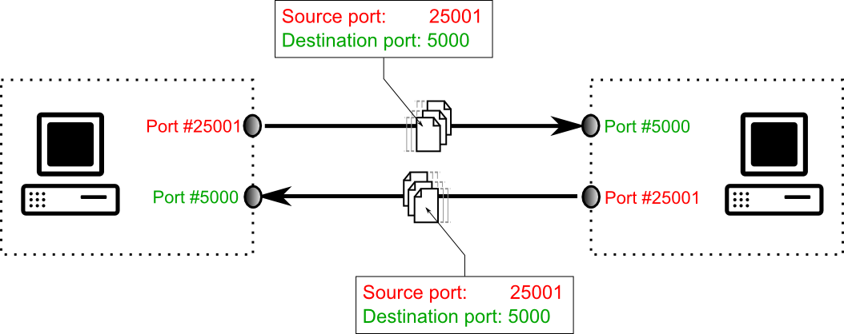
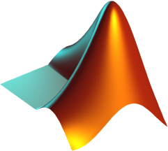

Network connection to MATLAB C library udpLib
C-Code library for easy network access (udpLib)
Establishing a connection (symmetric connection)
Sending/Receiving packets
Closing a network connection
MATLAB/Simulink

Slide 11
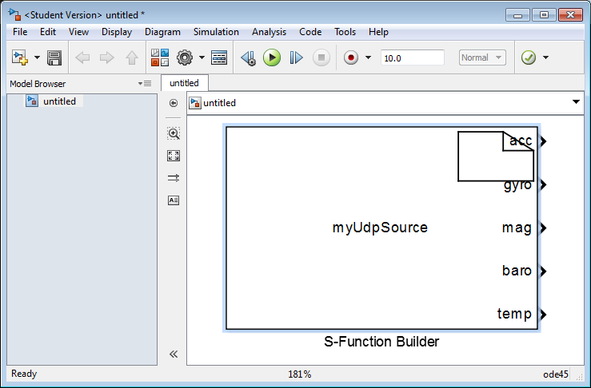
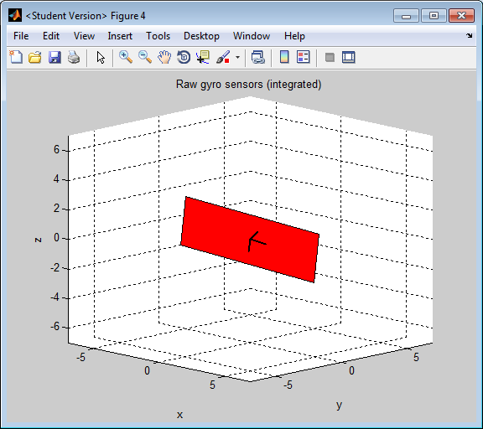
Network connection to MATLAB MATLAB S-Functions
Custom S-Function block
Network access in MATLAB/Simulink
Specific blocks for data of
Generic packet data
Inertial Measurement Unit
Sensor fusion output (orientation)
Graphical 3D representation

Slide 12
Sensor Fusion – Sensor restrictions
Magnetic sensor
Only Yaw rotation
Wrong if pitch/roll angle applied
Acceleration Sensor
Only Roll and pitch rotation
Noisy when vibrating
Gyroscope sensor
Roll/Pitch and Yaw rotation
Drift over time

Slide 13
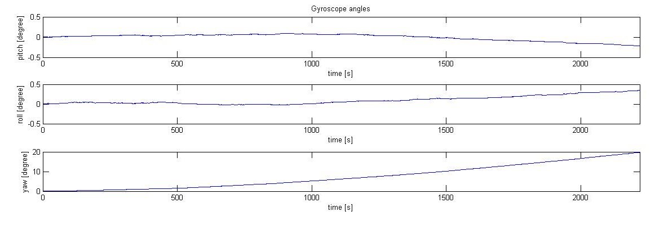
Sensor Fusion – Sensor restrictions
Gyroscope sensor

Slide 14
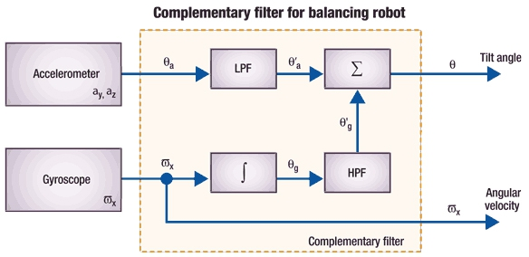
Sensor Fusion – Complementary Filter
Principle
[http://uk.mouser.com/applications/sensor_solutions_mems/]

Slide 15
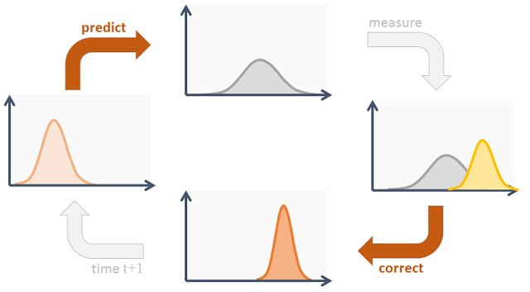
Sensor Fusion – Kalman Filter
Principle
[http://www.codeproject.com/Articles/865935/Object-Tracking-Kalman-Filter-with-Ease]

Slide 16
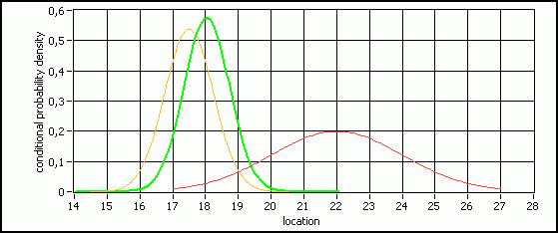
Sensor Fusion – Kalman Filter
Principle
[http://www.convict.lu/htm/rob/imperfect_data_in_a_noisy_world2.htm]

Slide 17
Outlook
Decoding of PWM signal
Setting the PWM signal to the motors
Sensor Fusion for position estimation
Quaternion based pose estimation
Implementation of controller
Mounting on Quadcopter

Slide 18
MasterQuad 2015 A Raspberry Pi based Quadrocopter Platform Project Work
Do you have questions?
29.06.2015
Oliver Breuning
Jürgen Schmidt

Slide 19
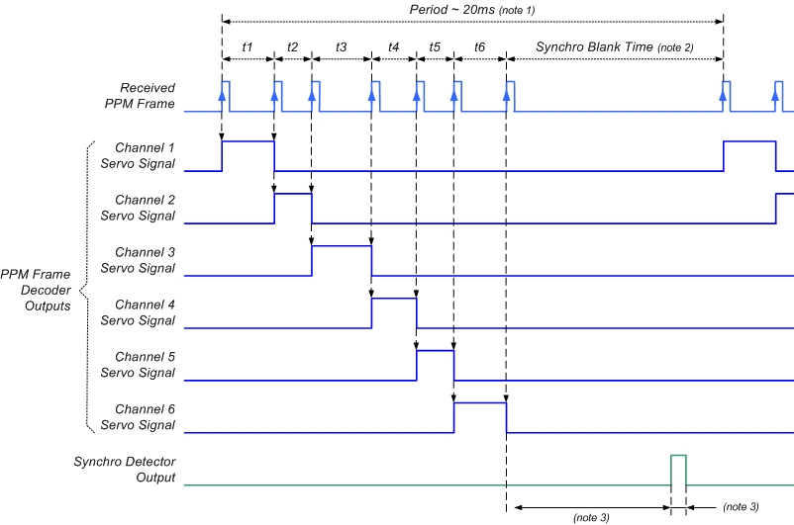
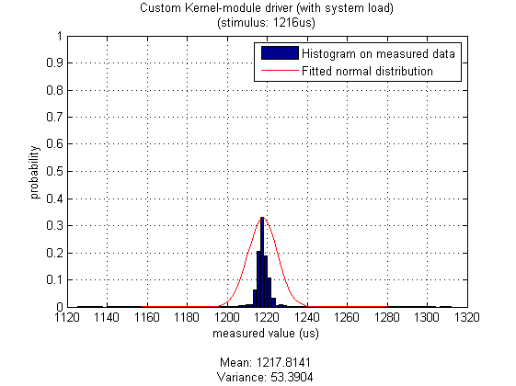
Raspberry Pi based platform Custom Kernel drivers
Graupner sum signal (Remote control)
Up to 12 PWN channels into one PPM signal
Pulse-to-pulse width: 1ms – 2ms
https://trandi.files.wordpress.com/2011/01/rc_receiver_timing_diagram.jpg

Slide 20
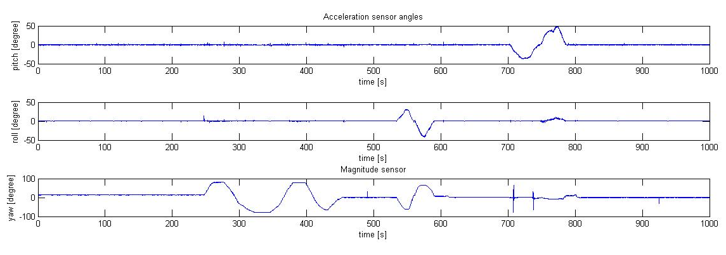
Sensor Fusion – Sensor restrictions
Acceleration/Magnetic sensor

Slide 21

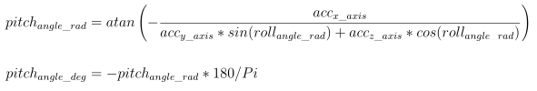
Sensor Fusion – Sensor restrictions
Acceleration sensor
Calculation of roll angle
Calculation of pitch angle

Slide 22
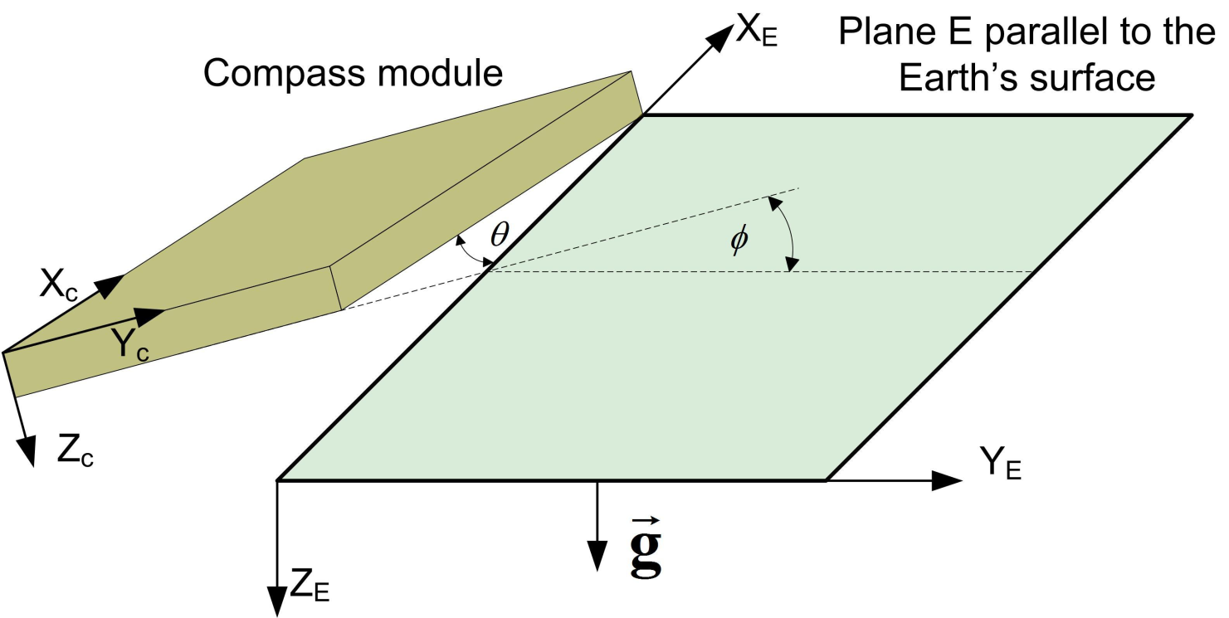
Sensor Fusion – Angle calculation
Magnetic sensor
Tilt compensation
[http://mycoordinates.org/operation-and-implementation-of-heading-reference-system/all/1/]

Slide 23
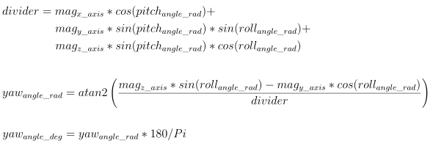
Sensor Fusion – Angle calculation
Magnetic sensor
Calculation of Yaw angle

Slide 24

Sensor Fusion – Angle calculation
Gyroscope sensor
Calculation of Roll/Pitch and Yaw angle

Slide 25
Demonstration
Demo of Sensor Fusion with MATLAB connection

