Slide 1
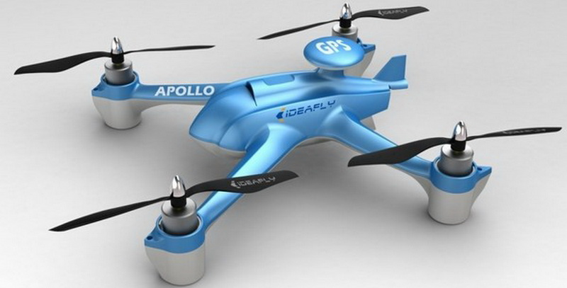
Quadcopter Dynamic Modeling and Simulation
[1]
29.06.2015
By
Nitesh Kumar Mahawar
Vikas Kumar Jha
Notes:
02.12.2014

Slide 2
Contents
Motivation
Project Management
Introduction to Quadcopter
Flight Dynamics Model
Data Acquisition and Analysis
Simulation
Results

Slide 3
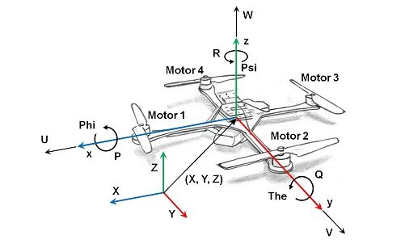
Motivation
Design a practical Quadcopter characterization process and configurable Simulation

Slide 4
Project Management
  Development Environment
Our project typically uses the V-Model for the development, each phase of the project uses its own set of tool/s.
Project Phases
Requirements Collection
Design & Documentation
Coding
Testing & Documentation of results
Notes:
02.12.2014

Slide 5
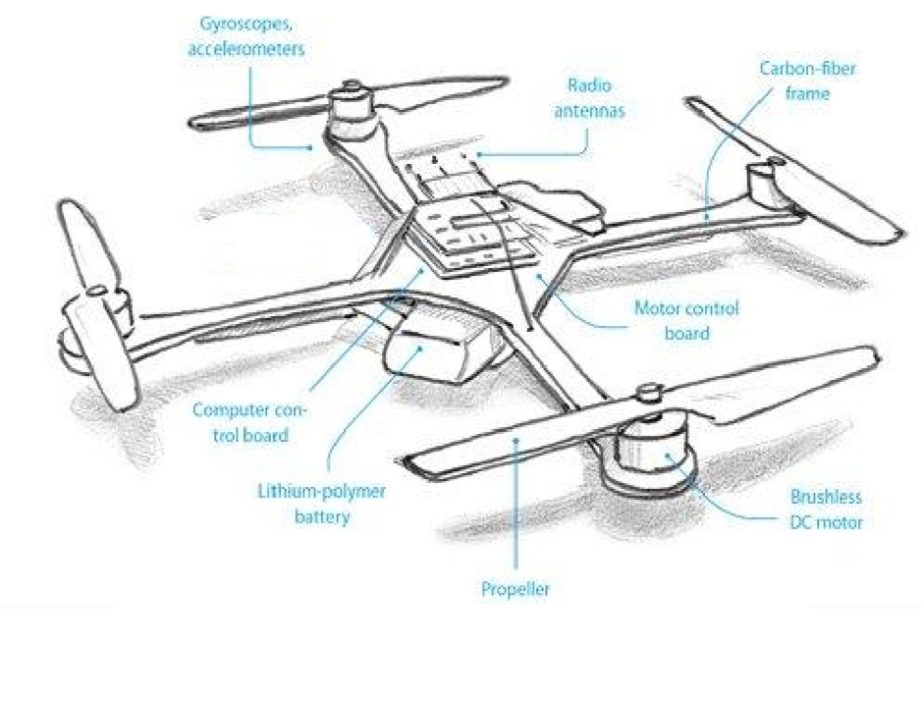
Introduction to Quadcopter
What?
Multirotor Helicopter
Parts
Motors
Propeller
Electronic Speed Controller (ESC)
Arms
Types
‘+’ Configuration
‘x’ Configuration
[2]
Notes:
A quadcopter, also called a quadrotor helicopter or quadrotor,[1] is a multirotor helicopter that is lifted and propelled by four rotors. Quadcopters are classified as rotorcraft, as opposed to fixed-wing aircraft, because their lift is generated by a set of rotors (vertically oriented propellers).
02.12.2014

Slide 6


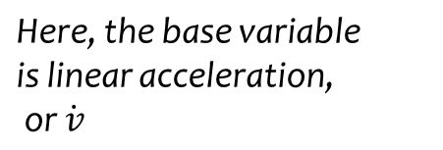


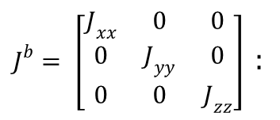

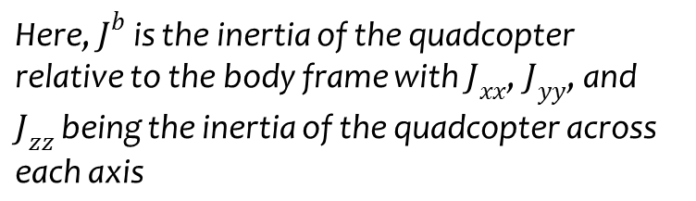

Flight Dynamics Model
Mathematical Equations
thrust coefficient for a
specific rotor
torque coefficient for a
specific rotor
expected steady-state motor RPM
throttle % to RPM conversion coefficient
arm length from quadcopter hub
center to motor/prop.
Notes:
A quadcopter, also called a quadrotor helicopter or quadrotor,[1] is a multirotor helicopter that is lifted and propelled by four rotors. Quadcopters are classified as rotorcraft, as opposed to fixed-wing aircraft, because their lift is generated by a set of rotors (vertically oriented propellers).
02.12.2014

Slide 7
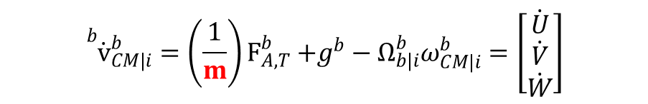
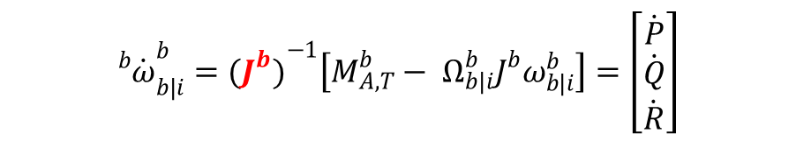
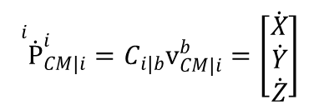

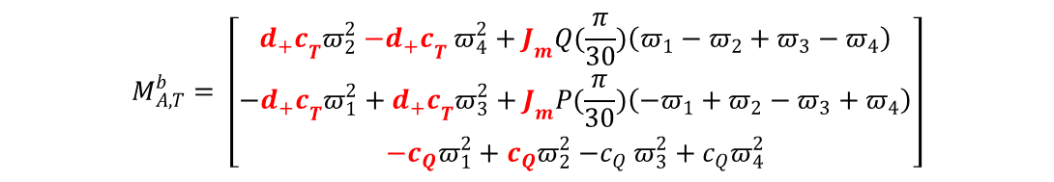
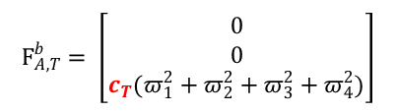
Flight Dynamics Model
Velocity State Equation
Angular Velocity State Equation
Position State Equation
Euler Kinematic Equation
Thrust Forces
Gyroscopic and Thrust Moments (‘+’)

Slide 8


Flight Dynamics Model
Thrust and Torque RPM relationships
Throttle % to RPM
Time Constant Delay

Slide 9
Data Acquisition & Analysis
Data Acquisition
Importing Data to the MATLAB Workspace
To obtain the performance parameters like CT, CQ, TC, CR we measure RPM, thrust, torque, and a first order model time constant for the motor, ESC, and prop system.
The overall Motor Test System includes designs for the required hardware and circuits, an Arduino Uno program that facilitates easy data collection, and a data analysis program that makes data analysis simple and fast.
Hence RPM, Thrust and Torque are tabulated at different time intervals in an Excel Spreadsheet.

Slide 10
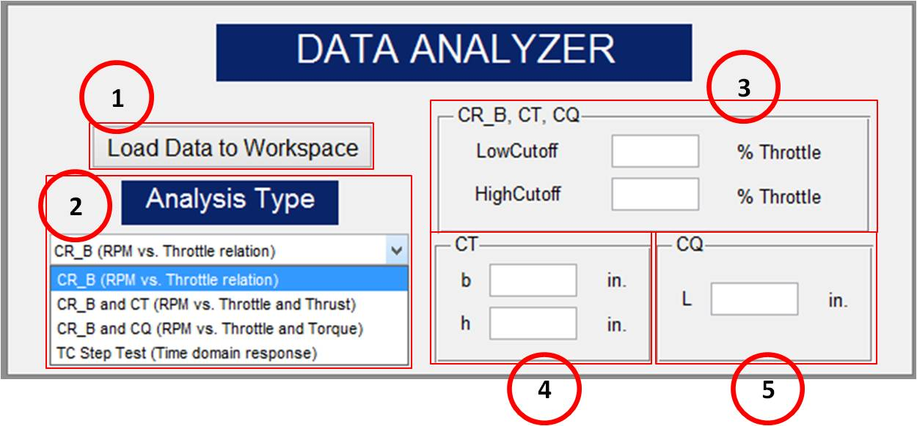
Data Acquisition & Analysis
Data Analyser
The simulation requires us to estimate several quadcopter performance parameters that are acquired through experimental testing of the motors of the quadcopter vehicle. This GUI was made to help analyze this motor test data..
The parameters this GUI is able to calculate are called: CR and b (Throttle to RPM conversion), CT (Thrust coefficient), CQ (Torque coefficient), and TC (motor time constant). By loading test data into the workspace the GUI can automatically calculate parameters and plot the data

Slide 11
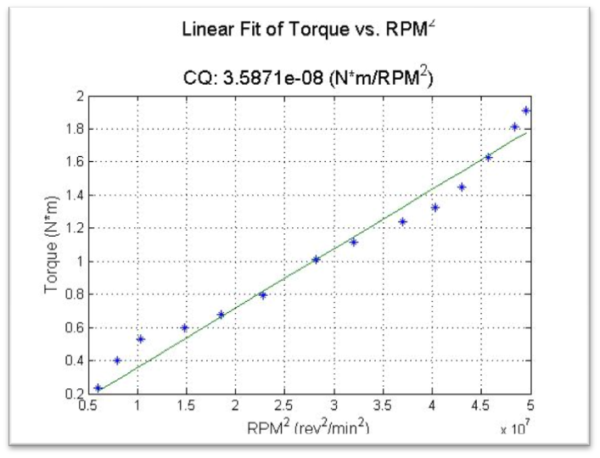
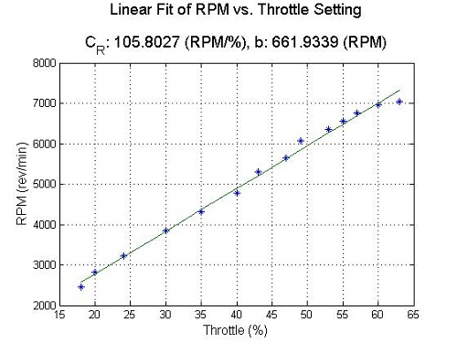
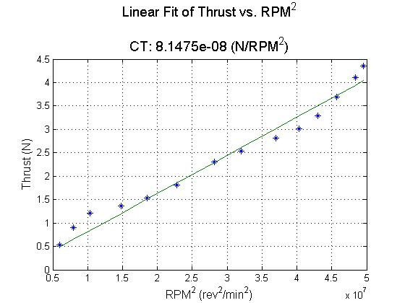
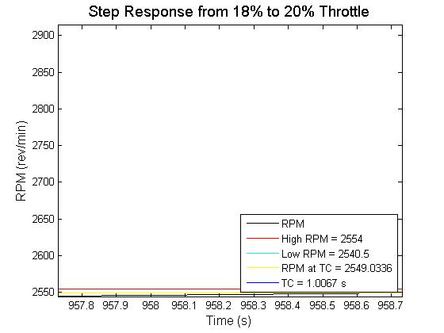
Data Acquisition & Analysis
Results

Slide 12
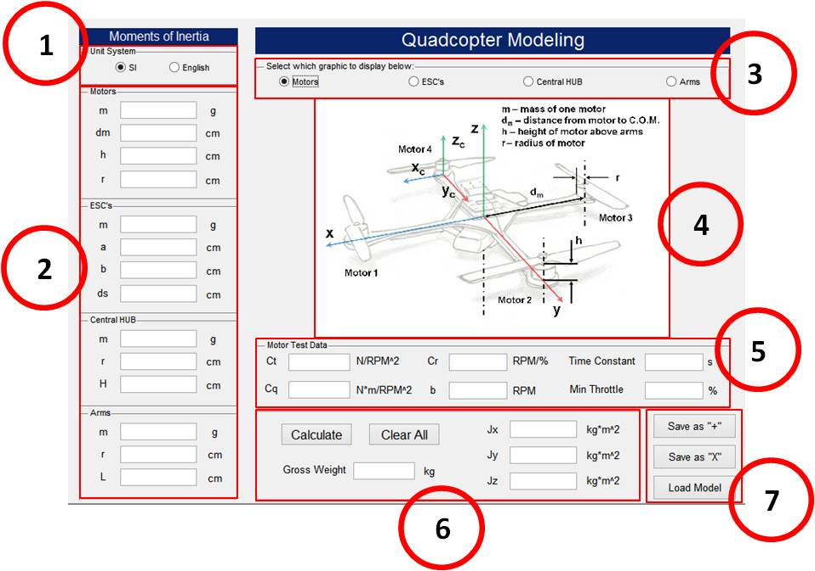
Modeling GUI
This GUI accepts user input of physical measurements from their quadcopter vehicle

Slide 13
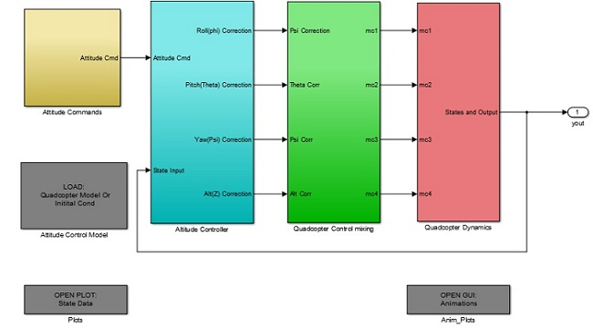
Simulation of Attitude Control Model

Slide 14
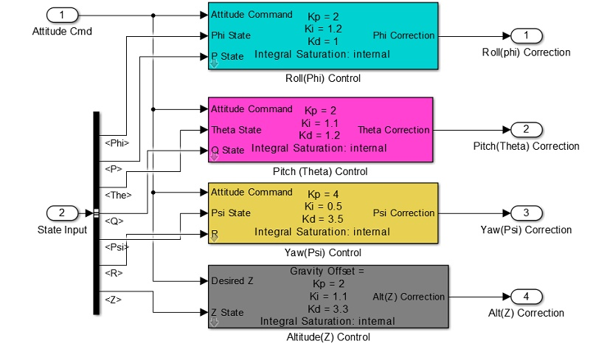
Simulation of Attitude Control Model
Attitude Controller

Slide 15
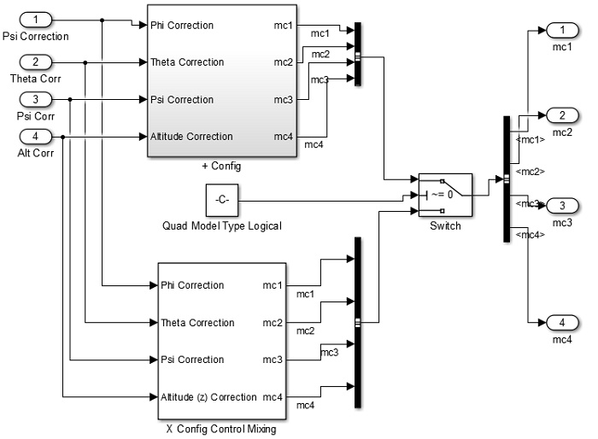
Simulation of Attitude Control Model
Quadcopter Control Mixing

Slide 16
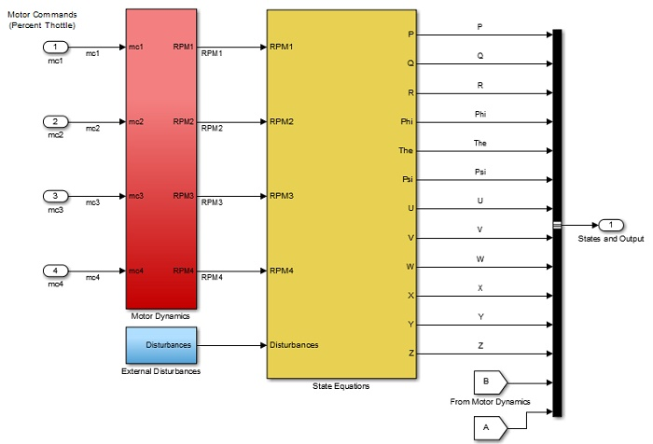
Simulation of Attitude Control Model
Quadcopter Dynamics

Slide 17
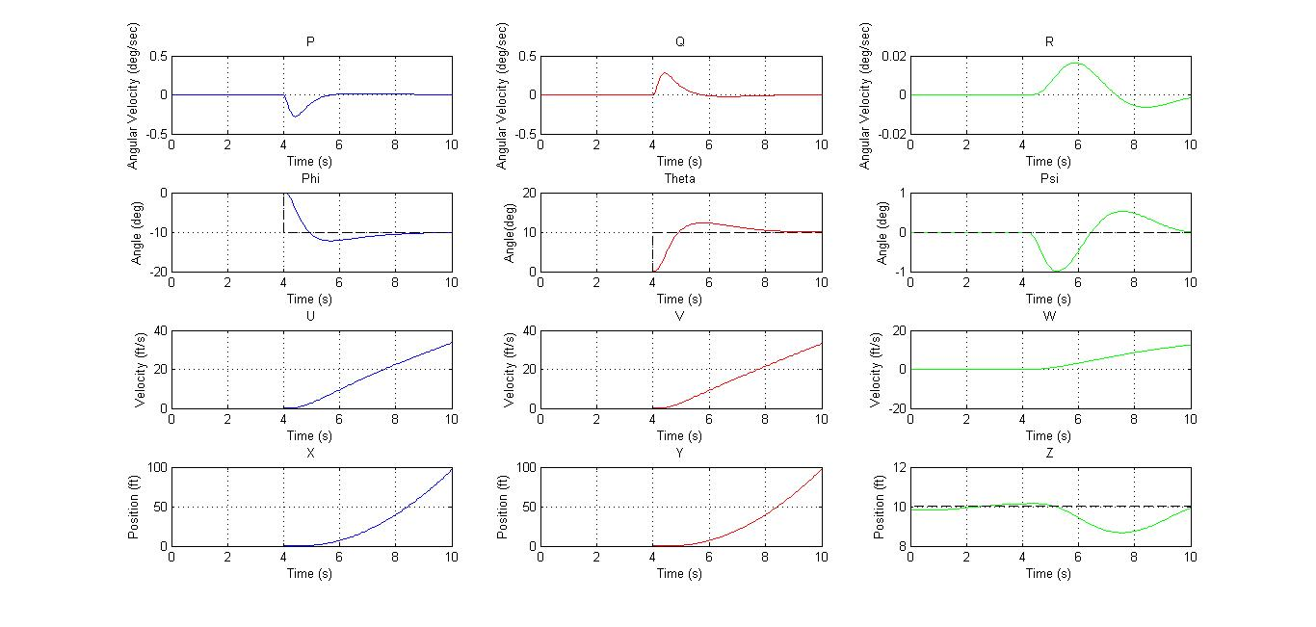
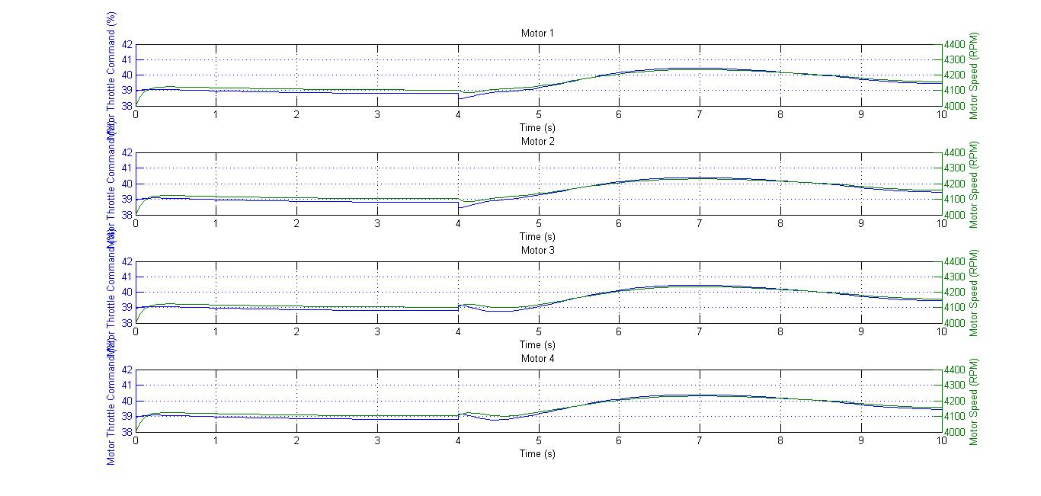
Results
Plot 1
Plot 2

Slide 18
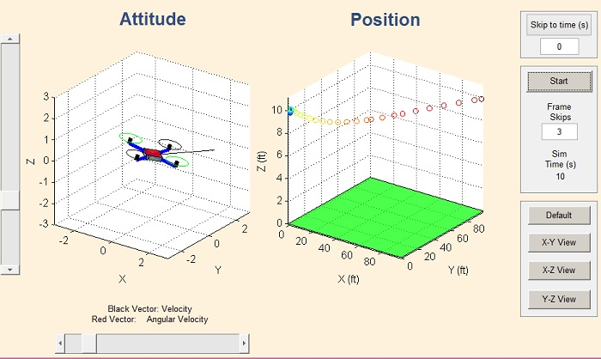
Results
Animation GUI

Slide 19
Reference
[1] http://www.firstquadcopter.com/wp-content/uploads/2014/08/IDEA-FLY-Apollo-Quadcopter-review.jpg
[2]http://s1293.photobucket.com/user/Cooliovato/media/StructureofaQuadcoptor_zps018a9292.jpg.html

Slide 20
Thank You

