Slide 1
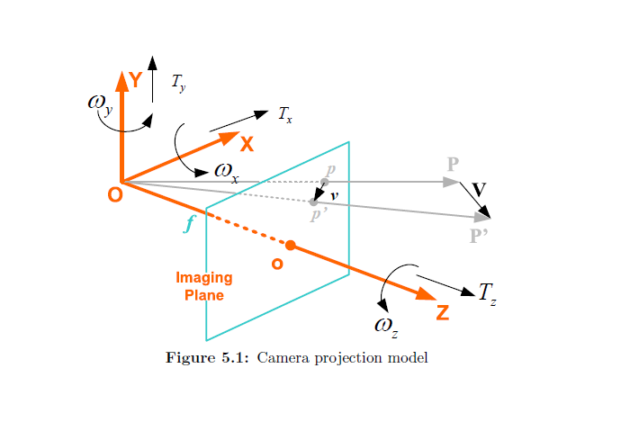
ψ
θ
ϕ
E-Frame

Slide 2
Ideal Projection Model
Complex Physical Projection Model
Pincushion-
Distortion
Barrel-
Distortion
Decentering-
Distortion
Distortion-Free
Optical Axis
Image Plane

