Slide 1
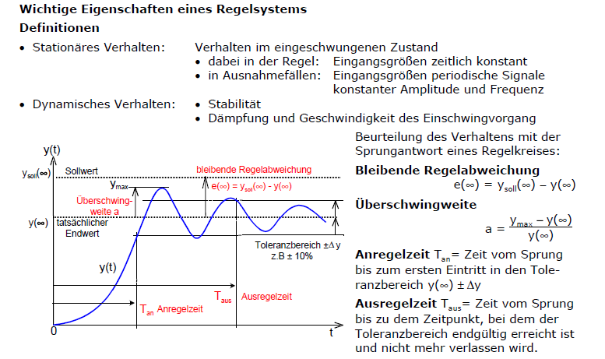
set value
steady state error
Maximum
overshoot
range of
tolerance
Rise time
Settling time

