Slide 1
BMOF
1
1
‚COOF

Slide 2
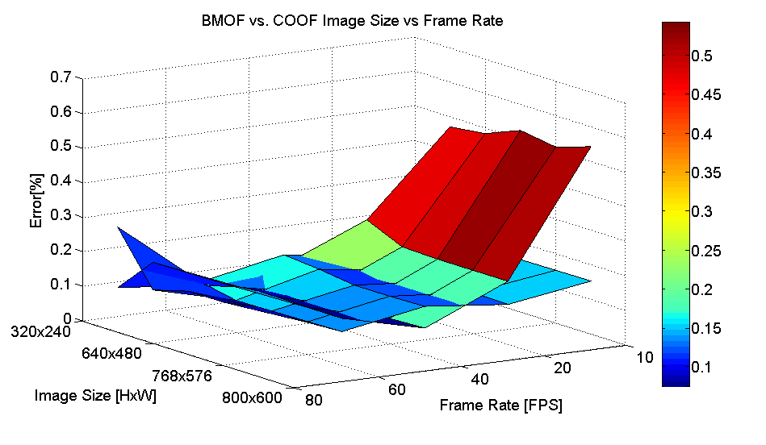
BMOF
3
2
COOF

