Slide 1

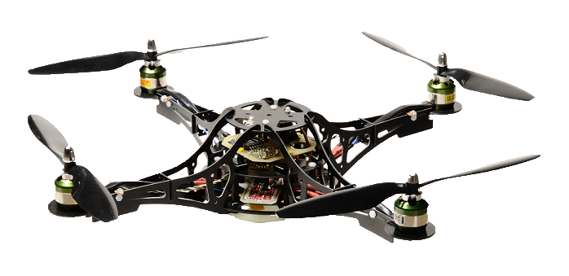
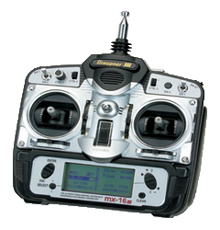
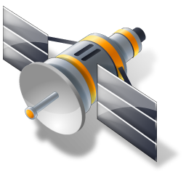
Base Station
Quadrocopter
Vision Processing
Xbee-Module
Vision System
CCU
Remote Control
Gyros
Xbee-Module
SCI
μC
ADC
RC-Sender
Pressure Sensor
ECT
RC-Receiver
IIC
SPI
Accelerometer
GPS
GPS-Module
GPS-Data
Height
Sensor
Brushless Controller
Brushless Motors
Existing Components
Pending Components

Slide 2
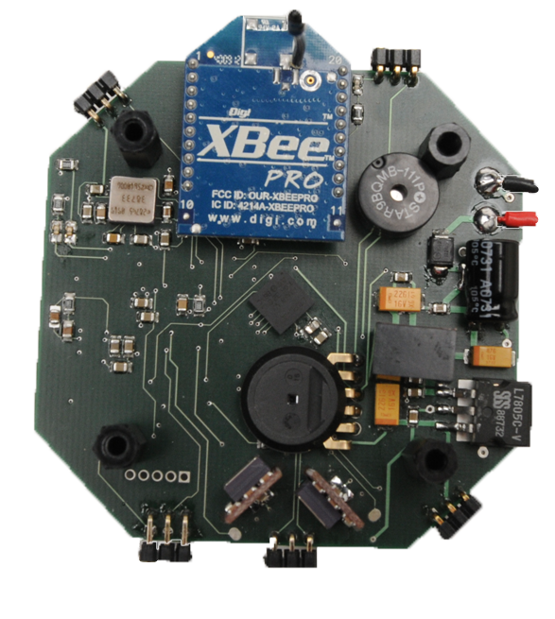
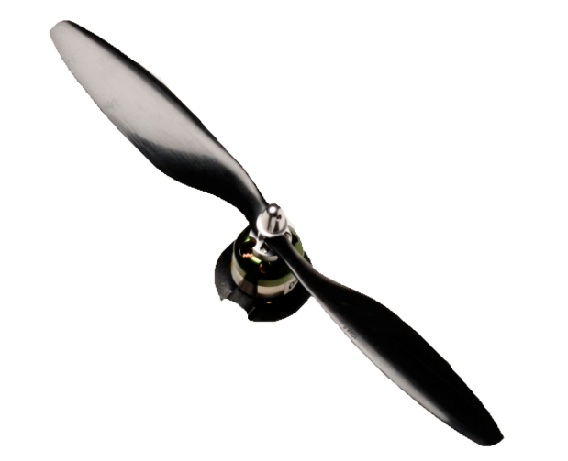
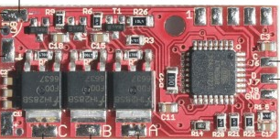
Motor
Fernsteuerung
Basis Station
Brushless Control
Motor
Flight Control
Brushless Control
Brushless Control
Brushless Control
Motor

