Slide 1
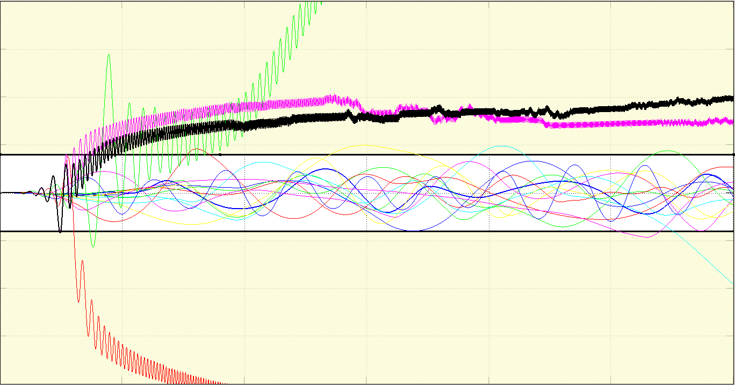
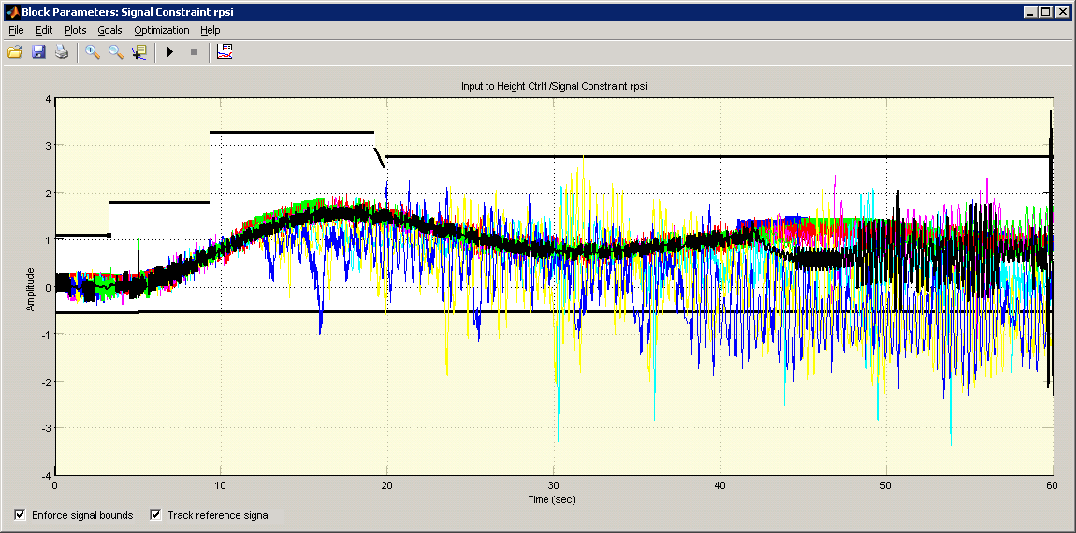
3
2
1
0
‚Phi and Theta rate [rad/s]
-1
-2
-3
0
5
10
15
20
25
30
Time [s]
3
2
1
Psi rate [rad/s]
0
-1
-2
-3
0
5
10
15
20
Time [s]

Slide 2
3
2
1
1
Psi rate [rad/s]
0
2
-1
-2
-3
0
5
10
15
20
Time [s]

Slide 3
1
Pole-Zero Map
0.5
Imaginary Axis
0
-0.5
-1
-30
-25
-20
-15
Real Axis
-10
-5
0
5

Slide 4
Step on Phi
Step on Theta
Step on Psi
2
Phi [Rad]
0
-2
123
5
Theta [rad]
Amplitude
0
-5
123
1
Psi [rad/sec]
0
-1
0.25
0.3
0.35
0.4
0.45
0.5
0.25
0.3
0.35
0.4
0.45
0.5
0.25
0.3
0.35
0.4
0.45
0.5
Time (sec)

