Slide 1
B-Frame
θ, ϕ
θ, ϕ
ψ
E-Frame
ϕ
θ

Slide 2
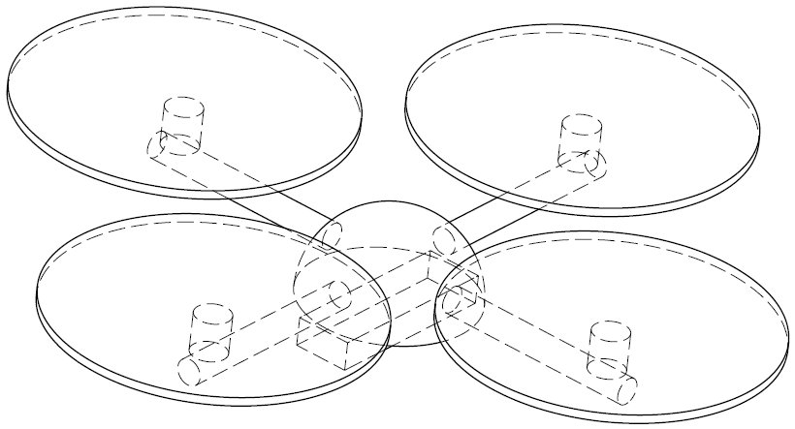
ψ
θ, ϕ
ϕ
θ, ϕ
θ, ϕ
θ, ϕ
θ

Slide 3






0.0
1.1
1.0
1.2
2.0
3.0
4.0
4.1
5.0

