Slide 1
Synthetic Video Source
Synthetic
Video
Real Video Source
Real
Video
Frame Rate
Downsampling

Slide 2

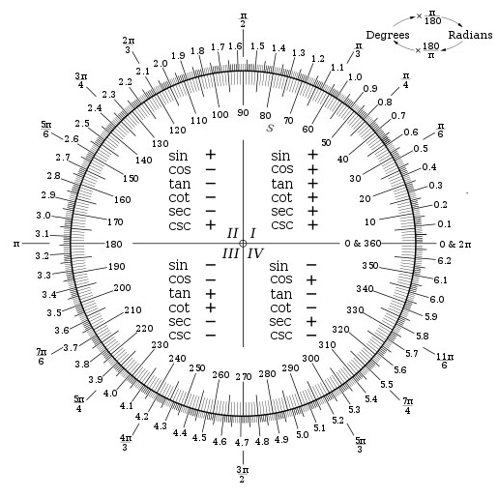

Slide 3
Synthetic Video
Environment
Rotational Test
Translational Test

