Slide 1
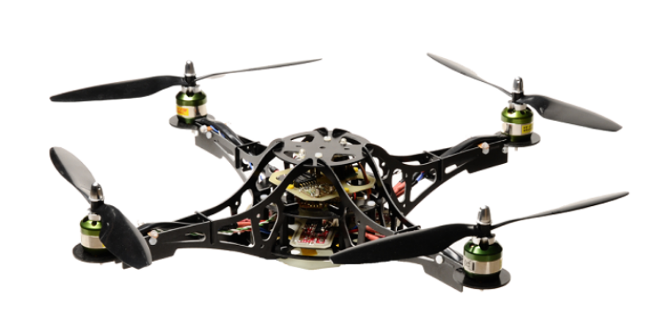
Quadrocopter
Dongliang Li
Yin Hao
Chandana Rokhade
GuangXun Nan
Kah Ho Pau
Nivas Devendran

Slide 2



Introduction
Introduction:
  Flying drone will be quite helpful in a lot of cases, thanks to its agility and size. It can scout out regions which are out of reach for humans or dangerous to humans. For example, scouting in Nuclear Plant Fukushima. The ultimate goal of our project, Quadrocopter, is to create an autonomous drone which is capable to perform scout missions or some simple instructions (like buying pizza) in any landscape. In this semester, we will try to further improve the algorithm used in the microcontroller and install new functions which would lead us to the ultimate goal in future.
Inputs:
  Source code
  Quadrocopter which is capable to fly with remote control
  GPS sensor
  Ultrasonic sensor
  Documents from previous groups
  Parameter Visualisation software
Outputs:
  Optimized control
    Timing compare
  Communication between Quadrocopter and PC
  2 extra functions installed( soft landing, stay in position)
    Installation of sensors onto Quadrocopter
✓
✓
✓
✓
✓

Slide 3
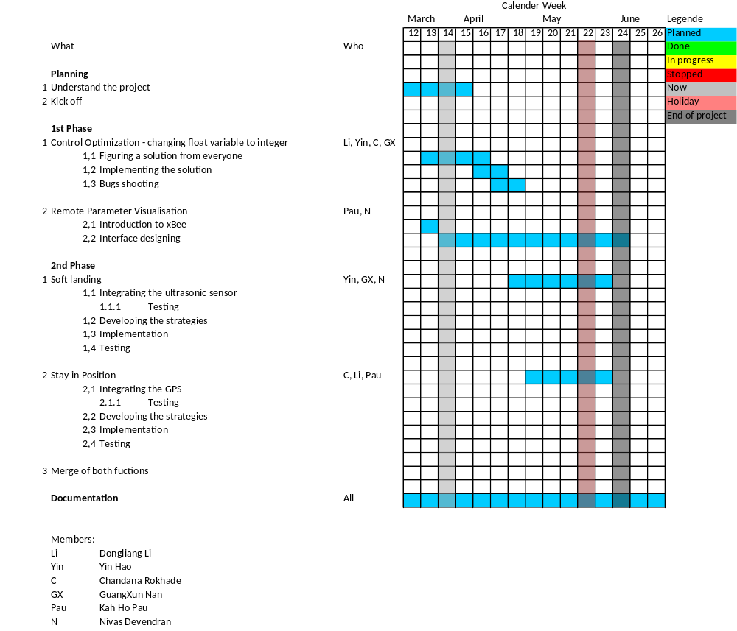
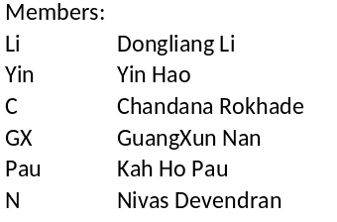
Project Plan

Slide 4
Progress
Current stage
  Development environment setup is done
  Compilation using Codewarrior hasn´t succeed
    Linking error
  Float -> int
    Smallest decimal point found : 0.000x
    Largest found : xx.00
    Long int32 might not sufficient

