Slide 1
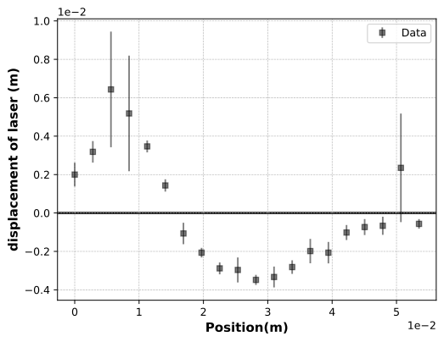
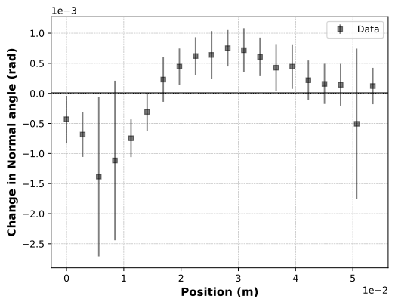
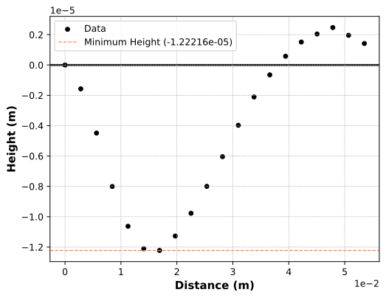



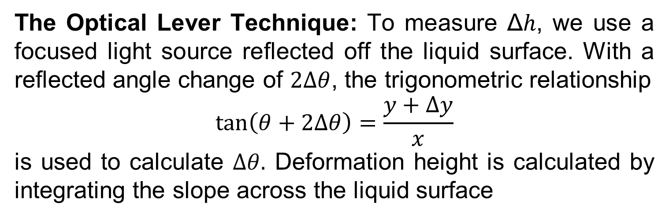
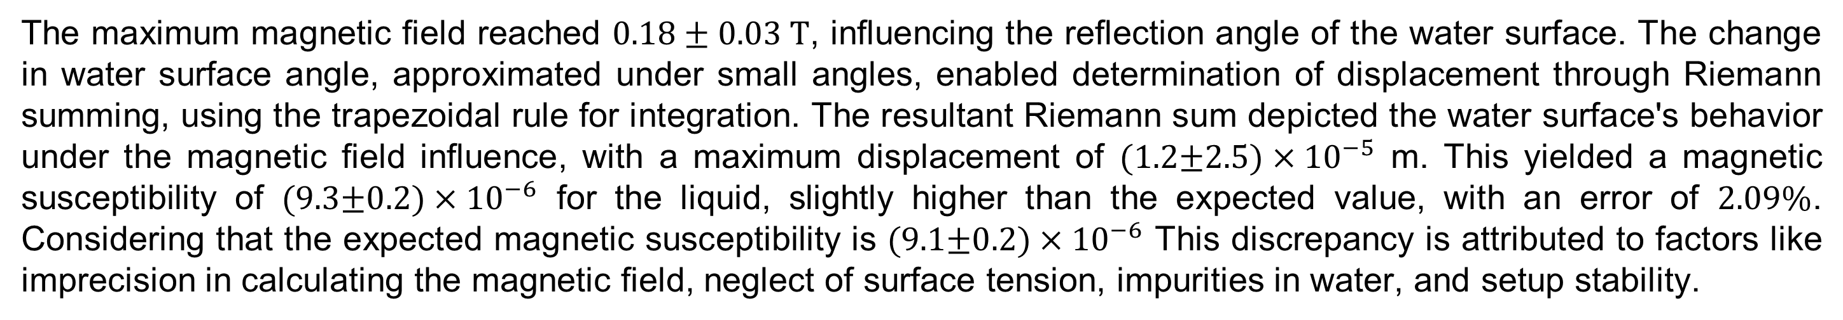




Exploring Magnetic Field-Induced Deformations in Fluids To Find Magnetic Susceptibility Akshat Sharma University of Minnesota, MXP, Spring 2024
Abstract
Motivation/Theory
Setup
The magnetic susceptibility of liquids is found to be sensitive to outcomes created by Moses effect. We exploit this behavior to understand a new method to measure magnetic susceptibility in liquids. The method relies on the deformation of the liquid surface by a magnetic field that is used to calculate the magnetic susceptibility of the liquid and is detected using an optical lever technique. The optical lever involves using a laser beam incident on the liquid and observing the reflected beam to quantify the changes induced by a magnetic field. This technique also utilizes the idea of overlaying liquids to amplify surface deformations, termed the enhanced Moses effect. Our preliminary measurements indicate a magnetic susceptibility of water to be $\left(9.3±0.2\right)×{10}^{−6}$, which is approximately $1σ$ higher than expected.
Moses Effect: Under a magnetic field, materials exhibit Dia/Para-magnetism, which leads to liquid surface deformation, known as The Moses Effect, reaching equilibrium where gravitational and magnetic energy densities are balanced, yielding the formula:
$$Δh= \frac{μ_{0}H^{2}χ}{2 g ρ},$$
which relates the susceptibility $χ$, density of liquid $ρ$, auxiliary field $H$and permeability of free space $μ_{0}$ with the height of the deformed surface of the liquid.
A HeNe laser is used along with a mirror to precisely control the angle of incidence on the liquid surface. The NdFeB magnet is mounted on a motorized translational stage. To gather experimental data, the magnet's position is systematically adjusted in incremental steps using a stepper motor. With each increment, corresponding changes in the laser beam's reflected position on a distant wall (∆𝑦) are meticulously recorded until the magnet has moved beyond the point of reflection on the petri dish. By correlating these incremental changes in magnet position with the corresponding shifts in the reflected laser beam's position, precise measurements of the surface deformation and slope can be obtained.
$$F_{B}$$
$$F_{g}$$
The Optical Lever Technique: To measure Δℎ, we use a focused light source reflected off the liquid surface. With a reflected angle change of $2Δθ$, the trigonometric relationship
$$\tan\left(θ+2Δθ\right)=\frac{y+Δy}{x}$$
​is used to calculate $Δθ.$ Deformation height is calculated by integrating the slope across the liquid surface
Δy
Δθ
y
Δy
x
Laser
PASCO magnet
Data Analysis & Results
y
Liquid Container
θ+ Δθ
Δθ
Δθ
Linear Translation Stage
$$Δh$$
References
D. J. Griffiths, *Introduction to Electrodynamics*. New York, NY: Cambridge University Press, 4th edition, 2024.
Z. Chen, J. Ellis, and E. D. Dahlberg, “A Simple Technique to Measure the Magnetic Susceptibility of Liquids,” *Review of Scientific Instruments*, vol. 83, p. 095112, Sept. 2012.
The maximum magnetic field reached $0.18±\text{0}\text{.03 }\text{T}$, influencing the reflection angle of the water surface. The change in water surface angle, approximated under small angles, enabled determination of displacement through Riemann summing, using the trapezoidal rule for integration. The resultant Riemann sum depicted the water surface's behavior under the magnetic field influence, with a maximum displacement of $(1.2\text{±}2.5)×{10}^{−5}$ m. This yielded a magnetic susceptibility of $(\text{9.3}\text{±}0.2)×{10}^{−6}$ for the liquid, slightly higher than the expected value, with an error of $2.09\%$. Considering that the expected magnetic susceptibility is $(\text{9.}\text{1}\text{±}0.2)×{10}^{−6}$ This discrepancy is attributed to factors like imprecision in calculating the magnetic field, neglect of surface tension, impurities in water, and setup stability.
$$Δθ{≈\tan{Δθ}=slope }$$
Slope of a function
Integrate
Function
Acknowledgement
$$χ= \frac{B^{2}}{2μ_{0}ρg(Δh)}$$
Thanks to the MXP faculty for (esp. TA Joe Gehrke and Dr. Theresa Chmiel) helping us with this project.
Thanks to the Dept. of Physics and UMN for funding it.

