Slide 1
STUDIFY STUDENT SPHERE
-A hub for campus connections and opportunities

Slide 2
Team Presentation
AYUSH KUMAR 21BCS9869 SKELETON,CHAT ABOUTUS HOMEPAGE,FIREBASE BACKEND | NIRBHAY SINGH MAHAN 21BCS1433 PROFILE PAGE BACKEND | HARSHIT BAMOTRA 21BCS10003 EXPLORE PAGE BACKEND

Slide 3
CONTENTS
PROJECT DESCRIPTION
Objective
PROJECT METHODOLOGY
Procedure & Key assuming
PLANNING
Weekly planning & roadmap
CHALLENGES
Challenges to be faced
SWOT ANALYSIS
Pictorial Representation
CONCLUSION
Future outcomes &
conclusion

Slide 4
PROJECT DESCRIPTION
PROBLEM STATEMENT
POSSIBLE SOLUTIONS
OBJECTIVE

Slide 5
The increasing use of multiple social media applications instead of a single app is becoming a concern for individuals and society. Many people are using more than one social media platform to stay connected, share content, and engage with their communities. While having access to multiple apps can be convenient, it can also have negative effects on mental health, productivity, and personal relationships.
Example:-
Twitter: News & Feed
Discord: chatting
LinkedIn: Profile building and opportunities
PROBLEM
STATEMENT

Slide 6
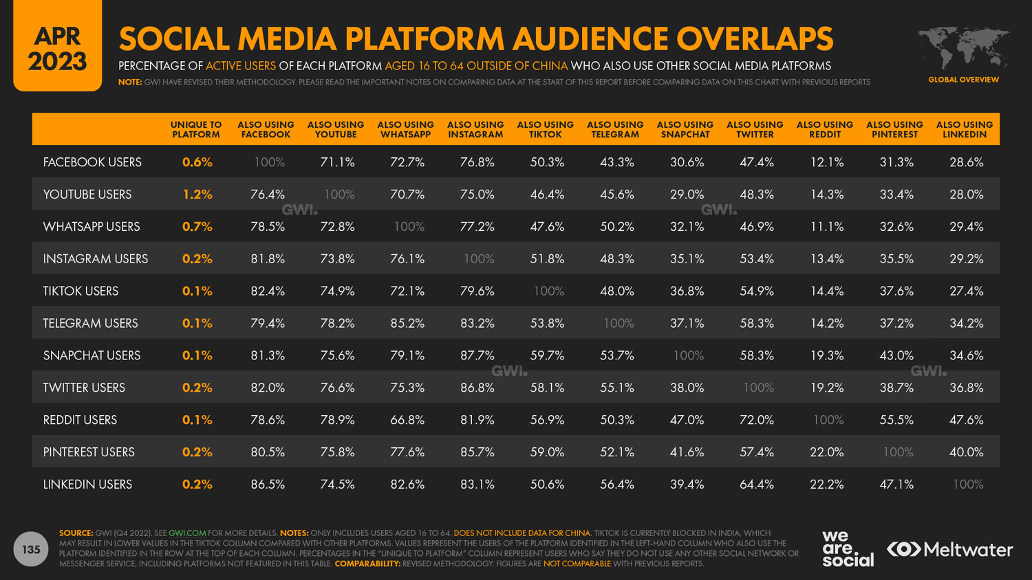

Slide 7
Creating a social media application that encapsulates the features of different platforms could be a viable idea, as long as there is a demand for such a service and the execution is done correctly.
As currently, these social media applications are using the concept of centralization, putting a step towards decentralization can also be a significant advancement in the factor of rapid tech advancement
POSSIBLE
SOLUTIONS

Slide 8
To develop a react-redux-based web application, social media community which mainly targets students by providing the encapsulation of pre-existing features of the other social media platforms and putting our step towards decentralization
OBJECTIVE

Slide 9
React-Redux is a popular and powerful combination of tools that can be used to build complex, data-driven web applications. --Efficient state management --Component reusability --Large developer community --Compatible with other technologies : React-Redux can be easily integrated with other technologies like React Native, allowing developers to create applications for multiple platforms using the same codebase. --Optimized performance: React-Redux uses a virtual DOM (Document Object Model) to optimize performance, allowing it to update the DOM efficiently and reduce the number of unnecessary re-renders. This can help improve application performance and speed.
WHY
REACT.js

Slide 10
PROJECT METHODOLOGY
PROCEDURE
PATH

Slide 11
PROCESS
PART- I
PART - II
PART - III
COMPONENT-II
COMPONENT-III
COMPONENT-IV
INTEGRATION + REDUX+ FIREBASE
BACKEND
ENCAPSULATION
TESTING
HOSTING
PROTOTYPE
COMPONENTS LISTING
COMPONENT - I

Slide 12
PROCEDURE PATH
Using Adobe xd
For some often used components and icons
Create the backbone of the react-redux web app
Includes coding in an abstract manner and close to real world
(eg. Using dynamic variables )
Adding components into the same page
Eg. Header-content-footer-sidebar etc.
Adding backend :-firebase and node
Using the redux features
And test at local servers
Prototype
Breakdown
of Components
Material UI
Full-fill
Requirements
Skeleton
implement
working on components
Effecitent coding
Testing
Integration of components
Integration of pages
Appling redux and backend
Hosting &
Improvements
Includes to breakdown of the complete work into small individual units
Install required packages
Creating the components as per requirements
Inclues unit testing
i.e. responsiveness & custom testcases
Merging all the pages using react router
And testing the complete front end
Hosting the website and improving as per the user needs

Slide 13
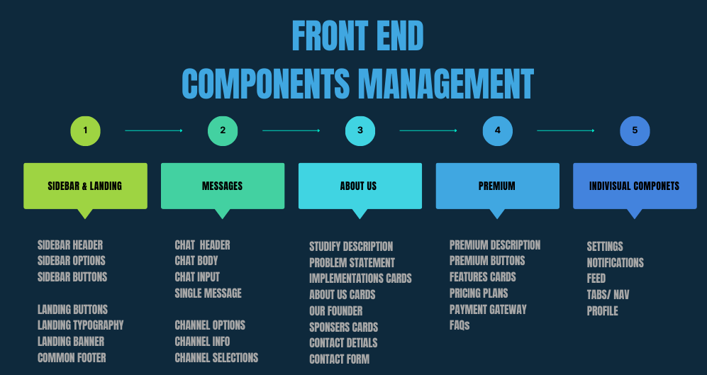

Slide 14
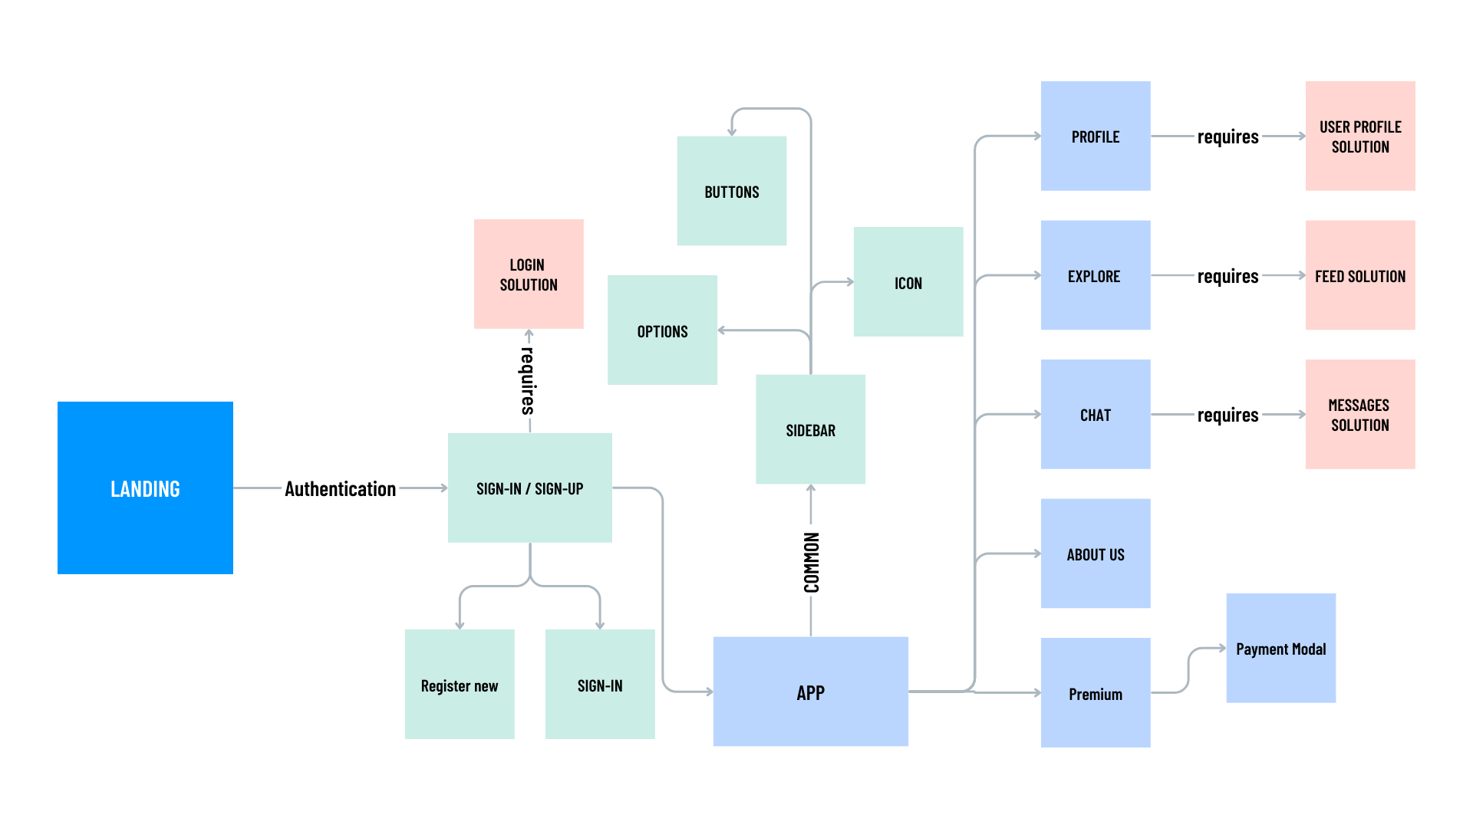

Slide 15
FEATURES & BENIFITS
Efficient State Management
Simplified Debugging
Component-Based Architecture
Increased Scalability
Improved Performance
Comprehensive and unified experience
Improved user engagement
Reduced competition
Greater engagement opportunities
Personalization feature
Enhanced privacy and security
Increased convenience
Increased efficiency
Focus on students and academics

Slide 16
PLANNING
ROADMAP
DAYWISE PLANNING

Slide 17
Roadmap
CREATION OF INDIVISUAL COMPONENTS
CREATION OF INDIVISUAL PAGES BY USING THE BUILT COMPONENTS
ENCAPSULATING ALL THE INDVISUAL PARTS INTO SINGLE UNIT
1
3
5
2
4
6
CREATION OF SKELETON
STRUCUTURE
APPLING BACKEND
(NODE,EXPREESS,MONGDB)
(FIREBASE)
HOSTING AND IMPROVEMENTS

Slide 18
Expected time line & chart mapping
 | FEBRUARY |  |  | MARCH |  |  |  | APRIL & REMAINING TIME
 | 8-11 | 11-15 | 15-28 | 6-10 | 11-20 | 21-25 | 25-31 | 1-3 | 4-10 | 11-16 | 17-19 | 20-23 | 24-28 | 29-rest
Design & Prototype |  |  | ◆
Skeleton |  |  |  |  |  | ◆
Components-I |  |  |  | ◆
Components-II |  |  |  |  |  |  |  |  |  |  | ◆
Components-III |  |  |  |  |  |  |  |  |  | ◆
Components-IV |  |  |  |  |  |  |  |  |  |  |  |  | ◆
Backend |  |  |  |  |  |  |  |  |  |  |  |  | ◆
Hosting |  |  |  |  |  |  |  |  |  |  |  |  |  | ◆

Slide 19
CHALLENGES
CHALLENGES TO BE FACED
CHALLENGES FACED WHILE CREATION

Slide 20
SEVERAL CHALLENGES TO CONSIDER BEFORE IMPLEMENTING SUCH AN IDEA:
DATA PRIVACY: Social media applications typically collect and store a lot of user data, and merging different features from various platforms could make it challenging to ensure the privacy and security of user data.
TECHNICAL CHALLENGES: Merging different features from different platforms could pose technical challenges, especially if the platforms use different technologies and frameworks.
COMPETITION: There are already several social media platforms available, and creating a new one that combines features from others may not necessarily make it stand out in the market.
USER EXPERIENCE: Combining different features into a single application could make the user experience complex and overwhelming. Careful consideration needs to be given to how different features can be seamlessly integrated into the application.

Slide 21
CHALLENGES FACED WHILE CREATION
Performance optimization: React is designed to be efficient, but large applications with many components can slow down if not optimized correctly. Optimizing React components for performance is an ongoing process.
Routing using React Router or other routing libraries.
Managing application state using React's built-in state management or external state management libraries like Redux.
Browser compatibility: React applications can sometimes have compatibility issues with older browsers or different browser environments. Developers need to be aware of the different browser environments that their application will run in and ensure that it is compatible with all of them.
Integrating with other libraries: React can be used with other libraries, but integrating them can be challenging. Developers need to learn how to use REACT’s lifecycle methods to integrate other libraries into their components.
Debugging: Debugging React components can be challenging since the component's state can change over time. Developers need to learn how to use React DevTools and other tools to debug their code.

Slide 22
conclusion
FUTURE OUTCOMES
SWOT ANALYSIS
CONCLUSION

Slide 23
Can incorporate blockchain technology
Further courses, competitive platform can be introduced
Enhanced collaboration and networking opportunities
Virtual & Augmented reality experiences
Integration with e-commerce
FUTURE OUTCOMES

Slide 24
SWOT Analysis
STRENGTHS
Innovation
Convenience
Increased functionality
WEAKNESSES
Compatibility issues
User adoption
Data privacy
S
W
Increased user base
Monetization
Enhanced user experience
OPPORTUNITIES
Competition
Changing user preferences
Regulatory issues
THREATS
O
T

Slide 25
Overall, its success will depend on its ability to attract and retain a large and engaged user base, differentiate itself from established social media platforms, and continually innovate and improve its features and benefits to meet user needs. React-Redux is a powerful and versatile tool for building complex, data-driven web applications like STUDIFY. Its efficient state management, component reusability, large developer community, compatibility with other technologies, and optimized performance make it a great choice for developing robust and scalable web applications.
CONCLUSION

Slide 26
Thanks!
STUDIFY WILL BE LIVE SOON
@studify
username@stud.mail
https://github.com/HarshitBamotra/student-sphere.git

