Slide 1

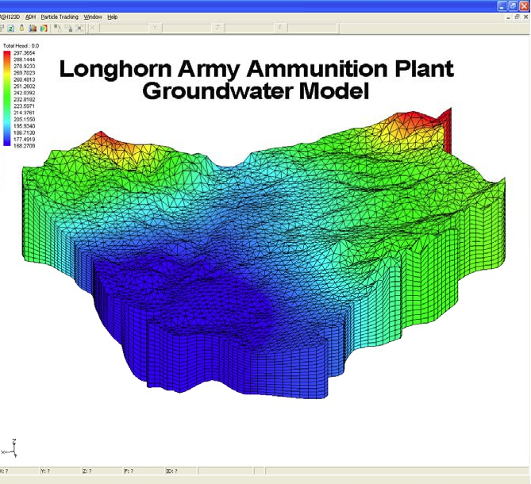
OPTIMIZATION OF PSO CODE EXPLORATORY PROJECT
BAIBHAV MOHANTY | ARYAN GUPTA | ADITYA GUPTA
Optimized the mechanism to reduce resource and time complexities.

Slide 2
SWARM OPTIMIZATION
PROBLEMS
01
02
03
04
Large computational time for simulation model
Particle swarm optimization (PSO) is one of the bio-inspired algorithms and it is a simple one to search for an optimal solution in the solution space. It is different from other optimization algorithms in such a way that only the objective function is needed and it is not dependent on the gradient or any differential form of the objective. It also has very few hyperparameters.
Large number of decision variables
Pareto front Extension between different algorithms
Different pumping rates for different stress periods

Slide 3
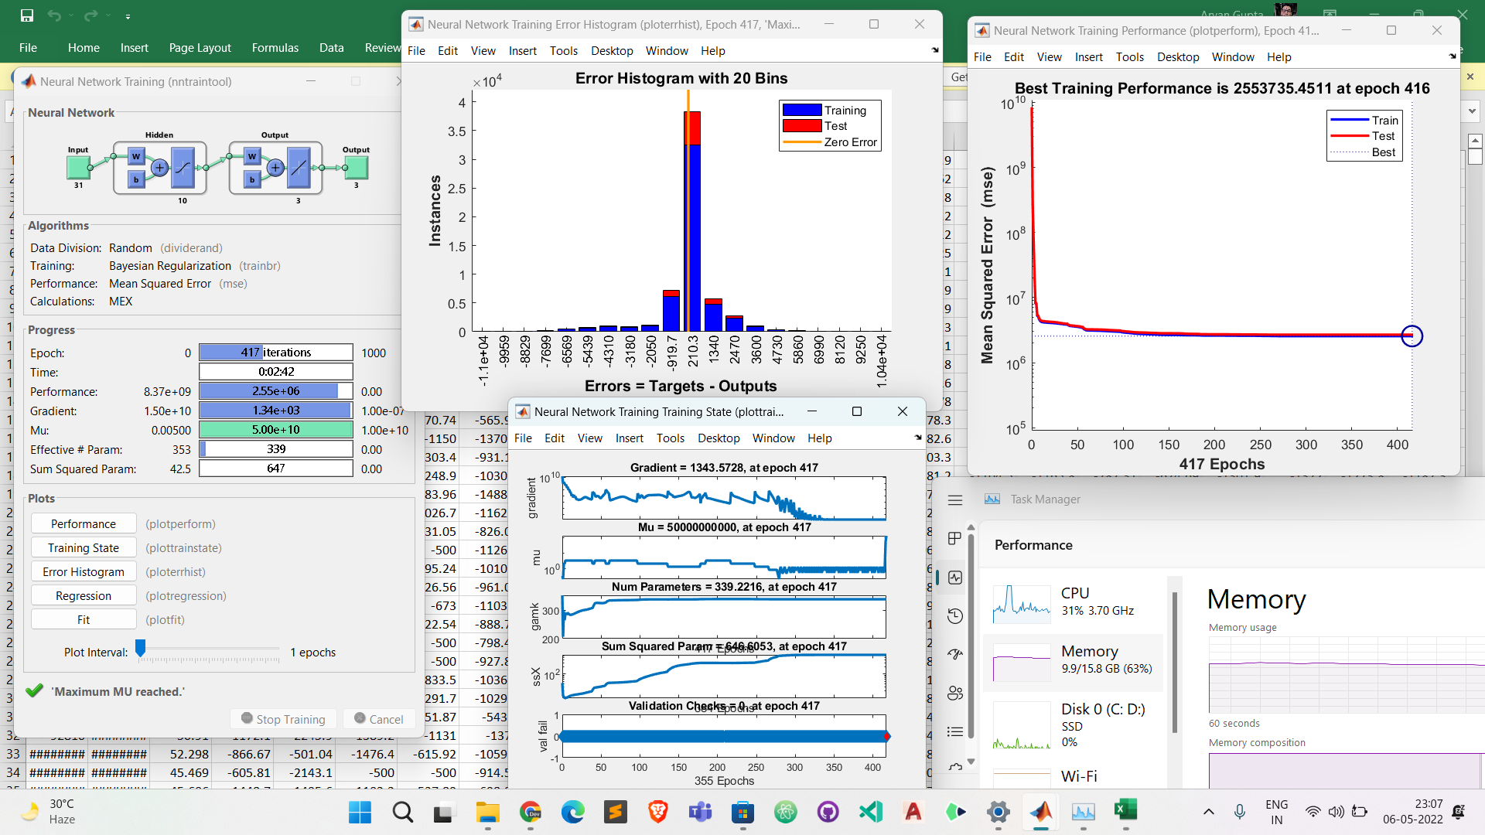
LARGE NUMBER OF DECISION VARIABLES
It is always better to reduce the dimension of the problem by making optimal feature selection- so that only significant features will decide the optimal solution. We are aware of the fact that no algorithm would promise global optimum. Given this , considering too many decision variables will lead to compromising with the optimal solution.
For a simulation model to run, if it takes around 2 minutes, Imagine for 2000 iterations & 30 particles (Math: 2*2000*30 minutes) It’s around 85 days!! How can we reduce this simulation time???

Slide 4
SOLUTIONS TO THE SO CODE ISSUES
COOPERATIVE CO-EVOLUTION
PROBLEM TRANSFORMATION
1
3
This method divides the decision variables into multiple groups and then optimizes each group separately.
This method solves the problem by transforming the original large-scale problem into a small-scale problem through the problem transformation function.
DECISION VARIABLE ANALYSIS
2
SEARCH WITH LEARNING STRATEGIES
4
This method focuses on proposing a mechanism for analyzing decision variables and strives to get the best grouping of decision variables
This method uses the learning mechanism between particles in the original decision space to improve the searchability
PROBLEM WITH OLDER ALGORITHMS : MOEAs based on the cooperative coevolution and grouping mechanism need to spend a lot of time analyzing decision variables to complete the grouping of decision variables. In addition, the performance of MOEAs based on the CC framework can be severely degraded due to inappropriate grouping.

Slide 5
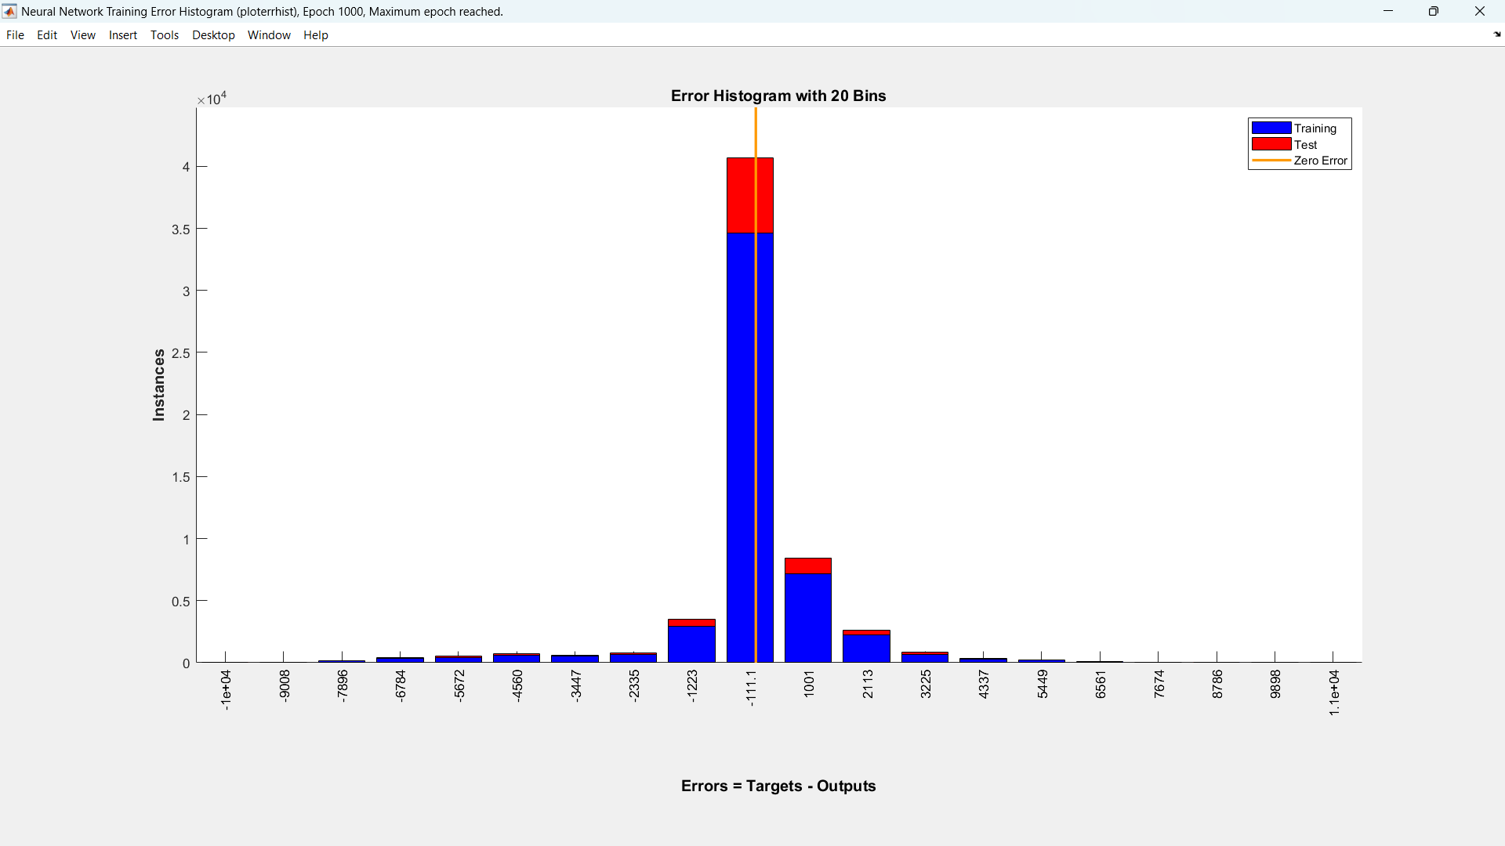
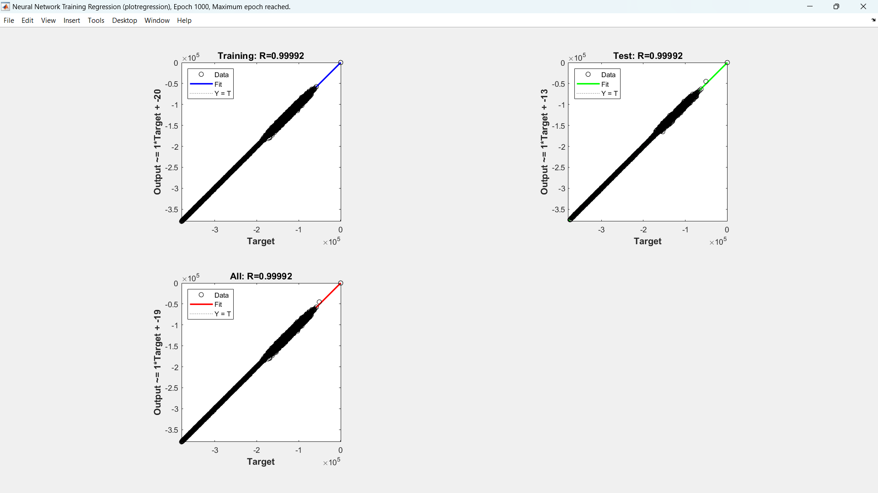
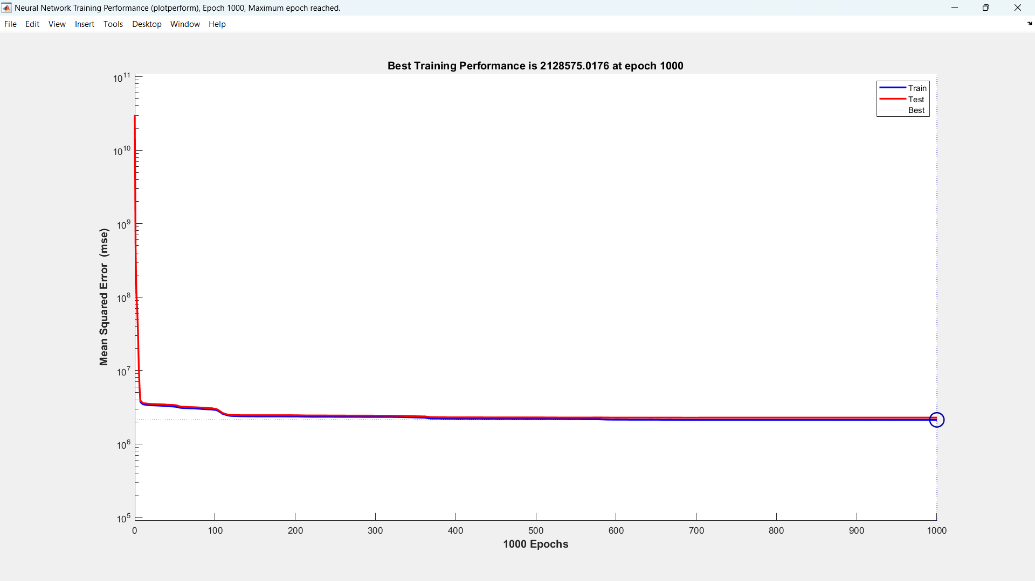
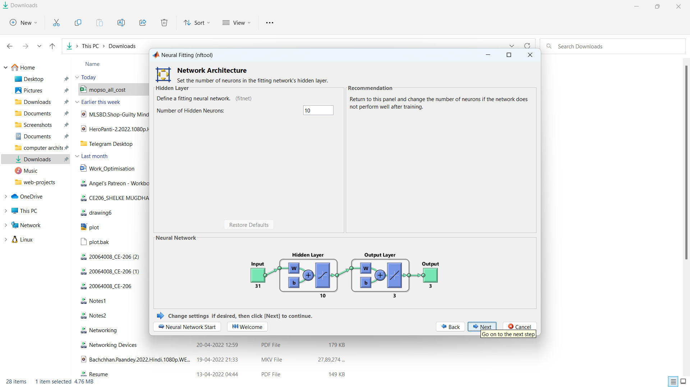
PROPOSED SOLUTION
FUZZY EVOLUTION
ANN TRAINING
In fuzzy evolution, the fuzzy evolutionary stage is divided into multiple sub-stages through the proposed method of fuzzy evolution sub-stages division. Each sub-stage has a different degree of fuzzification, and the degree of fuzzification decreases gradually. The value range of decision variables is reduced from an infinite number of original values to a finite number of fuzzy values, so the FDV framework reduces the search range of the algorithm and improves the search efficiency of the algorithm.
REFERENCE: Fuzzy decision Variable Framework

Slide 6
FUTURE GOALS
Incorporation of Fuzzy Evolution Code for the PSO Model
Instead of selecting random block areas, We can also define the pareto in the areas of distance from the river and this will help to effectively map out the areas where we have to consider the water exchange and with how much extent, this will help us to train our model with better time complexity and also making the model flexible to different data set.
Using Deep Learning Algorithm to generate more insights and analytics and even predict seasonal variations along with more Constraints

Slide 7
Guided By: Prof. Shishir Gaur &
Prof. Anurag Ohri
Special Mention: Shreyansh Mishra
THANK YOU

