Slide 1
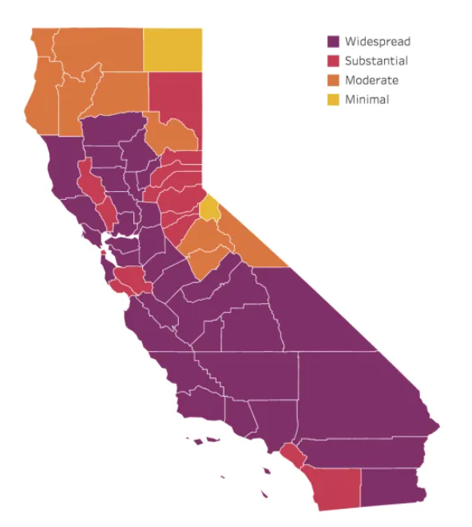
PowerPoint Infographics Sampler
Project CalFresh
Charting COVID-19
Impact to California’s Food
Assistance Program (SNAP)
May 1, 2021

Slide 2
Introduction
Project 1 - CalFresh
Research Question
Correlation of COVID-19, unemployment and rise of CalFresh enrollment overtime
Focus: California and its 58 counties
Data: CA Dept of Social Services (CalFresh), US Census data & NY Times US counties information
The data presented provides an accurate picture rather than precise one
Team:
John
DeJuan
Jackson
Siddharth

Slide 3
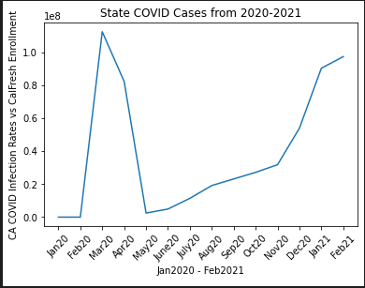
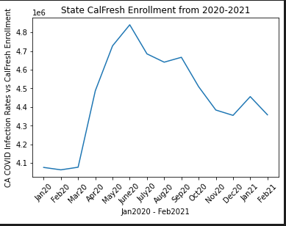
Infection Rates
Question 1:
As COVID infection rates increased, so did CalFresh enrollment.
Findings:
We presupposed that COVID infection rates impacted a correlative increase in unemployment and, by extension, enrollment in government assistance programs, like CalFresh. We wanted to analyze the degree to which they correlate. These graphs demonstrate a meaningful, substantial increase in program enrollment over the course of selected pandemic timeline.

Slide 4
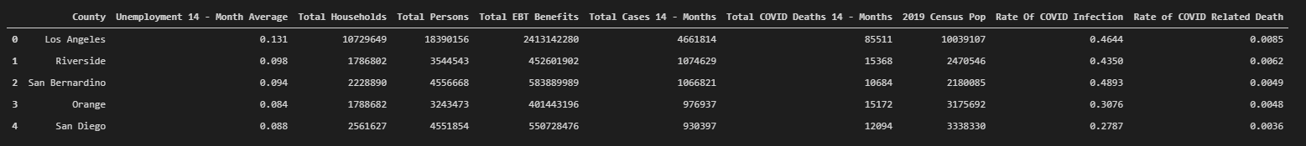
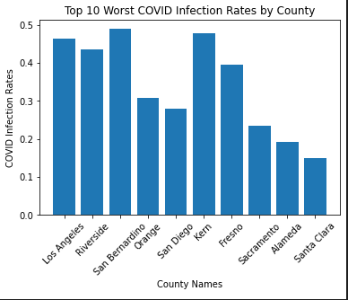
Highest Infection Rates by County
Question:
What are the 10 counties with the worst infection rates?
Findings:
Per the data, the highest infection rates in the state existed across Southern California. We initially expected metropolitan areas across the state to exhibit similar infection rates.

Slide 5
Worst Impact
What is the worst affected county?

Slide 6
Least Impact
What is the least affected county

Slide 7
Rural v. Urban Infections
Question 6:
What is the correlation between infection rates per capita in the least COVID infected counties. When compared to that of more populated counties. (Census 2019 Population Data)
Findings:
The average Infection rate was 15% per capita in more Rural Counties, while in dense populations the average was 34%. My initial ideas, lead me to believe that the infection rate per capita would have been higher in rural counties, or at least see a closer gap in parallel with more urban areas. But based on the data, rural population were infected a much lower rate. Possible reasons include
Sparse population – Less Contact between people.
Healthier population – Less susceptible to COVID infections.
*Rural defined as location with a population less then 50,000, Urban is defined as a location with greater than 50,000.

Slide 8
Population Impact
Question 7:
What are the worst covid infection rates as a percentage of population? Are the counties rural, urban, or mixed?
Findings:
With urban counties being counted as areas with over 50,000 in population, 9 of the top 10 most highly infected populations were considered “Urban”. The only rural county was Lessen, which had the second highest infection rate per capita in California, at 68%. Imperial county, which had an infection rate of 80%, and is the least populated county in Southern California. The county with the highest COVID infection rate, was also tops in average unemployment rate at 21%

Slide 9
Covid-19 impact to CalFresh
How did COVID-19 affect Californian enrollment in CalFresh?

Slide 10
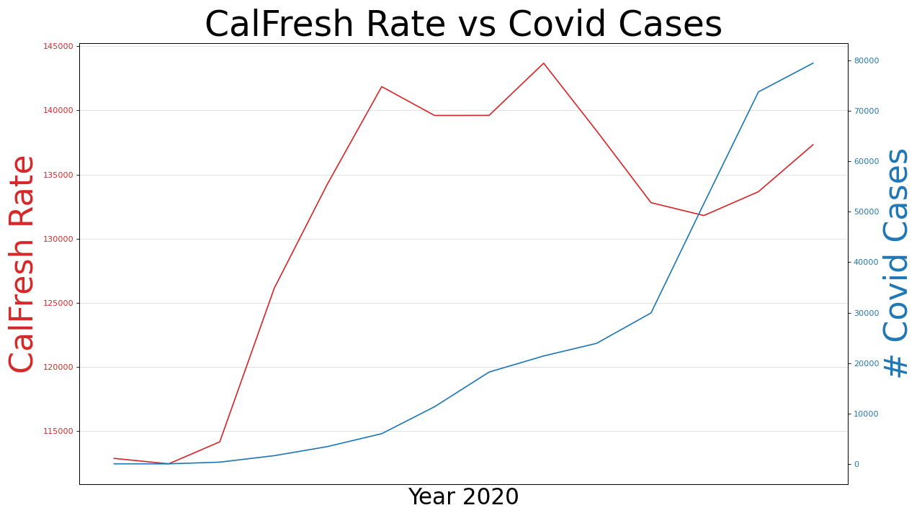
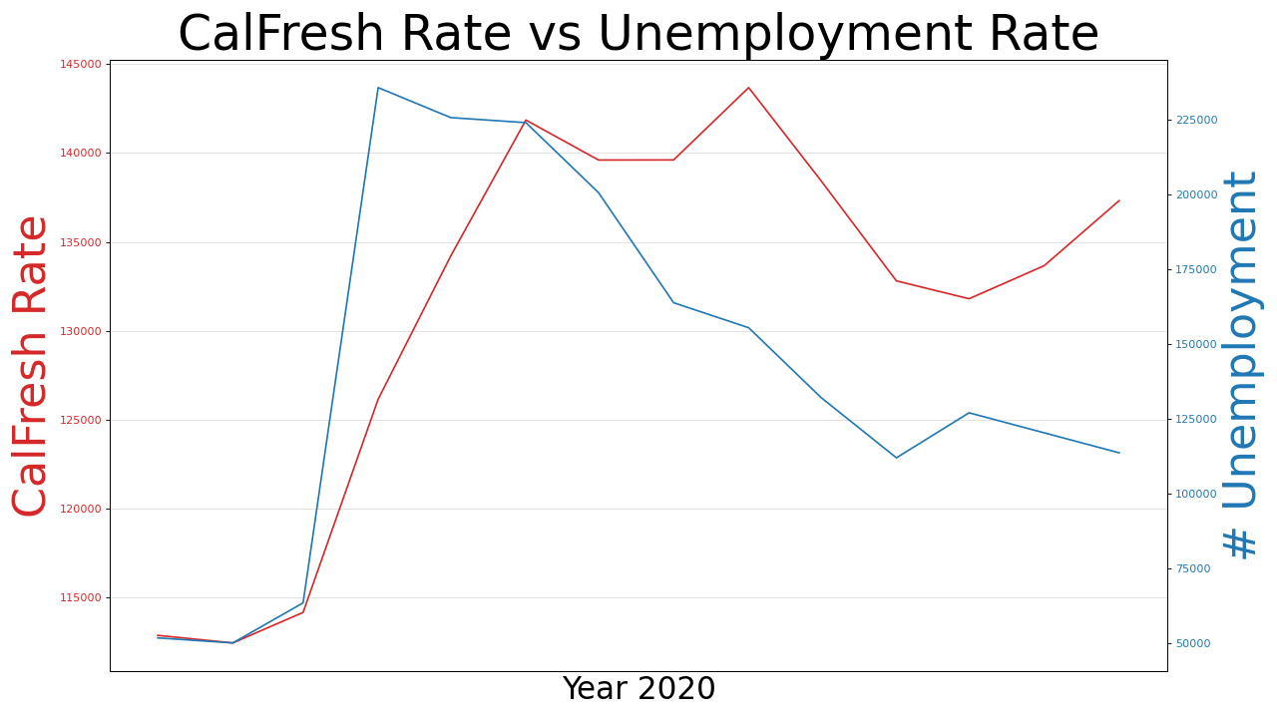
Conclusion
COVID had no direct impact…
Policies had immediate affect
initially
COVID-19 cases did affect CalFresh aid, but not until the second-wave spike in the Fall of 2020.
Inflection point for CalFresh enrollment
Notes:
Our initial assumption was that COVID infection rates would contribute to the rise of CalFresh assistance. It did not – initially
The government shutdown policies had a direct and pronounced affect to the rise of unemployment and consequently CalFresh assistance.
As unemployment dropped, so did CalFresh in parallel; except late in 2020, where the two diverged
If we look back at Covid cases, we see there was an inflection point when COVID cases spiked, CalFresh did as well, with a delayed response.

Slide 11
Thank You!

Slide 12
Sample 2
Your Infographic Title Here:
THE SUBTITLE IN THIS AREA
232
Place your words here.
15
Place additional content here.
2
Place additional content here.
232
Place your content here.
214
Place additional content here.
2
Place additional content here.
7
Place additional content here.
80%
Place additional content here.

Slide 13
Sample 3
Your Title Here
Proof…
Element One
Element Two
Element Three
One
14%
462
22%
ORG
Two
Three
31%
Place additional content here. Your content can be placed in this area. Place more words here, if needed.
Place additional content here. Your content can be placed in this area. Place more words here, if needed.
Place additional content here. Your content can be placed in this area. Place more words here, if needed.
4,368,723
Element Four
Element Five
Element Six
Place additional content here, if needed. Your content can be placed in this area. Place more words here, if needed. Your goal is to use less text. Place more words here, if needed. Your content can be placed in this area. Place more words here, if needed. Place additional content here. Your content can be placed in this area.
43%
28%
82%
Place additional content here. Your content can be placed in this area. Place more words here, if needed.
Place additional content here. Your content can be placed in this area. Place more words here, if needed.
Place additional content here. Your content can be placed in this area. Place more words here, if needed.

Slide 14
Sample 4
YOUR TITLE HERE
Males
Females
22% Element One
Place additional content here. Your content can be placed in this area.
43% Element One
Place additional content here. Your content can be placed in this area.
3 in 5
Place additional content here. Your content can be placed in this area.
Variable One
14%
14%
Variable One
2 in 5
Place additional content here. Your content can be placed in this area.
Variable Two
22%
22%
Variable Two
Variable Three
31%
31%
Variable Three
Variable Four
34%
34%
Variable Four
Variable Five
39%
39%
Variable Five
275 Element
Place additional content here. Your content can be placed in this area.
450 Element
Place additional content here. Your content can be placed in this area.
29%
Place additional content here.
80%
Place additional content here.

