Slide 1
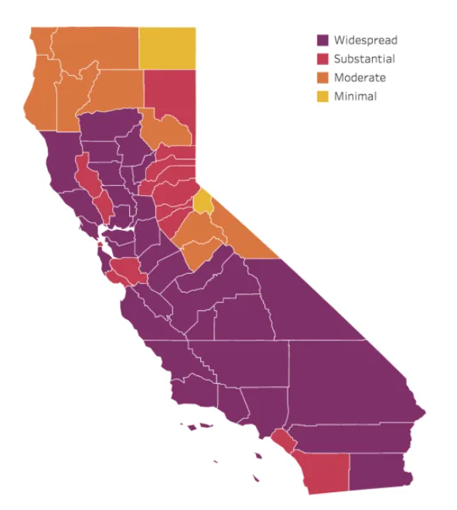
PowerPoint Infographics Sampler
Project CalFresh
Charting the California Impact

Slide 2
Introduction

Slide 3
Infection Rates
As Covid infection rates increased, so did CalFresh enrollment

Slide 4
Top 5 Counties
What are the top 5 counties with the worst infection rates?

Slide 5
Worst Impact
What is the worst affected county?

Slide 6
Least Impact
What is the least affected county

Slide 7
Infection Rates
As Covid infection rates increased, so did CalFresh enrollment

Slide 8
Rural v. Urban Infections
Question 6:
What is the correlation between infection rates per capita in the least COVID infected counties. When compared to that of more populated counties. (Census 2019 Population Data)
Findings:
The average Infection rate was 15% per capita in more Rural Counties, while in dense populations the average was 34%. My initial ideas, lead me to believe that the infection rate per capita would have been higher in rural counties, or at least see a closer gap in parallel with more urban areas. But based on the data, rural population were infected a much lower rate. Possible reasons include
Sparse population – Less Contact between people.
Healthier population – Less susceptible to COVID infections.
*Rural defined as location with a population less then 50,000, Urban is defined as a location with greater than 50,000.

Slide 9
Population Impact
Question 7:
What are the worst covid infection rates as a percentage of population? Are the counties rural, urban, or mixed?
Findings:
With urban counties being counted as areas with over 50,000 in population, 9 of the top 10 most highly infected populations were considered “Urban”. The only rural county was Lessen, which had the second highest infection rate per capita in California, at 68%. Imperial county, which had an infection rate of 80%, and is the least populated county in Southern California. The county with the highest COVID infection rate, was also tops in average unemployment rate at 21%

Slide 10
Conclusion

Slide 11
Methodology
Source
Datasets
Process
Challenges

Slide 12
Style placeholder

Slide 13
Sample 1
INFOGRAPHIC TITLE
Locations Measured
99%
Place additional content here. Your content can be placed in this area. Type more words here if needed. Your content can be placed in this area. Place additional content here. Add your words here.
A
B
C
12%
TITLE
Your content here
More bullets
45%
TITLE
Your content here
More bullets
55%
TITLE
Words you add
Important information
Category 1
Category 2
Category 3
Category 4
Category 5
Category 6

Slide 14
Sample 2
Your Infographic Title Here:
THE SUBTITLE IN THIS AREA
232
Place your words here.
15
Place additional content here.
2
Place additional content here.
232
Place your content here.
214
Place additional content here.
2
Place additional content here.
7
Place additional content here.
80%
Place additional content here.

Slide 15
Sample 3
Your Title Here
Proof…
Element One
Element Two
Element Three
One
14%
462
22%
ORG
Two
Three
31%
Place additional content here. Your content can be placed in this area. Place more words here, if needed.
Place additional content here. Your content can be placed in this area. Place more words here, if needed.
Place additional content here. Your content can be placed in this area. Place more words here, if needed.
4,368,723
Element Four
Element Five
Element Six
Place additional content here, if needed. Your content can be placed in this area. Place more words here, if needed. Your goal is to use less text. Place more words here, if needed. Your content can be placed in this area. Place more words here, if needed. Place additional content here. Your content can be placed in this area.
43%
28%
82%
Place additional content here. Your content can be placed in this area. Place more words here, if needed.
Place additional content here. Your content can be placed in this area. Place more words here, if needed.
Place additional content here. Your content can be placed in this area. Place more words here, if needed.

Slide 16
Sample 4
YOUR TITLE HERE
Males
Females
22% Element One
Place additional content here. Your content can be placed in this area.
43% Element One
Place additional content here. Your content can be placed in this area.
3 in 5
Place additional content here. Your content can be placed in this area.
Variable One
14%
14%
Variable One
2 in 5
Place additional content here. Your content can be placed in this area.
Variable Two
22%
22%
Variable Two
Variable Three
31%
31%
Variable Three
Variable Four
34%
34%
Variable Four
Variable Five
39%
39%
Variable Five
275 Element
Place additional content here. Your content can be placed in this area.
450 Element
Place additional content here. Your content can be placed in this area.
29%
Place additional content here.
80%
Place additional content here.

Slide 17
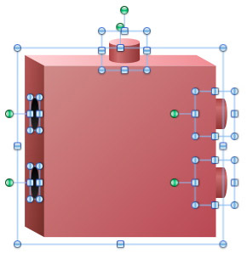
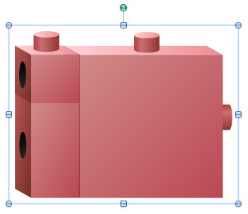
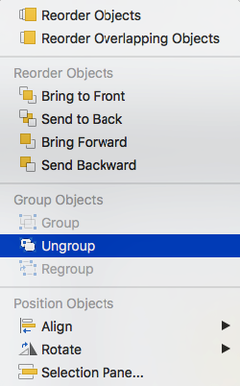
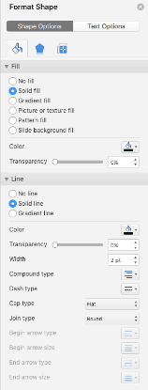
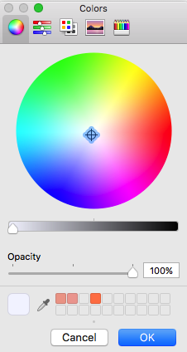
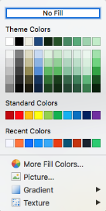
Tips and Tricks (PC and Mac)
Tips & Tricks (PC and Mac)
Group
Elements are grouped logically (hierarchically).
Scale
Group elements when scaling.
Use “Increase Font Size” and “Decrease Font Size” to scale text.
Scale proportionally (“Lock Aspect Ratio”).
Color
Edit colors via the “Shape Fill” tool.
Use the “Format” paintbrush to sample and apply other styles (e.g., gradients, lines).
For advanced editing select “Format Shape.”
General
Some quantitative graphics (e.g., bar charts) are data-driven. Use “Edit Data” to modify data. Use “Chart Tools” to edit aesthetics.
To embed fonts, follow these steps: Click the Microsoft Office Button, then click Save As. In the Save As dialog box, click Tools, then click Save Options. Click to select the Embed fonts in the file check box under Preserve fidelity when sharing this presentation, and then click OK.

Slide 18
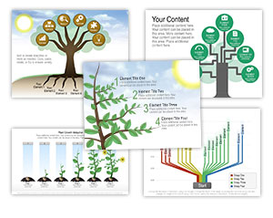

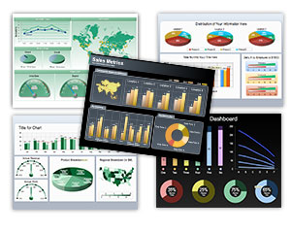
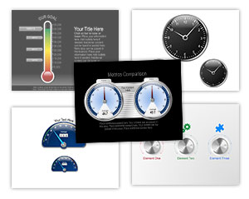
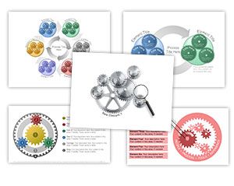
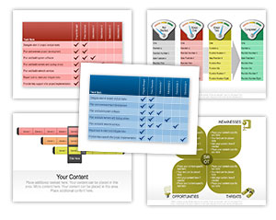
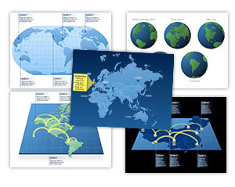
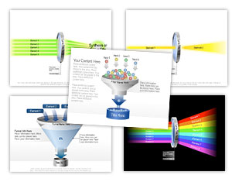

Check Out our PowerPoint Graphics Library
9,000+ fully editable PowerPoint Graphics
CLICK HERE
to Check Out our PowerPoint Graphics Library

