Slide 1
C与C++程序设计
刘禹 盛浩
buaa_liuyu@buaa.edu.cn

Slide 2
课程目标
熟悉编程语言的语法
熟悉面向对象编程思想
高阶语法掌握
能够把编程作为学习、验证和展现的手段
考核方式
课堂纪律10%
作业 30%
考试（闭卷）60%

Slide 3
User Interface & User Experience
Professional English for CS
Documents
Reference &
Help
Software Programming Technology
Database，Lib，Communication, Multi-Thread…
Programming Language → Compiler/Interpreter → Machine Code
Lib & API & Runtime Environment
OS
Hardware

Slide 4
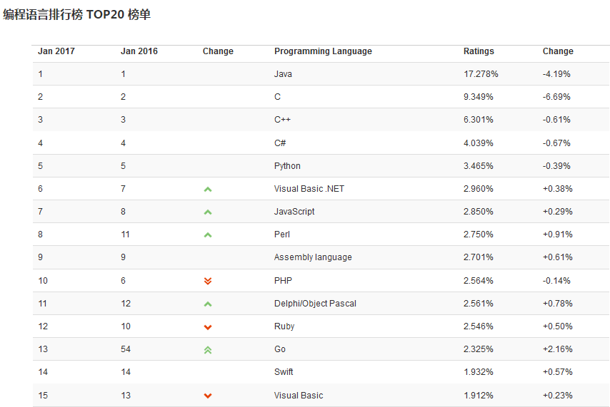

Slide 5




How to get better

Slide 6
Reference
C
《The C Programming Language》
C++
《Thinking In C++》
《C++ Primer 》
《The C++ Programming Language》
Application
《深入浅出MFC》
QT教程

Slide 7
Contents
Data Types, Functions and Variables
Array
Pointer
String in C and Dynamic Memory Allocation
Struct and Macro
From C to C++ (A better C)
Encapsulation
Inheritance &Polymorphism
Reuse & Template
C# & .NET

