Slide 1





路由协议
互联网异构性

Slide 2
网络层（网络互连）特点
经过许多节点和链路（无法广播问题）
经过不同通信子网（不同寻址问题）
通讯双方可能要经过多条路径（路由选择问题）
Source
Data
Head
A
B
R2
Data
Head
R1
R3
R4

Slide 3

路由的作用
路由作用: 完全依靠路标, 找到一条最佳路径(路径最短、速度最快、安全可靠、开销最小等)

Slide 4
What Is Routing?
  Routing is the process of generating the routing table and forwarding a packet from one location to another
  Routers forward traffic to a logical destination in a computer network
  Routers perform two major functions:
    Routing
      Learning the logical topology of the network
    Switching
      Forwarding packets from an inbound interface to an outbound interface

Slide 5
路由器工作原理
IP 报文
payload
header
Router
Destination
Address
路由引擎
报文转发引擎
Outgoing Port
路由表
Dest-network
Port
65.0.0.0/8
3
128.9.0.0/16
1
149.12.0.0/19
7

Slide 6
Internet 路由协议
Routing Goal: determine “good” path (sequence of routers) through network from source to dest.
B
1
C
7
A
8
2
1
E
D
2
路由协议的核心就是路由算法，即需要何种算法来获得路由表中的各路由表项。
如何生成路由表

Slide 7
理想路由算法特点
算法必须是正确的和完整的。
算法在计算上应简单。
算法应能适应通信量和网络拓扑的变化
算法应具有稳定性。
路由算法应收敛于一个可以接受的解，路由不应不停的变化。
算法应是公平的。
算法应是最佳的。
只能相对于某一种特定要求下得出的较为合理的选择。

Slide 8
路由协议分类
从路由算法能否随网络通信量或拓扑自适应地进行调整变化来划分，可分两大类：
  静态路由（非自适应路由选择）
    简单、开销小，但不能及时适应网络状态的变化。
  动态路由 （自适应路由选择）
    能较好的适应网络状态的变化，但实现起来较为复杂，开销比较大。

Slide 9
Routing vs. Forwarding
Forwarding: select an output port based on destination address and routing table
Routing: process by which routing table is built
  Function of finding paths in a network.
  Can display routing table using “netstat -rn”
Destination Gateway Flags Ref Use Interface
127.0.0.1 127.0.0.1 UH 0 26492 lo0
192.168.2. 192.168.2.5 U 2 13 fa0
193.55.114. 193.55.114.6 U 3 58503 le0
192.168.3. 192.168.3.5 U 2 25 qaa0
224.0.0.0 193.55.114.6 U 3 0 le0
default 193.55.114.129 UG 0 143454

Slide 10
Routing Table Structure
Fields: destination, gateway, flags, ...
Destination: can be a host address or a network address. If the ‘H’ flag is set, it is the host address.
Gateway: router/next hop IP address. The ‘G’ flag says whether the destination is directly or indirectly connected.
U flag: Is route up ?
G flag: router (indirect vs direct)
H flag: host (dest field: host or network address?)
Refcn:共享同一个链路层地址的路由条数
Use:通过该路由发送的分组数

Slide 11
Route Table Setup
Route Table setup by:
  a) ‘route’ command [Static] add
  b) ICMP redirect message.[Static]
  c) routing daemon. Eg: ‘routed’ [Dynamic]
  d) Windows 系统手工配置

Slide 12


静态路由
172.16.2.2
10.1.1.1
E0
E1
172.16.3.10
10.250.8.11
172.16.12.12
10.180.30.118
IP: 172.16.2.1
IP: 10.6.24.2
路由表
172.16
Network
Interface
.
12
.
12
Network
Host
172.16.0.0
10.0.0.0
E0
E1
Each router advertises destinations that lie beyond it

Slide 13
Automatic Routing
Used by IP routers
Requires special software
Each router communicates with neighbors
Pass routing information
Use route propagation protocol

Slide 14
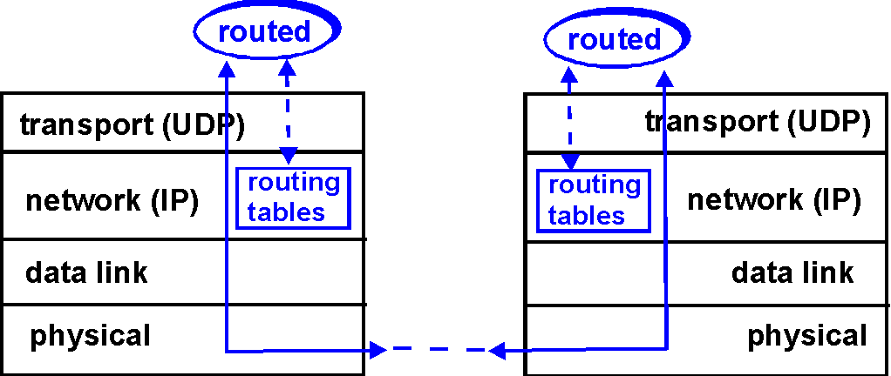
Dynamic Routing Model
A node makes a local choice depending on global topology: this is the fundamental problem

Slide 15

本地电话网路由
长途局
汇接局
汇接局
直达路由
端局
端局
端局
端局

Slide 16
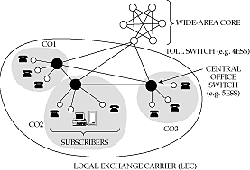
Telephony routing
3-level hierarchy, with a fully-connected core
AT&T: 135 core switches with nearly 5 million circuits
LECs may connect to multiple cores

Slide 17
Telephony Routing algorithm
If endpoints are within same CO, directly connect
If call is between COs in same LEC, use one-hop path between COs
Otherwise send call to one of the cores
Only major decision is at toll switch
  one-hop or two-hop path to the destination toll switch.
Essence of problem:
which two-hop path to use if one-hop path is full

Slide 18
Features of telephone routing
Stable load
  can predict pairwise load throughout the day
  can choose optimal routes in advance
Extremely reliable switches
  downtime is less than a few minutes per year
  can assume that a chosen route is available
  can’t do this in the Internet
Single organization controls entire core
  can collect global statistics and implement global changes
Very highly connected network
Connections require resources (but all need the same)

Slide 19
Factors Affecting Internet Routing
Routing algorithms view the network as a graph
Problem: find lowest cost path between two nodes
Factors
  Inherently large
  Many organizations
  Static/Dynamic topology
  Dynamic load
  Policy
  Dynamic delay
  Bandwidth
  etc
A
6
3
1
2
F
1
E
4
B
9
1
C
D

Slide 20
Routing in the Internet
The Internet consists of Autonomous Systems interconnected with each other
Two-level routing (Hierarchical ):
  Intra-AS: administrator is responsible for choice (AS内部）：RIP，OSPF
  Inter-AS: unique standard - BGP

Slide 21
Example
Interior router
BGP router
AS-1
AS-3
AS-2

Slide 22
AS number
The Internet uses hierarchical routing
The Internet is split into Autonomous Systems (AS’s)
  Examples of AS’s: Stanford (32), HP (71), MCI Worldcom (17373)
  Try: whois –h whois.arin.net ASN “MCI Worldcom”
Within an AS, the administrator chooses an Interior Gateway Protocol (IGP)
  Examples of IGPs: RIP (rfc 1058), OSPF (rfc 1247).
Between AS’s, the Internet uses an Exterior Gateway Protocol (EGP)
  AS’s today use the Border Gateway Protocol, BGP-4 ( rfc 1771)

Slide 23
我国的AS号
CSTNET 7497
CHINANET 4808, 4809 , 4810
CERNET 4538
北京市信息中心 7638
首都公用信息平台 7639

Slide 24
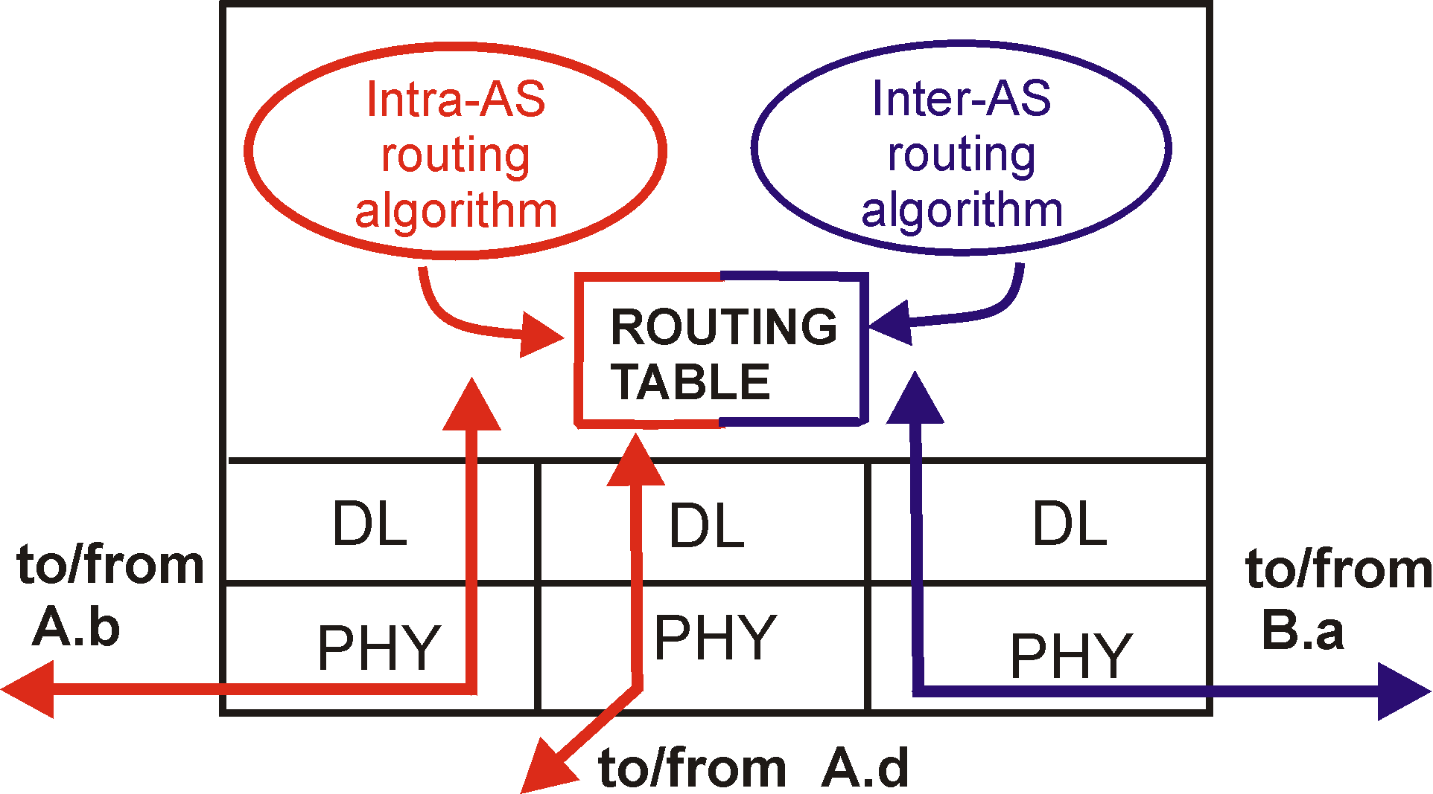
Intra-AS and Inter-AS routing
Inter-AS
routing
between
A and B
C.b
B.a
A.a
Host
h2
b
A.c
c
a
C
a
b
Host
h1
a
B
d
c
Intra-AS routing
within AS B
A
b
Intra-AS routing
within AS A
network layer
inter-AS,
intra-AS
routing in
gateway A.c

Slide 25
Intra-AS Routing
An Intra-AS routing protocol is used to configure and maintain the routing tables within an AS
  Also known as Interior Gateway Protocol (IGP)
Most common IGPs:
  RIP: Routing Information Protocol
  OSPF: Open Shortest Path First
  EIGRP: Cisco’s proprietary Enhanced Interior Gateway Routing Protocol

Slide 26
Dynamic Routing Methods
Source-based: chart route at src, given a map.
  signals the route-setup (eg: ATM approach)
  encodes the route into packets (inefficient)
Link state routing: Get map of network (in terms of link states) and calculate best route locally
Distance vector: At every node, set up distance signposts to destination nodes (a vector)
  Setup this by looking for neighbors’ signposts.

Slide 27
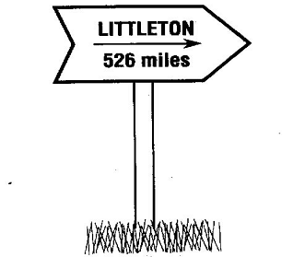
Distance Vector
DV = Set (vector) of Signposts, one for each destination

Slide 28
Distance Vector routing
“Vector” of distances (signposts) to each How to find distances ?
  Distance to local network is 0. （教材用 1 表示）
  Look in neighbors’ distance vectors, and add link cost to reach the neighbor
  Find which direction yields minimum distance to particular destination. Turn signpost that way.
  Keep checking if neighbors change their signposts and modify local vector if necessary.
  Called the “Bellman-Ford algorithm”
Idea: At node i, for destination j:
  Find neighbor/next-hop x that minimizes the sum
D(i,j) = C(i,x) + D(x,j)

Slide 29
距离向量思路
距离向量算法的基础就是 Bellman-Ford 算法（或 Ford-Fulkerson 算法）：
设X是结点 A 到 B 的最短路径上的一个结点。
若把路径 A→B 拆成两段路径 A→X 和 X→B，则每一段路径 A→X 和 X→B 也都分别是结点 A 到 X 和结点 X 到 B 的最短路径。

Slide 30
Distance Vector Algorithm
路由器启动时，对(V,D)路由表进行初始化，
起初只包含所有与该路由器直接相连的网络号及接口
V-D基本思想：
（1）每个路由器周期性的广播路由报文
（2）报文中含有（V，D）序偶组成，V--网络号，D--距离
（3）每个路由器收到路由报文后，依据（V，D）序偶，按照最短路径原则更新自己的路由表

Slide 31

路由刷新过程
Ri
Rj
路由器Ri收到Rj的路由报文(Vj ，Dj)
1) Ri路由表中没有Vj，则增加一项，（Vi=Vj，Di=Dj+1）
2) 已有，如果Dj+1<Di，则Ri 修改自己的表项，其中Vi不变，而Di=Dj +1。如果Dj+1 = Di ，nexthop=Rj (也有路由器厂商采用先入为主，即不变)。否则不变。
3) Ri 去往某目的地的路径经过Rj ，而Rj 去往目的地的路径发生了变化：
Ä．如果Rj 的V-D 表中不再包含去往Vi 的路径（断了）则Ri 中相应的表项需删除。(timeout)
B．如果Rj 去往目的地的距离发生了变化，则Ri 需修改自己的表项，Vi 不变，Di =Dj +1。（Dj为变化后的距离）

Slide 32
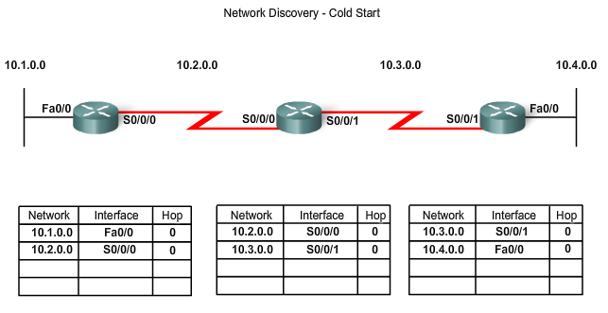
Network Discovery
Router initial start up (Cold Starts)
  Initial network discovery
    Directly connected networks are initially placed in routing table

Slide 33
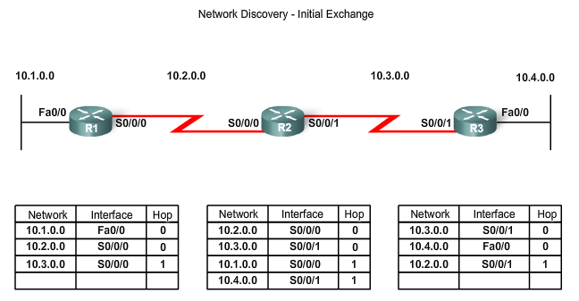
Network Discovery
Initial Exchange of Routing Information
  If a routing protocol is configured then:
    Routers will exchange routing information
    Routing updates received from other routers
Router checks update for new information
  If there is new information:
    Metric is updated
    New information is stored in routing table

Slide 34
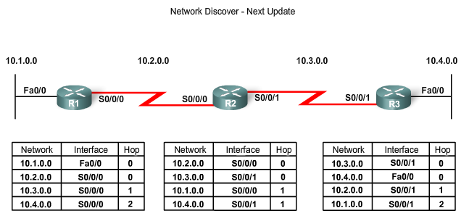
Network Discovery
Exchange of Routing Information
  Router convergence is reached when
    All routing tables in the network contain the same network information
  Routers continue to exchange routing information
    If no new information is found then Convergence is reached

Slide 35
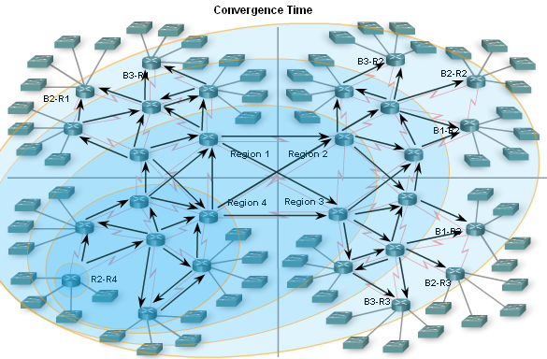
Network Discovery
Convergence must be reached before a network is considered completely operable
Speed of achieving convergence consists of 2 interdependent categories
  Speed of broadcasting routing information
  Speed of calculating routes

Slide 36
RIP ( Routing Information Protocol)
RFC 1058 and 1723
Included in BSD UNIX in 1982
Distance vector algorithm
Distance metric: number of hops (max = 15 hops)
Distance vectors: exchanged every 30 sec via RIP Response Message (also called “RIP advertisement”)
封装在UDP 报文中, 端口号为520。

Slide 37
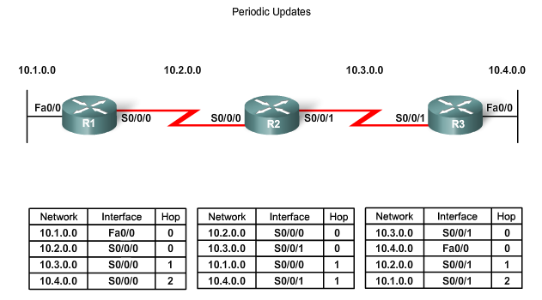
Routing Table Maintenance
Periodic Updates: RIPv1 & RIPv2
  These are time intervals in which a router sends out its entire routing table

Slide 38
协议运行流程
初始化：启动路由守护进程，它先判断启动了那些接口，并在每个接口上发送一个请求报文要求其它路由器发送完整路由表；
接收请求：路由器将完整的路由表发送给请求者；
接收到响应：使响应生效, 更新路由表；
定期路由更新：每过30秒所有路由器会将完整路由表发送给相邻路由表；
触发更新：每当一条路由的度量发生变化时，发送那些发生变化的表项。

Slide 39
RIP定时器
更新定时器
  设置路由器发送更新信息的速度，默认值为30秒。
无效定时器
  得不到更新的路径经过多少秒后将被认为是无效的, 默认值为180秒
保持定时器
  指明在多少秒之内拒绝接受更好的路由信息。
  默认值为180秒
刷新定时器
  设置路径从路由表中删除必须等待的时间。
  默认值为240秒

Slide 40
Routing Information Protocol (RIP v1)
命令字：1 请求； 2 响应。 一个报文最多25条路由
通常把命令域设为1，然后广播整个路由表
Command (1-6)
Version
0
Address Family
0
32-bit IP address
0
0
metric
24 more routes
AFI:地址族标志指明使用的地址族，用于支持多种不同协议的路由信息。IP的AFI=2，如为0xFFFF，则剩下的部分为认证信息(RIPv2)。

Slide 41
RIPv2
Why ? Installed base of RIP routers
Provides:
  VLSM、CIDR support
  Authentication
  Multicasting （地址为：224.0.0.0)
  Tags to support EGP/BGP routes.
Uses reserved fields in RIPv1 header.
First route entry replaced by authentication info.

Slide 42
Routing Information Protocol (RIP v2)
Command (1-6)
Version
保留
Address Family
路由标记
32-bit IP address
32-bit Subnet Mask
Next hop (32bit)
metric
24 more routes
如果在Address Family 中的数据为FFFF,则整个报文为
认证（authentication)报文。
路由标记：可带AS 号，使RIP能够从EGP/BGP routes.
中接受信息

Slide 43
RIP Table processing
RIP routing tables managed by application-level process called route-d (daemon)
advertisements sent in UDP packets, periodically repeated

Slide 44
RIP Table example (continued)
C>netstat -nr
Destination Gateway Flags Ref Use Interface
-------------------- -------------------- ----- ----- ------ ---------
127.0.0.1 127.0.0.1 UH 0 26492 lo0
192.168.2. 192.168.2.5 U 2 13 fa0
193.55.114. 193.55.114.6 U 3 58503 le0
192.168.3. 192.168.3.5 U 2 25 qaa0
224.0.0.0 193.55.114.6 U 3 0 le0
default 193.55.114.129 UG 0 143454
Three attached class C networks (LANs)
Router only knows routes to attached LANs
Default router used to “go up”
Route multicast address: 224.0.0.0
Loopback interface (for debugging)

Slide 45
RIP problems
Counting-to-infinity problem:
  Simple configuration A->B->C. If C fails, B needs to update and thinks there is a route through A. A needs to update and thinks there is a route thru B.
  No clear solution, except to set “infinity” to be small (eg 16 in RIP)
Slow convergence after topology change:
  Due to count to infinity problem
  Information propagates every 30s

Slide 46
RIP problems (contd)
Black-holes:
  If one node goes broken and advertises route of zero to several networks, all nodes immediately point to it.
Broadcasts consume non-router resources
Metric: hop count <=15 hop is not the best metric
No load balance

Slide 47
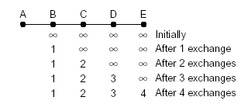
Properties of Distance Vector Algorithm
Good news propagate fast （A、B之间恢复链路）

Slide 48
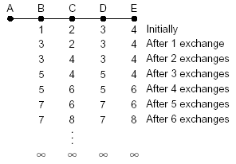
Properties of Distance Vector Algorithm
Bad news propagate slowly: the count-to-infinity problem （A、B之间中断）

Slide 49
解决方法
水平分割（split horizons )
路由器不向收到某条路由到来的方向回传此路由。
毒性逆转 (poison reverse)
把跳数设为16（不可达）并把这条路径告诉邻居路由器。
保持定时器 (hold down timer)
某路径删除后一定时间内拒绝接收新的路由信息。
触发更新 (Tiggered Update)
当某个路径的度量改变了，路由器立即发出更新信息。

Slide 50
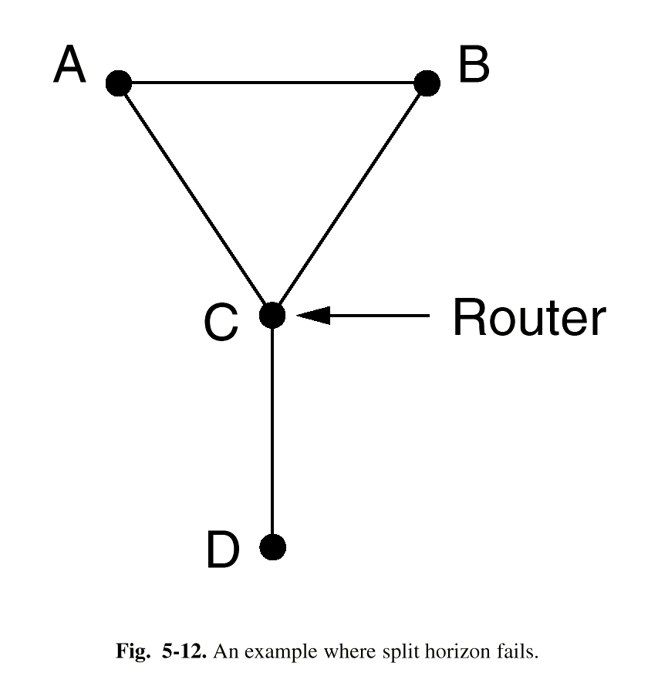
水平分割不能解决所有的问题
水平分割虽然广泛使用，但有时候会失败。
如右图:
  开始时，A和B到D的距离都为2，C到D的距离为1。
  假设CD线路断了， C发现直达D的线路断了，于是C很快认定D不可达了。使用水平分割，A和B都不能到达D。
  但是，A认为B有一条通向D长度为2的路径，通过B经过3个结点可到达D。类似，B也这样认为。于是两个结点每交换一次信息，到达D的距离就增加1，直至加大无穷。

Slide 51
RIP Summary
Routing within an autonomous system (IGP)
Unreliable transport (uses UDP)
Broadcast or multicast delivery
Can propagate a default route
Implemented by Unix program routed
DV protocol with hop count as metric
  Infinity value is 16 hops; limits network size
  Includes split horizon with poison reverse
Routers send vectors every 30 seconds
  With triggered updates for link failures
  Time-out in 180 seconds to detect failures
RIPv1 specified in RFC1058
  www.ietf.org/rfc/rfc1058.txt
RIPv2 (adds authentication etc.) in RFC1388
  www.ietf.org/rfc/rfc1388.txt

Slide 52
链接状态路由算法
简单步骤:
  发现邻居结点，并学习它们的网络地址。
  测量到每个邻居结点的延迟或开销。
  将所有学习到的内容封装成一个分组。
  将这个分组发送给所有其它路由器。
  生成一个网络拓扑图。
  利用Dijkstra算法计算最小生成树，从而得到该节点（树根）到其它路由器的最短路径。

Slide 53
最小生成树
带权连通图中,总的权值之和最小的带权生成树为最小生成树。最小生成树也称最小代价生成树,或最小花费生成树。
只能利用图中的边来构造最小生成树；
只能使用、且仅能使用图中的n-1条边来连接图中的n个顶点；
不能使用图中产生回路的边。

Slide 54
Link State Protocols
Key: Create a network “map” at each node.
Node collects the state of its connected links and forms a “Link State Packet” (LSP)
Flood LSP => reaches every other node in the network and everyone now has a network map.
Given map, run Dijkstra’s shortest path algorithm (SPF) => get paths to all destinations
Routing table = next-hops of these paths.

Slide 55
三个要点
向本自治系统/本区域（AREA）中所有路由器发送信息，这里使用的方法是洪泛法
发送的信息就是与本路由器相邻的所有路由器的链路状态，但这只是路由器所知道的部分信息。
  “链路状态”就是说明本路由器都和哪些路由器相邻，以及该链路的“度量”(metric)。
只有当链路状态发生变化时，路由器才用洪泛法向所有路由器发送此信息。

Slide 56
链路状态数据库 (link-state database)
由于各路由器之间频繁地交换链路状态信息，因此所有的路由器最终都能建立一个链路状态数据库。
这个数据库实际上就是全网的拓扑结构图，它在全网范围内是一致的（这称为链路状态数据库的同步）。
OSPF 的链路状态数据库能较快地进行更新，使各个路由器能及时更新其路由表。
OSPF 的更新过程收敛得快是其重要优点。

Slide 57
Dijkstra’s algorithm
Net topology, link costs known to all nodes
  accomplished via “link state broadcast”
  all nodes have same info
computes least-cost paths from one node (‘source or root”) to all other nodes
  gives routing table for that node
iterative: after k iterations, know least cost path to k dest.’s
Notation:
c(i,j): link cost from node i to j. cost infinite if not direct neighbors
D(v): current value of path cost from source to dest. V
p(v): predecessor node along path from source to v, that is next v
N: set of nodes whose least cost path definitively known

Slide 58
Dijkstra’s Algorithm
1 Initialization:
2 N = {A}
3 for all nodes v
4 if v adjacent to A
5 then D(v) = c(A,v)
6 else D(v) = infty
7
8 Loop
9 find w not in N such that D(w) is a minimum
10 add w to N
11 update D(v) for all v adjacent to w and not in N:
12 D(v) = min( D(v), D(w) + c(w,v) )
13 /* new cost to v is either old cost to v or known
14 shortest path cost to w plus cost from w to v */
15 until all nodes in N
5
B
3
C
2
5
A
2
1
F
3
1
2
D
E
1

Slide 59
Dijkstra’s algorithm: example
Step
0
1
2
3
4
5
start N
A
AD
ADE
ADEB
ADEBC
ADEBCF
D(B),p(B)
2,A
2,A
2,A
D(C),p(C)
5,A
4,D
3,E
3,E
D(D),p(D)
1,A
D(E),p(E)
infinity
2,D
D(F),p(F)
infinity
infinity
4,E
4,E
4,E
5
B
3
C
2
5
A
2
1
F
3
1
2
D
E
1

Slide 60
Dijkstra’s algorithm, discussion
Algorithm complexity: n nodes
each iteration: need to check all nodes, w, not in N
n*(n+1)/2 comparisons: O(n**2)
more efficient implementations possible: O(nlogn)

Slide 61
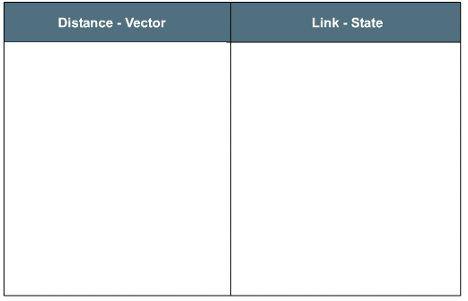
算法比较
路由器向邻居传送自己的路由表；
路由器通过邻居的路由表发现新的网络，并填写到自己的路由表中；
通过将前面路由器给出的距离，再累加自己的这段距离，得到判断最佳路径的依据；
不管网络是否有拓朴变化，都是等待定时时间到才发路由广播。收敛速度慢；
对于路由循环等问题，依靠被动的跳数、水平分割、抑制定时等技术解决。
路由器向邻居传送自己直接连接的网络；
通过转发过来的各个路由器的LSA报文，发现新的路由器和新的网络；
各个路由器根据自己的数据库（全网拓扑图），以自己为根节点各自推算最佳路径
一旦收到别人的LSA报文，就立即转发给其它路由器，收敛速度快；
不会出现循环路由。

Slide 62
OSPF (Open Shortest Path First)
RFC 2178
A Link State algorithm
  Link costs are configured by network administrator
  Link state packet disseminated to entire AS (via flooding) periodically
  Each router maintains an identical database describing the AS's topology
  Use Dijkstra’s algorithm to compute shortest path routes to all the routers

Slide 63
OSPF基本原理
路由器定时发送LSA（ link state advertisements ），通告整个网络自己直接连接哪个网段
其它路由器收听到别人的LSA，将更新自己的网络拓扑数据库
然后根据SPF算法，计算到达远端网段的最佳路径，并将那个网段的网络地址和到达那个网段的下一跳的路由器地址写入自己的路由表。

Slide 64
OSPF Advanced Features
Security: all OSPF messages authenticated, TCP connections used
Multiple same-cost paths allowed (only one path in RIP)
Allow each link to have different costs for different TOS (Type of Service) IP Packets
  E.g, high-bandwidth satellite link configured to have a low cost for non-time-critical traffic and have a high cost for delay-sensitive traffic
  Can compute different routes for each type of traffic
Integrated unicast and multicast support:
  Multicast OSPF (MOSPF, RFC 1584) provides simple extensions to OSPF to provide for multicast routing
Support for hierarchy within a single AS

Slide 65
Hierarchical OSPF
Two-level hierarchy: local area, backbone
  An AS is configured into areas, each area runs its own OSPF link-state routing algorithm
  One area in AS is configured to be the backbone area, job is to route traffic between other areas in the AS
Four types of OSPF routers:
Internal routers: in non-backbone areas and only perform intra-AS routing
Area border routers: belong to both an area and the backbone, route packets to outside the area
Backbone routers: perform routing within the backbone but are not area border routers
Boundary routers: connect to other ASs, exchange routing information with routers in other ASs

Slide 66

Hierarchical OSPF
  OSPF采用分层管理的方法，将一个AS分成若干个区域，一个区域内的路由器之间交换所有的信息而对于同一AS内的其他区域则隐藏其详细拓扑结构
每个区独立生成SPT，每个路由器独立计算最短路径

Slide 67
L-S路由建立过程
每台路由器了解其自身的链路（即与其直连的网络）
每台路由器负责“问候（hello）”直连网络中的相邻路由器
每台路由器创建一个链路状态数据包（LSA），其中包含与该路由器直连的每条链路的状态
每台路由器将LSA泛洪到所有邻居，然后邻居将收到的所有LSA存储到数据库中
每台路由器使用数据库构建一个完整的拓扑图并以自己为根计算通向每个目的网络的最佳路径

Slide 68
路由表的计算 （不同Area）
路由器根据它所在的区域数据库，计算到域内各网络的路由 （SPT）
路由器要根据ABR向本域散发的域外LSA来计算到本AS内的其他各区域子网的可达性信息
本路由器到本AS内目的网络的距离
= 本路由器到ABR的距离 + ABR到目的网络的距离
路由器根据与之邻接的ABR送来的ASBR掌握的本AS外LSA来计算到本AS外各网络的可达性
本路由器到本AS外目的网络的距离
= 本路由器到ASBR的距离 + ASBR到目的网络的距离

Slide 69
OSPF in IP Packets
89 - OSPF 6 - TCP
17 - UDP
Frame Payload
C
R
C
Frame Header
IP Header
Protocol Number
Packet Payload
OSPF is a link-state routing protocol
  Relies on IP packets for delivery of routing information
  Uses protocol number 89

Slide 70

OSPF Terminology
Interfaces

Slide 71
OSPF Terminology
Neighbors
Interfaces

Slide 72
OSPF Terminology
Neighbors
Interfaces
Cost = 10
Cost = 1785
Cost = 6

Slide 73
OSPF Terminology
Neighbors
Interfaces
Area 1
Cost = 10
Area 0
Cost = 1785
Cost = 6

Slide 74
OSPF Terminology
Autonomous System
Neighbors
Interfaces
Area 1
Cost = 10
Area 0
Cost = 1785
Cost = 6

Slide 75
OSPF Terminology
Autonomous System
Neighbors
Interfaces
Area 1
Cost = 10
Area 0
Cost = 1785
Cost = 6
Neighborship
Database
Lists Neighbors

Slide 76
OSPF Terminology
Autonomous System
Neighbors
Interfaces
Area 1
Cost = 10
Area 0
Cost = 1785
Cost = 6
Neighborship
Database
Lists Neighbors
Topology
Database
Lists All Routes

Slide 77
OSPF Terminology
Autonomous System
Neighbors
Interfaces
Area 1
Cost = 10
Area 0
Cost = 1785
Cost = 6
Neighborship
Database
Lists Neighbors
Topology
Database
Lists All Routes
Routing
Table
Lists Best Routes

Slide 78

OSPF Topologies
Broadcast
Multiaccess
Point-to-Point
NBMA
X.25
Frame Relay

Slide 79
OSPF五类报文
Type1 ,Hello分组，用来发现和维持邻站的可达性
2， Database Description, 向邻站给出自己的链路状态数据库中的所有链路状态项目的摘要信息
3，Link State Request 向对方请求发送某些链路状态项目的详细信息
4，Link State Update用Flooding向全网更新链路状态
5，Link State Acknowledgement 对链路更新分组的确认

Slide 80
Neighborship
D
E
每两个相邻的路由器10秒钟交换Hello报文
40秒没收到Hello报文，该相邻Router不可达
Hello
Router ID
Hello/dead intervals
Neighbors
Area-ID
Router priority
DR IP address
BDR IP address
Authentication password
Stub area flag
B
A
C
*
afadjfjorqpoeru
39547439070713
*
Hello
*
*
* Entry must match on neighboring routers

Slide 81
Neighborship (cont.)
D
E
Hello
Router ID
Hello/dead intervals
Neighbors
Area-ID
Router priority
DR IP address
BDR IP address
Authentication password
Stub area flag
B
A
C
*
afadjfjorqpoeru
39547439070713
*
Hello
*
*
* Entry must match on neighboring routers

Slide 82


Router A Choosing Routes
10.1.1.0/24
10.2.2.0/24
10.3.3.0/24
A
B
C
Cost=6
Cost=1
Cost=10
10.4.4.0/24
Topology Table
Net Cost Out Interface
10.2.2.0 6 To0
10.3.3.0 7 To0
10.3.3.0 10 E0
This is the best route to 10.3.3.0.

Slide 83
Maintaining Routing Information
Link-State Change
DR
1
x
LSU
x
A
B
Router A tells all OSPF DRs on 224.0.0.6

Slide 84
Maintaining Routing Information
2
Link-State Change
LSU
DR
1
x
LSU
x
A
B
Router A tells all OSPF DRs on 224.0.0.6
DR tells others on 224.0.0.5

Slide 85
Maintaining Routing Information
2
Link-State Change
LSU
DR
1
x
LSU
x
3
A
B
LSU
Router A tells all OSPF DRs on 224.0.0.6
DR tells others on 224.0.0.5

Slide 86
Maintaining Routing Information
2
Link-State Change
LSU
DR
4
I need to update
my routing table.
1
x
LSU
x
3
A
B
LSU
Router A tells all OSPF DRs on 224.0.0.6
DR tells others on 224.0.0.5

Slide 87
Maintaining Routing Information (cont.)
LSU
Is entry in
link-state
database?
LSA
No
Add to database
Send LSAck
to DR
Flood LSA
Run SPF to calculate
new routing table
End
Notes:
31

Slide 88
Maintaining Routing Information (cont.)
LSU
Is entry in
link-state
database?
Is seq. #
the same?
Ignore LSA
LSA
Yes
Yes
No
32bit 序号，序号越大，状态越新
OSPF规定，增长速率不超过每5秒
一次，600年内不会产生重复号
Add to database
Send LSAck
to DR
Flood LSA
Run SPF to calculate
new routing table
End
Notes:
33

Slide 89
Maintaining Routing Information (cont.)
LSU
Is entry in
link-state
database?
Is seq. #
the same?
Ignore LSA
LSA
Yes
Yes
No
No
Add to database
Is seq. #
higher?
Send LSAck
to DR
No
Flood LSA
Send LSU
with newer
information to
source
Run SPF to calculate
new routing table
End
End
Notes:
32

Slide 90
Maintaining Routing Information (cont.)
LSU
Is entry in
link-state
database?
Is seq. #
the same?
Ignore LSA
LSA
Yes
Yes
No
No
A
Add to database
Go
to
A
Is seq. #
higher?
Yes
Send LSAck
to DR
No
Flood LSA
Send LSU
with newer
information to
source
Run SPF to calculate
new routing table
End
End
Notes:
34

Slide 91
Point-to-Point Neighborship
  Router dynamically detects its neighboring router using the Hello protocol
  No election: Adjacency is automatic as soon as the two routers can communicate
  OSPF packets are always sent as multicast 224.0.0.5

Slide 92
OSPF Router Model
LSA Processing
Route Processor (CPU)
OSPF Process
LSA Flooding
Topology
View
SPF Calculation
FIB Update
SPF Calculation
LSA
FIB
LSA
LS Ack
Data packet
Forwarding
Forwarding
Data packet
Switching
Fabric
Interface card
Interface card

Slide 93
IGP与EGP的区别
Context：运行在不同的路由环境下，IGP感兴趣的是路由信息的创建和交换，EGP感兴趣的是网络的可达性信息。
Connectivity：IGP网络彼此间通过物理方式连接在一起，路由表建立在直接连接和相邻连接之上。EGP信息通过对等方进行交换，路由建立在AS之上。
Choice：IGP支持路由度量，允许Router选择最佳路径。EGP不支持路由度量，采用路由策略对通信行为进行管理。

Slide 94
外部网关协议EGP
不同AS为什么不能用IGP,原因：
  Internet规模太大，使Inter-AS路由选择非常困难
  当一条路径通过几个不同 AS 时，要想对这样的路径计算出有意义的代价是不太可能的。
  比较合理的做法是在 AS 之间交换“可达性”信息。
  AS内部的路由协议各自定义，千差万别
  Inter-AS路由选择必须考虑有关策略。例如：我国国内的站点互访不应经过国外兜圈子

Slide 95
Inter-Domain Routing
Large ISP AS1
Large ISP AS2
BGP
Stub
Small ISP
Dial-Up
ISP
Access
Network
Stub
Stub
Large number of diverse networks

Slide 96

Nontransit vs. Transit ASes
Internet Service
providers (ISPs)
have transit
networks
ISP 2
ISP 1
NET A
Nontransit AS
might be a corporate
or campus network.
Could be a “content
provider”
Traffic NEVER
flows from ISP 1
through NET A to ISP 2

Slide 97
Autonomous Systems (AS)
AS = set of routers and networks under the same administration
  No theoretical limit to the size of the AS
  All parts within an AS remain connected.
    If two networks rely on core-AS to connect, they don’t belong to a single AS
  AS is identified by a 16-bit AS number
  At least one border router per AS.
    This router also collects reachability information (“external routes”) and diffuses it internally and vice versa

Slide 98
Autonomous Systems (Continued)
AS types:
  Stub AS => only single connection to one other AS => it carries only local traffic.
  Multihomed AS: Connected to multiple AS, but does not allow transit traffic
  Transit AS: carries transit traffic under policy restrictions
Traffic types:
  Local = traffic originating or terminating at AS.
  Transit = non-local traffic

Slide 99
AS Numbers (ASNs)
ASNs are 16 bit values.
  64512 through 65535 are “private”
Currently over 11,000 in use.
  Genuity: 1
  MIT: 3
  Harvard: 11
  UC San Diego: 7377
  AT&T: 7018, 6341, 5074, …
  UUNET: 701, 702, 284, 12199, …
  Sprint: 1239, 1240, 6211, 6242, …
  Cernet: 4538, 4789, …
ASNs represent units of routing policy

Slide 100
路由策略特点
不影响分组的目标地址，它影响用于到达目标的路径。
不允许数据流采用与AS所选择路由不同的路径发往另一个AS
仅仅影响数据流怎样到达AS,不影响AS内部路由
可以实现任何于跳与跳范式相联系的规则
检测源地址，在入站接口上进行配置
内部路由优先于外部路由。

Slide 101
BGP 发言人
(BGP speaker)
每一个自治系统的管理员要选择至少一个路由器作为该自治系统的“ BGP 发言人” 。
一般说来，两个 BGP 发言人都是通过一个共享网络连接在一起的，而 BGP 发言人往往就是 BGP 边界路由器，但也可以不是 BGP 边界路由器。

Slide 102
BGP 交换路由信息
一个 BGP 发言人与其他自治系统中的 BGP 发言人要交换路由信息，就要先建立 TCP 连接，然后在此连接上交换 BGP 报文以建立 BGP 会话(session)，利用 BGP 会话交换路由信息。
使用 TCP 连接能提供可靠的服务，也简化了路由选择协议。
使用 TCP 连接交换路由信息的两个 BGP 发言人，彼此成为对方的邻站或对等站。

Slide 103
BGP 发言人和
自治系统 AS 的关系
BGP
发言人
AS₁
BGP
发言人
AS₂
BGP 发言人
BGP 发言人
AS₃
BGP 发言人
AS₄
AS₅

Slide 104
AS 的连通图举例
BGP 所交换的网络可达性的信息就是要到达某个网络所要经过的一系列 AS。
当 BGP 发言人互相交换了网络可达性的信息后，各 BGP 发言人就根据所采用的策略从收到的路由信息中找出到达各 AS 的较好路由。
AS₁
AS₂
AS₃
AS₄
AS₅

Slide 105
BGP 发言人交换路径向量
自治系统 AS₂ 的 BGP 发言人通知主干网的 BGP 发言人：“要到达网络 N₁, N₂, N₃ 和 N₄ 可经过 AS₂。”
本地 ISP（AS₄）
N₁， N₂
地区 ISP
（AS₂）
本地 ISP（AS₅）
N₃， N₄
主干网
（AS₁）
本地 ISP（AS₆）
N₅
地区 ISP
（AS₃）
本地 ISP（AS₇）
N₆， N₇

Slide 106
BGP 发言人交换路径向量
主干网还可发出通知：“要到达网络 N₅, N₆ 和 N₇ 可沿路径（AS₁, AS₃）。”
本地 ISP（AS₄）
N₁， N₂
地区 ISP
（AS₂）
本地 ISP（AS₅）
N₃， N₄
主干网
（AS₁）
本地 ISP（AS₆）
N₅
地区 ISP
（AS₃）
本地 ISP（AS₇）
N₆， N₇

Slide 107
BGP 协议的特点
BGP 协议交换路由信息的结点数量级是自治系统数的量级，这要比这些自治系统中的网络数少很多。
每一个自治系统中 BGP 发言人（或边界路由器）的数目是很少的。这样就使得自治系统之间的路由选择不致过分复杂。

Slide 108
BGP 协议的特点
BGP 支持 CIDR，因此 BGP 的路由表也就应当包括目的网络前缀、下一跳路由器，以及到达该目的网络所要经过的各个自治系统序列。
在BGP 刚刚运行时，BGP 的邻站是交换整个的 BGP 路由表。但以后只需要在发生变化时更新有变化的部分。这样做对节省网络带宽和减少路由器的处理开销方面都有好处。

Slide 109
BGP-4 共使用四种报文
(1) 打开(OPEN)报文，用来与相邻的另一个BGP发言人建立关系。
(2) 更新(UPDATE)报文，用来发送某一路由的信息，以及列出要撤消的多条路由。
(3) 保活(KEEPALIVE)报文，用来确认打开报文和周期性地证实邻站关系。
(4) 通知(NOTIFICATION)报文，用来发送检测到的差错。
在 RFC 2918 中增加了 ROUTE-REFRESH 报文，用来请求对等端重新通告。

Slide 110
BGP 报文具有通用的首部
字节 16 2 1
标 记
长 度
类 型
BGP 报文通用首部
BGP 报文主体部分
TCP首部
BGP 报文
IP 首部
TCP 报文

Slide 111
BGP-4
BGP = Border Gateway Protocol
Is a Policy-Based routing protocol
Is the de facto EGP of today’s global Internet
Classless Inter Domain Routing (CIDR) support
Path vector protocol
  Each BGP router broadcasts to neighbors (peers) entire path (i.e, sequence of ASs) to a destination AS, but not the cost to destination
Runs over TCP (port 179)
Relatively simple protocol, but configuration is complex and the entire world can see, and be impacted by, your mistakes.
Standards
  1989 : BGP-1 [RFC 1105]
    Replacement for EGP (1984, RFC 904)
  1990 : BGP-2 [RFC 1163]
  1991 : BGP-3 [RFC 1267]
  1995 : BGP-4 [RFC 1771]
    Support for Classless Interdomain Routing (CIDR)

Slide 112
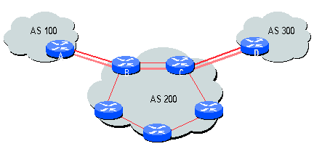
When Should I Use BGP
Dual- or multi-homed
Providing partial or full Internet routing to a downstream customer
Anytime the AS path information is required

Slide 113
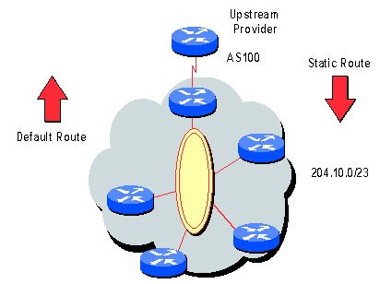
BGP Is Not Needed …
… if singularly homed
… if not providing downstream routing
Use a default route!

Slide 114
BGP运行过程
建立AS间的拓扑图。该拓扑图是通过各AS的BGP路由器交换路由信息获得的。
各AS通过邻居关系连接在一起，各个AS之间的链路构成了所谓的树。
BGP按距离—矢量算法计算最短路径。
BGP保留到每一个目的站的完整路由。

Slide 115

BGP Operations (Simplified)
Establish session on
TCP port 179
AS1
BGP session
Exchange all
active routes
AS2
While connection
is ALIVE exchange
route UPDATE messages
Exchange incremental
updates

Slide 116
AS PATH
AS 1129
135.207.0.0/16
AS Path = 1755 1239 7018 6341
Global Access
AS 1755
135.207.0.0/16
AS Path = 1239 7018 6341
135.207.0.0/16
AS Path = 1129 1755 1239 7018 6341
Ebone
AS 12654
AS 1239
135.207.0.0/16
AS Path = 7018 6341
RIPE NCC
RIS project
Sprint
AS7018
135.207.0.0/16
AS Path = 3549 7018 6341
135.207.0.0/16
AS Path = 6341
AT&T
AS 6341
AS 3549
135.207.0.0/16
AS Path = 7018 6341
AT&T Research
Global Crossing
135.207.0.0/16
Prefix Originated

Slide 117
Interdomain Loop Prevention
AS 7018
BGP at AS YYY will never accept a route with ASPATH containing YYY.
Don’t Accept!
12.22.0.0/16
ASPATH = 1 333 7018 877
AS 1

Slide 118
Traffic Often Follows AS PATH
135.207.0.0/16
ASPATH = 3 2 1
AS 1
AS 2
AS 3
AS 4
135.207.0.0/16
IP Packet Dest =
135.207.44.66

Slide 119




Many Routing Processes Can Run on a Single Router
RIP Process
BGP Process
RIP Routing tables
BGP Routing tables
BGP
OSPF Process
OSPF Routing tables
RIP
Domain
OS kernel
OSPF
Domain
Forwarding Table Manager
Forwarding Table

Slide 120

Join EGP with IGP For Connectivity
135.207.0.0/16
Next Hop = 192.0.2.1
135.207.0.0/16
10.10.10.10
AS 1
AS 2
192.0.2.1
192.0.2.0/30
Forwarding Table
destination
next hop
192.0.2.0/30
10.10.10.10
+
Forwarding Table
destination
next hop
EGP
135.207.0.0/16
10.10.10.10
destination
next hop
192.0.2.0/30
10.10.10.10
135.207.0.0/16
192.0.2.1

Slide 121
虚拟专用网 VPN
由于 IP 地址的紧缺，一个机构能够申请到的IP地址数往往远小于本机构所拥有的主机数考虑到互联网并不很安全，一个机构内也并不需要把所有的主机接入到外部的互联网。
假定在一个机构内部的计算机通信也是采用 TCP/IP 协议，那么从原则上讲，对于这些仅在机构内部使用的计算机就可以由本机构自行分配其 IP 地址。

Slide 122
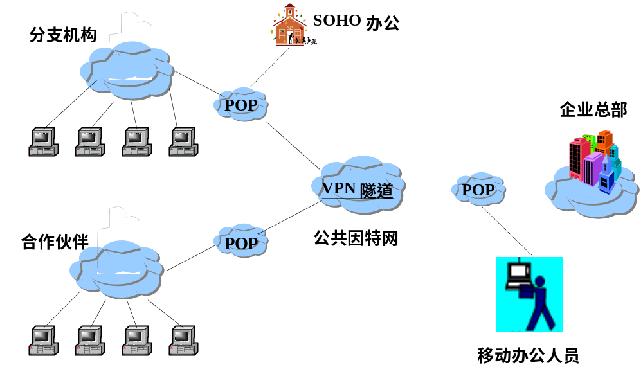
VPN
    VPN（Virtual Private Network )是指依靠ISP（因特网服务供应商），在公共网络中建立专用数据网络的技术。
    在VPN中，任意两个节点之间的连接并没有端到端物理链路，而是利用公众网的资源动态组成的。

Slide 123
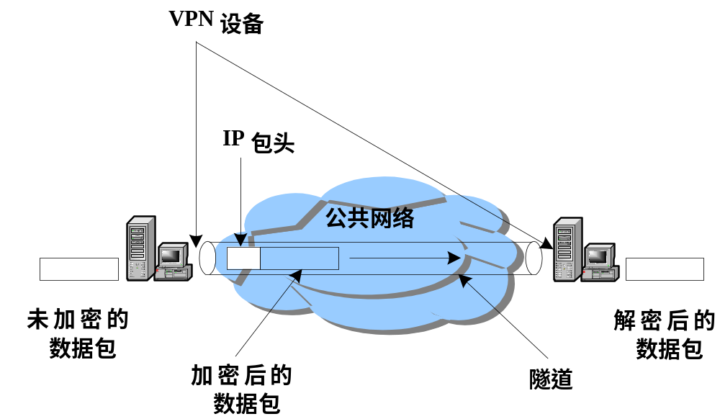
VPN的基本原理
  工作原理
    采用隧道技术
    数据包以密文形式在网上传输
Page <number>

Slide 124


用隧道技术实现虚拟专用网
本地地址
全球地址
本地地址
125.1.2.3
194.4.5.6
部门 A
网络
隧道
部门 B
网络
Y
X
R₁
R₂
10.2.0.3
10.1.0.1
互联网
使用隧道技术
网络地址 = 10.1.0.0
（本地地址）
网络地址 = 10.2.0.0
（本地地址）
隧道技术

Slide 125
源地址：125.1.2.3
目的地址：194.4.5.6
加密的从 X 到 Y 的内部数据报
外部数据报的数据部分
数据报首部
125.1.2.3
194.4.5.6
部门 A
网络
隧道
部门 B
网络
X
Y
R₁
R₂
10.2.0.3
10.1.0.1
互联网
使用隧道技术
125.1.2.3
194.4.5.6
R₁
R₂
Y
X
部门 A
网络
部门 B
网络
10.2.0.3
10.1.0.1
虚拟专用网 VPN
用隧道技术实现虚拟专用网

Slide 126
内联网 intranet 和外联网 extranet
它们都是基于 TCP/IP 协议的。
由部门 A 和 B 的内部网络所构成的虚拟专用网 VPN 又称为内联网 (intranet)，表示部门 A 和 B 都是在同一个机构的内部。
一个机构和某些外部机构共同建立的虚拟专用网 VPN 又称为外联网 (extranet)。
125.1.2.3
194.4.5.6
R₁
R₂
Y
X
部门 A
网络
部门 B
网络
10.2.0.3
10.1.0.1
内联网 (虚拟专用网 VPN)

Slide 127
远程接入 VPN
远程接入 VPN (remote access VPN)可以满足外部流动员工访问公司网络的需求。
在外地工作的员工拨号接入互联网，而驻留在员工 PC 机中的 VPN 软件可在员工的 PC 机和公司的主机之间建立 VPN 隧道，因而外地员工与公司通信的内容是保密的，员工们感到好像就是使用公司内部的本地网络。

Slide 128
网络地址转换 NAT
问题：在专用网上使用专用地址的主机如何与互联网上的主机通信（并不需要加密）？
解决：
  (1) 再申请一些全球 IP 地址。但这在很多情况下是不容易做到的。
  (2)采用网络地址转换 NAT。这是目前使用得最多的方法。

Slide 129
NAT: Network Address Translation
rest of
Internet
local network
(e.g., home network)
10.0.0/24
10.0.0.1
10.0.0.4
10.0.0.2
138.76.29.7
10.0.0.3
All datagrams leaving local
network have same single source NAT IP address: 138.76.29.7,
different source port numbers
Datagrams with source or
destination in this network
have 10.0.0/24 address for
source, destination (as usual)

Slide 130
网络地址转换 NAT
网络地址转换 NAT (Network Address Translation) 方法于1994年提出。
需要在专用网连接到互联网的路由器上安装 NAT 软件。装有 NAT 软件的路由器叫作 NAT路由器，它至少有一个有效的外部全球IP地址。
所有使用本地地址的主机在和外界通信时，都要在 NAT 路由器上将其本地地址转换成全球 IP 地址，才能和互联网连接。

Slide 131
网络地址转换的过程
全球 IP 地址
172.38.1.5
专用网 192.168.0.0
主机 B
213.18.2.4
源 IP 地址
192.168.0.3
主机 A
192.168.0.3
源 IP 地址
172.38.1.5
NAT
路由器
互联网
目的 IP 地址
192.168.0.3
目的 IP 地址
172.38.1.5
NAT 路由器的工作原理

Slide 132
网络地址转换的过程
内部主机 A 用本地地址 IP_{A} 和互联网上主机 B 通信所发送的数据报必须经过 NAT 路由器。
NAT 路由器将数据报的源地址 IP_{A} 转换成全球地址 IP_{G}，并把转换结果记录到NAT地址转换表中，目的地址 IP_{B} 保持不变，然后发送到互联网。
NAT 路由器收到主机 B 发回的数据报时，知道数据报中的源地址是 IP_{B} 而目的地址是 IP_{G}。
根据 NAT 转换表，NAT 路由器将目的地址 IP_{G} 转换为 IP_{A}，转发给最终的内部主机 A。

Slide 133
网络地址转换的过程
可以看出，在内部主机与外部主机通信时，在NAT路由器上发生了两次地址转换：
  离开专用网时：替换源地址，将内部地址替换为全球地址；
  进入专用网时：替换目的地址，将全球地址替换为内部地址；
NAT地址转换表举例
方向 | 字段 | 旧的IP地址 | 新的IP地址
出 | 源IP地址 | 192.168.0.3 | 172.38.1.5
入 | 目的IP地址 | 172.38.1.5 | 192.168.0.3
出 | 源IP地址 | 192.168.0.7 | 172.38.1.6
入 | 目的IP地址 | 172.38.1.6 | 192.168.0.7

Slide 134
网络地址转换 NAT
当 NAT 路由器具有 n 个全球 IP 地址时，专用网内最多可以同时有 n 台主机接入到互联网。这样就可以使专用网内较多数量的主机，轮流使用 NAT 路由器有限数量的全球 IP 地址。
通过 NAT 路由器的通信必须由专用网内的主机发起。专用网内部的主机不能充当服务器用，因为互联网上的客户无法请求专用网内的服务器提供服务。

Slide 135
网络地址与端口号转换 NAPT
为了更加有效地利用 NAT 路由器上的全球IP地址，现在常用的 NAT 转换表把运输层的端口号也利用上。这样，就可以使多个拥有本地地址的主机，共用一个 NAT 路由器上的全球 IP 地址，因而可以同时和互联网上的不同主机进行通信。
使用端口号的 NAT 叫作网络地址与端口号转换NAPT (Network Address and Port Translation)，而不使用端口号的 NAT 就叫作传统的 NAT (traditional NAT)。

Slide 136
NAPT 地址转换表
NAPT 地址转换表举例
方向 | 字段 | 旧IP地址和端口号 | 新IP地址和端口号
出 | 源IP地址:TCP源端口 | 192.168.0.3:30000 | 172.38.1.5:40001
出 | 源IP地址:TCP源端口 | 192.168.0.4:30000 | 172.38.1.5:40002
入 | 目的IP地址:TCP目的端口 | 172.38.1.5:40001 | 192.168.0.3:30000
入 | 目的IP地址:TCP目的端口 | 172.38.1.5:40002 | 192.168.0.4:30000
NAPT把专用网内不同的源 IP 地址，都转换为同样的全球 IP 地址。但对源主机所采用的 TCP 端口号（不管相同或不同），则转换为不同的新的端口号。因此，当 NAPT 路由器收到从互联网发来的应答时，就可以从 IP 数据报的数据部分找出运输层的端口号，然后根据不同的目的端口号，从 NAPT 转换表中找到正确的目的主机。

Slide 137
IPv4/v6 Tunneling
A
B
E
F
Logical view:
tunnel
IPv6
IPv6
IPv6
IPv6
A
B
C
D
E
F
Physical view:
IPv6
IPv6
IPv4
IPv4
IPv6
IPv6
Flow: X
Src: A
Dest: F
data
Src:B
Dest: E
Src:B
Dest: E
Flow: X
Src: A
Dest: F
data
Flow: X
Src: A
Dest: F
data
Flow: X
Src: A
Dest: F
data
A-to-B:
IPv6
B-to-C:
IPv6 inside
IPv4
B-to-C:
IPv6 inside
IPv4
E-to-F:
IPv6

Slide 138
隧道技术
在 IPv6 数据报要进入IPv4网络时，把 IPv6 数据报封装成为 IPv4 数据报，整个的 IPv6 数据报变成了 IPv4 数据报的数据部分。
当 IPv4 数据报离开 IPv4 网络中的隧道时，再把数据部分（即原来的 IPv6 数据报）交给主机的 IPv6 协议栈。

Slide 139

隧道技术
双协议栈
IPv6/IPv4
双协议栈
IPv6/IPv4
IPv6
IPv4 网络
IPv6
B
C
D
E
A
F
流标号：X
源地址：A
目的地址：F
……
数据部分
源地址：B
目的地址：E
源地址：B
目的地址：E
流标号：X
源地址：A
目的地址：F
……
数据部分
…
IPv6
数据报
IPv6
数据报
IPv6 数据报
IPv4 数据报
IPv4 数据报
IPv6 数据报
IPv4网络
使用隧道技术进行从 IPv4 到 IPv6 的过渡

Slide 140
Homework
P195-202
3,4,21,22,26,29,39,42,44,55
其中26题，加一组：
  212.56.134.0/24
  212.56.135.0/24
  212.56.136.0/24
  212.56.137.0/24

