Slide 1
应用层内容
应用层概述
客户/服务器模型
域名服务
网络安全
电子邮件
WWW
文件传输协议FTP
简单网络管理协议SNMP
2: Application Layer

Slide 2





应用层概述
Application: communicating, distributed processes
  running in network hosts in “user space”
  exchange messages to implement app
  e.g., email, file transfer, the Web
Application-layer protocols
  one “piece” of an app
  define messages exchanged by apps and actions taken
  user services provided by lower layer protocols
application
transport
network
data link
physical
application
transport
network
data link
physical
application
transport
network
data link
physical
2: Application Layer

Slide 3
应用层术语
  A process is a program that is running within a host.
  Within the same host, two processes communicate with interprocess communication defined by the OS.
  Processes running in different hosts communicate with an application-layer protocol
  A user agent is an interface between the user and the network application.
    Web:browser
    E-mail: mail reader
    streaming audio/video: media player
2: Application Layer

Slide 4
API: application programming interface
defines interface between application and transport layer
socket: Internet API
  two processes communicate by sending data into socket, reading data out of socket
Q: how does a process “identify” the other process with which it wants to communicate?
  IP address of host running other process
  “port number” - allows receiving host to determine to which local process the message should be delivered
2: Application Layer

Slide 5
What transport service does an app need?
Data loss
some apps (e.g., audio) can tolerate some loss
other apps (e.g., file transfer, telnet) require 100% reliable data transfer
Timing
some apps (e.g., Internet telephony, interactive games) require low delay to be “effective”
Bandwidth
some apps (e.g., multimedia) require minimum amount of bandwidth to be “effective”
other apps (“elastic apps”) make use of whatever bandwidth they get
2: Application Layer

Slide 6
Transport service requirements of common apps
Application
file transfer
e-mail
Web documents
real-time audio/video
stored audio/video
interactive games
financial apps
Data loss
no loss
no loss
loss-tolerant
loss-tolerant
loss-tolerant
loss-tolerant
no loss
Bandwidth
elastic
elastic
elastic
audio: 5Kb-1Mb
video:10Kb-5Mb
same as above
few Kbps up
elastic
Time Sensitive
no
no
no
yes, 100’s msec
yes, few secs
yes, 100’s msec
yes and no
2: Application Layer

Slide 7
Services provided by Internet transport protocols
TCP service:
connection-oriented: setup required between client, server
reliable transport between sending and receiving process
flow control: sender won’t overwhelm receiver
congestion control: throttle sender when network overloaded
does not providing: timing, minimum bandwidth guarantees
UDP service:
unreliable data transfer between sending and receiving process
does not provide: connection setup, reliability, flow control, congestion control, timing, or bandwidth guarantee
Q: why bother? Why is there a UDP?
2: Application Layer

Slide 8
Internet apps: their protocols and transport protocols
Application
layer protocol
smtp [RFC 821]
telnet [RFC 854]
http [RFC 2068]
ftp [RFC 959]
proprietary
(e.g. RealNetworks)
NSF
proprietary
(e.g., Vocaltec)
Underlying
transport protocol
TCP
TCP
TCP
TCP
TCP or UDP
TCP or UDP
typically UDP
Application
e-mail
remote terminal access
Web
file transfer
streaming multimedia
remote file server
Internet telephony
2: Application Layer

Slide 9
客户/服务器模型（1）
基本概念
  客户/服务器模型是所有网络应用的基础。客户/服务器分别指参与一次通信的两个应用实体，客户方主动地发起通信请求，服务器方被动地等待通信的建立。
application
transport
network
data link
physical
request
reply
application
transport
network
data link
physical
2: Application Layer

Slide 10
客户/服务器模型（2）
客户软件
  任何一个应用程序当需要进行远程访问时成为客户，这个应用程序也要完成一些本地的计算；
  一般运行于用户的个人计算机上；
  向服务器主动发起通信请求；
  可以访问多个服务器，但一次只能访问一个；
  不需要特殊的硬件和复杂的操作系统。
服务器软件
  是专用的提供某种服务的特权程序，可以同时处理多个远程客户；
  一般在系统启动时被执行，并连续运行以处理多次会话；
  被动的等待远程客户发起通信；
  需要特殊的硬件和复杂的操作系统。
2: Application Layer

Slide 11
客户/服务器模型（3）
数据在客户和服务器之间是双向流动的，一般是客户发出请求，服务器给出响应。
服务器软件的并发性
  由于服务器软件要支持多个客户的同时访问，它必须具备并发性。服务器软件为每个新到的客户创建一个进程或线程来处理和这个客户的通信。服务器方传送层实体使用客户的源端口号和服务的端口号来确定正确的服务器软件进程（线程）。
服务器软件的组成
  服务器软件一般分为两部分：一部分用于接受请求并创建新的进程或线程，另一部分用于处理实际的通信过程。
2: Application Layer

Slide 12
客户/服务器模型（4）
客户/服务器之间使用的传送层协议
  可以是基于连接的TCP协议，要求建立和释放连接，适用于可靠的交互过程；
  也可以是无连接的UDP协议，适用于可靠性要求不高的或实时的交互过程；
  同时使用TCP和UDP的服务，有两种服务器软件的实现或服务器软件同时和TCP、UDP协议交互，不对客户做限制。
客户和服务器的交互
  支持协议：在INTERNET中，客户和服务器的交互通过使用TCP/IP协议栈来完成。因此，客户和服务器所在的机器要求支持完全的协议栈。客户/服务器通过套接字访问传送层服务。
2: Application Layer

Slide 13
客户/服务器模型（5）
  多种服务：一台计算机上可以运行多个服务器软件，但是要求计算机有强大的硬件资源（服务器级别的计算机）和多任务操作系统（UNIX和WIN95/98/2000/NT）。
  服务的标识：客户是通过服务的标识来访问某种服务的，比如在INTERNET中，服务是用端口号来标识，UNIX在/etc/services文件中定义。服务器软件启动时将其标识通知传送层实体。
2: Application Layer

Slide 14
多个应用进程
使用系统调用的机制
应用程序 1
应用程序 2
…
应用程序 n
用户地址空间
中的应用程序
由应用程序调用的系统函数
系统调用接口
包括 TCP/IP 协议软件的操作系统内核
系统地址空间
中的协议软件
当某个应用进程启动系统调用时，控制权就从应用进程传递给了系统调用接口
此接口再将控制权传递给计算机的操作系统。操作系统将此调用转给某个内部过程，并执行所请求的操作。
内部过程一旦执行完毕，控制权就又通过系统调用接口返回给应用进程。系统调用接口实际上就是应用进程的控制权和操作系统的控制权进行转换的一个接口，即应用编程接口 API。

Slide 15
Socket:无连接循环服务器
客户
服务器
socket(…)
socket(…)
bind(…)
若需要就重复
请求
无限制重复
sendto(…)
recvfrom(…)
进程
响应
sendto(…)
recvfrom(…)
close(…)

Slide 16
Socket: 面向连接并发服务器
服务器
socket(…)
bind(…)
客户
socket(…)
listen(…)
连接请求
无限制重复
connect(…)
accept(…)
fork(…)
若需要就重复
close(…)监听
close(…)接受
write(…)
请求
若需要就重复
主服务器
read(…)
进程
响应
write(…)
read(…)
close(…)接受
close(…)
从属服务器

Slide 17
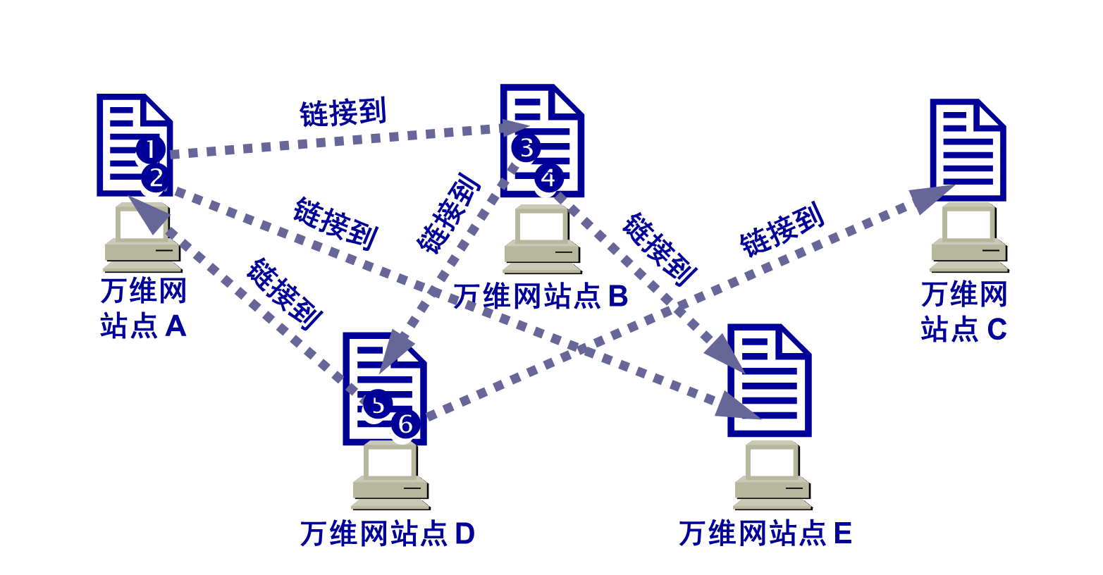
万维网与HTTP
万维网是分布式超媒体 (hypermedia) 系统，它是超文本 (hypertext) 系统的扩充。
一个超文本由多个信息源链接成。利用一个链接可使用户找到另一个文档。这些文档可以位于世界上任何一个接在互联网上的超文本系统中。超文本是万维网的基础。
超媒体与超文本的区别是文档内容不同。超文本文档仅包含文本信息，而超媒体文档还包含其他表示方式的信息，如图形、图像、声音、动画，甚至活动视频图像。

Slide 18
The Web: some jargon
Web page:
  consists of “objects”
  addressed by a URL
Most Web pages consist of:
  base HTML page, and
  several referenced objects.
URL has two components: host name and path name:
User agent for Web is called a browser:
  MS Internet Explorer
  Netscape Communicator
Server for Web is called Web server:
  Apache (public domain)
  MS Internet Information Server
<协议>://<主机>:<端口>/<路径>
www.someSchool.edu/someDept/pic.gif
2: Application Layer

Slide 19
The Web: the http protocol
http: hypertext transfer protocol
Web’s application layer protocol
client/server model
  client: browser that requests, receives, “displays” Web objects
  server: Web server sends objects in response to requests
http1.0: RFC 1945
http1.1: RFC 2068
http request
PC running
Explorer
http response
http request
Server
running
NCSA Web
server
http response
Mac running
Navigator
2: Application Layer

Slide 20
The http protocol: more
http: TCP transport service:
client initiates TCP connection (creates socket) to server, port 80
server accepts TCP connection from client
http messages (application-layer protocol messages) exchanged between browser (http client) and Web server (http server)
TCP connection closed
http is “stateless”
server maintains no information about past client requests
aside
Protocols that maintain “state” are complex!
past history (state) must be maintained
if server/client crashes, their views of “state” may be inconsistent, must be reconciled
2: Application Layer

Slide 21
http example
Suppose user enters URL www.someSchool.edu/someDepartment/home.index
(contains text,
references to 10
jpeg images)
1a. http client initiates TCP connection to http server (process) at www.someSchool.edu. Port 80 is default for http server.
1b. http server at host www.someSchool.edu waiting for TCP connection at port 80. “accepts” connection, notifying client
2. http client sends http request message (containing URL) into TCP connection socket
3. http server receives request message, forms response message containing requested object (someDepartment/home.index), sends message into socket
time
2: Application Layer

Slide 22
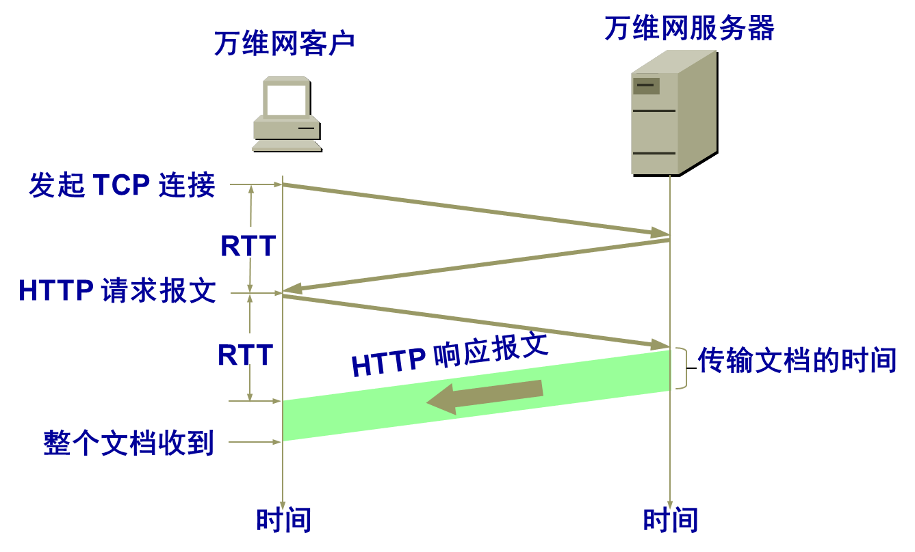
http example (cont.)
4. http server closes TCP connection.
5. http client receives response message containing html file, displays html. Parsing html file, finds 10 referenced jpeg objects
6. Steps 1-5 repeated for each of 10 jpeg objects
time
2: Application Layer

Slide 23
Single Transfer Example
Client
Server
0 RTT
SYN
Client opens TCP connection
SYN
1 RTT
ACK
Client sends HTTP request for HTML
DAT
ACK
DAT
Server reads from disk
2 RTT
FIN
ACK
Client parses HTML
Client opens TCP connection
FIN
ACK
SYN
SYN
3 RTT
ACK
Client sends HTTP request for image
DAT
Server reads from disk
ACK
4 RTT
DAT
Image begins to arrive
2: Application Layer

Slide 24



万维网的工作过程
服务器
www.buaa.edu.cn
链接到URL的超链
客户
某学生
浏览器
程序
服务器
程序
HTTP

HTTP 使用此 TCP 连接
因特网
建立 TCP 连接
❶ 请求文档
HTTP 请求报文

❷ 响应文档
HTTP 响应报文
释放 TCP 连接

Slide 25
用户点击鼠标后所发生的事件
(1) 浏览器分析超链指向页面的 URL。
(2) 浏览器向 DNS 请求解析 www.buaa.edu.cn 的 IP 地址。
(3) 域名系统 DNS 解析出北航服务器的 IP 地址。
(4) 浏览器与服务器建立 TCP 连接
(5) 浏览器发出取文件命令：
GET /buaa/index.htm。
(6) 服务器给出响应，把文件 index.htm 发给浏览器。
(7) TCP 连接释放。
(8) 浏览器显示index.htm 中的所有文本。
2: Application Layer

Slide 26
Non-persistent and persistent connections
Non-persistent
HTTP/1.0
server parses request, responds, and closes TCP connection
2 RTTs to fetch each object
Each object transfer suffers from slow start
Persistent
default for HTTP/1.1
on same TCP connection: server, parses request, responds, parses new request,..
Client sends requests for all referenced objects as soon as it receives base HTML.
Fewer RTTs and less slow start.
持续HTTP: 万维网服务器在发送响应后仍然在一段时间内保持这条连接，使同一个客户（浏览器）和该服务器可以继续在这条连接上传送后续的 HTTP 请求报文和响应报文。
2: Application Layer

Slide 27
HTTP的请求报文结构
空格
回车换行
开始行
方 法
URL
版 本
CRLF
请求行
首部字段名
:
值
CRLF
…
首部行
首部字段名
:
值
CRLF
CRLF
:
实体主体
（通常不用）
报文由三个部分组成，即开始行、首部行和实体主体。
在请求报文中，开始行就是请求行。
方法：Get， Head， Post，Put等

Slide 28
http message format: request
two types of http messages: request, response
http request message:
  ASCII (human-readable format)
request line
(GET, POST,
HEAD commands)
GET /somedir/page.html HTTP/1.0
User-agent: Mozilla/4.0
Accept: text/html, image/gif,image/jpeg
Accept-language:fr
(extra carriage return, line feed)
header
lines
Carriage return,
line feed
indicates end
of message
2: Application Layer

Slide 29
http message format: respone
status line
(protocol
status code
status phrase)
HTTP/1.0 200 OK
Date: Thu, 06 Aug 1998 12:00:15 GMT
Server: Apache/1.3.0 (Unix)
Last-Modified: Mon, 22 Jun 1998 …...
Content-Length: 6821
Content-Type: text/html
data data data data data ...
header
lines
data, e.g.,
requested
html file
2: Application Layer

Slide 30
http response status codes
In first line in server->client response message.
A few sample codes:
200 OK
  request succeeded, requested object later in this message
301 Moved Permanently
  requested object moved, new location specified later in this message (Location:)
400 Bad Request
  request message not understood by server
404 Not Found
  requested document not found on this server
505 HTTP Version Not Supported
2: Application Layer

Slide 31
Trying out http (client side) for yourself
1. Telnet to your favorite Web server:
telnet www.eurecom.fr 80
Opens TCP connection to port 80
(default http server port) at www.eurecom.fr.
Anything typed in sent
to port 80 at www.eurecom.fr
2. Type in a GET http request:
GET /~ross/index.html HTTP/1.0
By typing this in (hit carriage
return twice), you send
this minimal (but complete)
GET request to http server
3. Look at response message sent by http server!
2: Application Layer

Slide 32
User-server interaction: authentication
client
server
Authentication goal: control access to server documents
stateless: client must present authorization in each request
authorization: typically name, password
  authorization: header line in request
  if no authorization presented, server refuses access, sends
    WWW authenticate:
    header line in response
usual http request msg
401: authorization req.
WWW authenticate:
usual http request msg
+ Authorization:line
usual http response msg
usual http request msg
+ Authorization:line
usual http response msg
time
Browser caches name & password so
that user does not have to repeatedly enter it.
2: Application Layer

Slide 33
User-server interaction: cookies
client
server
server sends “cookie” to client in response mst
  Set-cookie: 1678453
client presents cookie in later requests
  cookie: 1678453
server matches presented-cookie with server-stored info
  authentication
  remembering user preferences, previous choices
usual http request msg
usual http response +
Set-cookie: #
usual http request msg
cookie: #
cookie-
spectific
action
usual http response msg
usual http request msg
cookie: #
cookie-
spectific
action
usual http response msg
Cookie 是网站服务器为用户产生一个唯一的识别码
2: Application Layer

Slide 34

Cookies: keeping “state”
client
server
ebay 8734
usual http request msg
Amazon server
creates ID
1678 for user
cookie file
usual http response
set-cookie: 1678
backend
database
create
entry
ebay 8734
amazon 1678
usual http request msg
cookie: 1678
cookie-
specific
action
access
usual http response msg
one week later:
access
ebay 8734
amazon 1678
usual http request msg
cookie: 1678
cookie-
specific
action
usual http response msg
Application Layer
2-<number>

Slide 35
User-server interaction: conditional GET
client
server
Goal: don’t send object if client has up-to-date stored (cached) version
client: specify date of cached copy in http request
  If-modified-since: <date>
server: response contains no object if cached copy up-to-date:
  HTTP/1.0 304 Not Modified
http request msg
If-modified-since: <date>
object
not
modified
http response
HTTP/1.0
304 Not Modified
http request msg
If-modified-since: <date>
object
modified
http response
HTTP/1.1 200 OK
…
<data>
2: Application Layer

Slide 36
Web Caches (proxy server)
Goal: satisfy client request without involving origin server
user sets browser: Web accesses via web cache
client sends all http requests to web cache
  if object at web cache, web cache immediately returns object in http response
  else requests object from origin server, then returns http response to client
origin
server
Proxy
server
http request
http request
client
http response
http response
http request
http request
http response
http response
client
origin
server
2: Application Layer

Slide 37
Why Web Caching?
origin
servers
Assume: cache is “close” to client (e.g., in same network)
smaller response time: cache “closer” to client
decrease traffic to distant servers
  link out of institutional/local ISP network often bottleneck
public
Internet
1.5 Mbps
access link
institutional
network
10 Mbps LAN
institutional
cache
2: Application Layer

Slide 38

ftp: the file transfer protocol
FTP
user
interface
FTP
client
file transfer
FTP
server
user
at host
local file
system
remote file
system
transfer file to/from remote host
client/server model
  client: side that initiates transfer (either to/from remote)
  server: remote host
ftp: RFC 959
ftp server: port 21
2: Application Layer

Slide 39
ftp: separate control, data connections
ftp client contacts ftp server at port 21, specifying TCP as transport protocol
two parallel TCP connections opened:
  control: exchange commands, responses between client, server.
    “out of band control”
  data: file data to/from server
ftp server maintains “state”: current directory, earlier authentication
TCP control connection
port 21
FTP
client
TCP data connection
port 20
FTP
server
2: Application Layer

Slide 40
ftp commands, responses
Sample commands:
sent as ASCII text over control channel
USER username
PASS password
LIST return list of file in current directory
RETR filename retrieves (gets) file
STOR filename stores (puts) file onto remote host
Sample return codes
status code and phrase (as in http)
331 Username OK, password required
125 data connection already open; transfer starting
425 Can’t open data connection
452 Error writing file
2: Application Layer

Slide 41
Typical FTP Session
CLIENT
SERVER
listen on port 21
Cntrl
Cntrl
Data
Data
Connect to port 21
1025
21
Cntrl
Cntrl
Data
Data
2: Application Layer

Slide 42
Typical FTP Session
CLIENT
SERVER
Ask for LIST, 1493
1025
21
Cntrl
Cntrl
PORT command OK
Data
1493
20
Data
List of files
1025
RETR gnotella.zip, 1522
21
Cntrl
Cntrl
PORT command OK
Data
Lots of data
Data
1522
20
Never talks to an unpriviledged port on an untrusted server
2: Application Layer

Slide 43
FTP中控制连接与数据连接的关系
连接类型 | 控制连接 | 数据连接
定义 | 是建立在用户协议解释器和服务器协议解释器之间用于交换命令与应答的通信链路 | 在控制连接作用下实现的全双工的数据传输
作用 | 为数据连接使用TCP建立一条命令链路 | 进行数据传输
使用条件 | 发送命令和接收应答时使用 | 下载和上传数据时使用
使用端口号 | 服务器：21 客户机：**** | 服务器：20 客户机：××××
二者关系 | 控制连接在前，数据连接在后； 控制连接关闭，数据连接也关闭； 数据连接关闭，控制连接仍然可以使用。

Slide 44
考研题（2009年第40题）
FTP客户和服务器传递FTP命令时，使用的连接是（ ）。
A.建立在TCP之上的控制连接
B.建立在TCP之上的数据连接
C.建立在UDP之上的控制连接
D.建立在UDP之上的数据连接
答案：A

Slide 45
Electronic Mail
outgoing
message queue
user mailbox
Three major components:
user agents
mail servers
simple mail transfer protocol: smtp
User Agent
a.k.a. “mail reader”
composing, editing, reading mail messages
e.g., Eudora, Outlook, elm, Netscape Messenger
outgoing, incoming messages stored on server
user
agent
mail
server
user
agent
SMTP
mail
server
user
agent
SMTP
SMTP
mail
server
user
agent
user
agent
user
agent
2: Application Layer

Slide 46
Electronic Mail: mail servers
Mail Servers
mailbox contains incoming messages (to be read) for user
message queue of outgoing (to be sent) mail messages
smtp protocol between mail servers to send email messages
  client: sending mail server
  “server”: receiving mail server
user
agent
mail
server
user
agent
SMTP
mail
server
user
agent
SMTP
SMTP
mail
server
user
agent
user
agent
user
agent
2: Application Layer

Slide 47
Electronic Mail: smtp [RFC 821]
uses tcp to reliably transfer email msg from client to server, port 25
direct transfer: sending server to receiving server
three phases of transfer
  handshaking (greeting)
  transfer of messages
  closure
command/response interaction
  commands: ASCII text
  response: status code and phrase
messages must be in 7-bit ASCII
2: Application Layer

Slide 48
try smtp interaction for yourself:
telnet servername 25
see 220 reply from server
enter HELO, MAIL FROM, RCPT TO, DATA, QUIT commands
above lets you send email without using email client (reader)
2: Application Layer

Slide 49
Sample smtp interaction
S: 220 hamburger.edu
C: HELO crepes.fr
S: 250 Hello crepes.fr, pleased to meet you
C: MAIL FROM: <alice@crepes.fr>
S: 250 alice@crepes.fr... Sender ok
C: RCPT TO: <bob@hamburger.edu>
S: 250 bob@hamburger.edu ... Recipient ok
C: DATA
S: 354 Enter mail, end with "." on a line by itself
C: Do you like ketchup?
C: How about pickles?
C: .
S: 250 Message accepted for delivery
C: QUIT
S: 221 hamburger.edu closing connection
2: Application Layer

Slide 50
smtp: final words
smtp uses persistent connections
smtp requires that message (header & body) be in 7-bit ascii
certain character strings are not permitted in message (e.g., CRLF.CRLF). Thus message has to be encoded (usually into either base-64 or quoted printable)
smtp server uses CRLF.CRLF to determine end of message
Comparison with http
http: pull
email: push
both have ASCII command/response interaction, status codes
http: each object is encapsulated in its own response message
smtp: multiple objects message sent in a multipart message
2: Application Layer

Slide 51
Mail message format
smtp: protocol for exchanging email msgs
RFC 822: standard for text message format:
header lines, e.g.,
  To:
  From:
  Subject:
  different from smtp commands!
body
  the “message”, ASCII characters only
header
blank
line
body
2: Application Layer

Slide 52
Message format: multimedia extensions
MIME: multimedia mail extension, RFC 2045, 2056
additional lines in msg header declare MIME content type
From: alice@crepes.fr
To: bob@hamburger.edu
Subject: Picture of yummy crepe.
MIME-Version: 1.0
Content-Transfer-Encoding: base64
Content-Type: image/jpeg
base64 encoded data .....
.........................
......base64 encoded data
MIME version
method used
to encode data
multimedia data
type, subtype,
parameter declaration
encoded data
2: Application Layer

Slide 53
MIME types
Content-Type: type/subtype; parameters
Text
example subtypes: plain, html
Image
example subtypes: jpeg, gif
Audio
exampe subtypes: basic (8-bit mu-law encoded), 32kadpcm (32 kbps coding)
Video
example subtypes: mpeg, quicktime
Application
other data that must be processed by reader before “viewable”
example subtypes: msword, octet-stream
2: Application Layer

Slide 54
Multipart Type
From: alice@crepes.fr
To: bob@hamburger.edu
Subject: Picture of yummy crepe.
MIME-Version: 1.0
Content-Type: multipart/mixed; boundary=98766789
--98766789
Content-Transfer-Encoding: quoted-printable
Content-Type: text/plain
Dear Bob,
Please find a picture of a crepe.
--98766789
Content-Transfer-Encoding: base64
Content-Type: image/jpeg
base64 encoded data .....
.........................
......base64 encoded data
--98766789--
2: Application Layer

Slide 55

Mail access protocols
SMTP
SMTP
POP3 or
IMAP
user
agent
user
agent
sender’s mail
server
receiver’s mail
server
SMTP: delivery/storage to receiver’s server
Mail access protocol: retrieval from server
  POP: Post Office Protocol [RFC 1939]
    authorization (agent <-->server) and download
  IMAP: Internet Mail Access Protocol [RFC 1730]
    more features (more complex)
    manipulation of stored msgs on server
  HTTP: Hotmail , Yahoo! Mail, etc.
2: Application Layer

Slide 56
POP3 protocol
S: +OK POP3 server ready
C: user alice
S: +OK
C: pass hungry
S: +OK user successfully logged on
authorization phase
client commands:
  user: declare username
  pass: password
server responses
  +OK
  -ERR
transaction phase, client:
list: list message numbers
retr: retrieve message by number
dele: delete
quit
C: list
S: 1 498
S: 2 912
S: .
C: retr 1
S: <message 1 contents>
S: .
C: dele 1
C: retr 2
S: <message 1 contents>
S: .
C: dele 2
C: quit
S: +OK POP3 server signing off
2: Application Layer

Slide 57
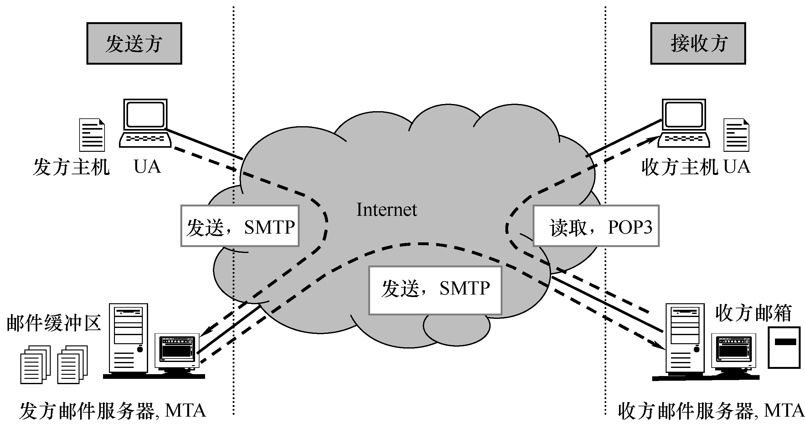
电子邮件系统

Slide 58
考研（2012年第40题）
若用户1和用户2之间发送和接收电子邮件的过程如图所示，则图中（1）（2）（3）阶段分别使用的应用层协议可以是（ ）。
A.SMTP,SMTP,SMTP B.POP3,SMTP,POP3
C.POP3,SMTP,SMTP D.SMTP,SMTP,POP3
用户1的邮件服务器
用户2的邮件服务器
用户1
（1）
（2）
（3）
用户2
答案：D

Slide 59
考研题（2013年第40题）
考研题（2013年第40题）
下列关于SMTP协议的叙述中，正确的是（ ）。
1.只支持传输7比特ASCII码内容
2.支持在邮件服务器之间发送邮件
3.支持从用户代理向邮件服务器发送邮件
4.支持从邮件服务器向用户代理发送邮件
A.1，2，3 B.1，2，4 C.1，3，4 D.2，3，4
答案：A

Slide 60
DNS: Domain Name System
People: many identifiers:
  SSN, name, Passport #
Internet hosts, routers:
  IP address (32 bit) - used for addressing datagrams
  “name”, e.g., gaia.cs.umass.edu - used by humans
Q: map between IP addresses and name ?
Domain Name System:
distributed database implemented in hierarchy of many name servers
application-layer protocol host, routers, name servers to communicate to resolve names (address/name translation)
  note: core Internet function implemented as application-layer protocol
  complexity at network’s “edge”
2: Application Layer

Slide 61
History
Original approach (ARPANET, 1970’s):
  File hosts.txt listed all hosts and their IP addresses.
  Every night every host fetches file from central repository.
  OK for a few hundred hosts.
  Scalability?
    File size.
    Centrally managed.
DNS概述
  域名系统是一个典型的客户/服务器交互系统；
  域名系统是一个多层次的、基于域的命名系统，并使用分布式数据库实现这种命名机制
2: Application Layer

Slide 62
DNS Name Space
Tree-based hierarchy.
int
com
edu
gov
mil
org
net
us
ca …
ibm
usc
cs
ee
eng
sales
2: Application Layer

Slide 63
域名系统 DNS
因特网采用层次结构的命名树作为主机的名字，并使用分布式的域名系统 DNS。
名字到IP地址的解析是由若干个域名服务器程序完成的。域名服务器程序在专设的结点上运行，运行该程序的机器称为域名服务器。

Slide 64
因特网的域名结构
因特网采用了层次树状结构的命名方法。
任何一个连接在因特网上的主机或路由器，都有一个唯
一的层次结构的名字，即域名。
域名的结构由标号序列组成，各标号之间用点隔开：
… . 三级域名 . 二级域名 . 顶级域名
各标号分别代表不同级别的域名。

Slide 65
强调：域名只是个逻辑概念
域名只是个逻辑概念，并不代表计算机所在的物理地点
变长的域名和使用有助记忆的字符串，是为了便于人来使用。而IP地址是定长的32位二进制数字则非常便于机器进行处理。
域名中的“点”和点分十进制IP地址中的“点”并无一一对应的关系。点分十进制IP地址中一定是包含三个“点”，但每一个域名中“点”的数目则不一定正好是三个。

Slide 66
顶级域名TLD (Top Level Domain)的分类
1.国家顶级域名 nTLD
2.通用顶级域名 gTLD
3.基础结构域名(infrastructure domain)

Slide 67
顶级域名TLD (Top Level Domain)的分类
1.国家顶级域名 nTLD
如: .cn 表示中国，.us 表示美国，.uk 表示英国，等等。

Slide 68
顶级域名TLD (Top Level Domain)的分类
2. 通用顶级域名 gTLD：
最早的通用顶级域名是：
.com （公司和企业）
.net （网络服务机构）
.org （非赢利性组织）
.edu （美国专用的教育机构）
.gov （美国专用的政府部门）
.mil （美国专用的军事部门）
.int （国际组织）

Slide 69
新增加了下列的通用顶级域名
.aero （航空运输企业）
.biz （公司和企业）
.cat （加泰隆人的语言和文化团体）
.coop （合作团体）
.info （各种情况）
.jobs （人力资源管理者）
.mobi （移动产品与服务的用户和提供者）
.museum （博物馆）
.name （个人）
.pro （有证书的专业人员）
.travel （旅游业）

Slide 70
树状结构的DNS域名服务器
根域名服务器
根域名服务器
…
顶级域名服务器
org 域名服务器
com 域名服务器
edu 域名服务器
abc.com
域名服务器
abc 公司有两个
权限域名服务器
权限域名服务器
授权域名服务器
授权域名服务器
y.abc.com
域名服务器

Slide 71
DNS Names
Domain names:
  Concatenation of all domain names starting from its own all the way to the root separated by “.”
  Refers to a tree node and all names under it
  Case insensitive
  Components up to 63 characters
  Full name less than 255 characters
2: Application Layer

Slide 72
Name Space Management
Domains are autonomous.
  Organizational boundaries.
  Each domain manages its own name space independently of other domains.
Delegation:
  When creating new domain: register with parent domain.
    For name uniqueness.
    For name resolution.
2: Application Layer

Slide 73
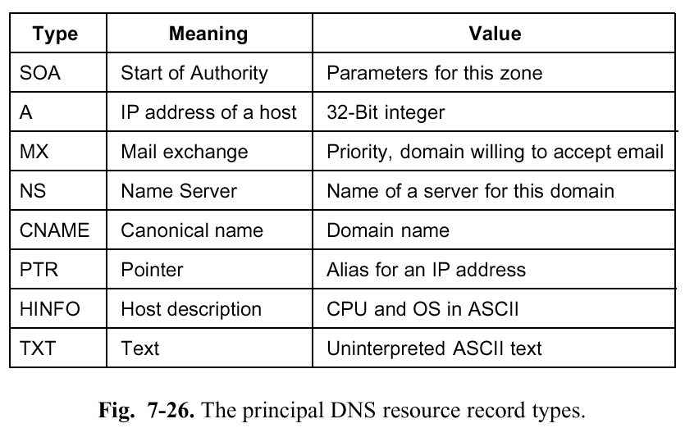
域名服务
资源记录
  在DNS的数据库中用资源记录来表示主机和子域的信息，当应用程序进行域名解析时，得到的便是域名所对应的资源记录。
  资源记录是一个五元式
  Domain_name Time_to_live Type Class Value
2: Application Layer

Slide 74
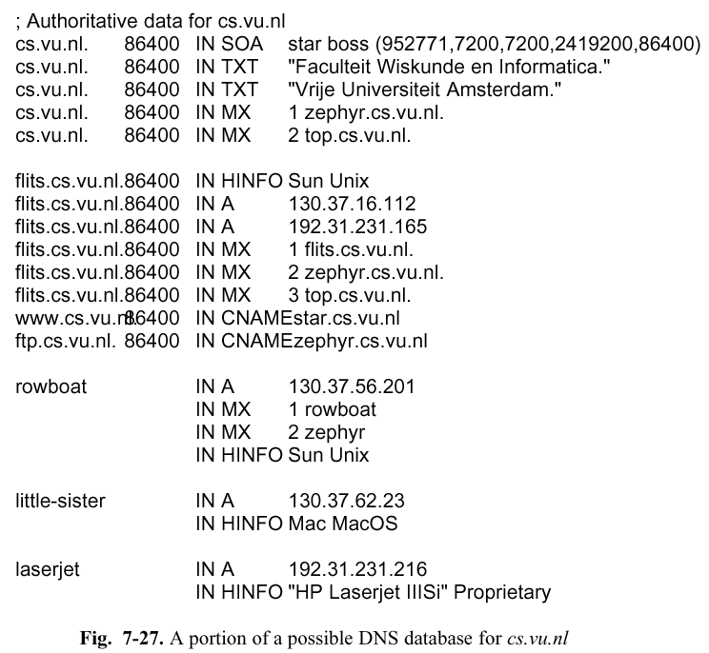
2: Application Layer

Slide 75
DNS name servers
Why not centralize DNS?
single point of failure
traffic volume
distant centralized database
maintenance
doesn’t scale!
no server has all name-to-IP address mappings
local name servers:
  each ISP, company has local (default) name server
  host DNS query first goes to local name server
authoritative name server:
  for a host: stores that host’s IP address, name
  can perform name/address translation for that host’s name
2: Application Layer

Slide 76
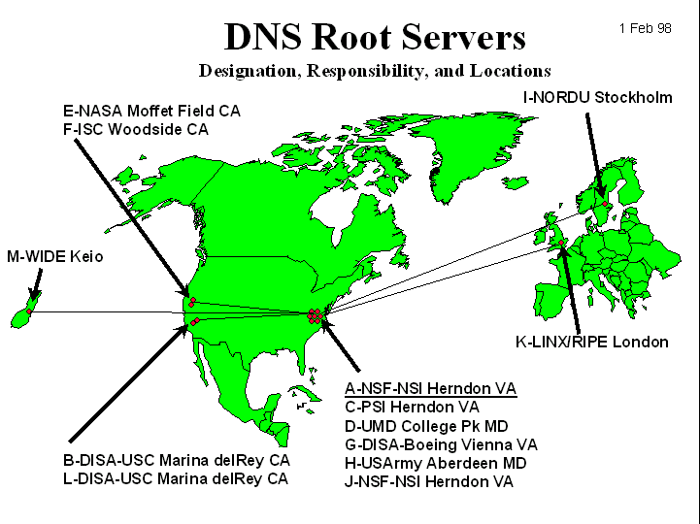
DNS: Root name servers
contacted by local name server that can not resolve name
root name server:
  contacts authoritative name server if name mapping not known
  gets mapping
  returns mapping to local name server
~ dozen root name servers worldwide
2: Application Layer

Slide 77
根域名服务器
根域名服务器是最高层次的域名服务器，也是最重要的域名服务器。所有的根域名服务器都知道所有的顶级域名服务器的域名和 IP 地址。
不管是哪一个本地域名服务器，若要对互联网上任何一个域名进行解析，只要自己无法解析，就首先求助于根域名服务器。
在互联网上共有 13 个不同 IP 地址的根域名服务器，它们的名字是用一个英文字母命名，从 a 一直到 m（前 13 个字母）。

Slide 78
根域名服务器共有 13 套装置
根域名服务器共有 13 套装置，不是 13 个机器。
这些根域名服务器相应的域名分别是：
a.rootservers.net
b.rootservers.net
…
m.rootservers.net
到2016年2月，全世界已经在 588 个地点安装了根域名服务器，使世界上大部分 DNS 域名服务器都能就近找到一个根域名服务器。

Slide 79
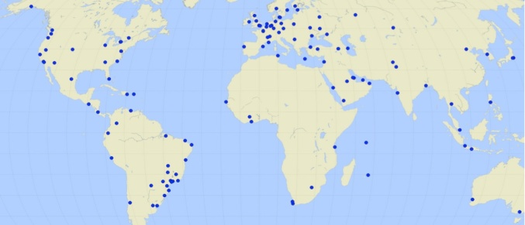
举例：根域名服务器 L 的地点分布图
根域名服务器 L 分布在世界 150 个地点
根域名服务器并不直接把域名直接转换成 IP 地址。
在使用迭代查询时，根域名服务器把下一步应当找
的顶级域名服务器的 IP 地址告诉本地域名服务器。

Slide 80
本地域名服务器采用迭代查询
从请求主机到本地DNS的查询是递归的，其余的查询是迭代的（recursive query）
根域名服务器
迭代查询
顶级域名服务器
dns.com
❸
❺
❷
❹
本地域名服务器
dns.xyz.com
❻
权限域名服务dns.abc.com
❼
❽
递归
查询
y.abc.com 的 IP 地址
❶
需要查找 y.abc.com 的 IP 地址
m.xyz.com
2: Application Layer

Slide 81
本地域名服务器采用递归查询
（比较少用）
递归查询
根域名服务器
❸
顶级域名服务器
dns.com
❻
❹
❼
❷
❺
本地域名服务器
dns.xyz.com
权限域名服务dns.abc.com
递归
查询
❽
y.abc.com 的 IP 地址
❶
需要查找 y.abc.com 的 IP 地址
m.xyz.com
2: Application Layer

Slide 82
DNS: caching and updating records
once (any) name server learns mapping, it caches mapping
  cache entries timeout (disappear) after some time
update/notify mechanisms under design by IETF
  RFC 2136
  http://www.ietf.org/html.charters/dnsind-charter.html
当一个DNS服务器接收DNS回答时，它能将该回答的信息缓存在本地存储器上。
2: Application Layer

Slide 83
DNS records
DNS: distributed db storing resource records (RR)
RR format: (name, value, type,ttl)
Type=A
  name is hostname
  value is IP address
Type=CNAME
  name is an alias name for some “cannonical” (the real) name
  value is cannonical name
Type=NS
  name is domain (e.g. foo.com)
  value is IP address of authoritative name server for this domain
Type=MX
  value is hostname of mailserver associated with name
2: Application Layer

Slide 84

DNS protocol, messages
DNS protocol : query and repy messages, both with same message format
msg header
identification: 16 bit # for query, repy to query uses same #
flags:
  query or reply
  recursion desired
  recursion available
  reply is authoritative
2: Application Layer

Slide 85
DNS protocol, messages
Name, type fields
for a query
RRs in reponse
to query
records for
authoritative servers
additional “helpful”
info that may be used
2: Application Layer

Slide 86
考研题（2010年第40题）
如果本地域名服务器无缓存，当采用递归方法解析另一网络某主机域名时，用户主机、本地域名服务器发送的域名请求消息数分别为（）。
A.一条，一条 B.一条，多条
C.多条，一条 D.多条，多条
答案：A

Slide 87
Network Management
Chapter goals:
introduction to network management
  motivation
  major components
Internet network management framework
  MIB: management information base
  SMI: data definition language
  SNMP: protocol for network management
  security and administration
presentation services: ASN.1
firewalls
2: Application Layer

Slide 88

What is network management?
autonomous systems (aka “network”): 100s or 1000s of interacting hw/sw components
other complex systems requiring monitoring, control:
  jet airplane
  nuclear power plant
  others?
"Network management includes the deployment, integration
and coordination of the hardware, software, and human
elements to monitor, test, poll, configure, analyze, evaluate,
and control the network and element resources to meet the
real-time, operational performance, and Quality of Service
requirements at a reasonable cost."
2: Application Layer

Slide 89
Infrastructure for network management
definitions:
managing entity
agent
data
managing
entity
managed devices contain
managed objects whose
data is gathered into a
Management Information
Base (MIB)
data
managed device
agent
data
network
management
protocol
managed device
agent
data
agent
data
managed device
managed device
2: Application Layer

Slide 90
Network Management standards
OSI CMIP
Common Management Information Protocol
designed 1980’s: the unifying net management standard
too slowly standardized
SNMP: Simple Network Management Protocol
Internet roots (SGMP)
started simple
deployed, adopted rapidly
growth: size, complexity
currently: SNMP V3
de facto network management standard
2: Application Layer

Slide 91
SNMP overview: 4 key parts
Management information base (MIB):
  distributed information store of network management data
Structure of Management Information (SMI):
  data definition language for MIB objects
SNMP protocol
  convey manager<->managed object info, commands
security, administration capabilities
  major addition in SNMPv3
2: Application Layer

Slide 92
SMI: data definition language
Purpose: syntax, semantics of management data well-defined, unambiguous
base data types:
  straightforward, boring
OBJECT-TYPE
  data type, status, semantics of managed object
MODULE-IDENTITY
  groups related objects into MIB module
Basic Data Types
INTEGER
Integer32
Unsigned32
OCTET STRING
OBJECT IDENTIFIED
IPaddress
Counter32
Counter64
Guage32
Tie Ticks
Opaque
2: Application Layer

Slide 93
SNMP MIB
MIB module specified via SMI
MODULE-IDENTITY
(100 standardized MIBs, more vendor-specific)
MODULE
OBJECT TYPE:
OBJECT TYPE:
OBJECT TYPE:
objects specified via SMI
OBJECT-TYPE construct
2: Application Layer

Slide 94
SMI: Object, module examples
OBJECT-TYPE: ipInDelivers
MODULE-IDENTITY: ipMIB
ipMIB MODULE-IDENTITY
LAST-UPDATED “941101000Z”
ORGANZATION “IETF SNPv2
Working Group”
CONTACT-INFO
“ Keith McCloghrie
……”
DESCRIPTION
“The MIB module for managing IP
and ICMP implementations, but
excluding their management of
IP routes.”
REVISION “019331000Z”
………
::= {mib-2 48}
ipInDelivers OBJECT TYPE
SYNTAX Counter32
MAX-ACCESS read-only
STATUS current
DESCRIPTION
“The total number of input
datagrams successfully
delivered to IP user-
protocols (including ICMP)”
::= { ip 9}
2: Application Layer

Slide 95
MIB example: UDP module
Object ID Name Type Comments
1.3.6.1.2.1.7.1 UDPInDatagrams Counter32 total # datagrams delivered
at this node
1.3.6.1.2.1.7.2 UDPNoPorts Counter32 # underliverable datagrams
no app at portl
1.3.6.1.2.1.7.3 UDInErrors Counter32 # undeliverable datagrams
all other reasons
1.3.6.1.2.1.7.4 UDPOutDatagrams Counter32 # datagrams sent
1.3.6.1.2.1.7.5 udpTable SEQUENCE one entry for each port
in use by app, gives port #
and IP address
2: Application Layer

Slide 96
SNMP Naming
question: how to name every possible standard object (protocol, data, more..) in every possible network standard??
answer: ISO Object Identifier tree:
  hierarchical naming of all objects
  each branchpoint has name, number
1.3.6.1.2.1.7.1
ISO
ISO-ident. Org.
US DoD
Internet
udpInDatagrams
UDP
MIB2
management
2: Application Layer

Slide 97
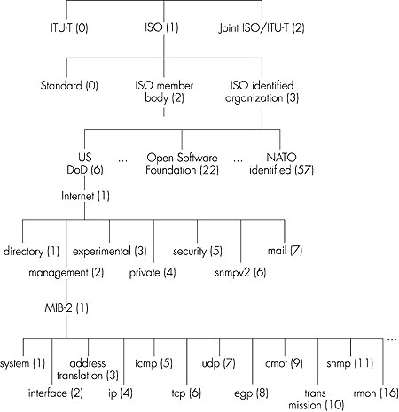
OSI
Object
Identifier
Tree
Check out www.alvestrand.no/harald/objectid/top.html
2: Application Layer

Slide 98
SNMP protocol
Two ways to convey MIB info, commands:
managing
entity
managing
entity
request
trap msg
response
agent
data
agent
data
Managed device
Managed device
request/response mode
trap mode
2: Application Layer

Slide 99
SNMP protocol: message types
Message type
Function
GetRequest
GetNextRequest
GetBulkRequest
Mgr-to-agent: “get me data”
(instance,next in list, block)
InformRequest
Mgr-to-Mgr: here’s MIB value
SetRequest
Mgr-to-agent: set MIB value
Response
Agent-to-mgr: value, response to
Request
Trap
Agent-to-mgr: inform manager
of exceptional event
2: Application Layer

Slide 100
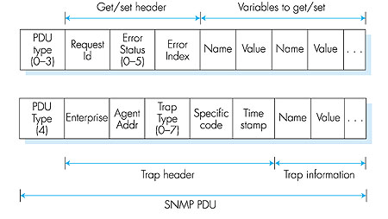
SNMP protocol: message formats
2: Application Layer

Slide 101
SNMP security and administration
encryption: DES-encrypt SNMP message
authentication: compute, send MIC(m,k): compute hash (MIC) over message (m), secret shared key (k)
protection against playback: use nonce
view-based access control
  SNMP entity maintains database of access rights, policies for various users
  database itself accessible as managed object!
2: Application Layer

Slide 102
The presentation problem
Q: does perfect memory-to-memory copy solve “the communication problem”?
A: not always!
struct {
char code;
int x;
} test;
test.x = 256;
test.code=‘a’
test.code
test.x
a
00000001
00000011
test.code
test.x
a
00000011
00000001
host 1 format
host 2 format
problem: different data format, storage conventions
2: Application Layer

Slide 103
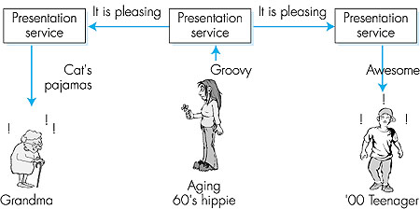
Solving the presentation problem
1. Translate local-host format to host-independent format
2. Transmit data in host-independent format
3. Translate host-independent format to remote-host format
2: Application Layer

Slide 104
ASN.1: Abstract Syntax Notation 1
ISO standard X.680
  used extensively in Internet
  like eating vegetables, knowing this “good for you”!
defined data types, object constructors
  like SMI
BER: Basic Encoding Rules
  specify how ASN.1-defined data objects to be transmitted
  each transmitted object has Type, Length, Value (TLV) encoding
2: Application Layer

Slide 105
TLV Encoding
Idea: transmitted data is self-identifying
  T: data type, one of ASN.1-defined types
  L: length of data in bytes
  V: value of data, encoded according to ASN.1 standard
Tag Value Type
1
2
3
4
5
6
9
Boolean
Integer
Bitstring
Octet string
Null
Object Identifier
Real
2: Application Layer

Slide 106
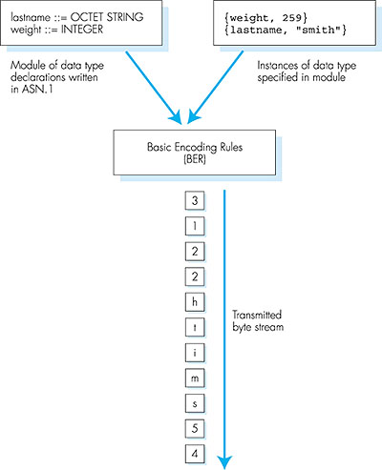
TLV encoding: example
Value, 259
Length, 2 bytes
Type=2, integer
Value, 5 octets (chars)
Length, 5 bytes
Type=4, octet string
2: Application Layer

Slide 107
网络安全问题概述
计算机网络面临的安全性威胁
安全的计算机网络
数据加密模型

Slide 108
计算机网络面临的安全性威胁
计算机网络上的通信面临以下两大类威胁：被动攻击和主动攻击。
源站
目的站
源站
目的站
源站
目的站
源站
目的站
恶意
程序
拒绝
服务
截获
篡改
被动攻击
主 动 攻 击
Notes:
n

Slide 109
计算机网络面临的安全性威胁
被动攻击
  指攻击者从网络上窃听他人的通信内容。
  通常把这类攻击成为截获。
  在被动攻击中，攻击者只是观察和分析某一个协议数据单元 PDU，以便了解所交换的数据的某种性质。但不干扰信息流。
  这种被动攻击又称为流量分析 (traffic analysis)。
Notes:
n

Slide 110
计算机网络面临的安全性威胁
主动攻击主要有：
  篡改——故意篡改网络上传送的报文。这种攻击方式有时也称为更改报文流。
  恶意程序——种类繁多，对网络安全威胁较大的主要包括：计算机病毒、计算机蠕虫、特洛伊木马、逻辑炸弹、后门入侵、流氓软件等。
  拒绝服务——指攻击者向互联网上的某个服务器不停地发送大量分组，使该服务器无法提供正常服务，甚至完全瘫痪。
Notes:
n

Slide 111
分布式拒绝服务 DDoS
若从互联网上的成百上千的网站集中攻击一个网站，则称为分布式拒绝服务 DDoS (Distributed Denial of Service)
有时也把这种攻击称为网络带宽攻击或连通性攻击。
Notes:
n

Slide 112
计算机网络通信安全的目标
对于主动攻击，可以采取适当措施加以检测。
对于被动攻击，通常却是检测不出来的。
根据这些特点，可得出计算机网络通信安全的目标：
  (1) 防止析出报文内容和流量分析。
  (2) 防止恶意程序。
  (3) 检测更改报文流和拒绝服务。
对付被动攻击可采用各种数据加密技术。
对付主动攻击则需将加密技术与适当的鉴别技术相结合。
Notes:
e

Slide 113
安全的计算机网络
网络的安全性是不可判定的。
一个安全的计算机网络应达到四个目标：
  1. 保密性
  2. 端点鉴别
  3. 信息的完整性
  4. 运行的安全性
只有信息的发送方和接收方才能懂得所发送信息的内容
是网络安全通信的最基本的内容，也是对付被动攻击必须具备的功能。
为了使网络具有保密性，需要使用各种密码技术。
Notes:
n

Slide 114
安全的计算机网络
网络的安全性是不可判定的。
一个安全的计算机网络应达到四个目标：
  保密性
  端点鉴别
  信息的完整性
  运行的安全性
鉴别信息的发送方和接收方的真实身份。
在对付主动攻击中是非常重要的。
Notes:
n

Slide 115
安全的计算机网络
网络的安全性是不可判定的。
一个安全的计算机网络应达到四个目标：
  1. 保密性
  2. 端点鉴别
  3. 信息的完整性
  4. 运行的安全性
信息的内容未被篡改过。
在应对主动攻击中是必不可少的
信息的完整性与端点鉴别往往是不可分割的。
在谈到“鉴别”时，也同时包含了端点鉴别和报文完整性。
Notes:
n

Slide 116
安全的计算机网络
网络的安全性是不可判定的。
一个安全的计算机网络应达到四个目标：
  1. 保密性
  2. 端点鉴别
  3. 信息的完整性
  4. 运行的安全性
系统能正常运行并提供服务访问控制 (access control) 对计算机系统的安全性是非常重要的。必须对访问网络的权限加以控制，并规定每个用户的访问权限。
Notes:
n

Slide 117

数据加密，是一切安全的基础
截获
截取者
篡改
A
B
E 运算
加密算法
密文 Y
密文 Y
D 运算
解密算法
互联网
明文 X
明文 X
加密密钥 K_{E}
解密密钥 K_{D}
安全信道
密钥源
用户 A 向 B 发送明文 X，通过加密算法 E 运算后，就得出密文 Y。
Notes:
e

Slide 118
复习
体系结构: OSI, TCP/IP,网络基本概念
物理层:编码,复用,调制解调
数据链路:流控算法,HDLC,PPP帧结构,CRC
LAN: 以太网及组网,CSMA/CD,网络设备
网络层: IP规划及聚合,路由协议及路由表
传输层:TCP, UDP,端口号
应用层:几个常用的协议，C/S模式，Socket
2: Application Layer

Slide 119
物理层知识结构图
物理层
通信基础
传输介质
物理层设备
概念
传输率
编码与调制
交换方式
双绞线、同轴电缆
光纤、无线介质
中继器
集线器
信道、信号、带宽
码元、波特、速率
信源、信宿
奈奎斯特定理
香农定理
不归零编码
（差分）曼彻斯特编码
电路交换
调幅
调频
调相
报文交换
分组交换
数据报（无连接）
虚电路（连接）

Slide 120
数据链路层知识结构图
数据链路层
差错控制
流量控制
介质访问控制
局域网
广域网
链路层设备
CRC校验
滑动窗口
信道划分
随机访问
轮询访问
以太网
无线局域网
PPP
HDLC
网桥
交换机
停止等待协议
退后N帧协议
选择重传协议
频分多路复用
时分多路复用
波分多路复用
码分多路复用
ALOHA
CSMA
令牌传递协议
802.3
802.11
零比特填充
CSMA/CA
CSMA/CD

Slide 121
网络层知识结构图
网络层
功能
路由
IP地址
网络设备
路由算法
路由协议
IPv4
IPv6
IP组播
移动IP
路由器
静态路由
域内路由
地址
动态路由
RIP
分类地址、子网划分
CIDR、NAT
距离向量算法
OSPF
协议
链路状态算法
域间路由
ARP协议、DHCP
ICMP
层次路由
BGP
自治系统
BGP

Slide 122
传输层知识结构图
传输层
寻址与
端口号
服务
UDP
TCP
面向无连接
服务
面向连接
服务
面向无连接
服务
面向数据报
UDP校验
面向连接
服务
连接管理
可靠传输
流量控制
拥塞控制
三步握手
四步分离
面向字节流
序号机制
累积确认
滑动窗口
发送窗口取
接收窗口的
最小值
慢开始
拥塞避免
快恢复
快重传

Slide 123
应用层知识结构图
应用层
P2P模型
客户服务器模型
DNS
FTP
电子邮件
WWW
层次域名空间
域名服务器
域名解析过程
（递归过程/迭代过程）
基于UDP协议（53）
控制连接（21）
数据连接（20）
基于TCP协议
组成结构
邮件格式
POP3（110）
SMTP（25）
MIME
基于TCP协议
组成结构
HTTP（80）
持续连接
基于TCP协议

Slide 124
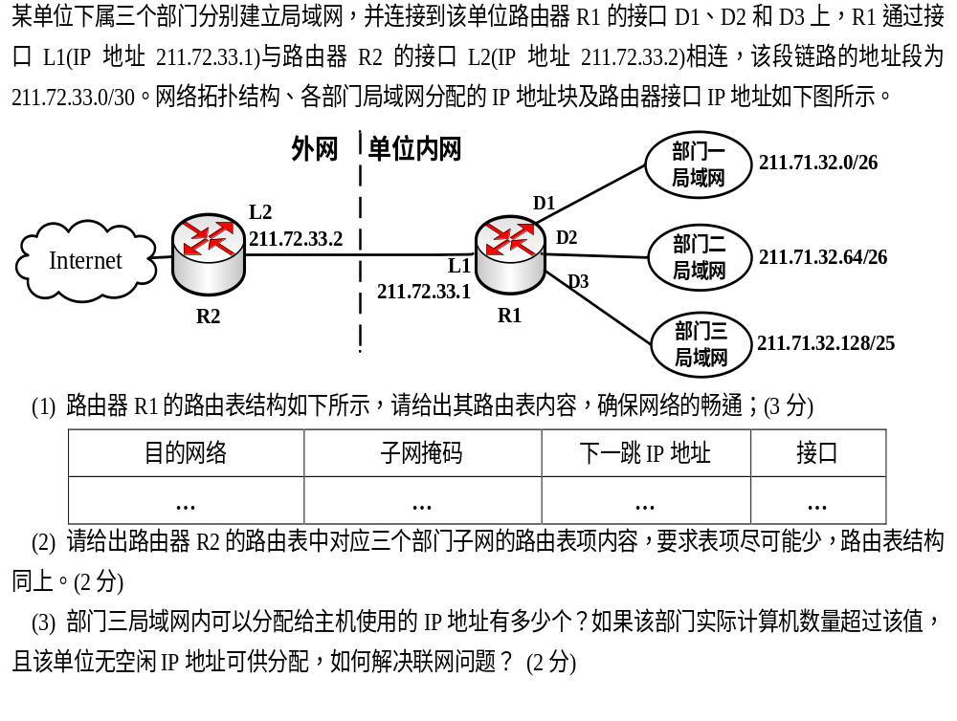

Slide 125


