Slide 1
Lab 2: Finite State Machines CS 3410 Spring 2015

Slide 2
Mealy Machines and Moore Machines
In Mealy Machines, output and next state both depend on current state and input.
Registers
Current State
Comb. Logic
Output
Input
Next State

Slide 3
Mealy Machines and Moore Machines
In Moore Machines, output only depends on current state (next state still depends on both current state and input).
Registers
Current State
Comb. Logic
Output
Comb. Logic
Input

Slide 4
Mealy Machines FSM
down/on
input/output
up/off
down/on
A
B
state
start state
up/off
down/off
Legend
up/off
C
D
up/off
Input: up or down
Output: on or off
States: A, B, C, or D
up/off

Slide 5
Moore Machines FSM
down
input
up
down
A off
B on
state out
startout
up
down
Legend
up
C off
D off
up
Input: up or down
Output: on or off
States: A, B, C, or D
up

Slide 6
Representing State in Logisim
In electric circuits, state must be represented by devices like Flip-Flops and Registers.
Maintaining and changing their values requires a clock!
Changing the input pin and “ticking” the clock once is equivalent to a new input to the FSM (you can use this to simulate a stream of input).

Slide 7
Lab 2
The lab is available at http://www.cs.cornell.edu/courses/CS3410/2015sp/lab/lab2.html
Your first task will be to draw out the FSM on paper.
After your FSM has been checked off then you can begin creating it in Logisim.
Strategy:
Draw a state diagram (e.g. Mealy Machine)
Write output and next-state tables
Encode states, inputs, and outputs as bits
Determine logic equations for next state and outputs

Slide 8
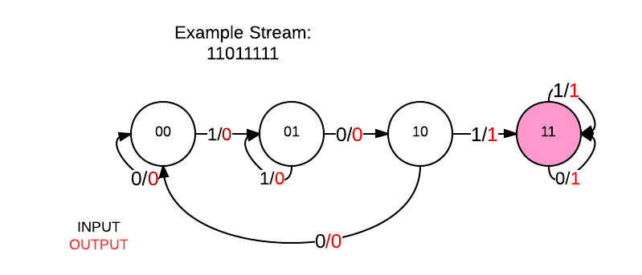
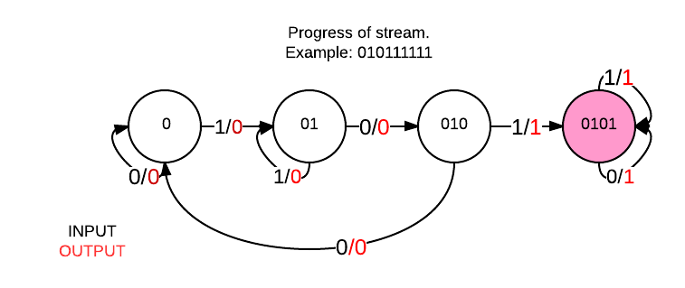
FSM Solution 1
Mealy Machine
String Progress

Slide 9
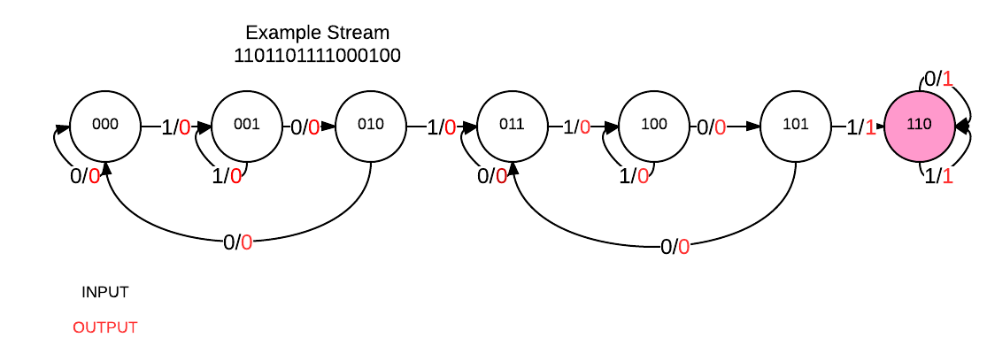
FSM Solution 2

