Slide 1

HABITAT STABILITY AND STORM SURGE IMPACTS IN EAST RIVER – MORICHES BAY, LONG ISLAND
GSS354.01 – Geospatial Science for the Coastal Zone
By: Evan Lassiter

Slide 2
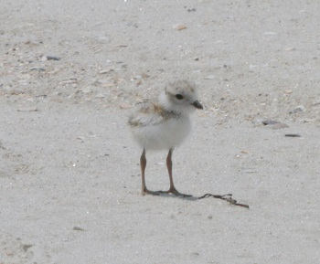
INTRODUCTION
Purpose: My project aims to comprehensively demonstrate which areas of Moriches Bay and Moriches Inlet are especially susceptible to specific flooding phenomena such as breaching or overwash. Furthermore, the geospatial processing should delineate areas to protect native species of concern.
Background: East River – Long Island’s South Shore is extremely vulnerable to flooding because the barrier islands protecting it are very low-lying in elevation. If these barrier islands are breached, seaward flow into the estuaries will adversely affect the current state of Moriches Bay in myriad ways (Cañizares). Moriches Bay is the shallowest bay with an inlet on the south shore. Therefore, predictive geospatial processing for hurricanes should be paramount in this area (“Significant…”). This area is rich with common, threatened, and endangered seabird species.
https://www.dec.ny.gov/images/wildlife_images/pipingploverchick.jpg
Notes:
Image: a piping plover; which is federally listed as a threatened species (“Significant…”).

Slide 3
METHODS
Question: Which natural areas in Moriches Bay are most susceptible to the potential impacts of a storm surge?
STORM SURGE
ELEVATION
DREDGING
Obtain and import SLOSH data from NOAA’s website
Obtain and import MHHW data from the NOAA Sea Level Rise Data Download
Project and clip feature layers for visual and further analysis
Reclassify MHHW
Combine both raster layers for a cohesive storm surge map
Obtain and import DEM data from the NOAA Sea Level Rise Data Download
Set the map properties appropriate for accurate analysis
Clip and project the feature layer to the Moriches Bay study area
Transform the data to a raster
Combine the DEM and the Moriches Bay waterbody layer for a hydro flattened DEM.
Imported shapefile from Suffolk County Open Data
Projected and clipped dredging shapefile for accurate representation in the study area
Altered symbology for visual aid
Buffer Tool to assess distance

Slide 4
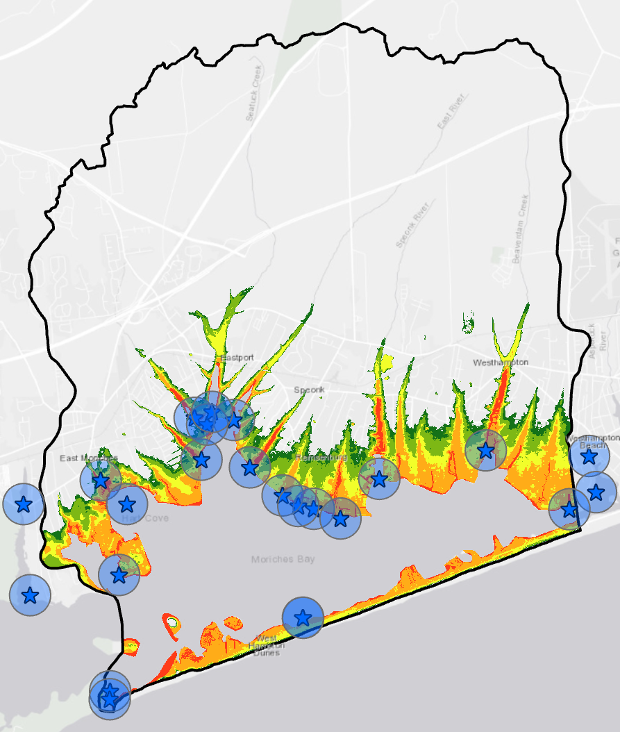
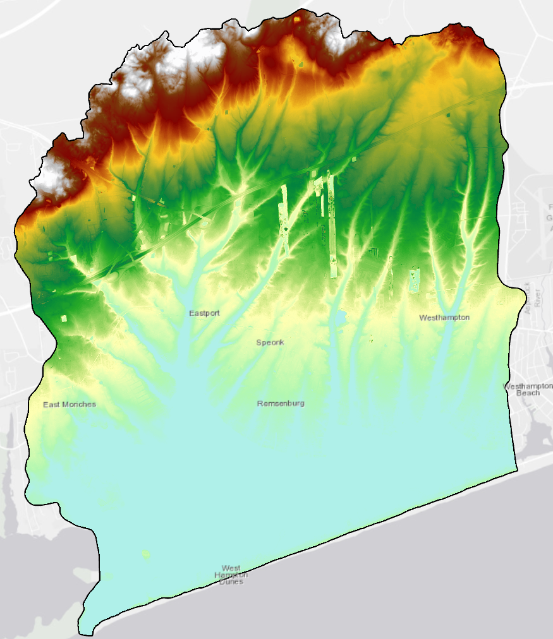
RESULTS
The most vulnerable areas to a storm surge in Moriches Bay lie within a quarter-mile upstream from a recent dredging project.

Slide 5
CONCLUSIONS
Anthropogenic influences, such as dredging for recreation, are clearly expediting Moriches Bay’s vulnerability to a potential storm surge. This is especially the case for the inland rivers that have been dredged within the past four years.
This in turn will likely have an adverse effect on endemic wildlife because of the loss of the protected intertidal ecosystem the barrier islands protect.

Slide 6
RECOMMENDATIONS
For tedious studies such as this, manipulating the map to a larger-scale once the areas of concern are established will provide the team with precise delineations for where guarded habitats should be implemented.
When recording and studying species data, it is vital that the necessary data type is available for the conceptual objective you're trying to justify. For instance, the loggerhead sea turtle range data I acquired did not aid at all in representing on-land nest data.

Slide 7
CITATIONS
Cañizares, Rafael, and Jennifer L. Irish. “Simulation of Storm-Induced Barrier Island Morphodynamics and Flooding.” Coastal Engineering, vol. 55, no. 12, Dec. 2008, pp. 1089–1101., doi:10.1016/j.coastaleng.2008.04.006.
“Dredge Project Details - 2016.” Suffolk County, New York Open Data, opendata.suffolkcountyny.gov/datasets/dredge- project-details-2016?geometry=-74.745%2C40.581%2C-70.661%2C41.307.
“Significant Habitats and Habitat Complexes of the New York Bight Watershed.” Moriches Bay, nctc.fws.gov/pubs5/web_link/text/mb_form.htm.

