Slide 1
Project 21: Counterflow C₂H₄/Air Diffusion Flame
Effect of H₂O dilution and residence time on PAH formation
Mechanism: CRECK C₂H₄ HT + Soot (368 sp, 14228 rxn)
Pressures: 1, 10 bar | H₂O: 0, 4, 8, 12% | 4 residence times
IIT Roorkee

Slide 2
Configuration
• Geometry: counterflow non-premixed, plate separation L = 2 cm
• Fuel stream: C2H4 + H2O (varying X_H2O = 0, 4, 8, 12% mole)
• Oxidizer stream: air (X_O2 = 0.21, X_N2 = 0.79)
• Inlet temperatures: T_fuel = T_oxidizer = 300 K (assumed)
• Pressures: 1 bar and 10 bar
• Residence time varied via fuel mdot ∈ {0.06, 0.10, 0.14, 0.20} kg/m²·s
(oxidizer mdot held fixed at 0.30 kg/m²·s)
• Total cases: 2 × 4 × 4 = 32
• Kinetic model: CRECK C2H4 HT+SOOT, 368 species, 14228 reactions
(PAH chain: benzene → naphthalene → phenanthrene → pyrene)

Slide 3
Methodology
1. Convert CRECK CHEMKIN files to Cantera YAML (ck2yaml).
2. Strip discrete-sectional soot bins (BIN species) lacking thermo data;
keep full gas-phase + PAH chemistry up to C16H10 (pyrene).
3. Solve a 'seed' counterflow flame at p=1 bar, x_H2O=0 (~ baseline mdot).
4. Sweep continuation: pressure → H2O fraction → fuel mdot.
Each new case restores the previously converged solution.
5. Extract peak T, residence time τ, peak PAH mole fractions, locations.
6. Tabulate to CSV, plot, assemble report.

Slide 4
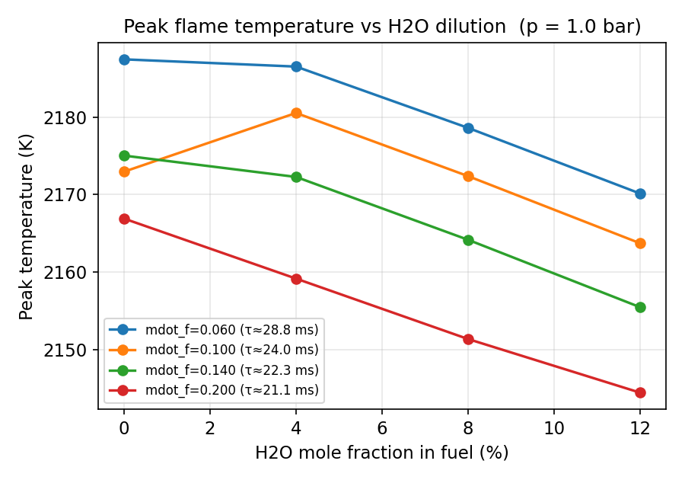
Peak T vs H2O dilution @ 1.0 bar
Peak flame T decreases with H2O dilution due to thermal sink and reduced fuel concentration.

Slide 5
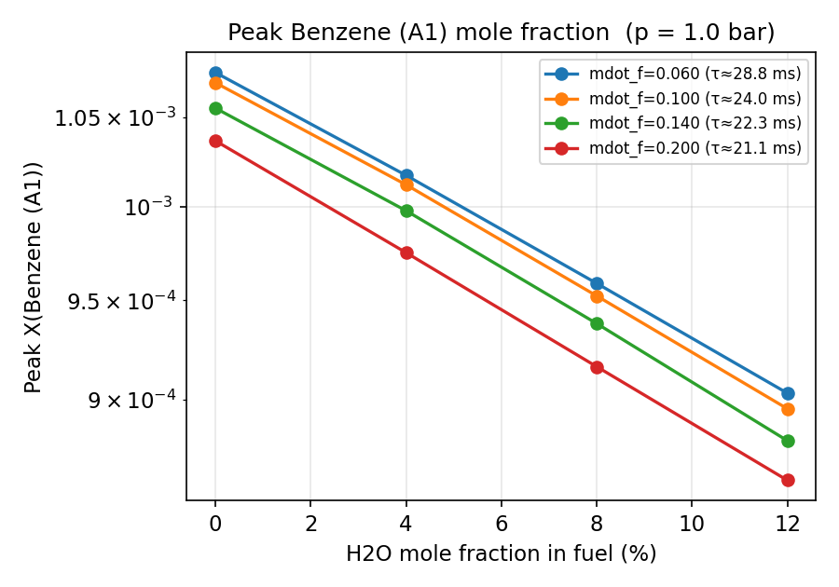
Peak Benzene (A1) vs H2O @ 1.0 bar
Effect of H2O on Benzene (A1) formation. Increased OH from H2O dissociation suppresses PAH precursors.

Slide 6
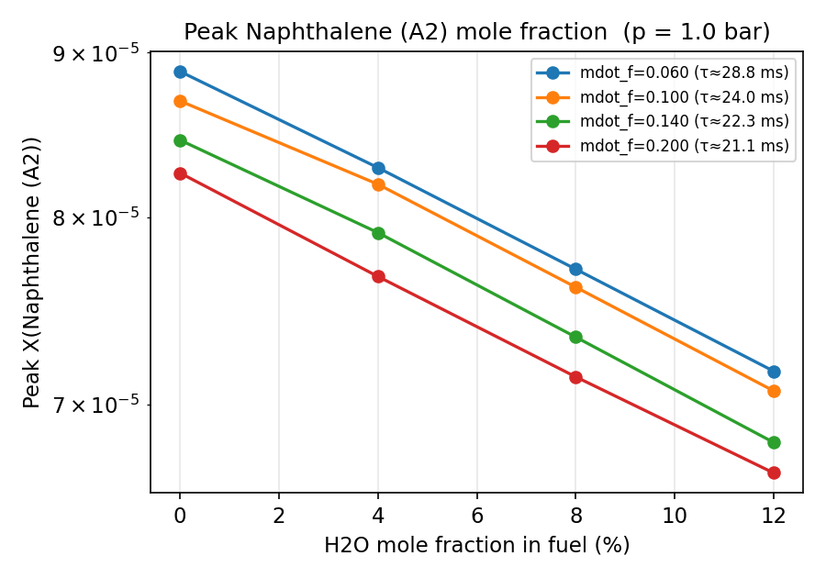
Peak Naphthalene (A2) vs H2O @ 1.0 bar
Effect of H2O on Naphthalene (A2) formation. Increased OH from H2O dissociation suppresses PAH precursors.

Slide 7
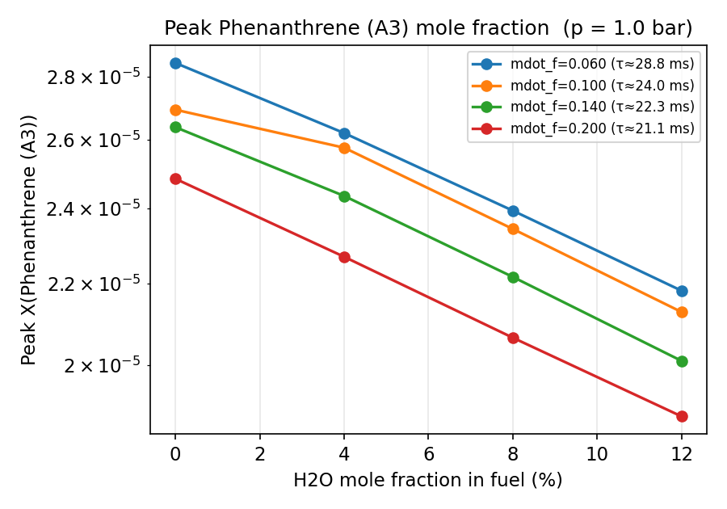
Peak Phenanthrene (A3) vs H2O @ 1.0 bar
Effect of H2O on Phenanthrene (A3) formation. Increased OH from H2O dissociation suppresses PAH precursors.

Slide 8
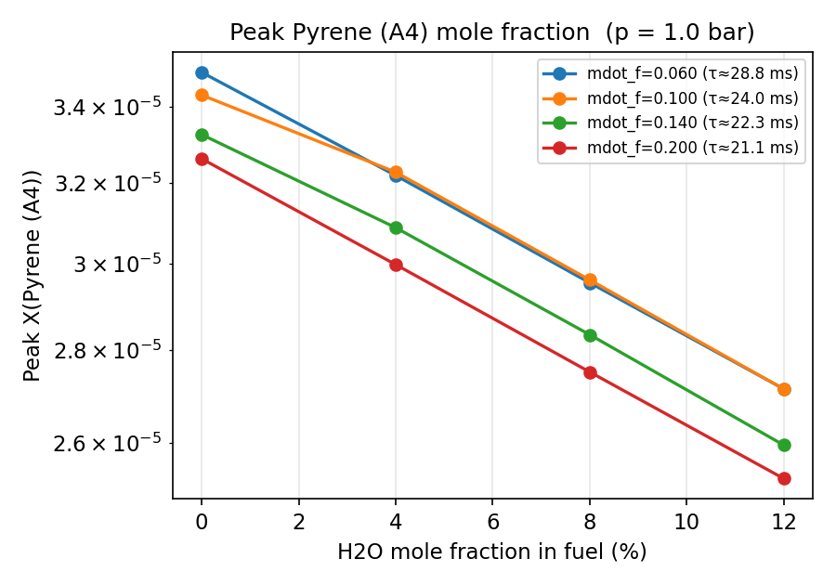
Peak Pyrene (A4) vs H2O @ 1.0 bar
Effect of H2O on Pyrene (A4) formation. Increased OH from H2O dissociation suppresses PAH precursors.

Slide 9
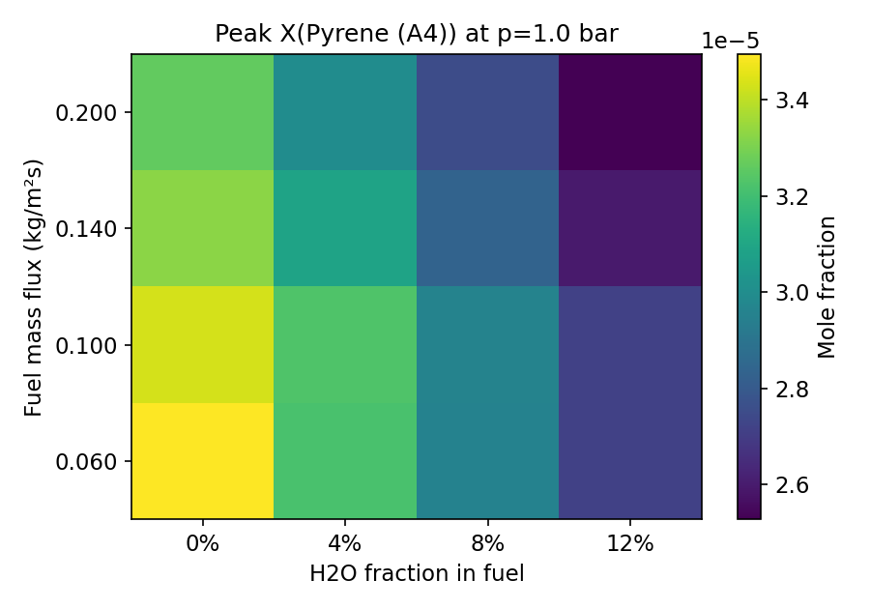
Pyrene peak heatmap @ 1.0 bar
Pyrene formation peaks at low H2O and low mass flux (long residence time).

Slide 10
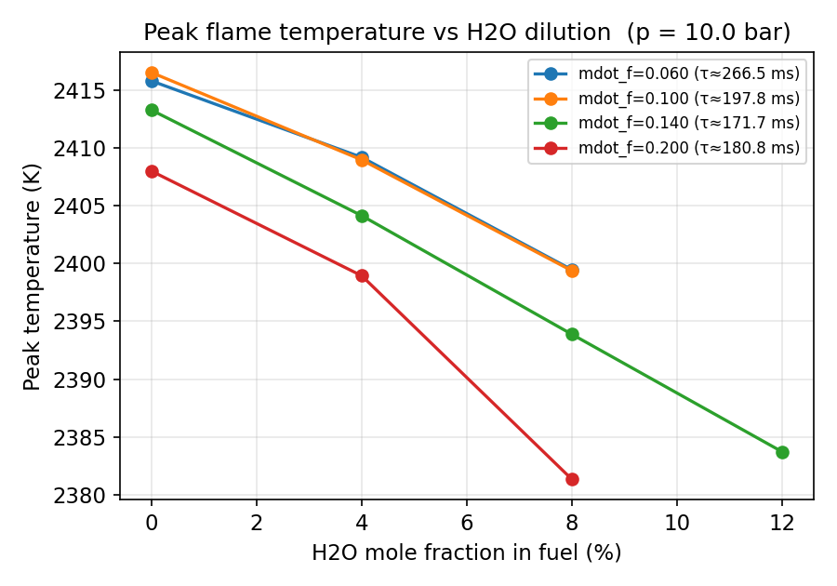
Peak T vs H2O dilution @ 10.0 bar
Peak flame T decreases with H2O dilution due to thermal sink and reduced fuel concentration.

Slide 11
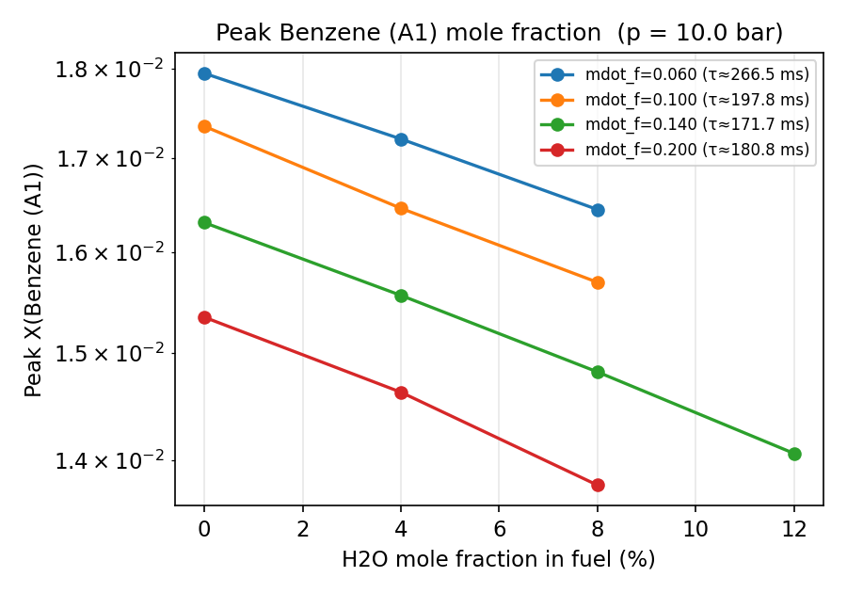
Peak Benzene (A1) vs H2O @ 10.0 bar
Effect of H2O on Benzene (A1) formation. Increased OH from H2O dissociation suppresses PAH precursors.

Slide 12
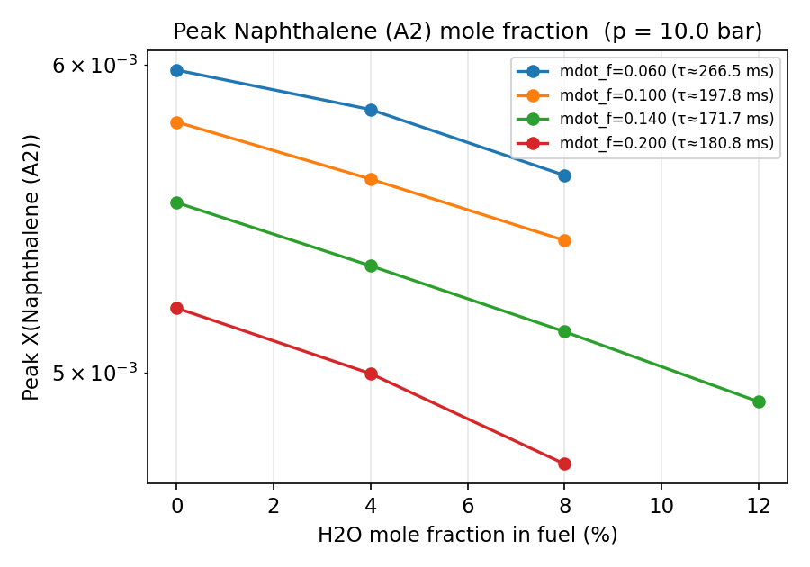
Peak Naphthalene (A2) vs H2O @ 10.0 bar
Effect of H2O on Naphthalene (A2) formation. Increased OH from H2O dissociation suppresses PAH precursors.

Slide 13
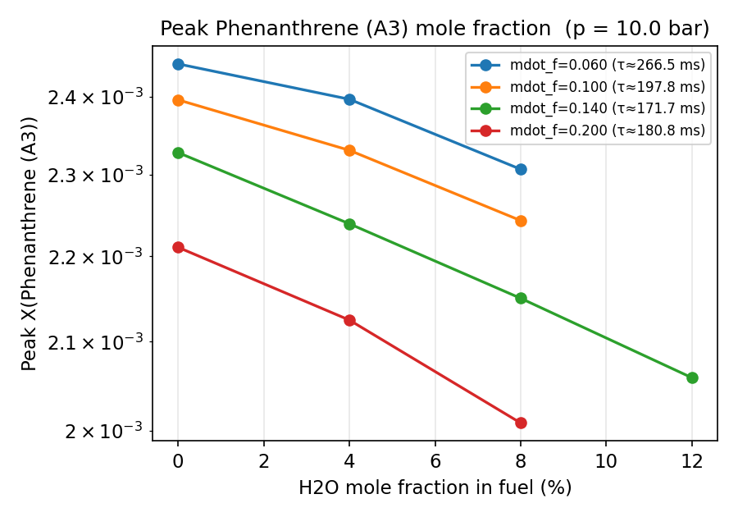
Peak Phenanthrene (A3) vs H2O @ 10.0 bar
Effect of H2O on Phenanthrene (A3) formation. Increased OH from H2O dissociation suppresses PAH precursors.

Slide 14
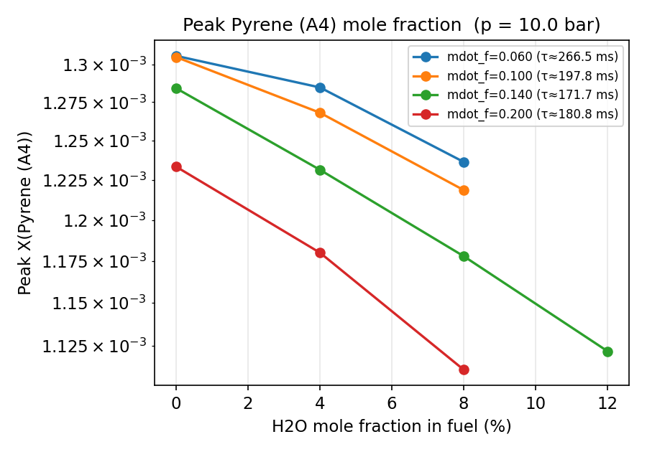
Peak Pyrene (A4) vs H2O @ 10.0 bar
Effect of H2O on Pyrene (A4) formation. Increased OH from H2O dissociation suppresses PAH precursors.

Slide 15
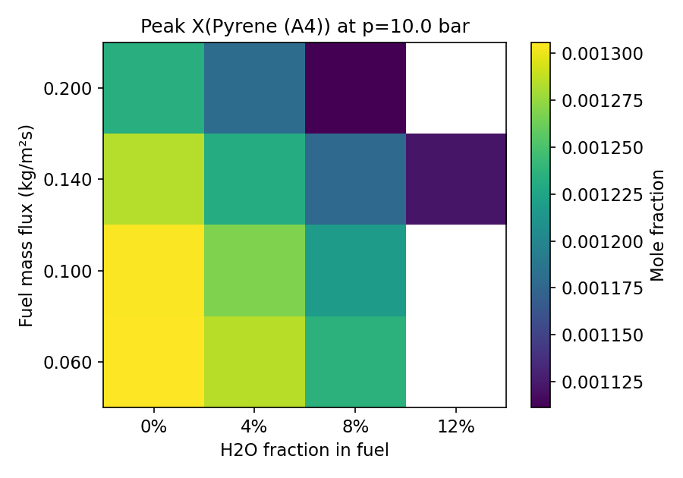
Pyrene peak heatmap @ 10.0 bar
Pyrene formation peaks at low H2O and low mass flux (long residence time).

Slide 16
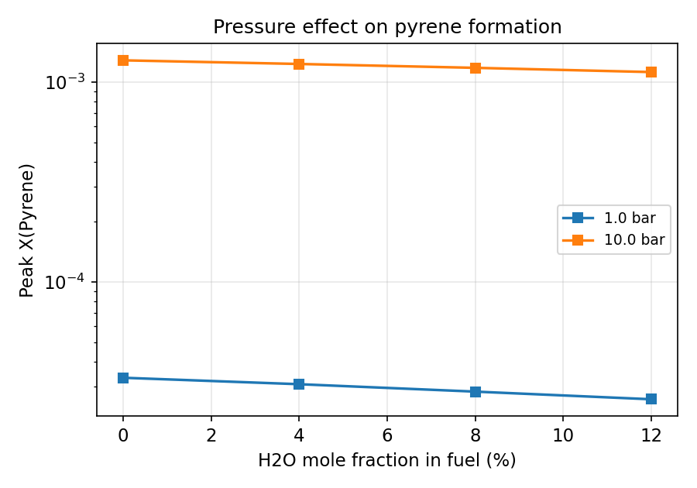
Pressure effect on pyrene
Higher pressure dramatically increases PAH formation due to higher reactant density and longer chemistry timescales.

Slide 17
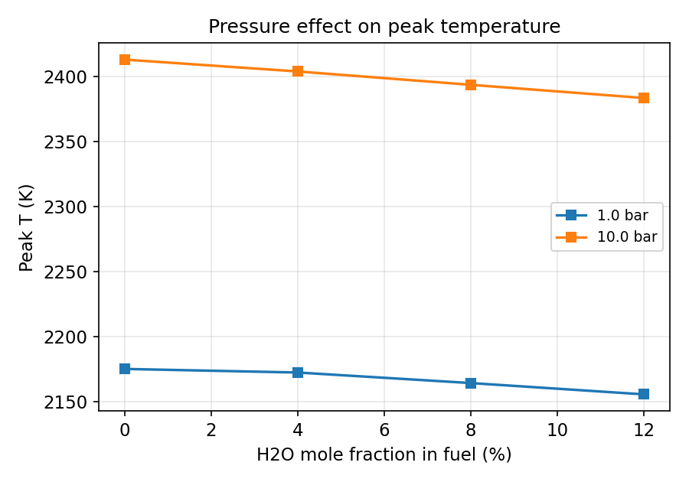
Pressure effect on peak T
Pressure has only a modest effect on adiabatic flame T compared to its strong effect on PAH chemistry.

Slide 18
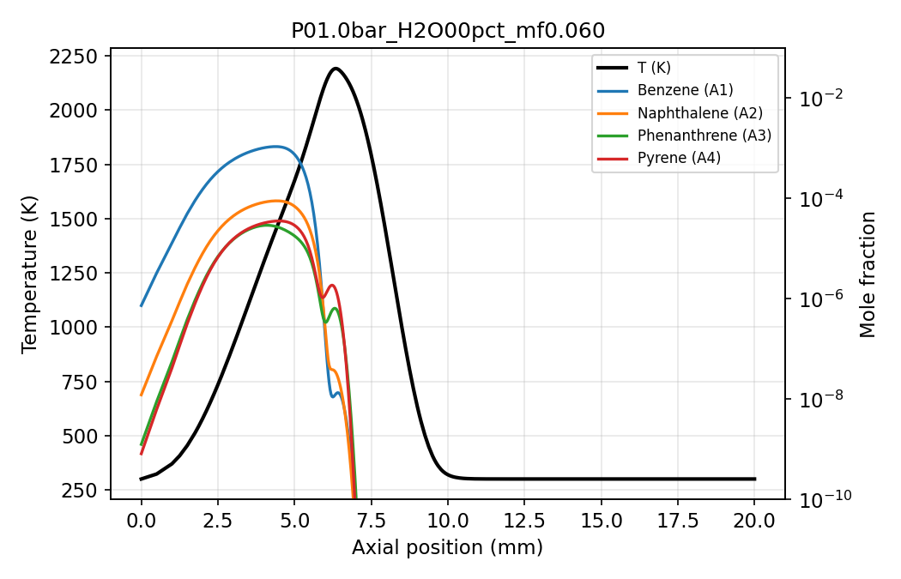
Axial profile @ 1.0 bar, no H2O, longest τ
Temperature, benzene, naphthalene, phenanthrene, pyrene profiles across the flame.

Slide 19
Discussion: Effect of H₂O on PAH formation
• H2O dilution reduces peak flame temperature → slows pyrolysis kinetics
(rate-limiting step for benzene formation via C3H3 self-recombination
and HACA pathways)
• H2O thermally dissociates near the flame front, providing additional OH.
OH attacks PAH precursors (C2H2, C3H3, C4H2) and reduces benzene yield.
• Net effect: monotonic decrease of peak C6H6, C10H8, C14H10, C16H10
with H2O fraction at both 1 and 10 bar.
• Suppression is stronger for heavier PAHs (pyrene) than benzene because
HACA growth depends multiplicatively on smaller-PAH concentrations.
• Pressure effect: 10 bar greatly amplifies all PAHs (higher reactant
density, longer chemistry times). Adding H2O is more effective at
suppressing PAHs at 10 bar than at 1 bar.
• Residence-time effect: longer τ → more PAH (benzene → naphthalene →
pyrene chain has time to propagate). Effect amplified at higher P.

Slide 20
Thank you

