Slide 1

HTML
Hypertext Markup Language

Slide 2

HTML is to a webpage what 2x4s are to a house The use of HTML tags are necessary to create webpages. GOOD NEWS! Only a handful of HTML tags are necessary to kick off a webpage.
HTML STRUCTURE

Slide 3
A website’s HTML structure can be kicked off by defining an html tag, a head tag, and a body tag. To keep harmony, this presentation focuses on HTML5. It is important to master these three tags, because everything that goes inside will follow you for the rest of your web designing career.
HTML STRUCTURE

Slide 4
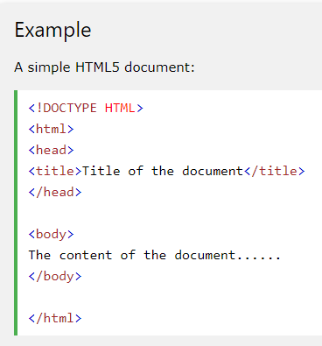
That’s right. There is an “html” HTML tag. The html tag serves as a document wrapper’s wrapper (stay with me).
THE HTML HTML TAG.
Whaaaaaat?

Slide 5
When developers and designers talk about “The DOM” it can sound intimidating to a beginner. This is because usually “The DOM” is not brought up until it needs to be manipulated. DOM stands for Document Object Model, and is most mentioned amongst JavaScript developers. This is because at some point they find it not feasible to edit a “template” globally. A “template” meaning an HTML structure that should be common across a category of webpages.
THE DOM

Slide 6
In reality you’ll be working with “The DOM” all the time. The D: in DOM is simply the “.html” page (document), regardless of what’s in it. The O: in DOM is simply all the code (objects) inside the document (D). The M: in DOM is simply the standards (model) to follow so that all browsers can render the webpage. See? No that difficult!
THE DOM

Slide 7
Now that we have a geeky explanation, we can say that the model for throwing objects into the html document is (for simplicity purposes): html head body
THE DOM

Slide 8
Here is an example of the DOM in it’s simplest form. Notice that the “title” tag is inside the “head” tag. This demonstrates that many HTML tags will only work validly if they are inside their corresponding parent tag of the DOM. <html> <head> <title></title> </head> <body> </body> </html>
THE DOM

Slide 9
Change the title to “hello title”. While we updated the webpage accordingly, guess what the boss meant! <html> <head> <title>hello title</title> </head> <body> <h1>blah blah blah</h1> </body> </html>
BOSS CALLS

Slide 10
Now that we have made peace with how things are seen thru the eyes of others we can concentrate on building a webpage. To build a webpage all you need to have is the content. Everything that follows is simply positioning within tags. QUICK START: p: paragraph a: link img: image, photo
IF WE DON’T BUILD IT, THEY WILL CALL

Slide 11
What if we wanted to add colors or font styles to the webpage? Within HTML tags we can add styles, but before we move any further let’s review the meaning of blahblah inside of elements. Anything added to an HTML tag, aside from its own, is called an “attribute”. Example: <a href=“https://www.blinn.edu” target=“_blank”>open this link</a> In the example above the whole target=“_blank” is an attribute of the “a” tag. The attribute’s name is: “target” and the attribute’s value is “_blank”. Capisce?
STYLING

