Slide 1
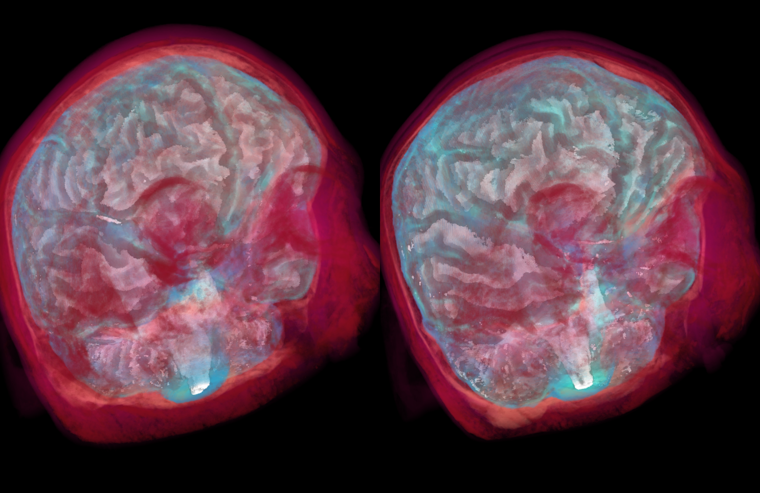
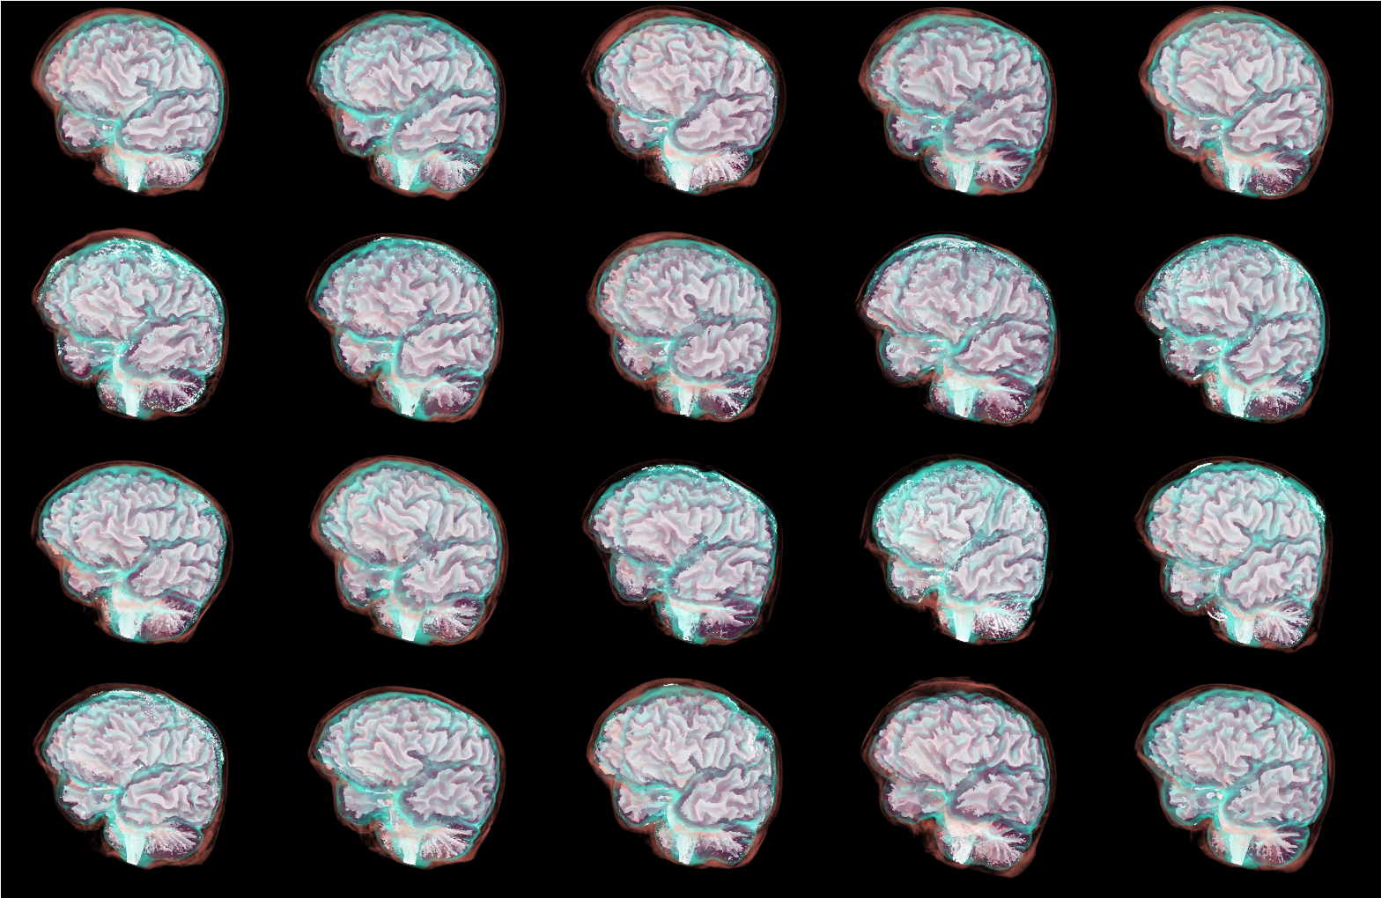
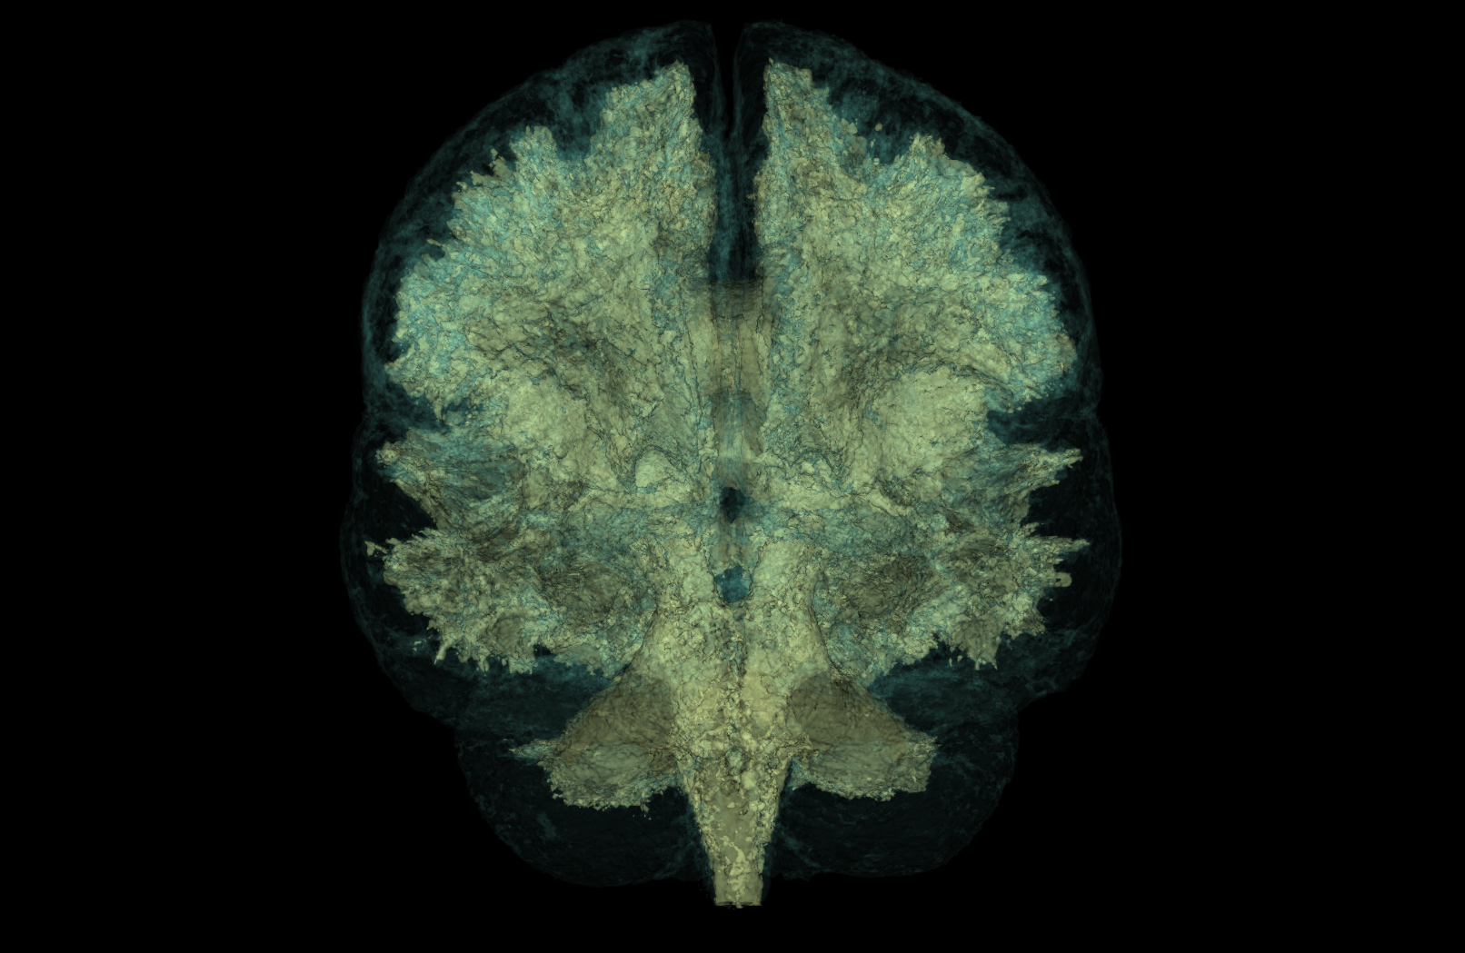
VU Computational Aspects of Digital Fabrication
3D Printable Microstructures from
Polyhedral Voronoi Diagrams
Jonas Prohaska / 01449302
Marcel Jira / 11909464
Institute of Visual Computing & Human-Centered Technology, TU Wien, Austria
Notes:
Lukas

Slide 2
Motivation
How do brains differ from one another and where are they similar?
What’s the best way to visualize differences/similarities?
  Juxtaposition?
  Blending?
  Explicit Encoding?
  Mesh comparison? e.g. [J. Schmidt et al. 2014]
Start with basics and see how far we can get
→ Implemented Juxtaposition, Blending & Explicit Encoding
Jonas Prohaska & Marcel Jira
Notes:
Jonas

Slide 3
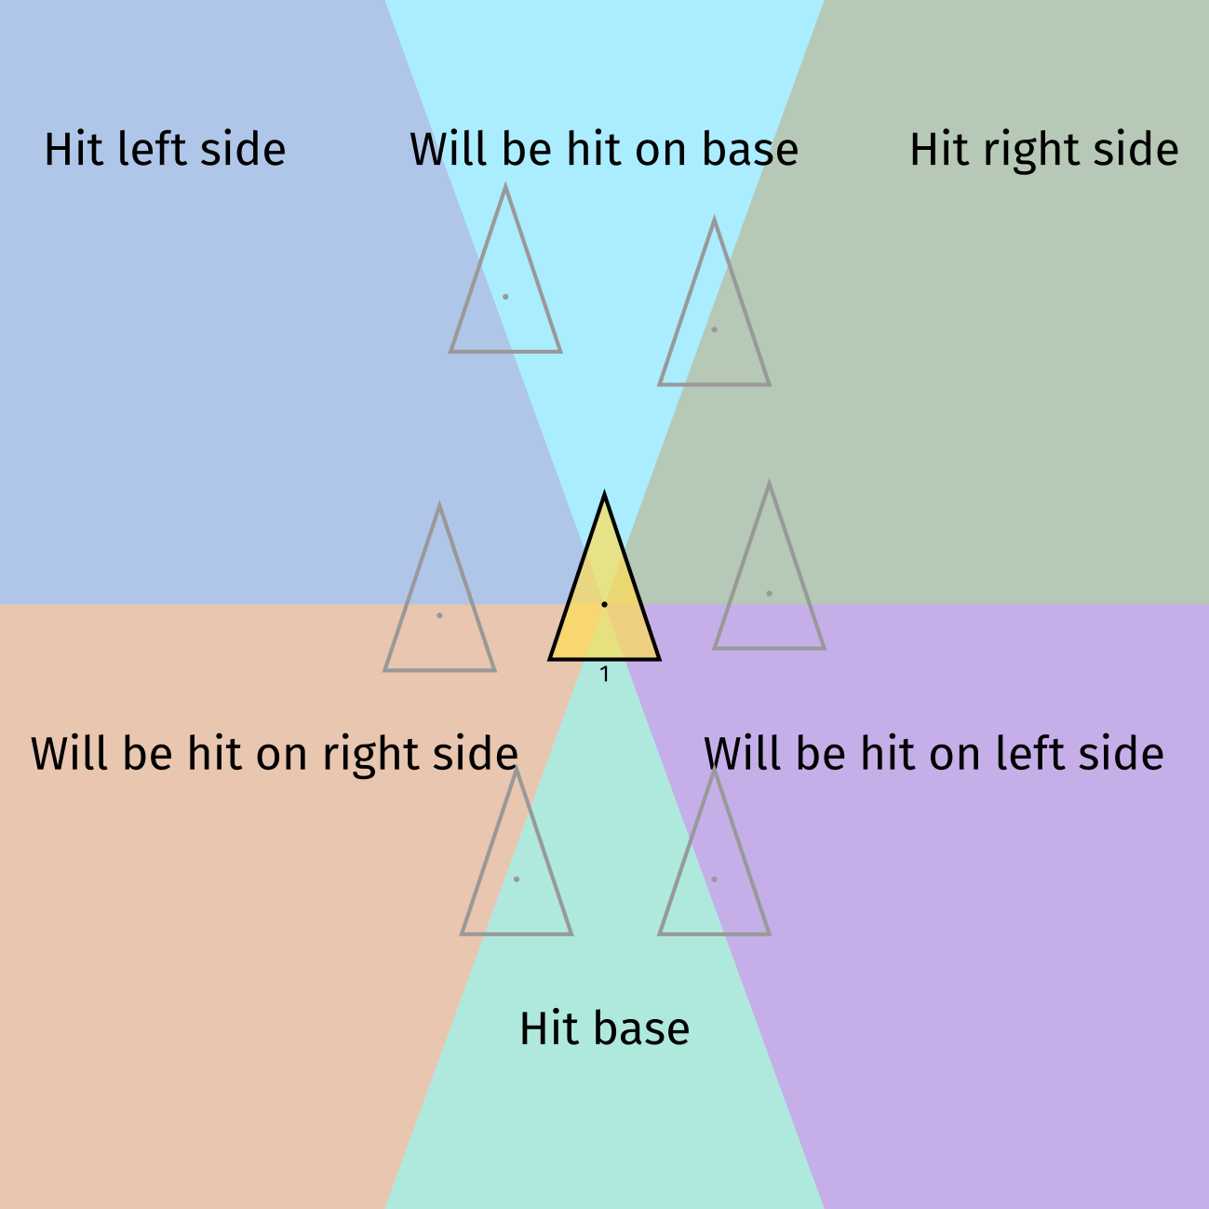
Collision Planning: HOW will the Triangles collide?
Jonas Prohaska & Marcel Jira
Notes:
Jonas

Slide 4
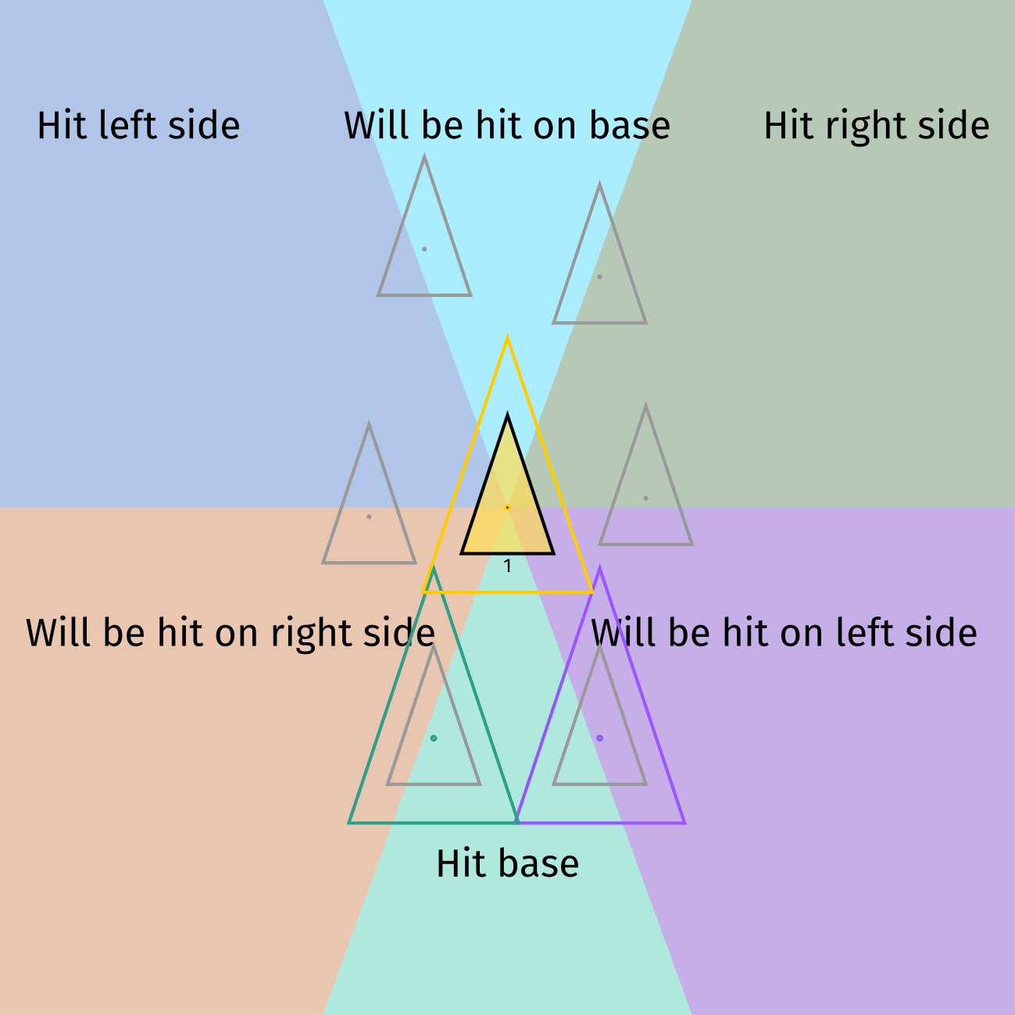
Collision Planning: HOW will the Triangles collide?
Jonas Prohaska & Marcel Jira
Notes:
Jonas

Slide 5
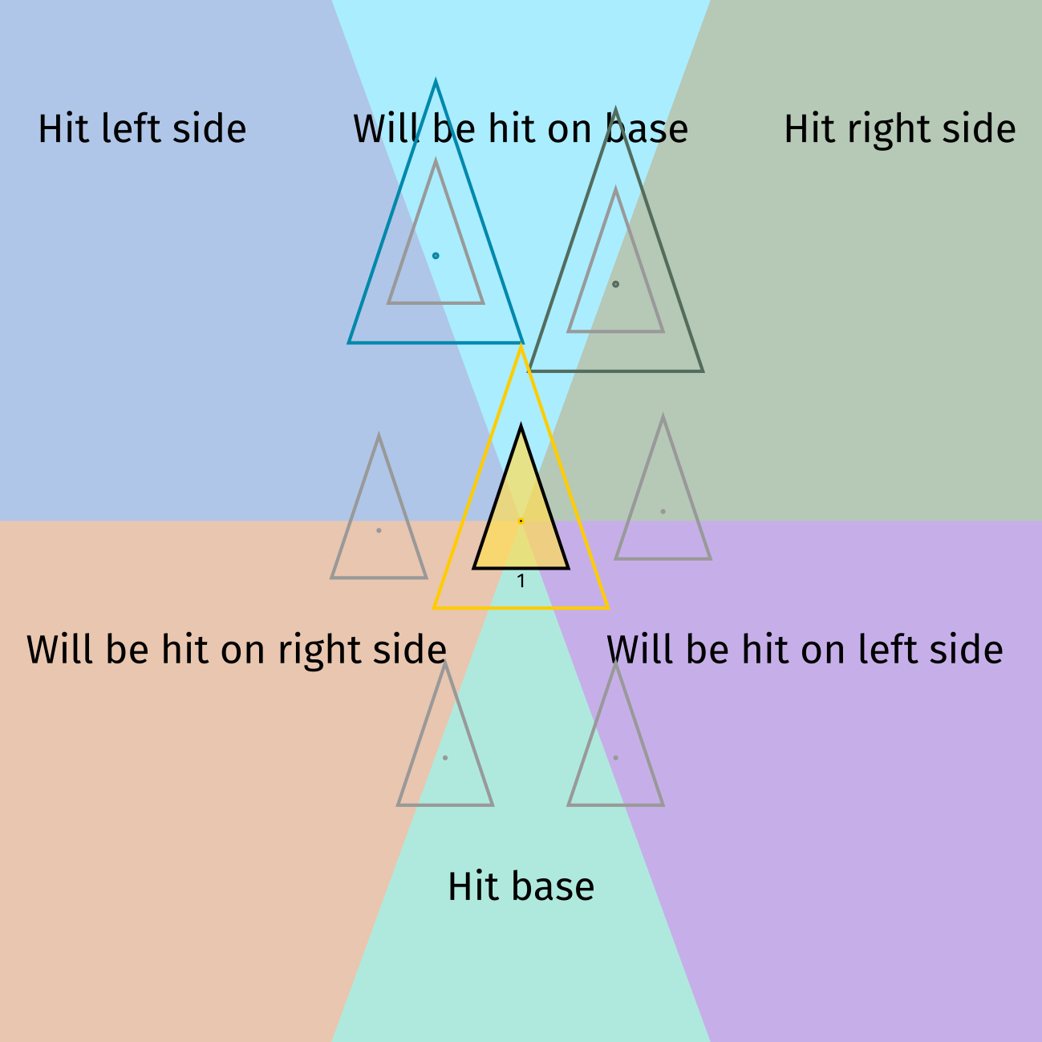
Collision Planning: HOW will the Triangles collide?
Jonas Prohaska & Marcel Jira
Notes:
Jonas

Slide 6
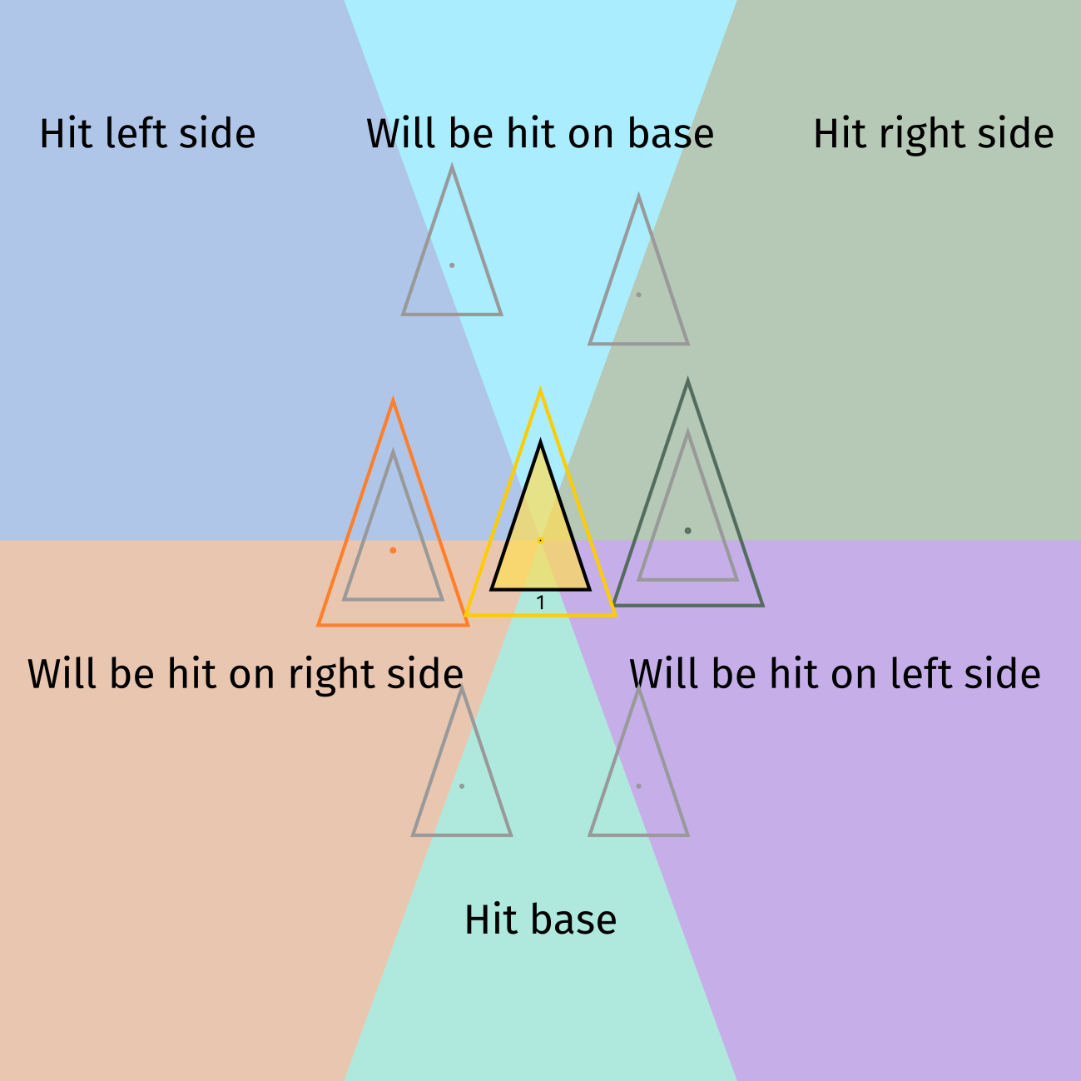
Collision Planning: HOW will the Triangles collide?
Jonas Prohaska & Marcel Jira
Notes:
Jonas

Slide 7
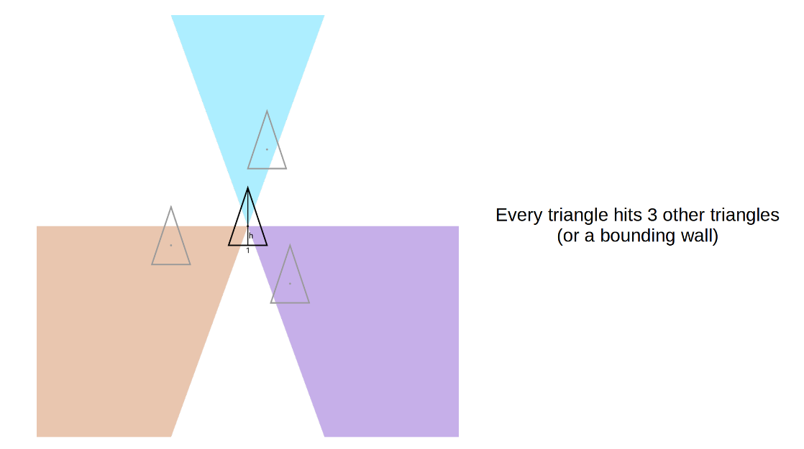
Collision Planning: WHERE will the Triangles collide?
Jonas Prohaska & Marcel Jira
Notes:
Jonas

Slide 8
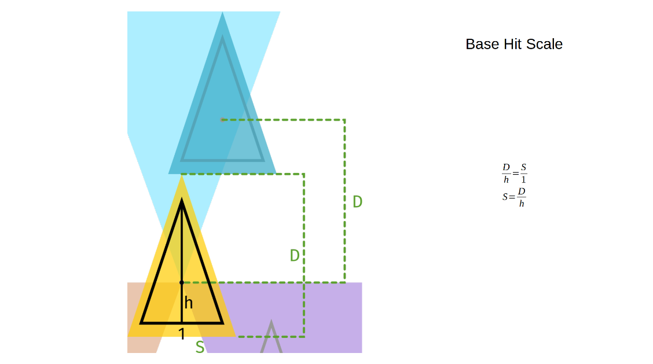
Collision Planning: WHERE will the Triangles collide?
Jonas Prohaska & Marcel Jira
Notes:
Jonas

Slide 9
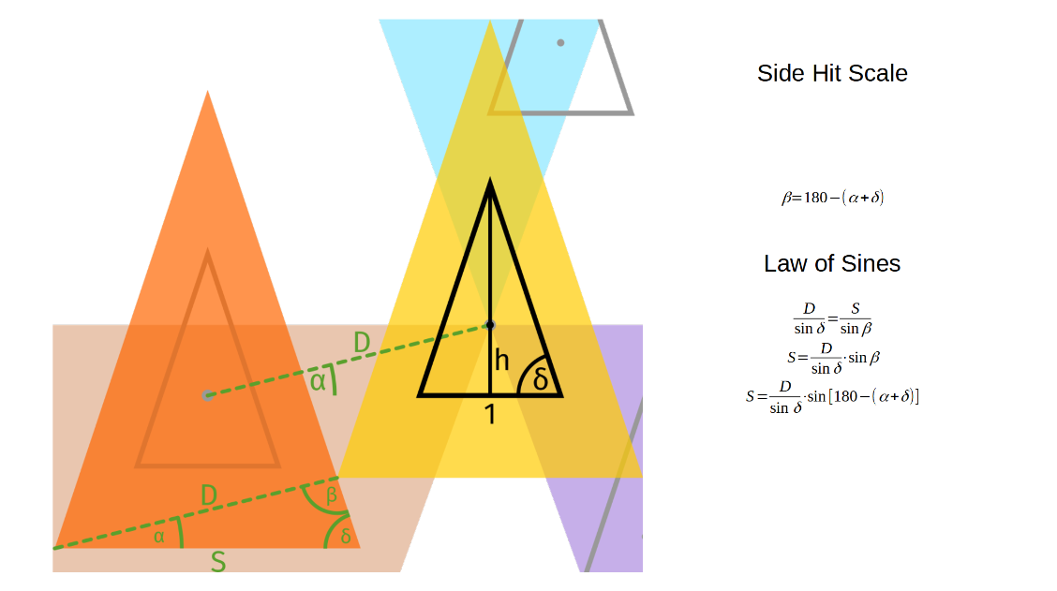
Collision Planning: WHERE will the Triangles collide?
Jonas Prohaska & Marcel Jira
Notes:
Jonas

Slide 10
Strategy to find collisions
Create random points stored in a list points
Create two lists of points
For base = 1, find h and δ
  pointsx = points sorted by x
  pointsy = points sorted by y
Jonas Prohaska & Marcel Jira
Notes:
Jonas

Slide 11
Strategy to find collisions
4) Set currentScale = 1
5) In a loop, do the following
  1) Find minimal scale > currentScale for two triangles to collide, respecting
    1) Hitted triangle center is in hitting zone of hitting triangle center
    2) Hitting point has analyzed hitting zone = true
    3) For base hit, use use Base Hit Scale (Euclidean Distance)
    4) For side hit, use Side Hit Scale
  2) Store the following information in a list
    Hitting point, Hitted point, Hitting side, Coordinates, (Scale factor)
  3) For the hitting point set respective hitting zone (top, left or right) to false
  4) Set currentScale = scale factor
Jonas Prohaska & Marcel Jira
Notes:
Jonas

Slide 12
Technology Approaches
Tried with FreeCAD
  Idea: Use FreeCAD sketcher tools to do the math for us
  Pros: Works pretty good in theory, helps try out geometric ideas
  Cons: Begins to struggle really fast, syntax is rather difficult
Visual Debugging using a simple renderer in C++
  Pros: Faster code, simpler math operations, custom GUI debugging
  Cons: Building a custom renderer using C++/OpenGL
Python using Plotly 3D graphs
  Pros: Features 3D camera movements and tooltips out of the box, renders many thousand points flawlessly once loaded
  Cons: Designed for plots, objects are per default distorted if too far between
Jonas Prohaska & Marcel Jira
Notes:
Jonas

Slide 13
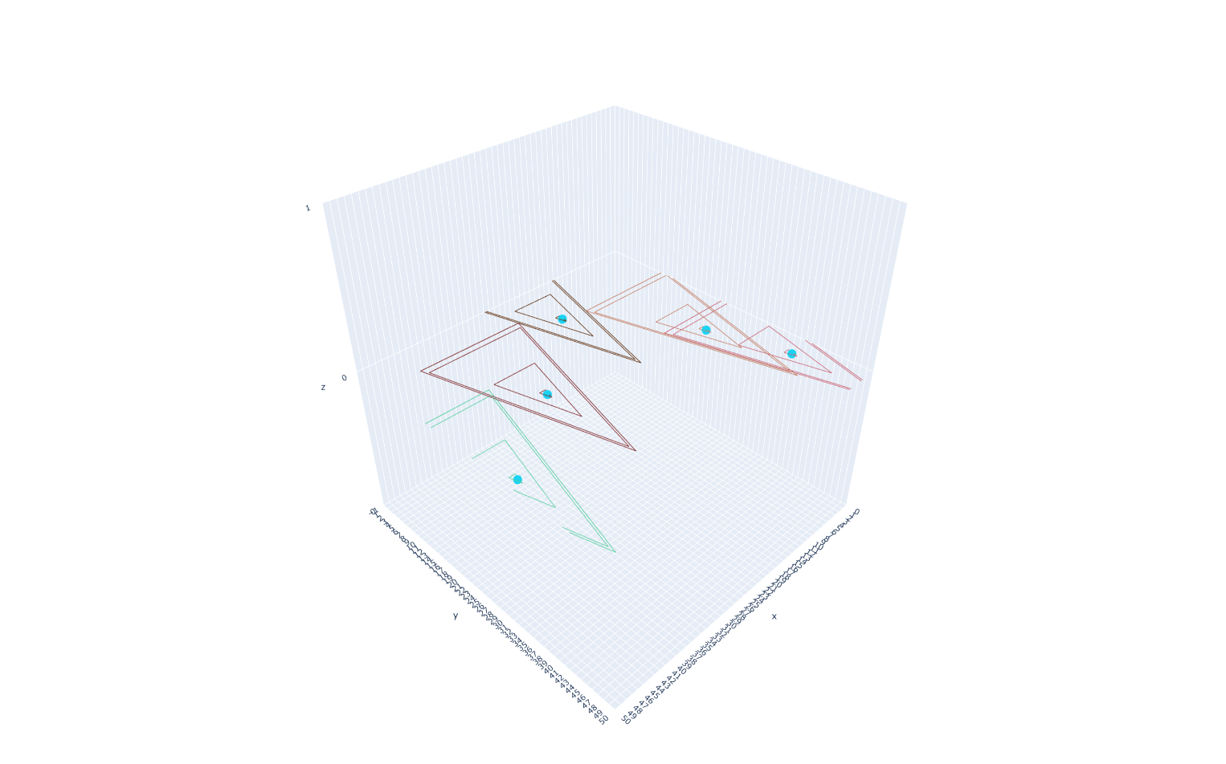
Live Demo of Progress
Jonas Prohaska & Marcel Jira
Notes:
Jonas

