Slide 1
Collision Planning
How will the triangles collide?

Slide 2
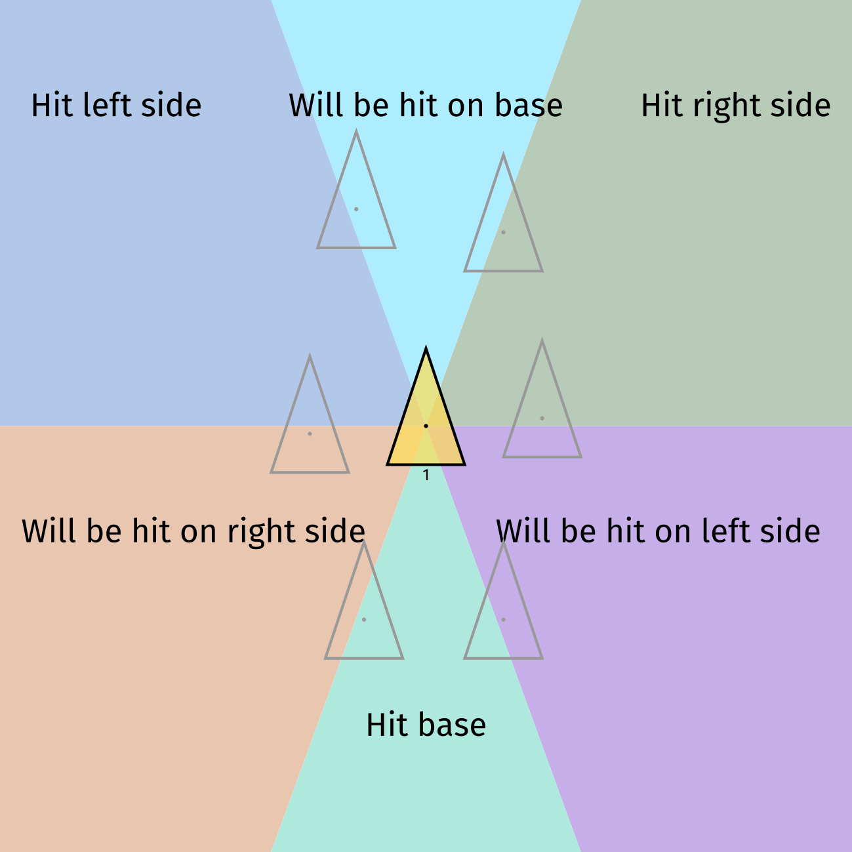

Slide 3
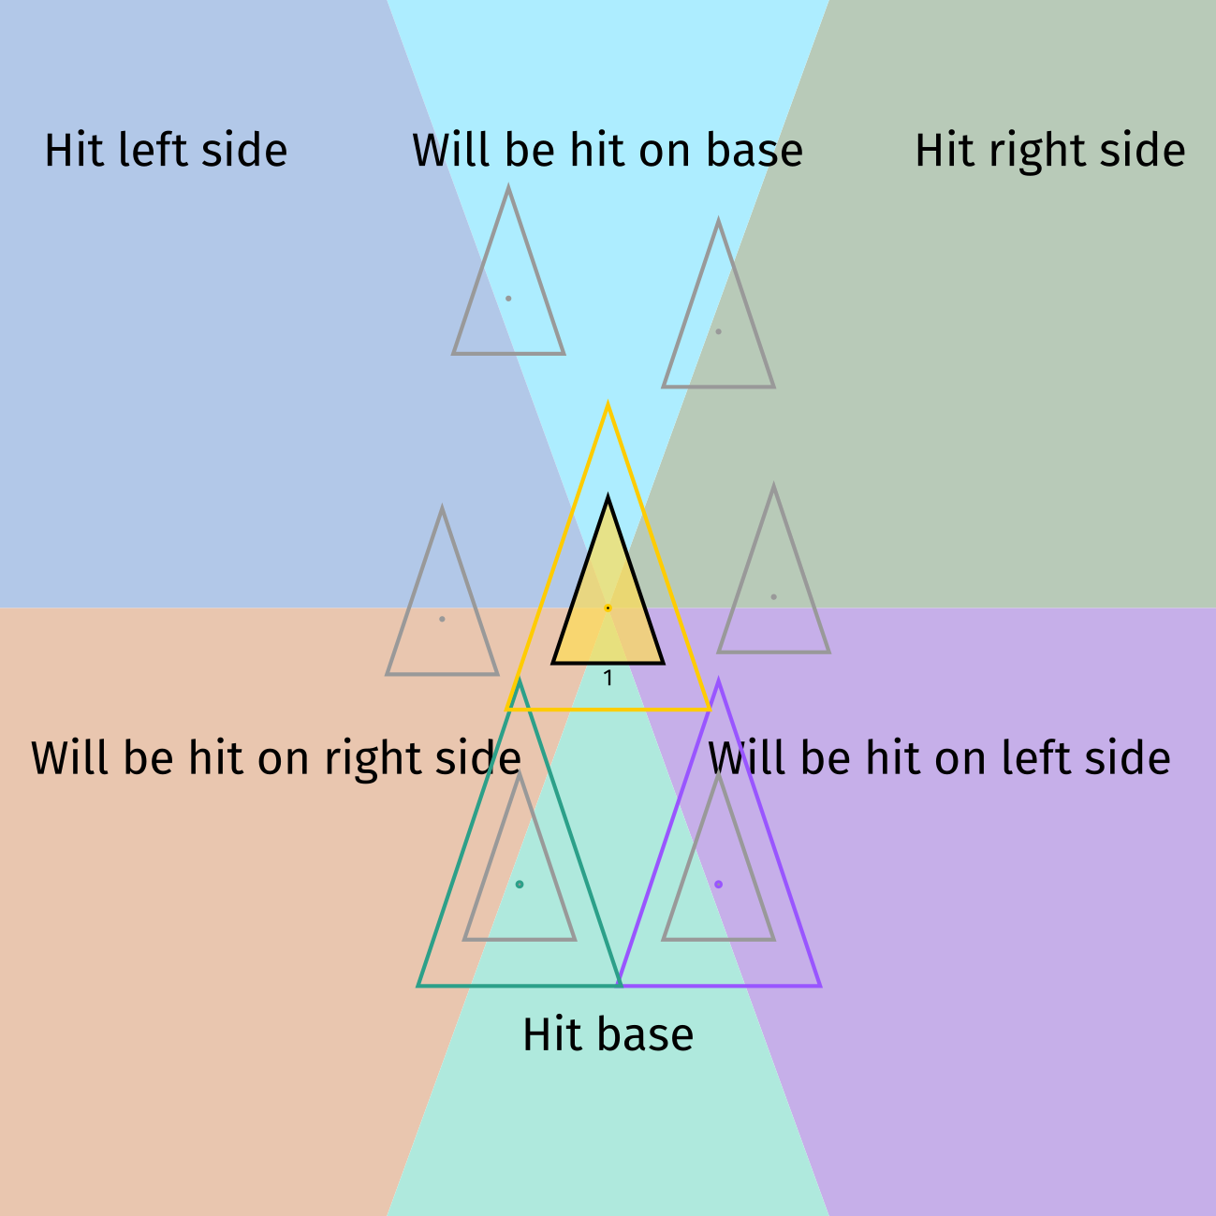

Slide 4
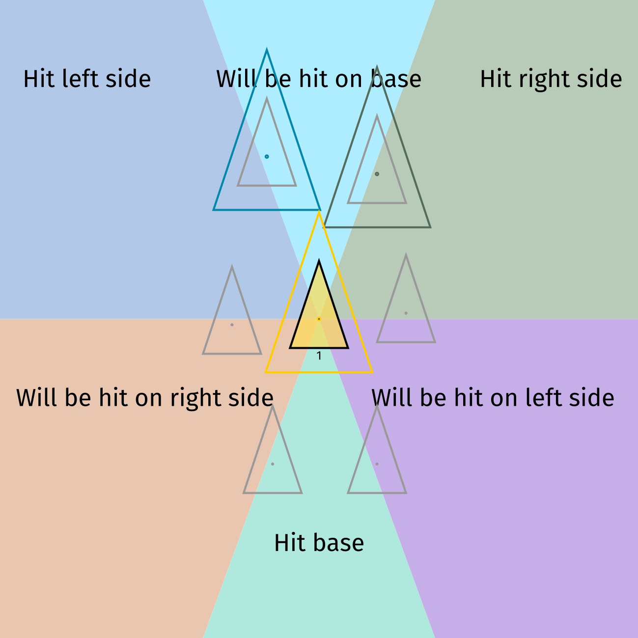

Slide 5
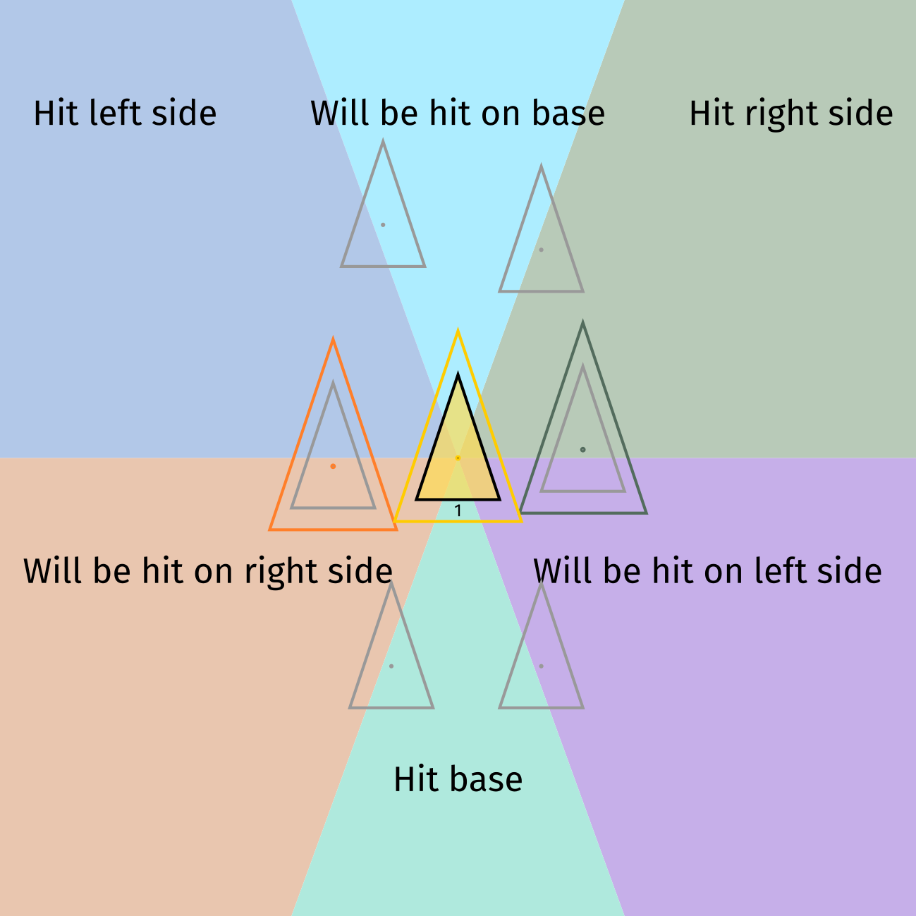

Slide 6
Collision Planning
Where will the triangles collide?

Slide 7
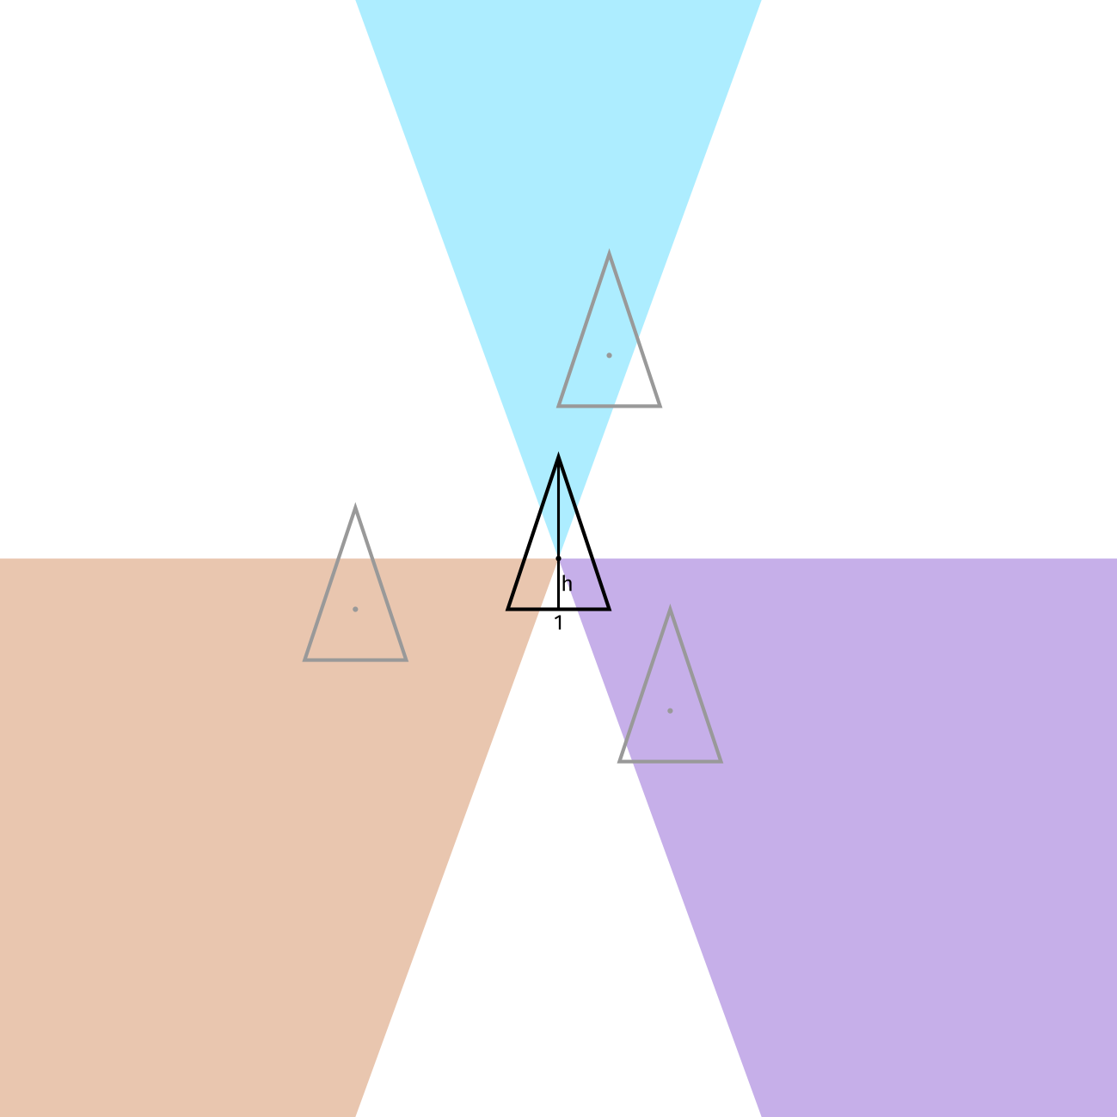
Every triangle hits 3 other triangles (or a bounding wall)

Slide 8
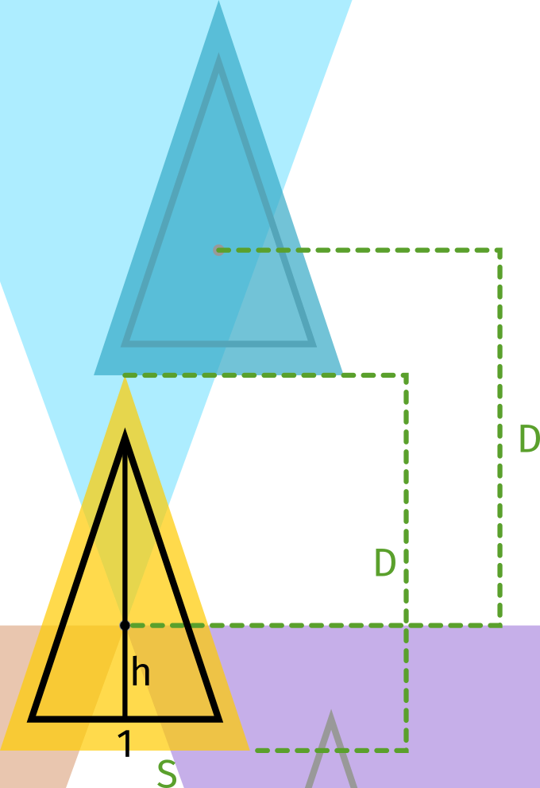
Base Hit Scale

Slide 9
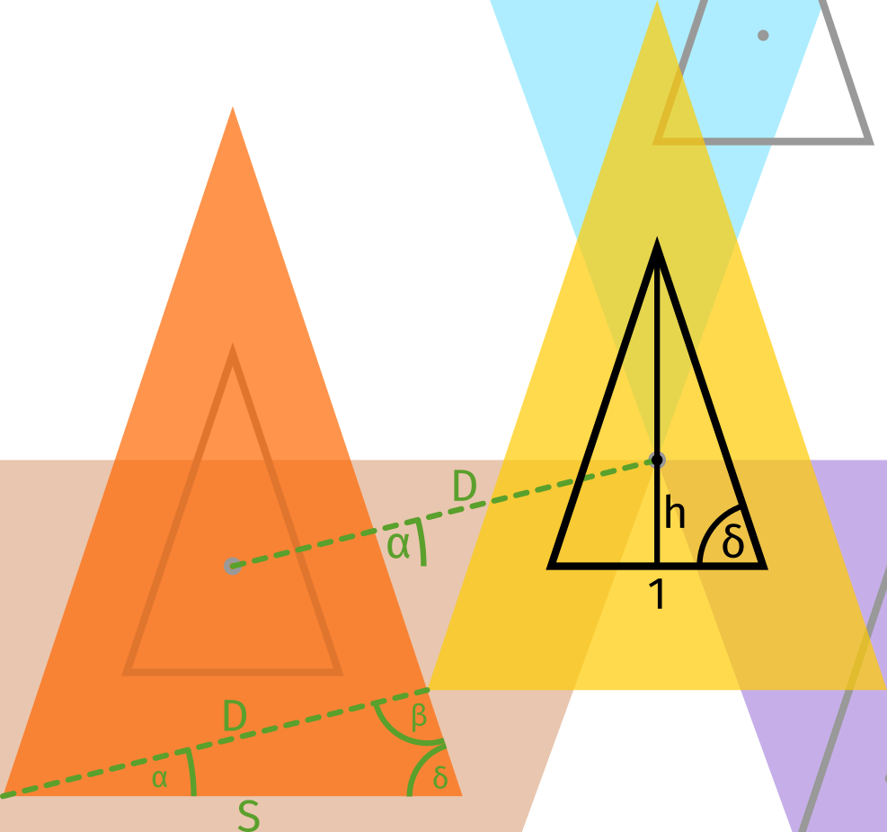
Side Hit Scale
Law of Sines

Slide 10
Collision Planning
Strategy to find collisions

Slide 11
Strategy (1/2)
For base = 1, find h and δ
Create random points stored in a list points
Create two lists of points
  pointsx = points sorted by x
  pointsy = points sorted by y

Slide 12
Strategy (2/2)
Set currentScale = 1
In a loop, do the following
  Find minimal scale > currentScale for two triangles to collide, respecting
    Hitted triangle center is in hitting zone of hitting triangle center
    Hitting point has analyzed hitting zone = true
    For base hit, use use Base Hit Scale (Euclidian Distance)
    For side hit, use Side Hit Scale
  Store the following information in a list
    Hitting point
    Hitted point
    Coordinates
    (Scale factor)
  For the hitting point set respective hitting zone (top, left or right) to false
  Set currentScale = scale factor
Draw voronoi (expand on that later)

