Slide 1


Slide 2
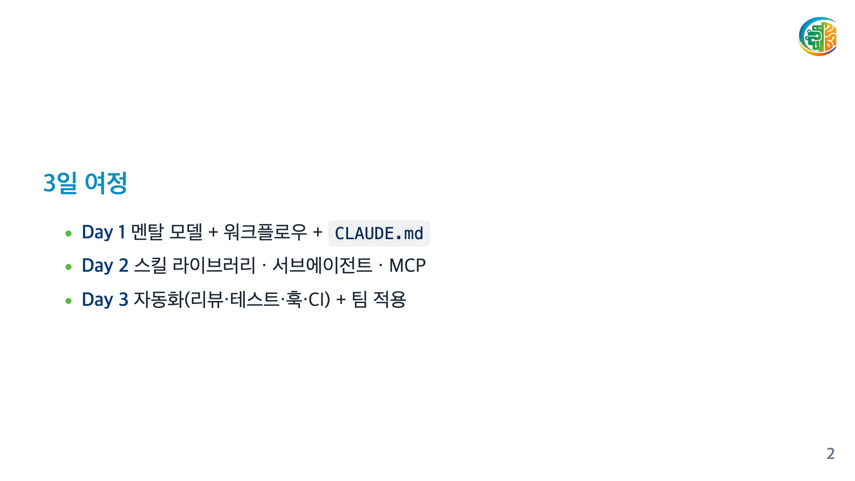

Slide 3

Notes:
===== DAY 1 =====

Slide 4
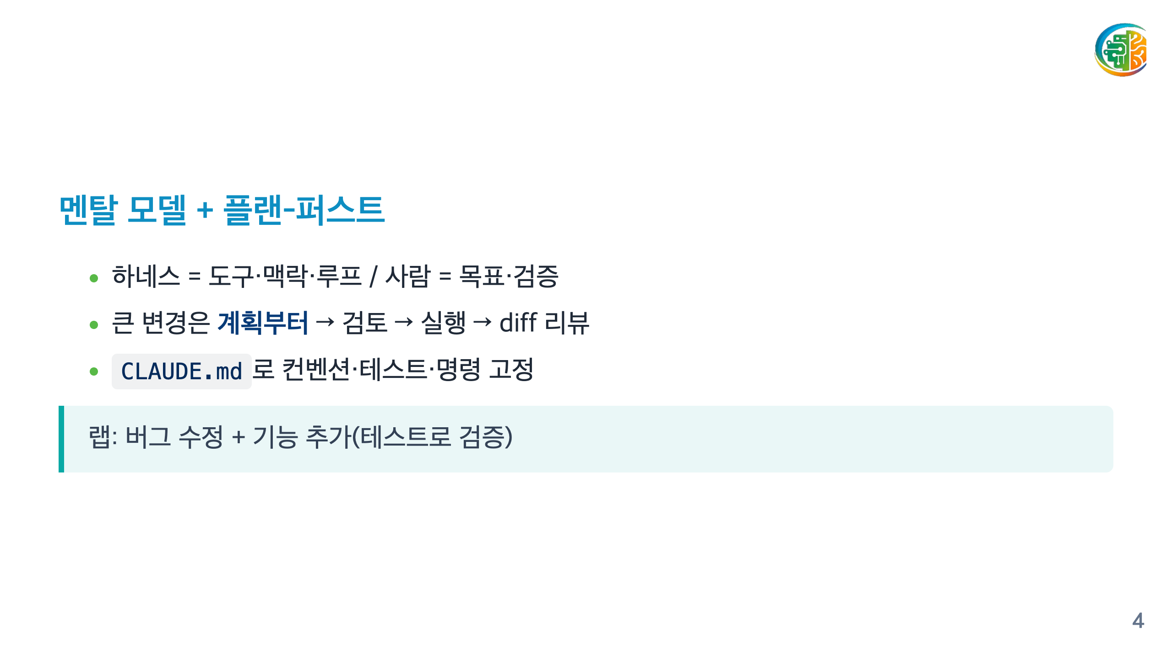

Slide 5

Notes:
===== DAY 2 =====

Slide 6
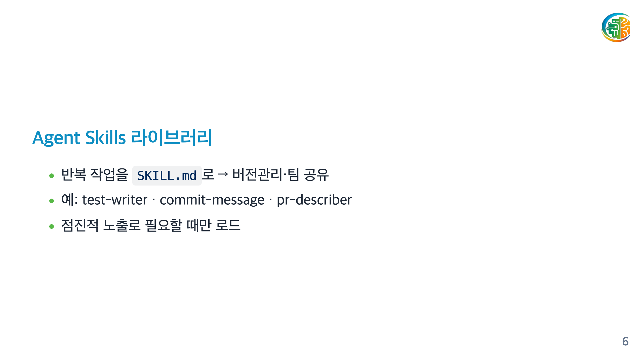

Slide 7
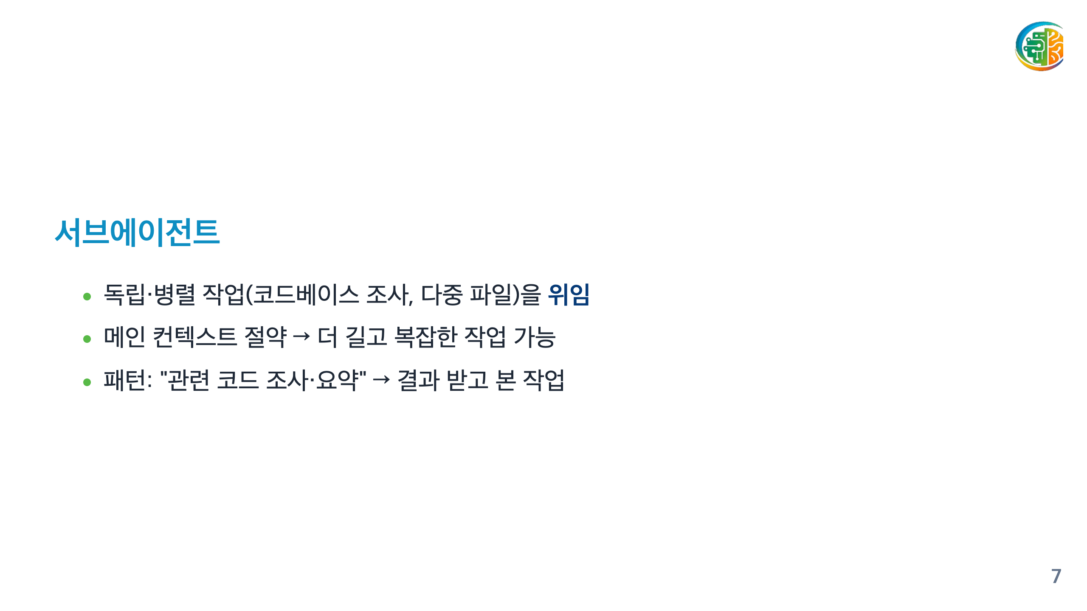

Slide 8
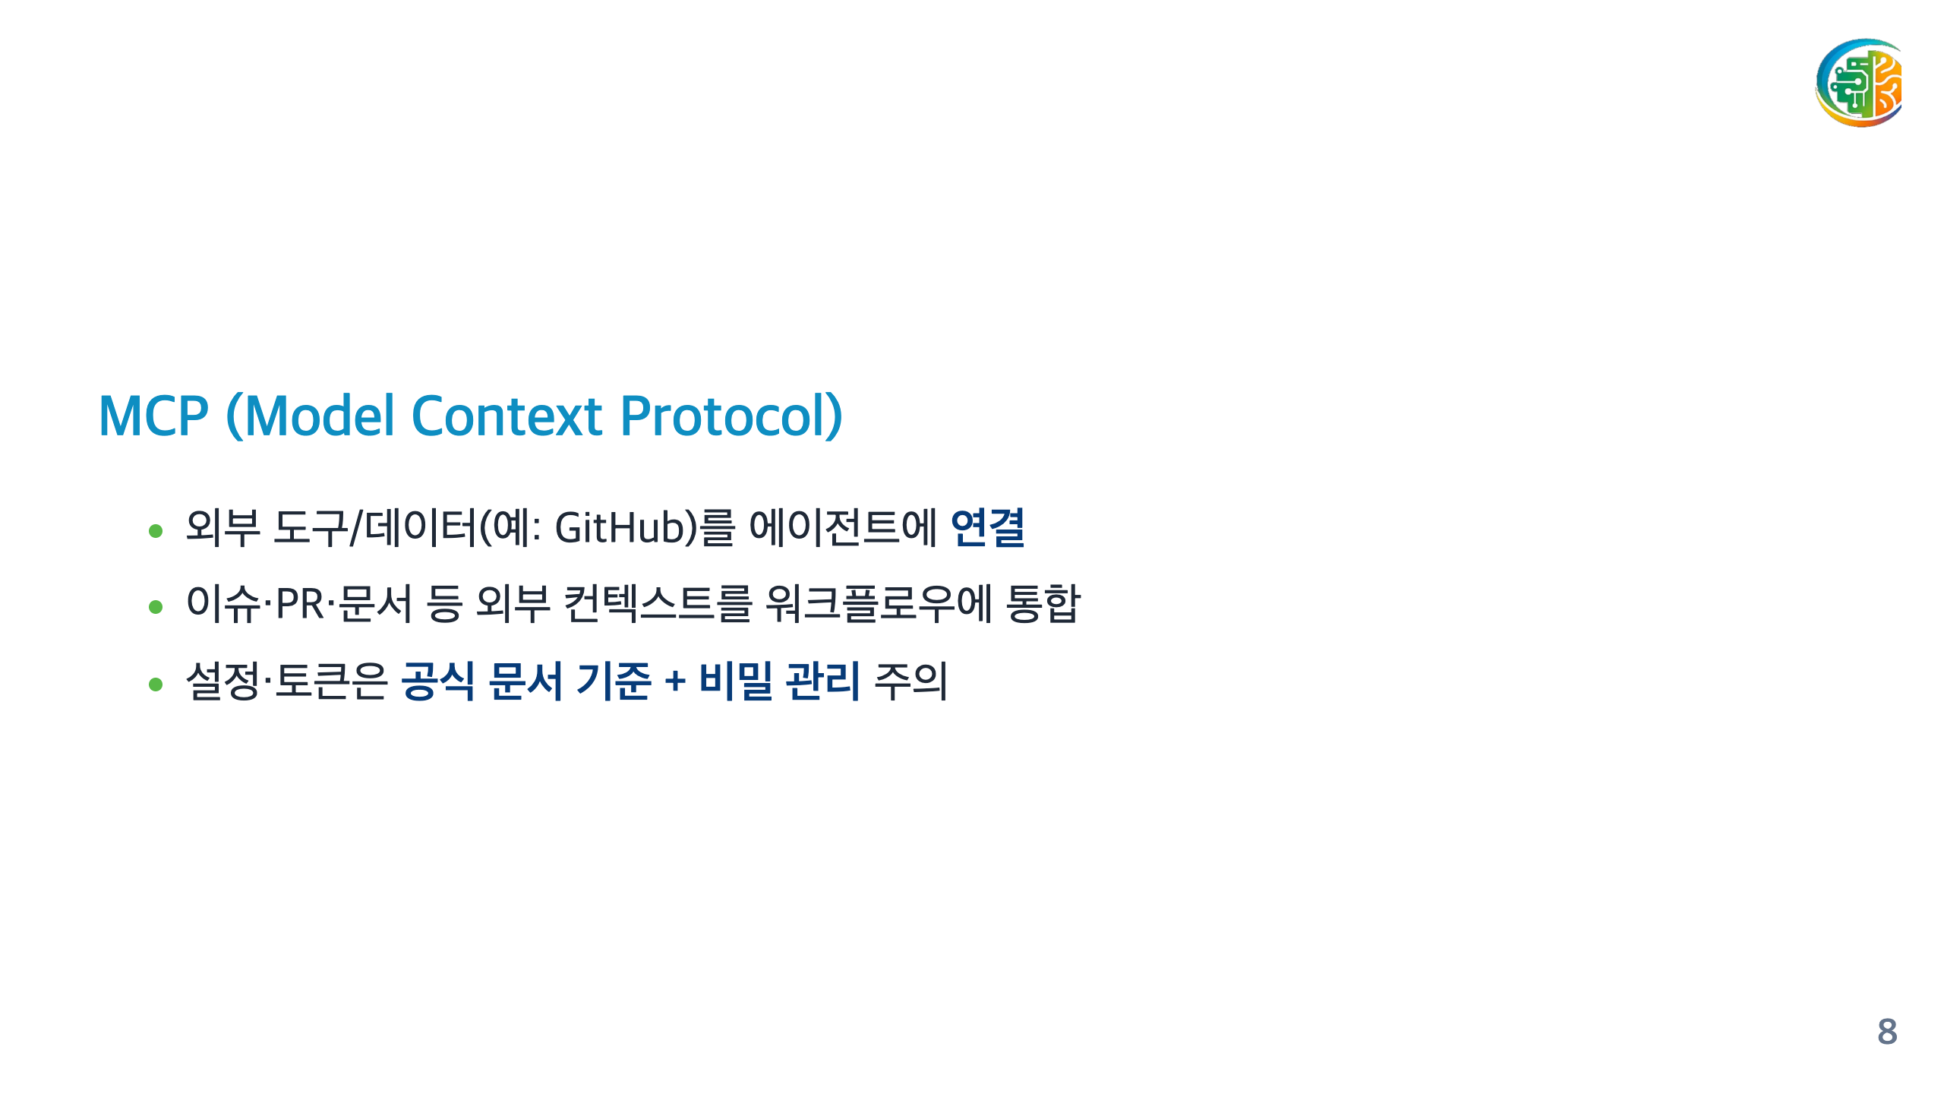

Slide 9

Notes:
===== DAY 3 =====

Slide 10
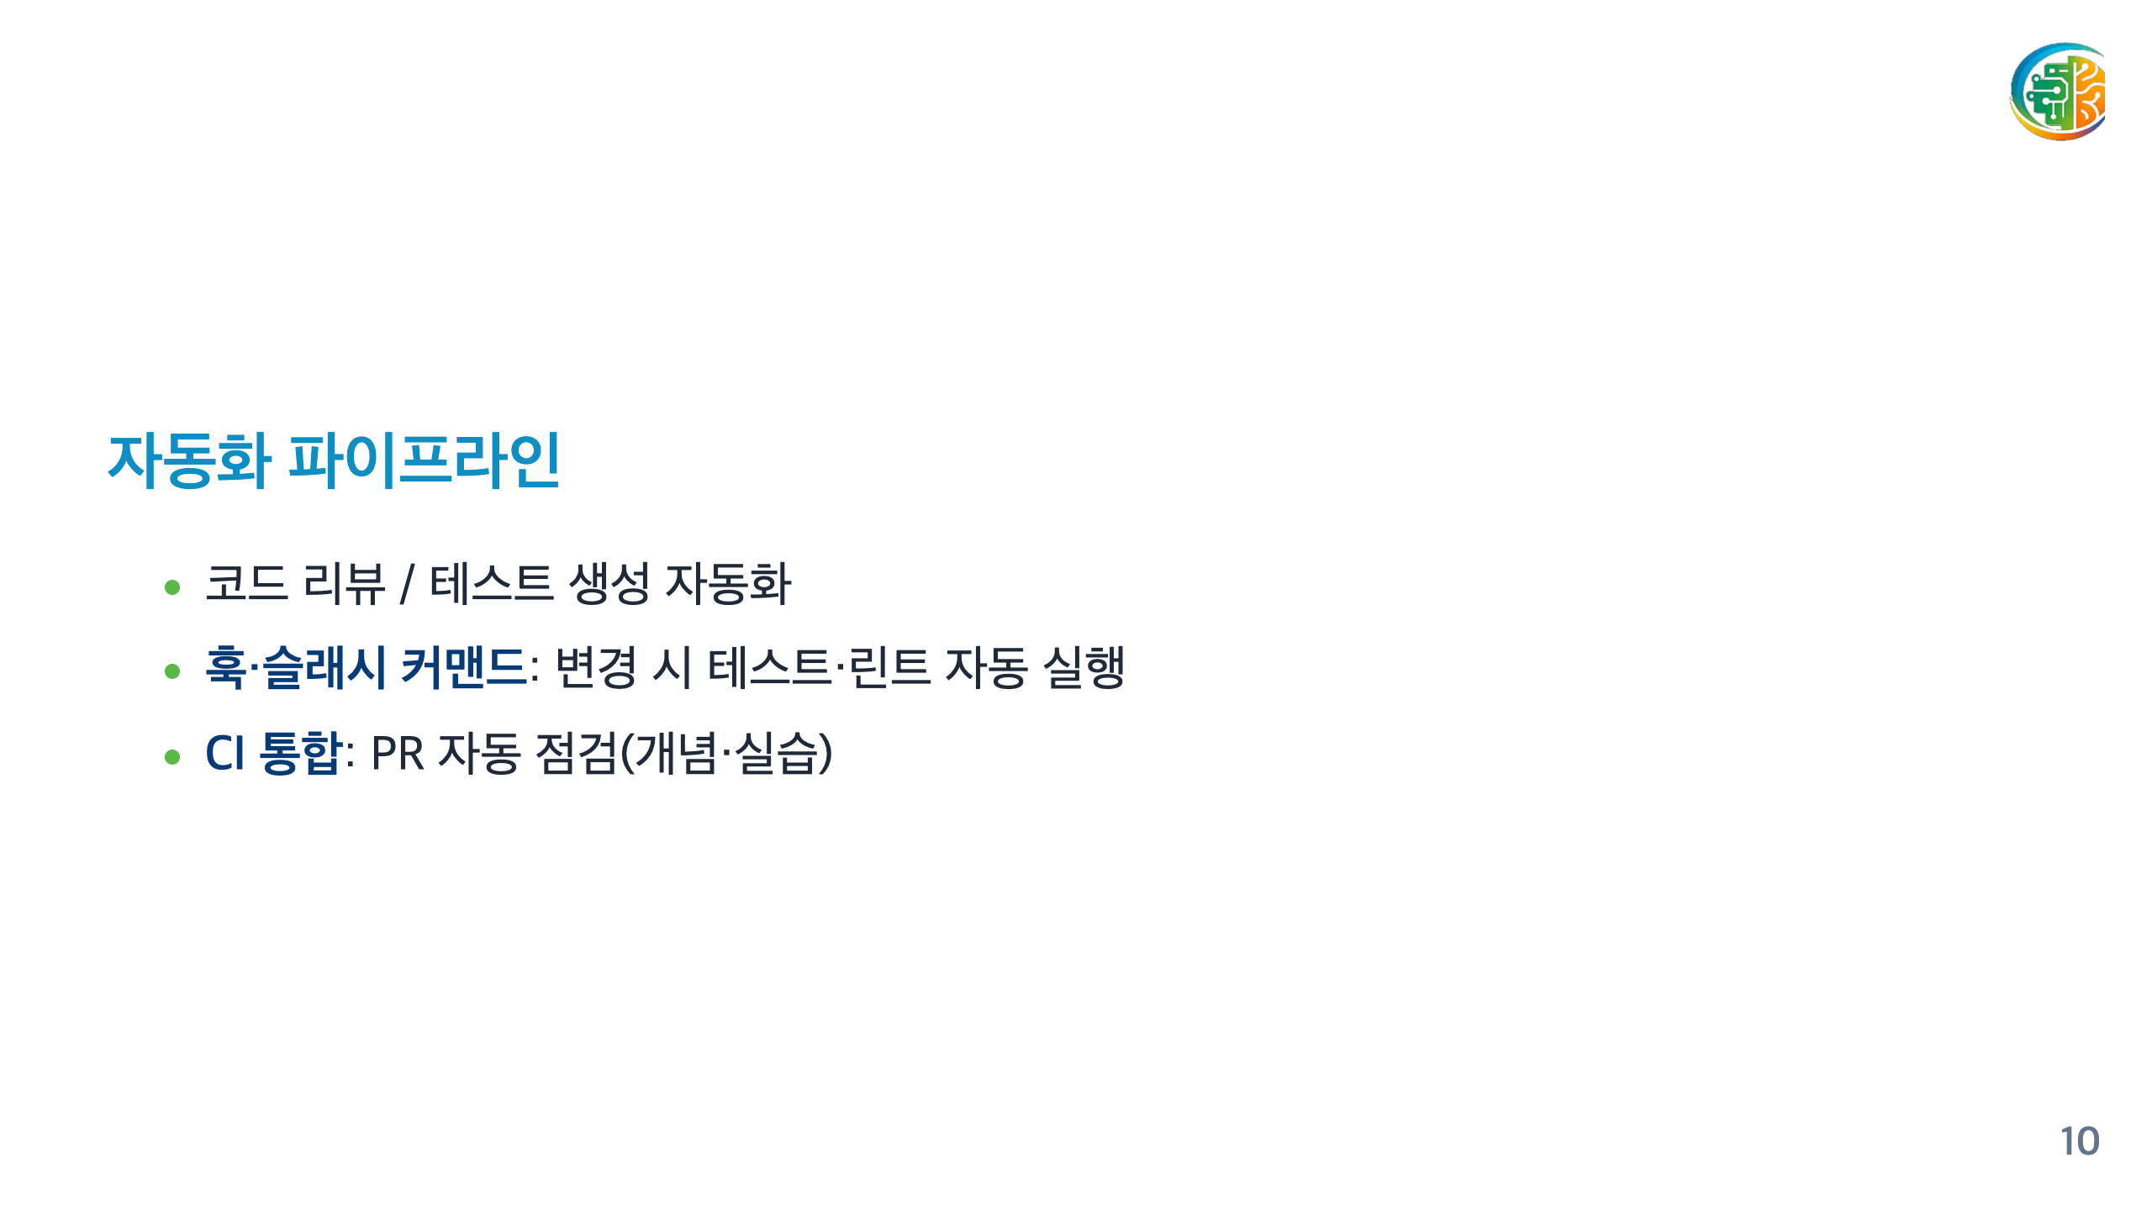

Slide 11


Slide 12
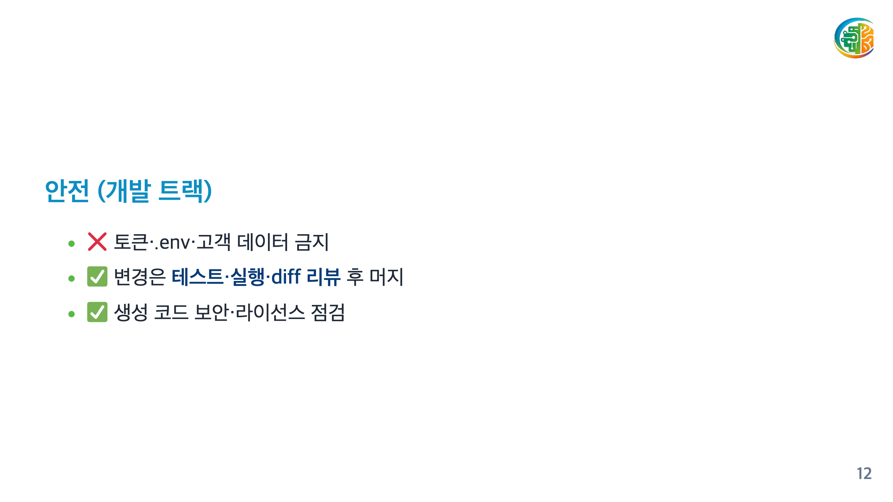

Slide 13
