Slide 1
What is a multivariate linear regression?
It is a way of modeling growth or decline of a phenomena.
Think of it as a function y = f(x1,x2,x..n)
Where y = slope1(x1) + slope2(x2) + slopeN(xn) + constant or y intercept

Slide 2
Why did we use this linear regression?
We thought a multivariate linear regression would do a good job modeling health insurance costs for smokers.
From there we could use this model as a “data driven” method to inform people to stop smoking, make healthy decisions about their body, and teach their children to never start using tobacco and smoke anything due to a financial penalty.

Slide 3
How did we build the multivariant linear regression?
We found this dataset on Kaggle and it had age, bmi, and number of children for all fifty of the united states
We built a relational database in postgre SQL to hold the data from kaggel in a persistence location.
Then we used jupyter notebooks to use a supervised Machine learning algorithm within a multivariant linear regression to predict our future health care costs

Slide 4
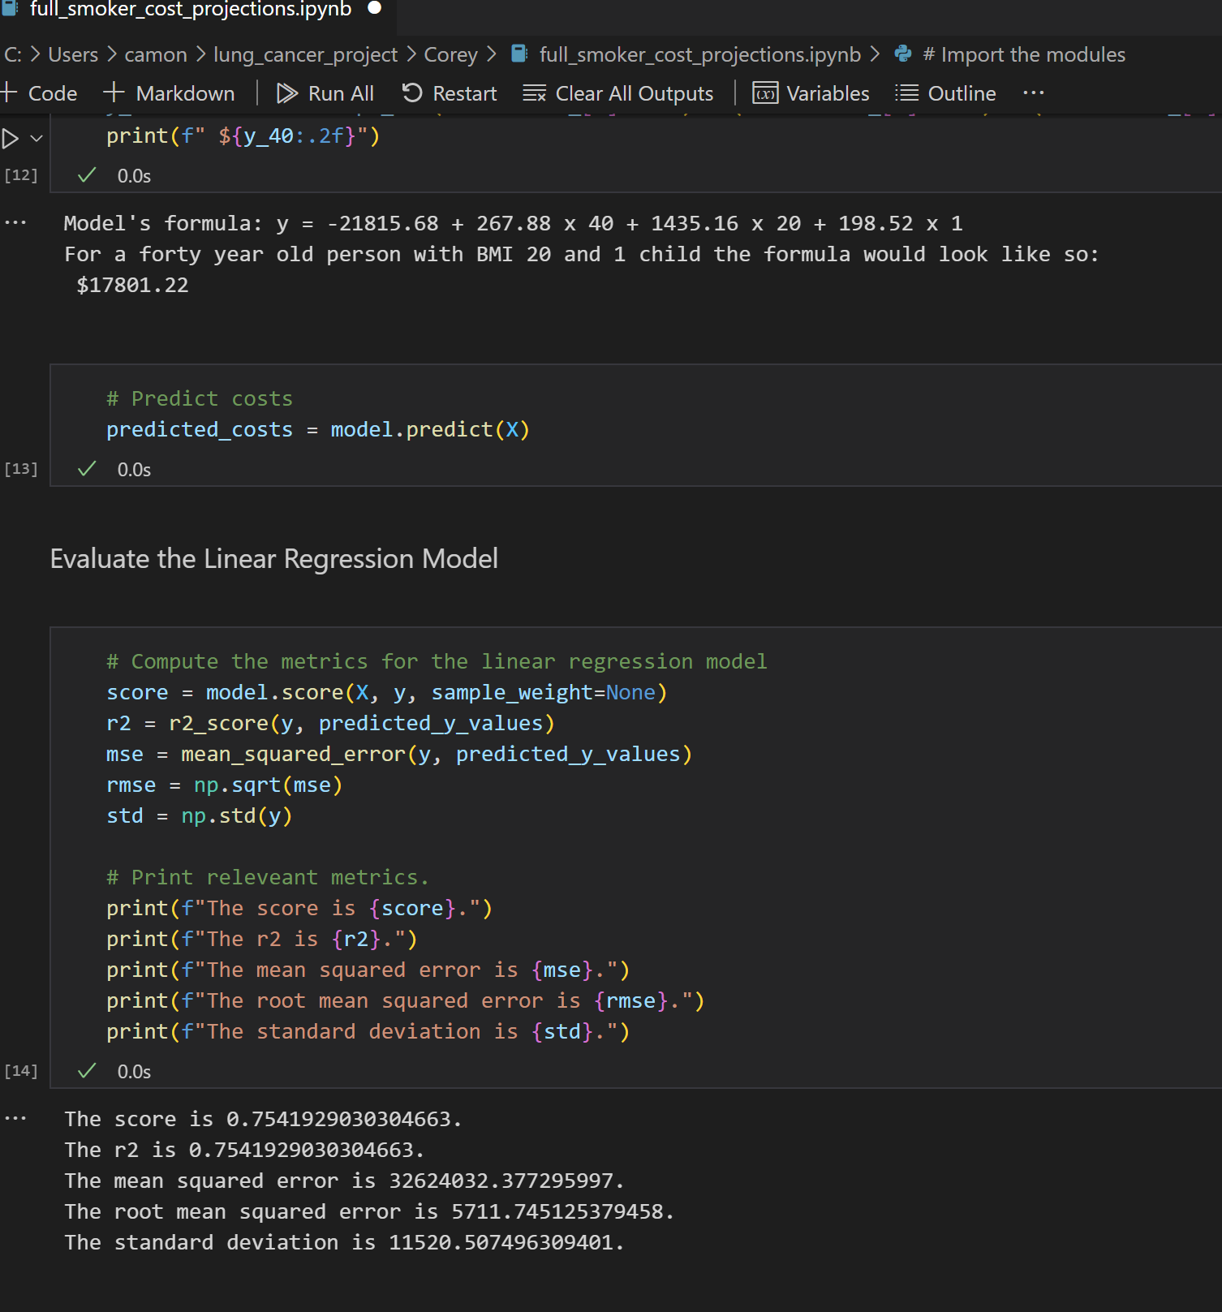
Corey will demonstrate the notebook and show the R2 and future cost predictions

