Slide 1
STRUCTURAL PHYLOGENETICS
When did PIF1 and RRM3 split?
Dating a budding-yeast helicase duplication with structural phylogenetics
Answer: the Saccharomycotina ancestor, ~330–383 Mya
Spencer Gray

Slide 2
The question
S. cerevisiae has two PIF1-family DNA helicases: Pif1 and Rrm3
Most fungi — and the common ancestor — have just one
So the pair arose by a gene duplication
But when, and on which branch of the fungal tree?
Hard: the alignable helicase core is short and fast-evolving, so it saturates at the relevant depth
ancestral PIF1
?
duplication — when?
Pif1
Rrm3

Slide 3
Approach
1
2
3
4
Sample
Build trees
Reconcile
Read off
957 PIF1 proteins,
728 fungal species
sequence + 3Di
structure
gene tree vs
species tree
the duplication's
branch
Structures: AlphaFold DB + ColabFold · reconciliation: GeneRax + species-overlap

Slide 4
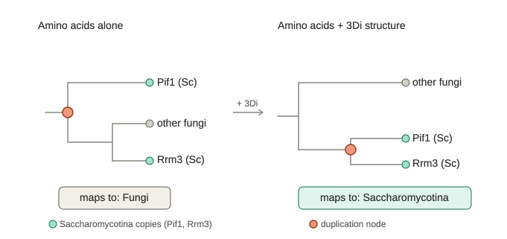
Sequence can't resolve it — structure can
Amino-acid trees place the split at the base of Fungi — unresolved
Adding the 3Di structural alphabet pulls it into Saccharomycotina
Sequence even marginally favors the wrong answer (AU p = 0.033) — a long-branch-attraction artifact (Saccharomycotina copies evolve ~2× faster)

Slide 5
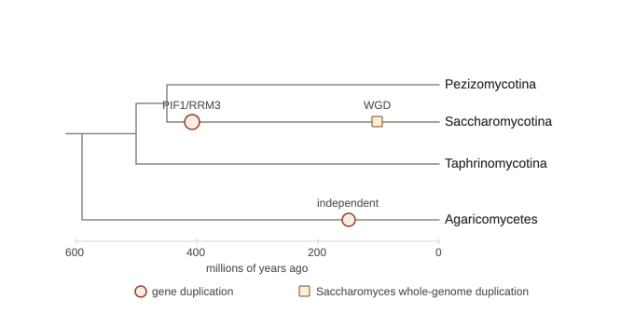
It maps to the Saccharomycotina ancestor
~330–383 Mya
Devonian–Carboniferous
Confirmed by GeneRax reconciliation
Robust to the published Y1000+ phylogenomic tree
Long predates the Saccharomyces whole-genome duplication (~100 Mya)

Slide 6
Two more results
Mushrooms duplicated PIF1 independently
RRM3 is the derived paralog
The two-copy Agaricomycetes are a separate, convergent event — not orthologs of the yeast pair. Copy-counting can't tell; the gene tree can.
Single-copy PIF1s outside budding yeasts lean toward Pif1 by sequence. Pif1 kept more of the ancestral state; Rrm3 diverged further (and faster).

Slide 7
Take-home
PIF1 and RRM3 arose from one duplication in the Saccharomycotina ancestor, ~330–383 Mya — long before the Saccharomyces whole-genome duplication
Amino-acid phylogenetics is confidently misled here; the protein's structure recovers the true relationship
The mushroom two-copy state is an independent duplication; Rrm3 is the derived copy
A clean case where structural phylogenetics corrects a sequence artifact — and the first dated placement of this split

Slide 8
Caveats & next steps
Caveats
Next
Deep node is bootstrap-weak (UFBoot 29) and sequence marginally conflicts (p=0.033) — reconciliation + the biology (RRM3 only in budding yeasts) carry it
Early-diverging budding yeasts thinly sampled → stem vs early-crown not fully pinned
GeneRax loss-pattern on a grafted phylogenomic tree
AA+3Di bootstrap robustness; alternative 3Di model
Finish the Y1000+ orthogroup novelty check

