Slide 1
When did PIF1 and RRM3 split?
Structural phylogenetics places the budding-yeast helicase duplication at the origin of Saccharomycotina
957 cellular PIF1-family proteins · 728 fungal species · AlphaFold + foldseek 3Di
Spencer Gray · 2026-06-18 · github.com/spegray/pif1-foldtree

Slide 2
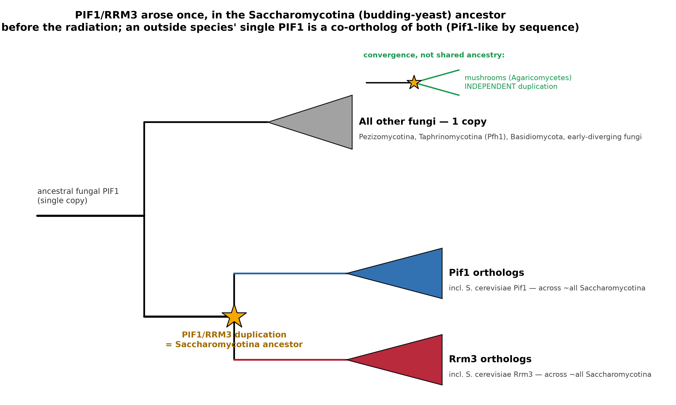
One ancestral gene → two helicases
Why the deep split is hard to see
S. cerevisiae has two PIF1-family 5′→3′ DNA helicases:
• Pif1 — mtDNA maintenance, telomerase inhibition, Okazaki processing
• Rrm3 — replication through protein–DNA barriers (rDNA, tRNA, telomeres)
Question: where/when did one ancestral fungal PIF1 duplicate into the Pif1 + Rrm3 pair?
Why it's hard: the short, fast-evolving helicase core saturates — amino-acid trees lose the deep signal and place the split at “Fungi” (kingdom), unresolved.

Slide 3
A fungi-wide, structure-aware gene tree
1
957 proteins, 728 species
Cellular PIF1 via InterPro IPR048293 — not the Helitron-contaminated Pfam PF05970.
2
828 AFDB + 129 ColabFold
AlphaFold structures for all 957; the 129 AFDB gaps folded with ColabFold (AF2). Trimmed to the helicase core.
3
foldseek 3Di alphabet
Per-residue structural alphabet → an AA+3Di alignment over the same core columns.
4
reconcile vs species tree
Gene tree → GeneRax duplication–loss reconciliation → the duplication branch (the answer).

Slide 4
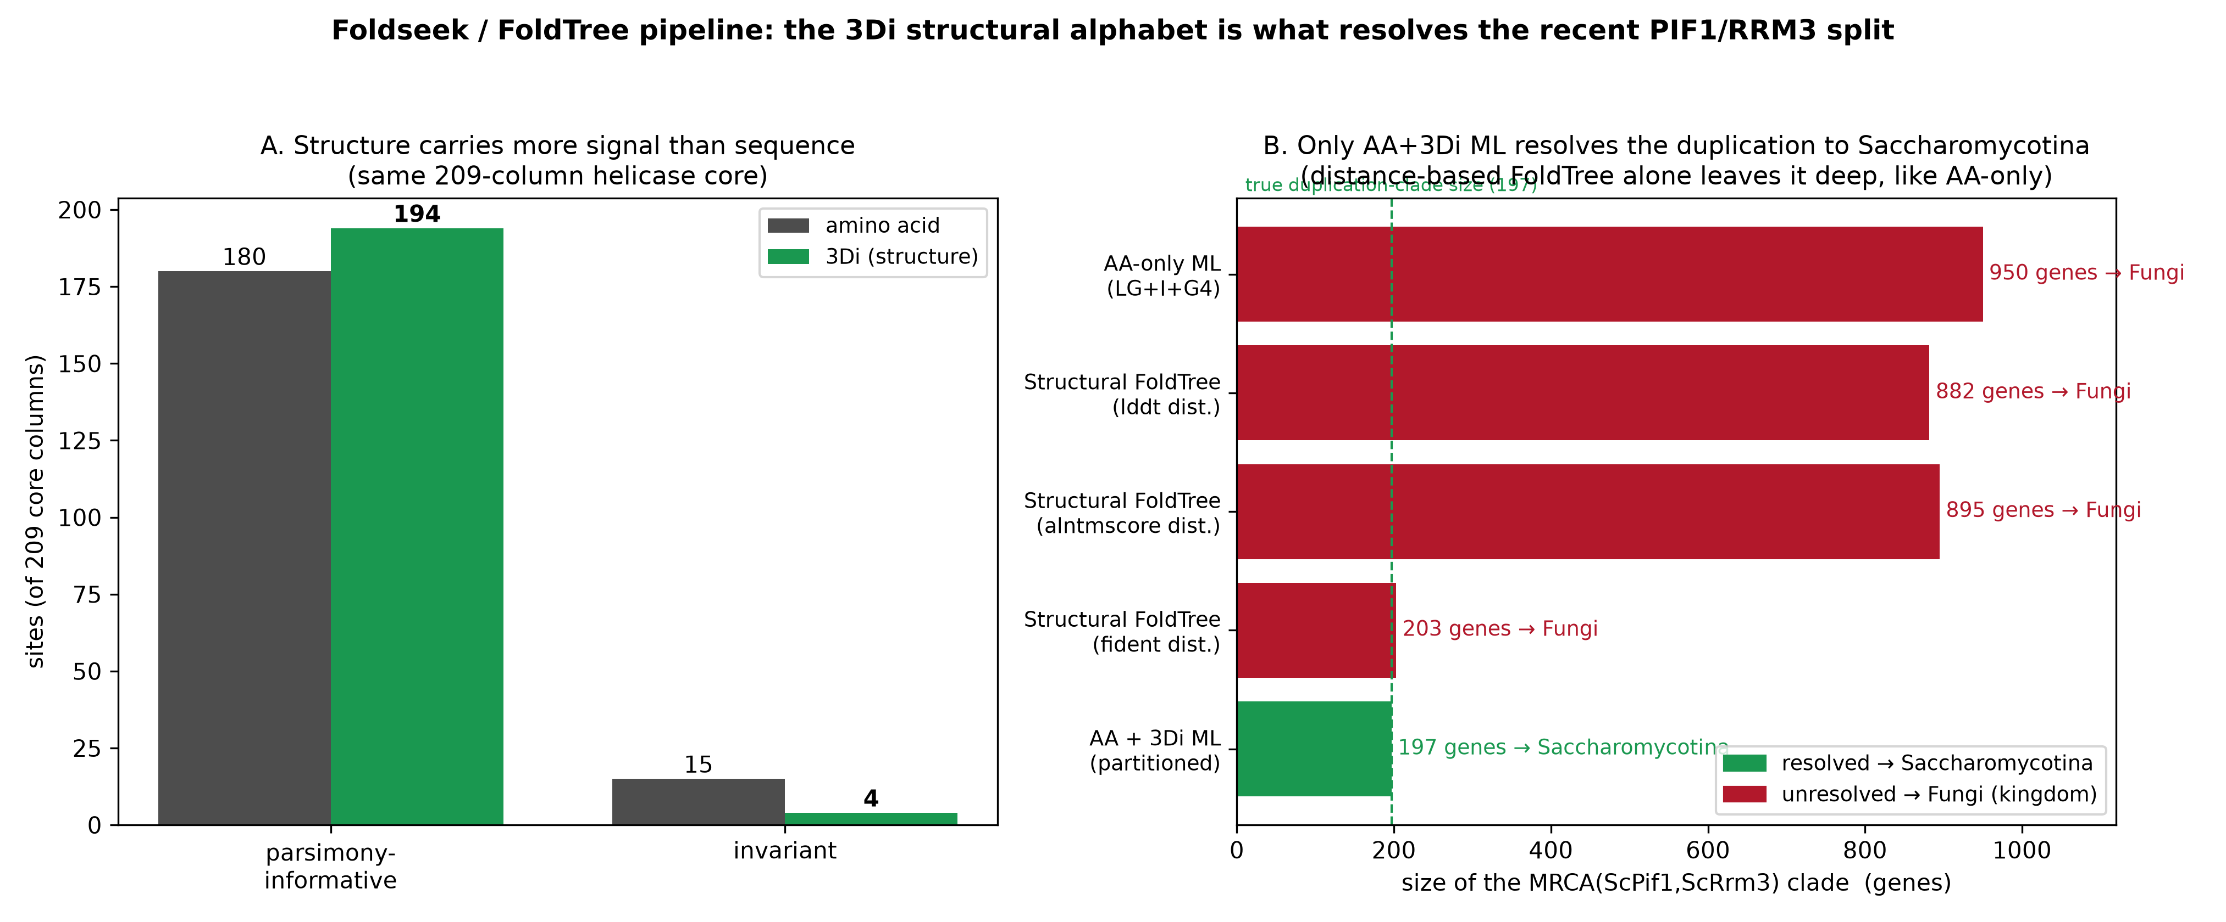
The fold carries the signal sequence lost
3Di structural characters — not structural distances — are what resolve the node
3Di has more informative sites than amino acids (194 vs 180) — yet only the AA+3Di ML partition reaches Saccharomycotina; pure distance-based FoldTree (fident/alntmscore/lddt) stays deep, like AA-only.

Slide 5
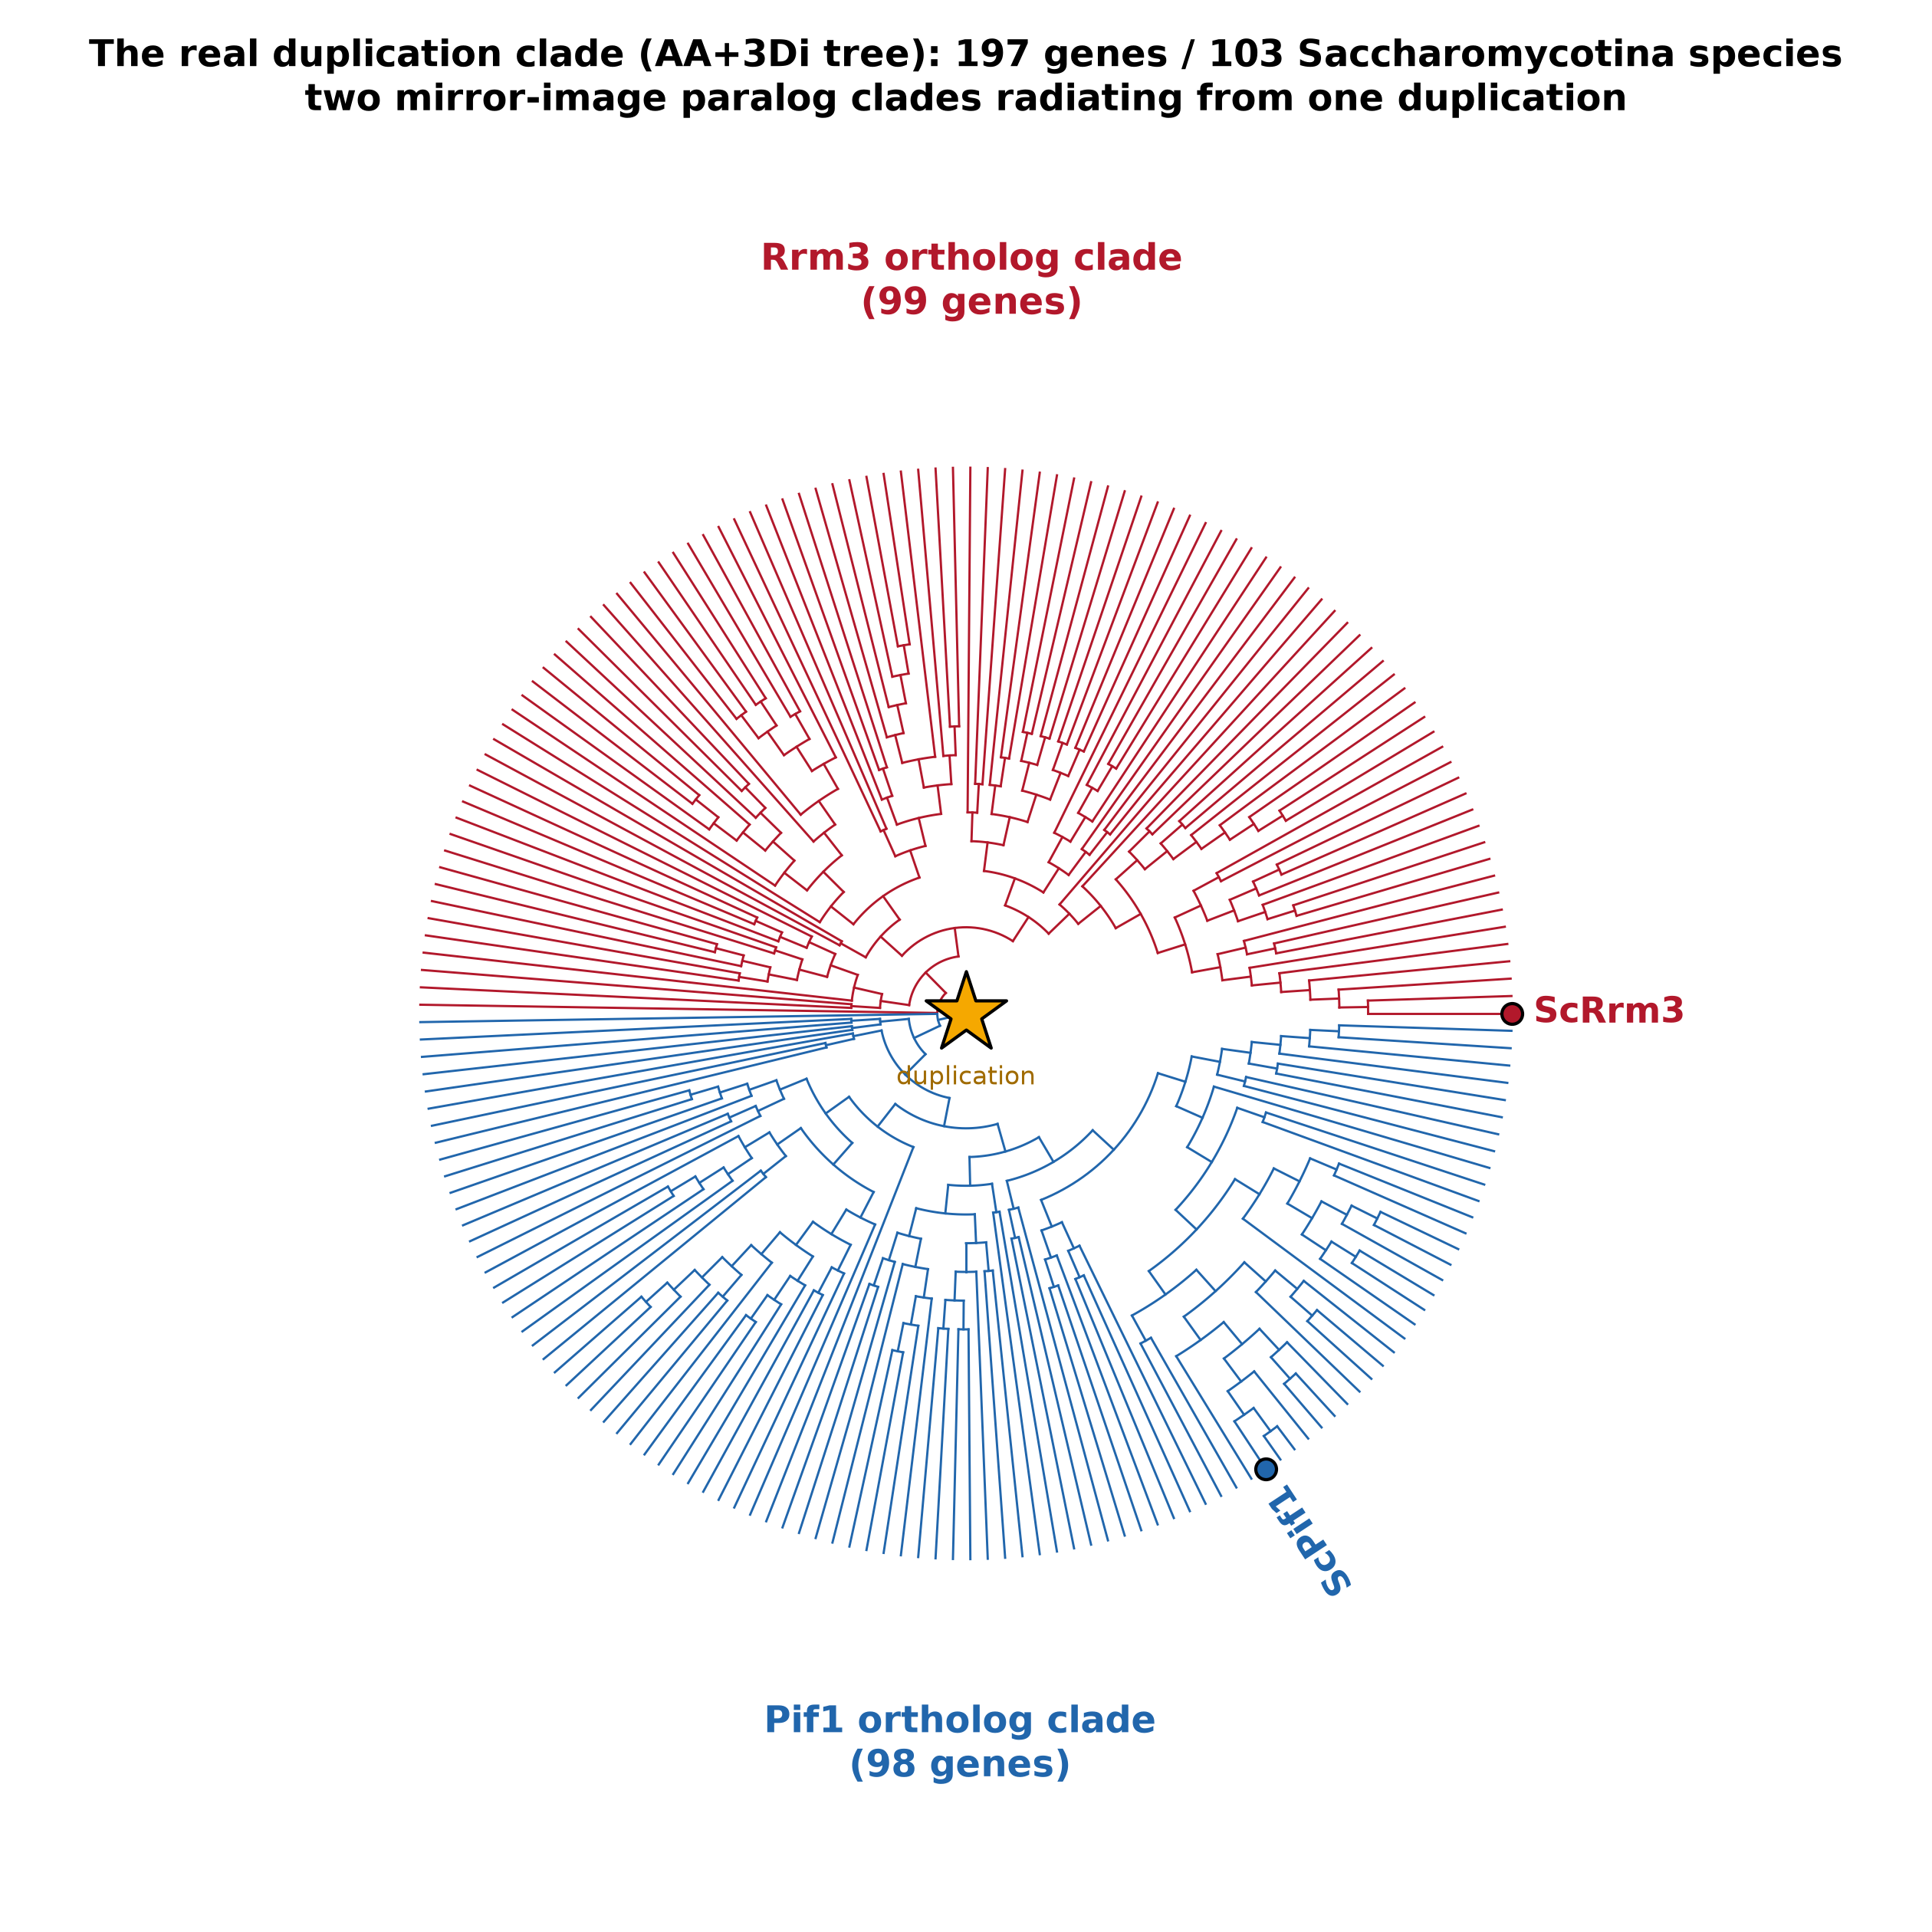
PIF1/RRM3 arose once — in the Saccharomycotina ancestor
The duplication clade: 197 genes / 103 species
★ Two mirror-image paralog clades (Pif1 + Rrm3) radiate from a single duplication.
★ Both paralogs span ~all Saccharomycotina families → the event predates the budding-yeast radiation.
★ Independently confirmed by GeneRax (ML) and species-overlap reconciliation.
★ Two-copy mushrooms are a separate, convergent duplication — not yeast Pif1/Rrm3 orthologs.

Slide 6
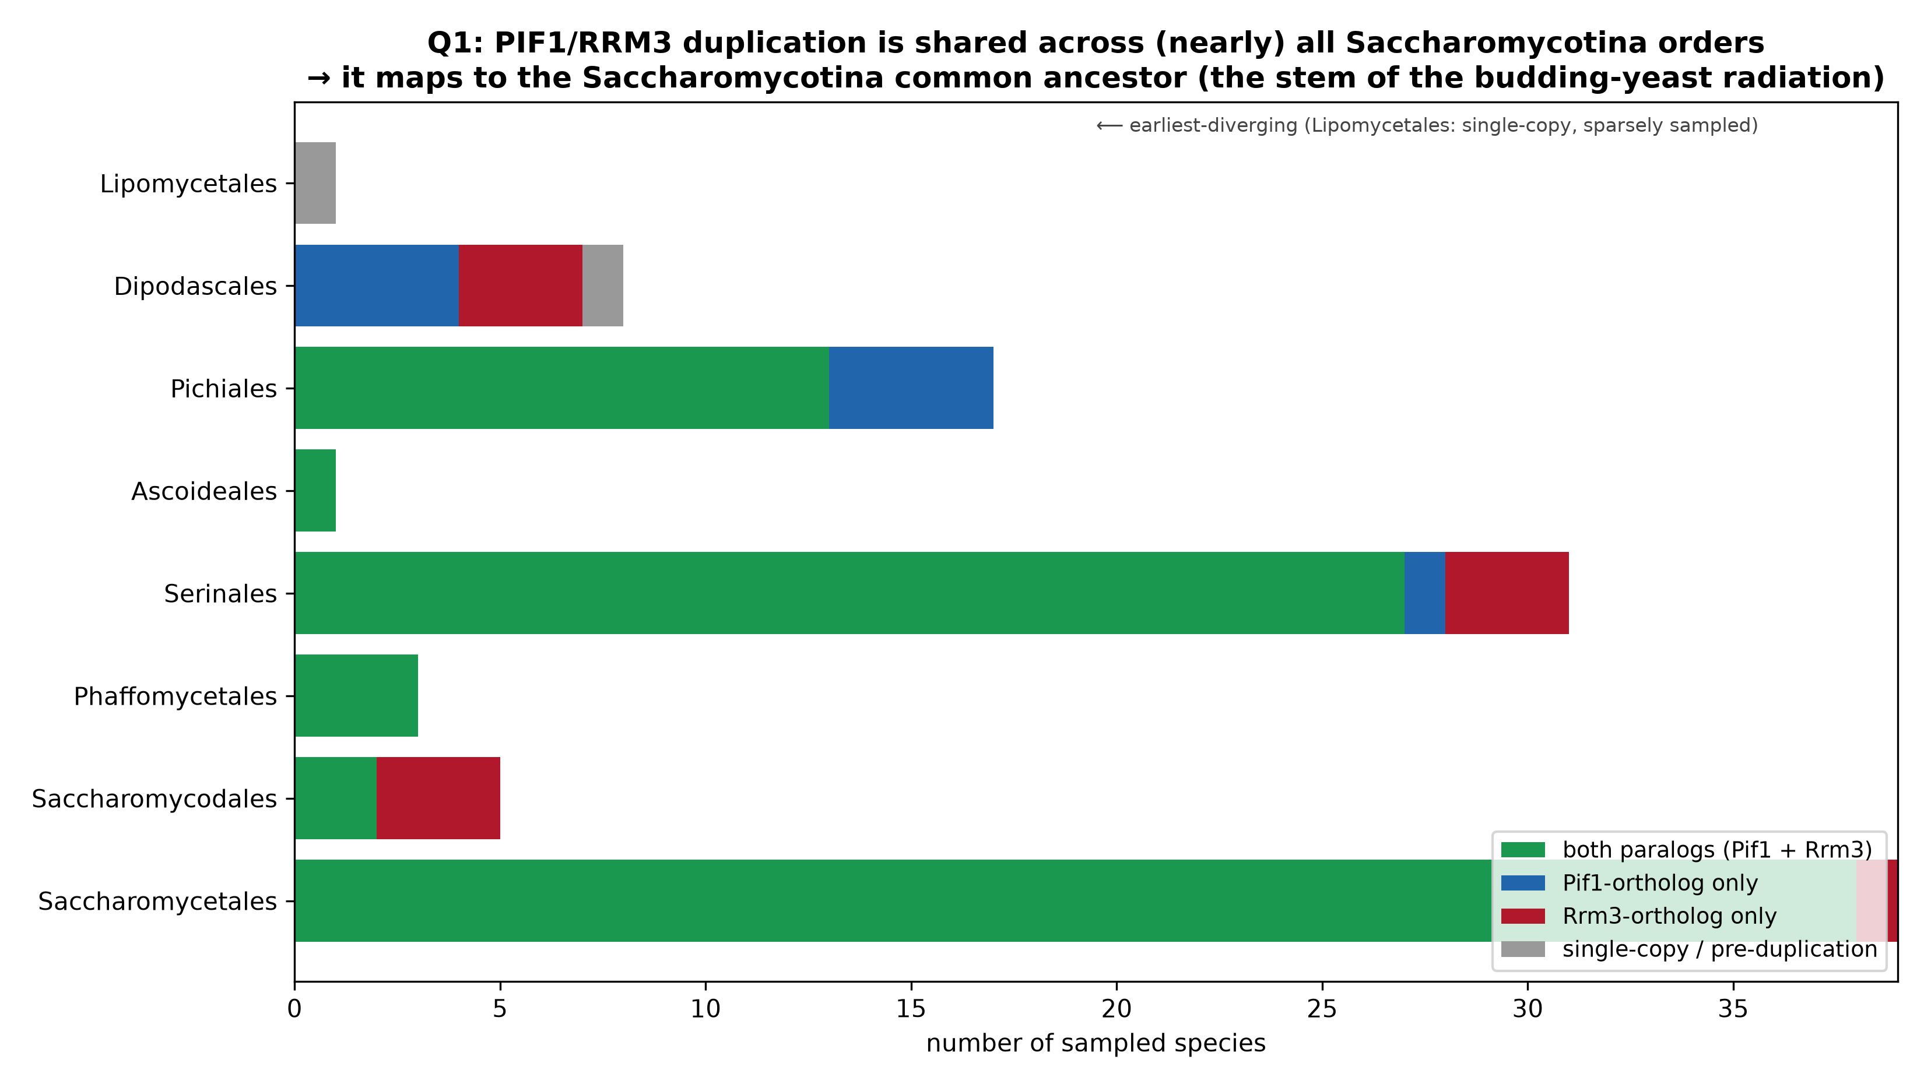
Reconciliation pins it to the Saccharomycotina stem
★ GeneRax (gold-standard ML duplication–loss) maps the duplication to the Saccharomycotina common ancestor.
★ Both paralogs present in 8 of 9 sampled families → stem of the radiation.
★ Earliest branch (Lipomycetales) is single-copy; deeper sampling would refine before-vs-after that first split.

Slide 7
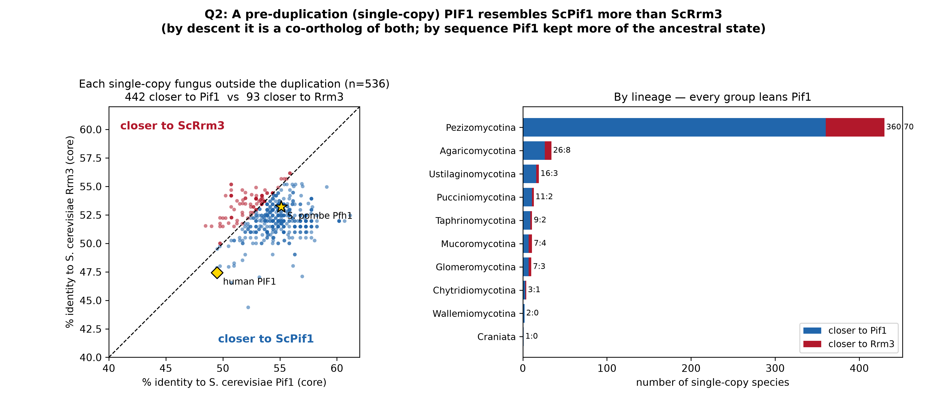
The ancestral fungal PIF1 was “Pif1-like”
A single-copy PIF1 outside the duplication is, by descent, a co-ortholog of both paralogs (0/536 nest inside either). But by sequence it resembles ScPif1 more (442 vs 93 species; every subphylum) — Pif1 kept more of the ancestral state; Rrm3 is the derived paralog.

Slide 8
Takeaways
★ The PIF1/RRM3 duplication maps to the Saccharomycotina ancestor — the stem of the budding-yeast radiation.
★ Structure (3Di) resolves a node amino acids can't — but as ML characters, not distances.
★ GeneRax and species-overlap reconciliation agree; the two-copy mushrooms are an independent, convergent duplication.
★ The ancestral fungal PIF1 was Pif1-like; Rrm3 is the more-derived paralog.
★ Fully reproducible: github.com/spegray/pif1-foldtree · IQ-TREE 3.1.2, foldseek, GeneRax 2.0.4, ColabFold (AF2).

