Slide 1
IOT to controle HenHouse
Lasse Greve Rasmussen

Slide 2
Requirements
The system must collect data of sunrise and sunset from an API on dayli basis
The system must controle a servo to open and close the gate
When the time of sunset is reached, the gate must close
When the time of sunrise is reached, the gate must open
While nothing to proceed the system should go to sleep
If sunrise and sunset isn’t updated, the system will be controlled by lightlevels meassured by a photoresistor

Slide 3
Extra options
The system could be driven by a battery charged froma solacell
While the nights are long in wintertime, there could be turned on ligth in the Henhouse for some houers after sunset

Slide 4
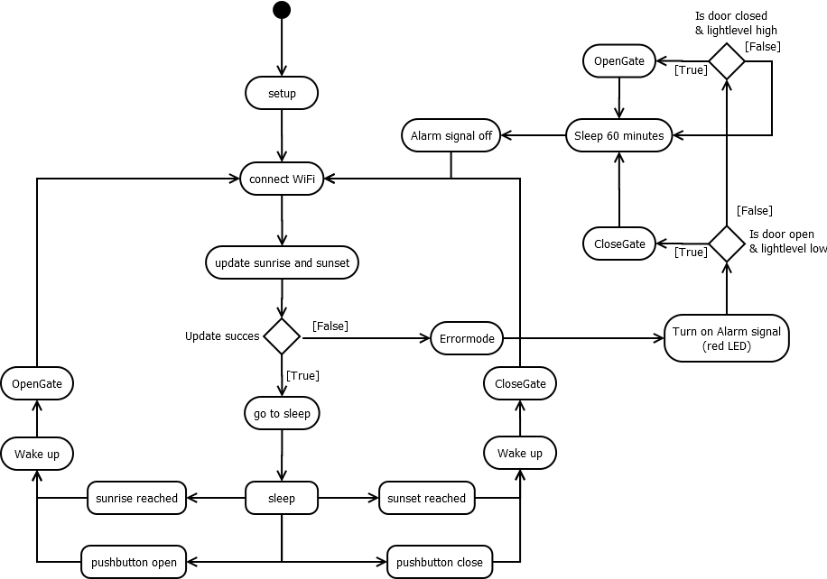
Activity Diagram of system-to-be

Slide 5
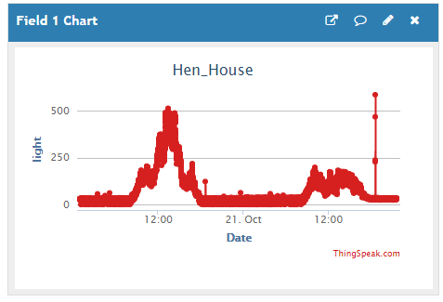
Status
Gate is controlled by Argon
Ligthlevels are being logget
API
https://api.sunrise-sunset.org/json?lat=56.126211&lng=9.165724&date=today

Slide 6
Further work
Energy demands and options
Supply for servo on demand
Reading data from API
Sleepmode controlled by timestamp- and input interrupts

