Slide 1
Embedding Analytical Fracture Mechanics into Neural Networks
From Williams-Enriched Kolosov–Muskhelishvili Network to a Variational Formulation
Shuwei Zhou, Christian Häffner, Sophie Stebner, Sebastian Münstermann
Institute of Metal Forming, RWTH Aachen University
12.09.2026
ECF 25, Athens

Slide 2
Outline
01
Background & Theory
02
Williams-Enriched KMINN
03
Variational KMINN
04
Conclusions & Outlook

Slide 3
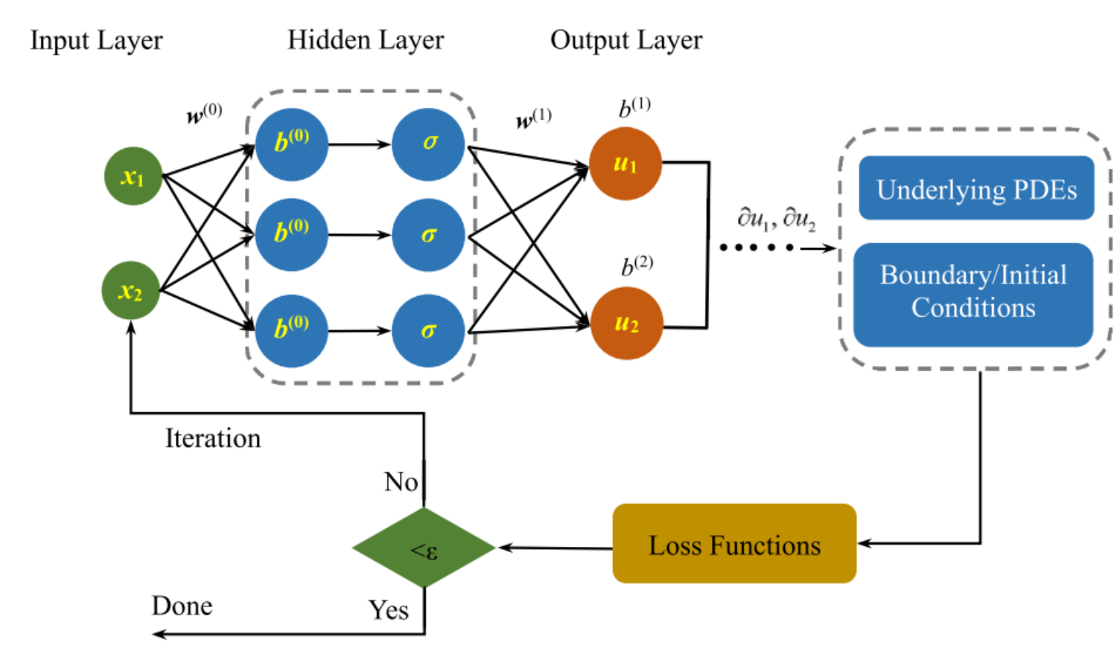
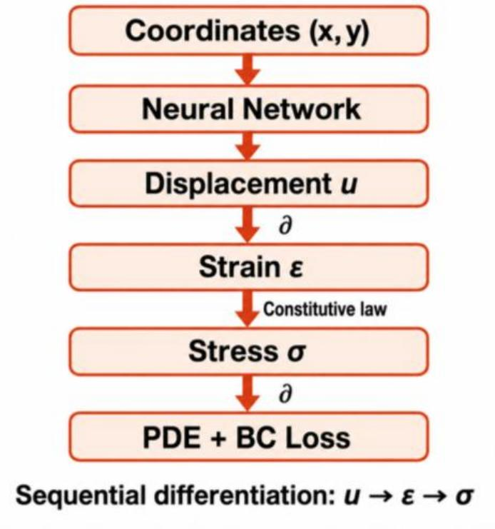
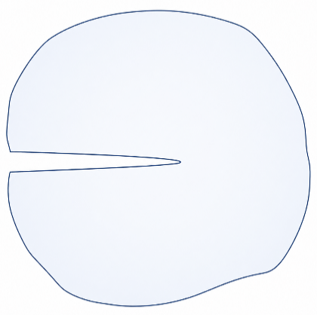
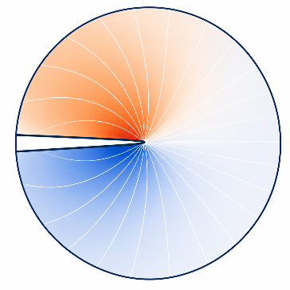


1.1 Background
Two Difficulties of Conventional PINNs
Conventional PINN
Residual-based training
PDE and boundary losses must be carefully balanced
Training becomes stiff and sensitive to loss weighting
$$\begin{aligned}\boxed{ℒ=λ_{PDE}ℒ_{PDE}+λ_{BC}ℒ_{BC}+⋯}\end{aligned}$$
[ 1]
Localized crack-tip fields
Generic NNs are biased toward smooth fields
Crack-tip singularity and displacement discontinuity are difficult to capture
Accuracy strongly depends on near-tip sampling
r
θ
Stress:$\frac{1}{\sqrt{r}}$
Displacement: $\sqrt{r}$
$$\begin{aligned}\boxed{\begin{aligned}⟦u⟧≠0\end{aligned} and \begin{aligned}{ r}^{−1/2}\end{aligned} }\end{aligned}$$
Crack Surface $\begin{aligned}⟦u⟧≠0\end{aligned}$
Crack surface discontinuity
Crack-tip singularity
[ 1] Y Gu et al. International Journal of Solids and Structures. 2023
Ω
Notes:
inverse square-root singularity
r to the minus one-half.
displacement has a jump across the crack faces

Slide 4









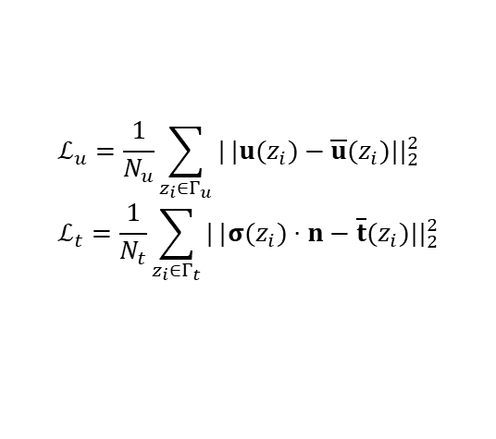





1.2 Theory
Equilibrium satisfied by construction
Network Structure
Kolosov–Muskhelishvili (KM) Function ^{[1]}
KMINN
z
PINN
$$\left\{\begin{matrix}σ_{xx}=\operatorname{Re}\left(2φ^{′}−\bar{z}φ^{″}−ψ^{′}\right), \\ σ_{yy}=\operatorname{Re}\left(2φ^{′}+\bar{z}φ^{″}+ψ^{′}\right), \\ σ_{xy}=\operatorname{Im}\left(\bar{z}φ^{″}+ψ^{′}\right), \\ u_{x}=\frac{1}{2μ}\operatorname{Re}\left(κφ−\bar{z}φ^{′}−\bar{ψ}\right), \\ u_{y}=\frac{1}{2μ}\operatorname{Im}\left(κφ−\bar{z}φ^{′}−\bar{ψ}\right),\end{matrix}\right.$$
…
…
Coordinates (x, y)
Complex coordinate z
…
…
Branch 2 for $φ$
Branch 1 for $ψ$
Neural Network
Holomorphic Network
…
…
Displacement u
Potentials φ, ψ
exp(z )
$$φ$$
$$ψ$$
∂
Loss Function
Strain ε
$$ℒ=w_{u}ℒ_{u}{+w}_{t}ℒ_{t}$$
Displacement u
Stress σ
$$\overline{{ ∂}_{\overline{z}}}$$
¯¯
$${ ∂}_{zz}$$
$${ ∂}_{z}$$
Constitutive law
$$ℒ_{u}=\frac{1}{N_{u}}\sum_{z_{i}∈Γ_{u}}{|}|u(z_{i})−\overline{u}(z_{i})||_{2}^{2} \\ ℒ_{t}=\frac{1}{N_{t}}\sum_{z_{i}∈Γ_{t}}{|}|σ(z_{i})⋅n−\overline{t}(z_{i})||_{2}^{2}$$
KM formulations
Stress σ
$${\text{u}}_{y}$$
$${\text{u}}_{x}$$
$${\text{σ}}_{xy}$$
$${\text{σ}}_{yy}$$
$${\text{σ}}_{xx}$$
∂
PDE + BC Loss
BC Loss Only
[1] Matteo Calafà et al. Comput. Methods Appl. Mech. Engrg. 2024
Notes:
inverse square-root singularity
r to the minus one-half.

Slide 5






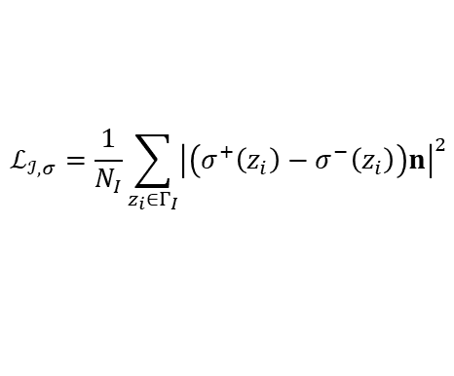




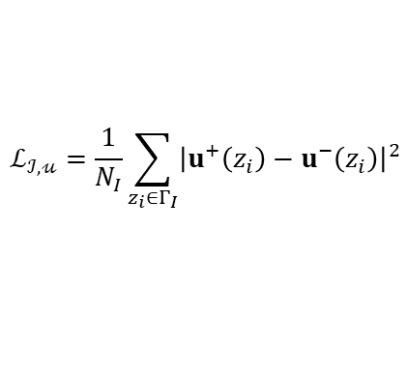




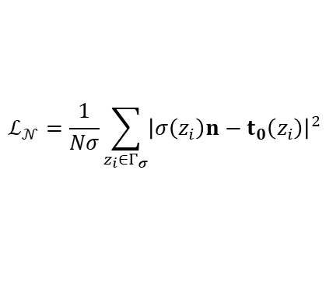
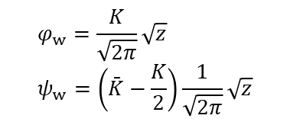





















2.1 Williams-Enriched KMINN
Williams’ Network Structure
Williams’ model expansion ^{[1]}
BC loss
Crack loss
z
$$ℒ_{𝒟}=\frac{1}{N_{u}}\sum_{z_{i}∈Γ_{u}}{{\left|u\left(z_{i}\right)−u_{0}\left(z_{i}\right)\right|}^{2}}$$
$$ℒ_{𝒸}=\frac{1}{N_{c}}\sum_{z_{i}∈Γ_{c}}{{\left|σ\left(z_{i}\right)n\right|}^{2}}$$
…
…
$$\left|σ_{y}−σ_{x}+2iσ_{xy}\right| =2\left[\bar{z}​φ^{″}(z)+ψ^{′}(z)\right]$$
$$=\left|Az^{−1/2}+Bz^{−3/2}\bar{z}+Cz^{0}\right|$$
…
…
Branch 2 for $φ$
Branch 1 for $ψ$
$$ℒ_{𝒩}=\frac{1}{Nσ}\sum_{z_{i}∈Γ_{σ}}{{\left|σ\left(z_{i}\right)n−t_{0}\left(z_{i}\right)\right|}^{2}}$$
$$Γ_{t}$$
…
…
$$A=−B=K_{I}/2\sqrt{2π},C=−T$$
Crack potentials
Interface loss
$φ$_{n}
$$φ_{w}^{+}$$
$$ψ_{w}^{+}$$
$$ψ_{w}^{−}$$
$ψ$_{n}
$$φ_{w}^{−}$$
Enrichment
$$Ω_{1}$$
$$φ_{w}=\frac{K}{\sqrt{2π}}\sqrt{z} \\ ψ_{w}=\left(\bar{K}−\frac{K}{2}\right)\frac{1}{\sqrt{2π}}\sqrt{z}$$
$$ℒ_{ℐ,σ}=\frac{1}{N_{I}}\sum_{z_{i}∈Γ_{I}}{{\left|\left(σ^{+}\left(z_{i}\right)−σ^{−}\left(z_{i}\right)\right)n\right|}^{2}}$$
$$η_{1}^{+}$$
$$η_{2}^{+}$$
$$L_{1}$$
$$η_{1}^{−}$$
$$η_{2}^{−}$$
$$L_{2}$$
exp(z )
$$φ$$
$$ψ$$
$$ℒ_{ℐ,𝓊}=\frac{1}{N_{I}}\sum_{z_{i}∈Γ_{I}}{{\left|u^{+}\left(z_{i}\right)−u^{−}\left(z_{i}\right)\right|}^{2}}$$
$$Ω_{2}$$
$$η_{3}^{+}$$
$$η_{3}^{−}$$
$$\overline{{ ∂}_{\overline{z}}}$$
¯¯
$${ ∂}_{zz}$$
$${ ∂}_{z}$$
$$L_{3}$$
$$K=K_{I}+{iK}_{II}$$
$$Ω_{3}$$
KM formulations
$${\text{u}}_{y}$$
$${\text{u}}_{x}$$
$${\text{σ}}_{xy}$$
$${\text{σ}}_{yy}$$
$${\text{σ}}_{xx}$$
$$Γ_{u}$$
[1] Matteo Calafà. Engineering Fracture Mechanics 2025
Notes:
Instead of asking the network to learn the singular structure from data, we explicitly build it in.

Slide 6
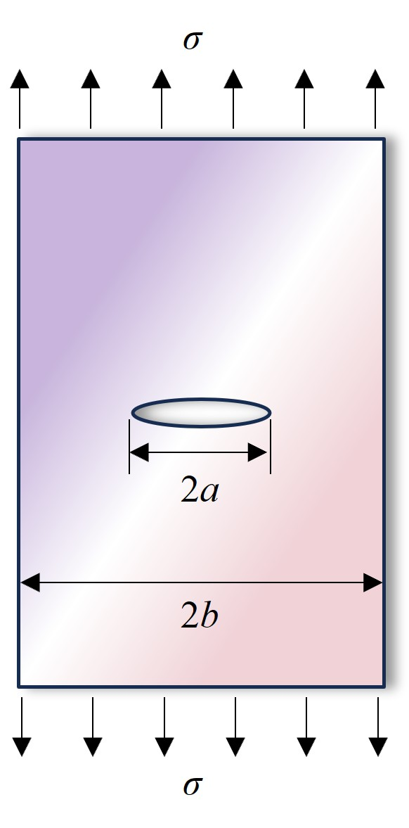
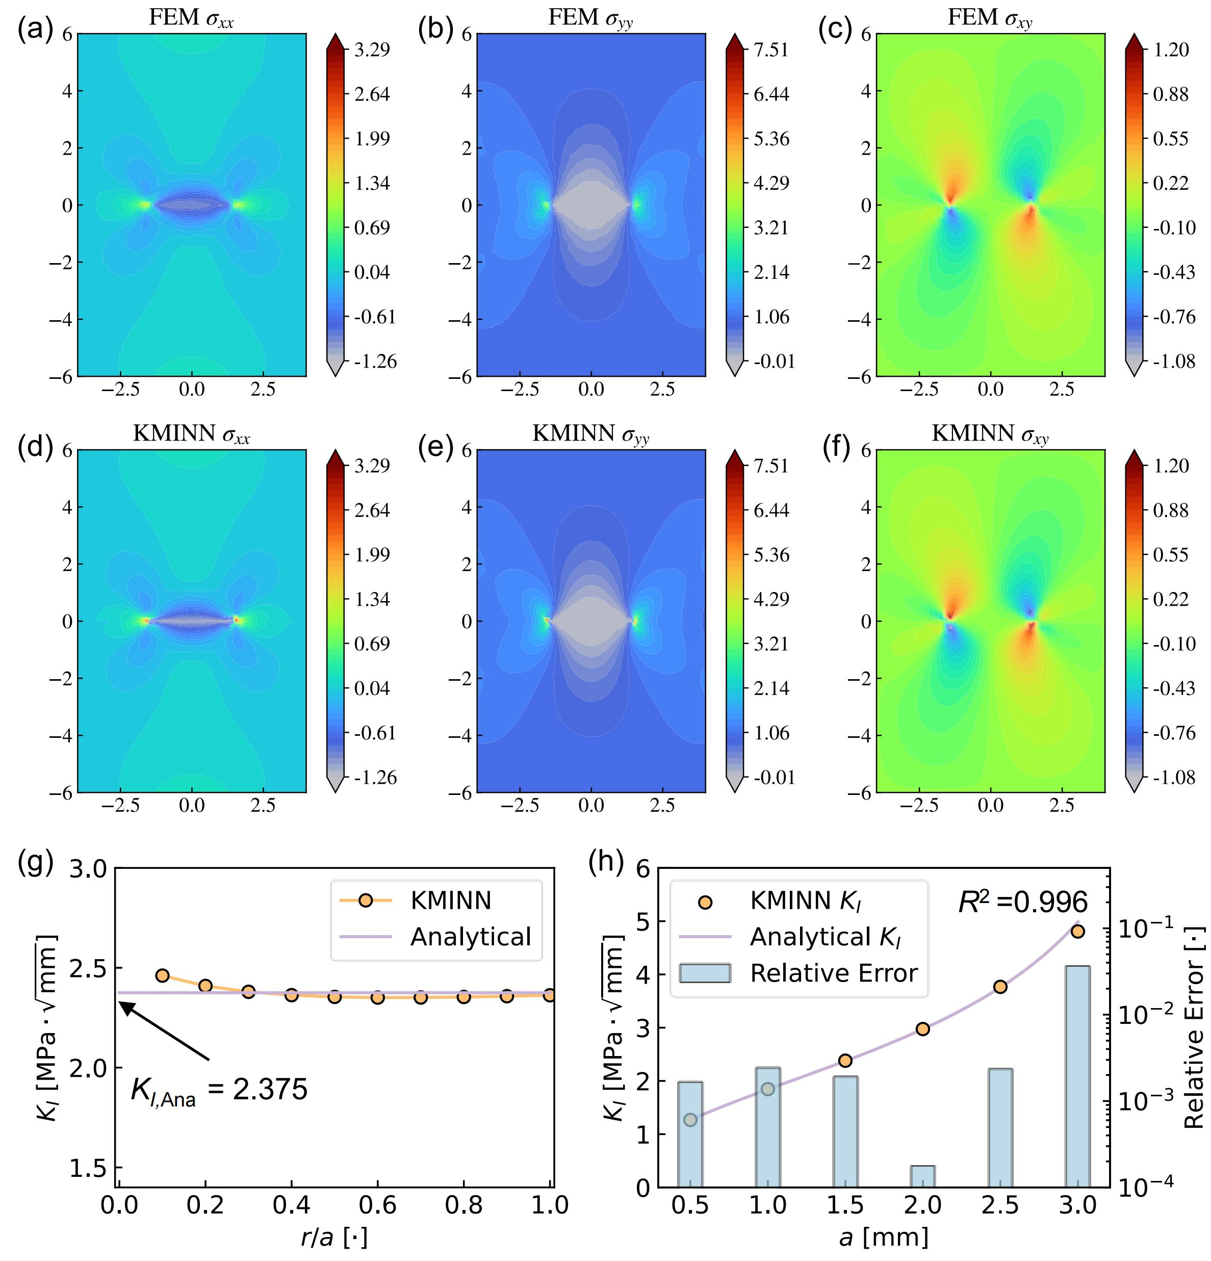
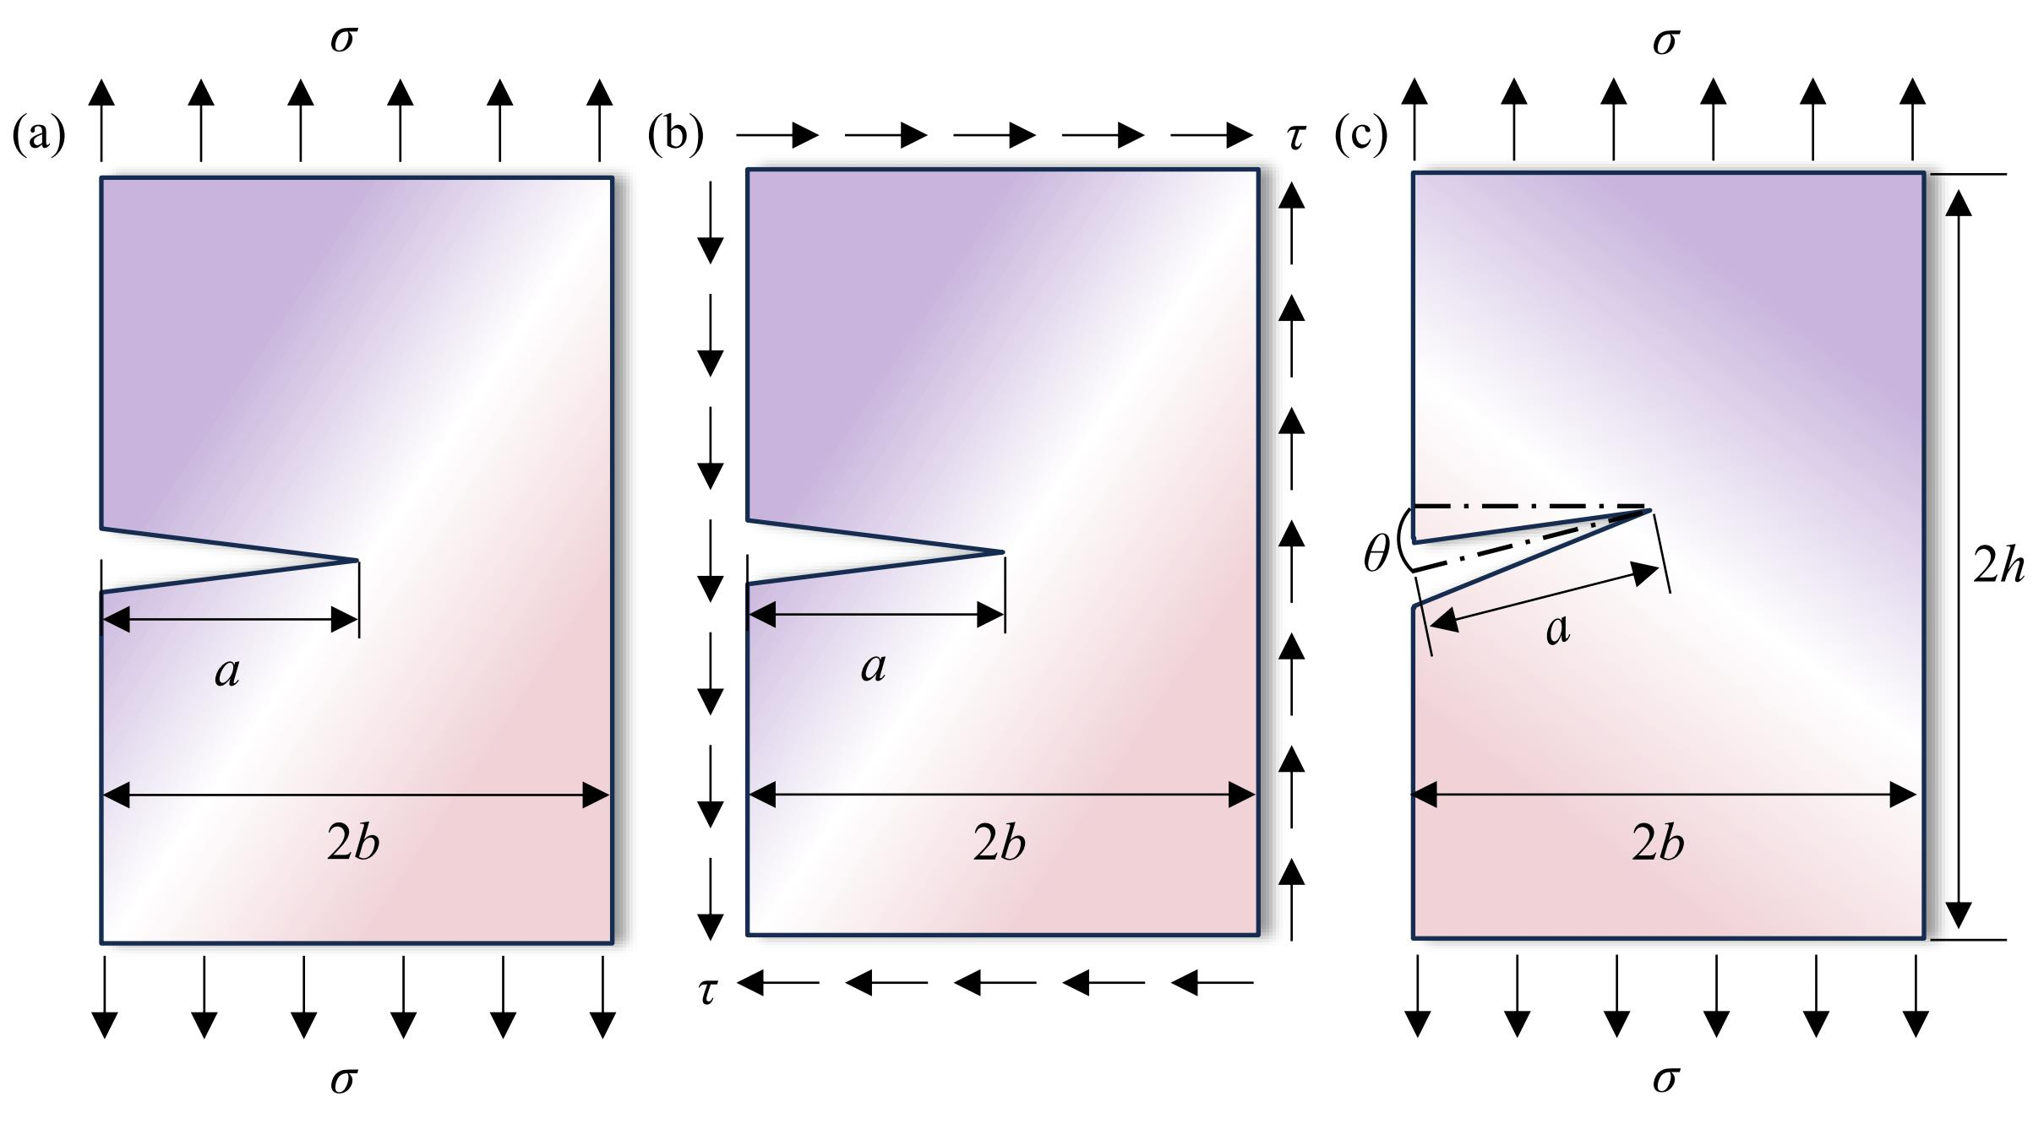
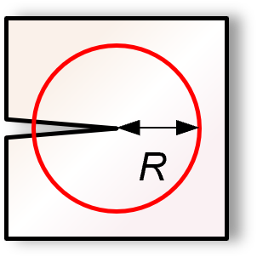





2.2 Williams-Enriched KMINN
Static crack
Crack propagation
$$\begin{aligned}I=\oint_{Θ}{\left[\left(σ:ε^{aux}\right)n_{x}−t⋅u_{,x}^{aux}−t^{aux}⋅u_{,x}\right]}ds\end{aligned}$$
Fields
$$\begin{aligned}\left(K_{I}^{aux},K_{II}^{aux}\right)=\left(1,0\right)⇒\boxed{K_{I}=\frac{E′}{2}I^{\left(I\right)}}\end{aligned}$$
interaction-integral
$$\begin{aligned}\left(K_{I}^{aux},K_{II}^{aux}\right)=\left(0,1\right)⇒\boxed{K_{II}=\frac{E′}{2}I^{\left(II\right)}}\end{aligned}$$
$$\begin{aligned}K_{I}, K_{II}\end{aligned}$$
The interaction integral extracts individual Mode-I and Mode-II SIFs using analytically known auxiliary fields.
Propagation criterion
MTS · MERR · PLS
Crack angle $\begin{aligned}θ_{c}\end{aligned}$
Center Crack Tension (CCT)
Notes:
Maximum Tangential Stress Criterion，Maximum Energy Release Rate Criterion，Principle of Local Symmetry

Slide 7




3.1 Limitation of Residual-based Method
Residual-based KMINN
Why this is a problem
$$ℒ=s_{u}ℒ_{𝒟}+s_{σ}ℒ_{𝒩}+s_{I}ℒ_{I}+s_{c}ℒ_{𝒸}$$
$$s_{σ}ℒ_{𝒩}$$
$$s_{u}ℒ_{𝒟}$$
$$s_{I}ℒ_{I}$$
Γ_{N}
Loss balancing remains problem-dependent
Ω₁
Γ_{N} Neumann BC
Γ_{D} Dirichlet BC
…
Γ_{I} Interface
Training can be sensitive to weighting choices
Γ_{c}
Γ_{c} Crack surface
Γ_{I}
crack tip
Optimization
Complex boundary problems become difficult to optimize
crack tip
Ω₂
Manual weighting
of loss terms
Multi-term objective
Γ_{D}
Notes:
Physics is embedded in the solution representation, but training still relies on manually constructed residual losses.

Slide 8
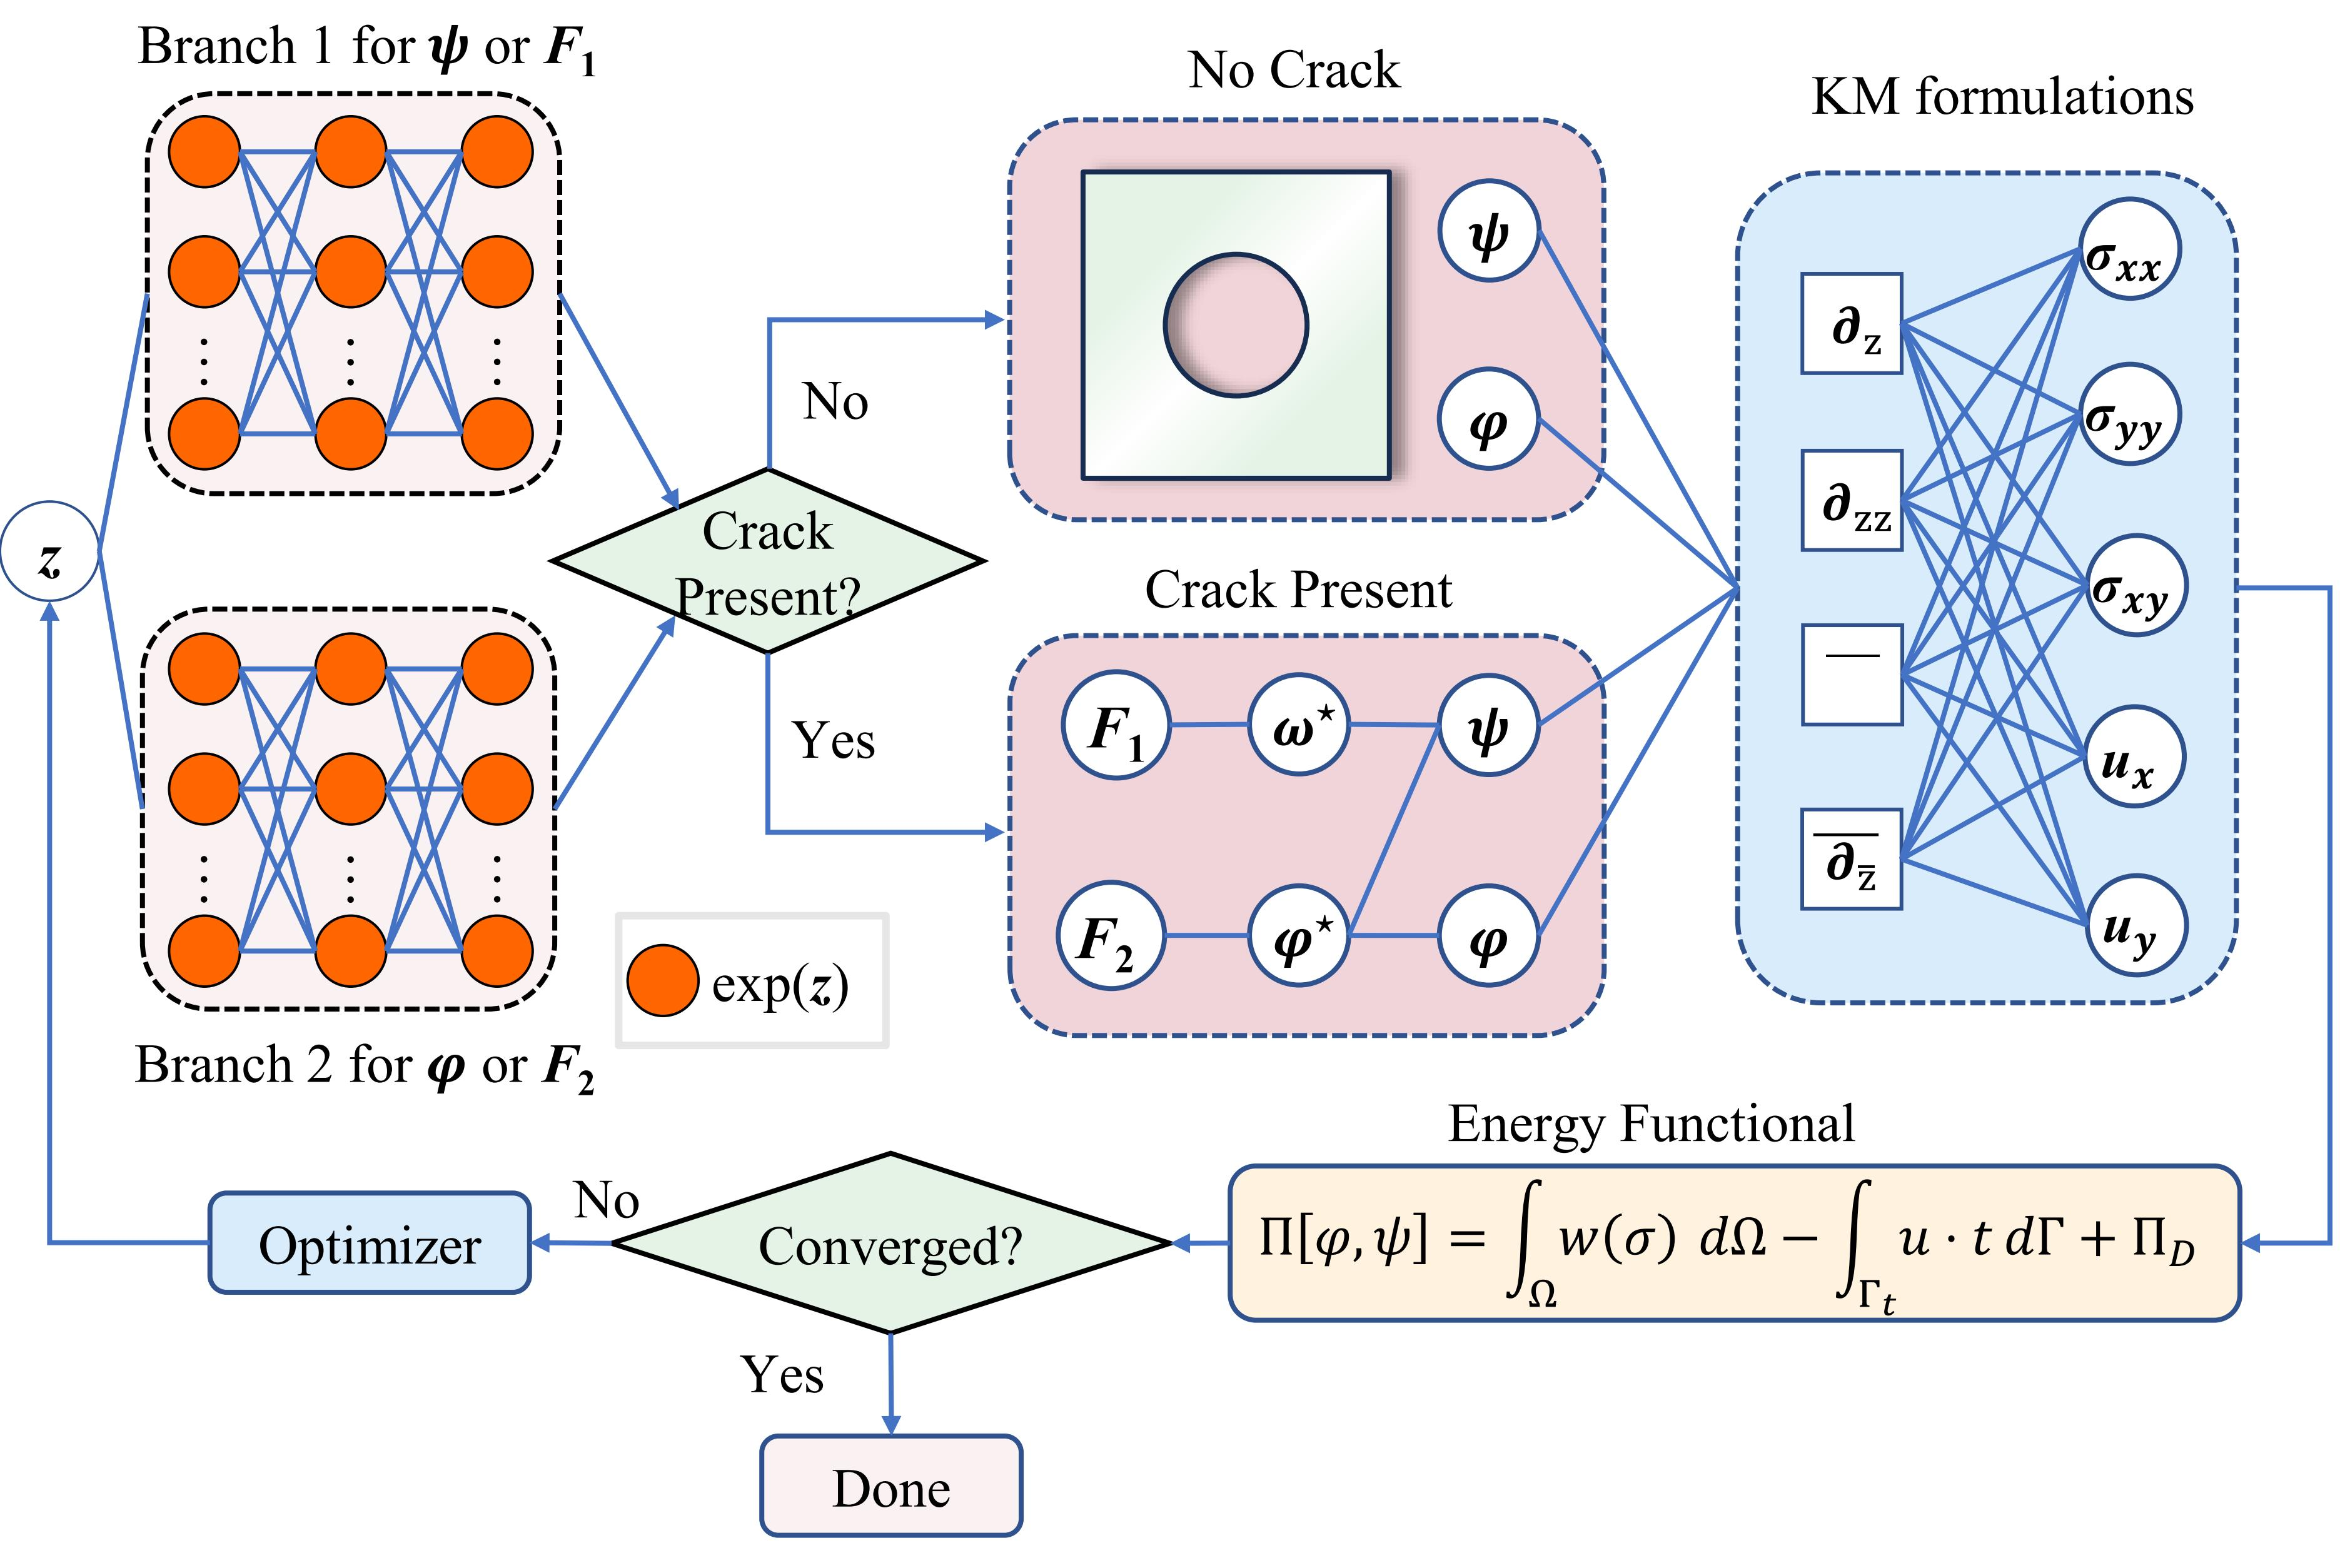




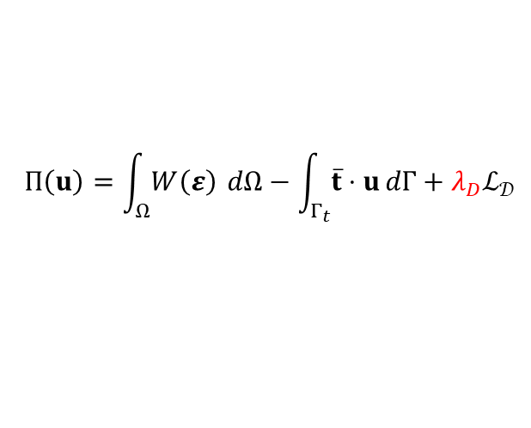



3.2 Theory of Energy Concept
Residual loss → energy minimization
$$∇⋅σ=0⟹δΠ\left(u\right)=0$$
$$Π\left(u\right)=\int_{Ω}{W\left(ε\right)} dΩ−\int_{Γ_{t}}{\overline{t}⋅u dΓ}+λ_{D}ℒ_{𝒟}$$
$W\left(ε\right)=\frac{1}{2}σ:ε$, $ℒ=Π\left(φ,ψ\right)$
Crack discontinuity auto-embedded
$ζ\left(z\right)=\sqrt{z}$ for edge crack
[1]
$ζ\left(z\right)=\sqrt{z−a}$ $\sqrt{z+a} for internal crack$
$$φ\left(z\right)=ζ\left(z\right)F_{1}\left(z\right)+F_{2}\left(z\right)$$
[2]
$$ω\left(z\right)=ζ\left(z\right)F_{1}^{⋆}\left(z\right)−F_{2}^{⋆}\left(z\right)$$
$$\begin{aligned}F^{⋆}\left(z\right):=\overline{F\left(\overline{z}\right)}\end{aligned}$$
$$ψ\left(z\right)=zφ^{′}\left(z\right)−ω\left(z\right)$$
vKMINN replaces multi-term residual loss balancing with a variational energy objective, while the discontinuous crack potential embeds the crack-face discontinuity and crack-tip singularity directly into the solution ansatz.
[1] Rice J R, International Journal of Fracture. (1980). [2] C. W. WOO, Engineering Fracture Mechanics. 1989.

Slide 9
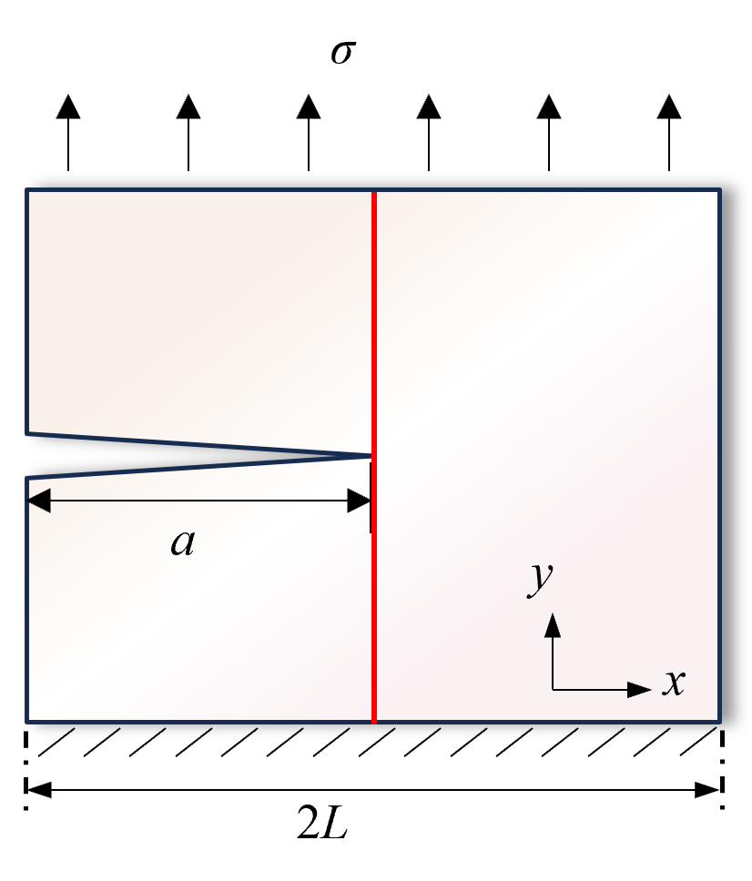
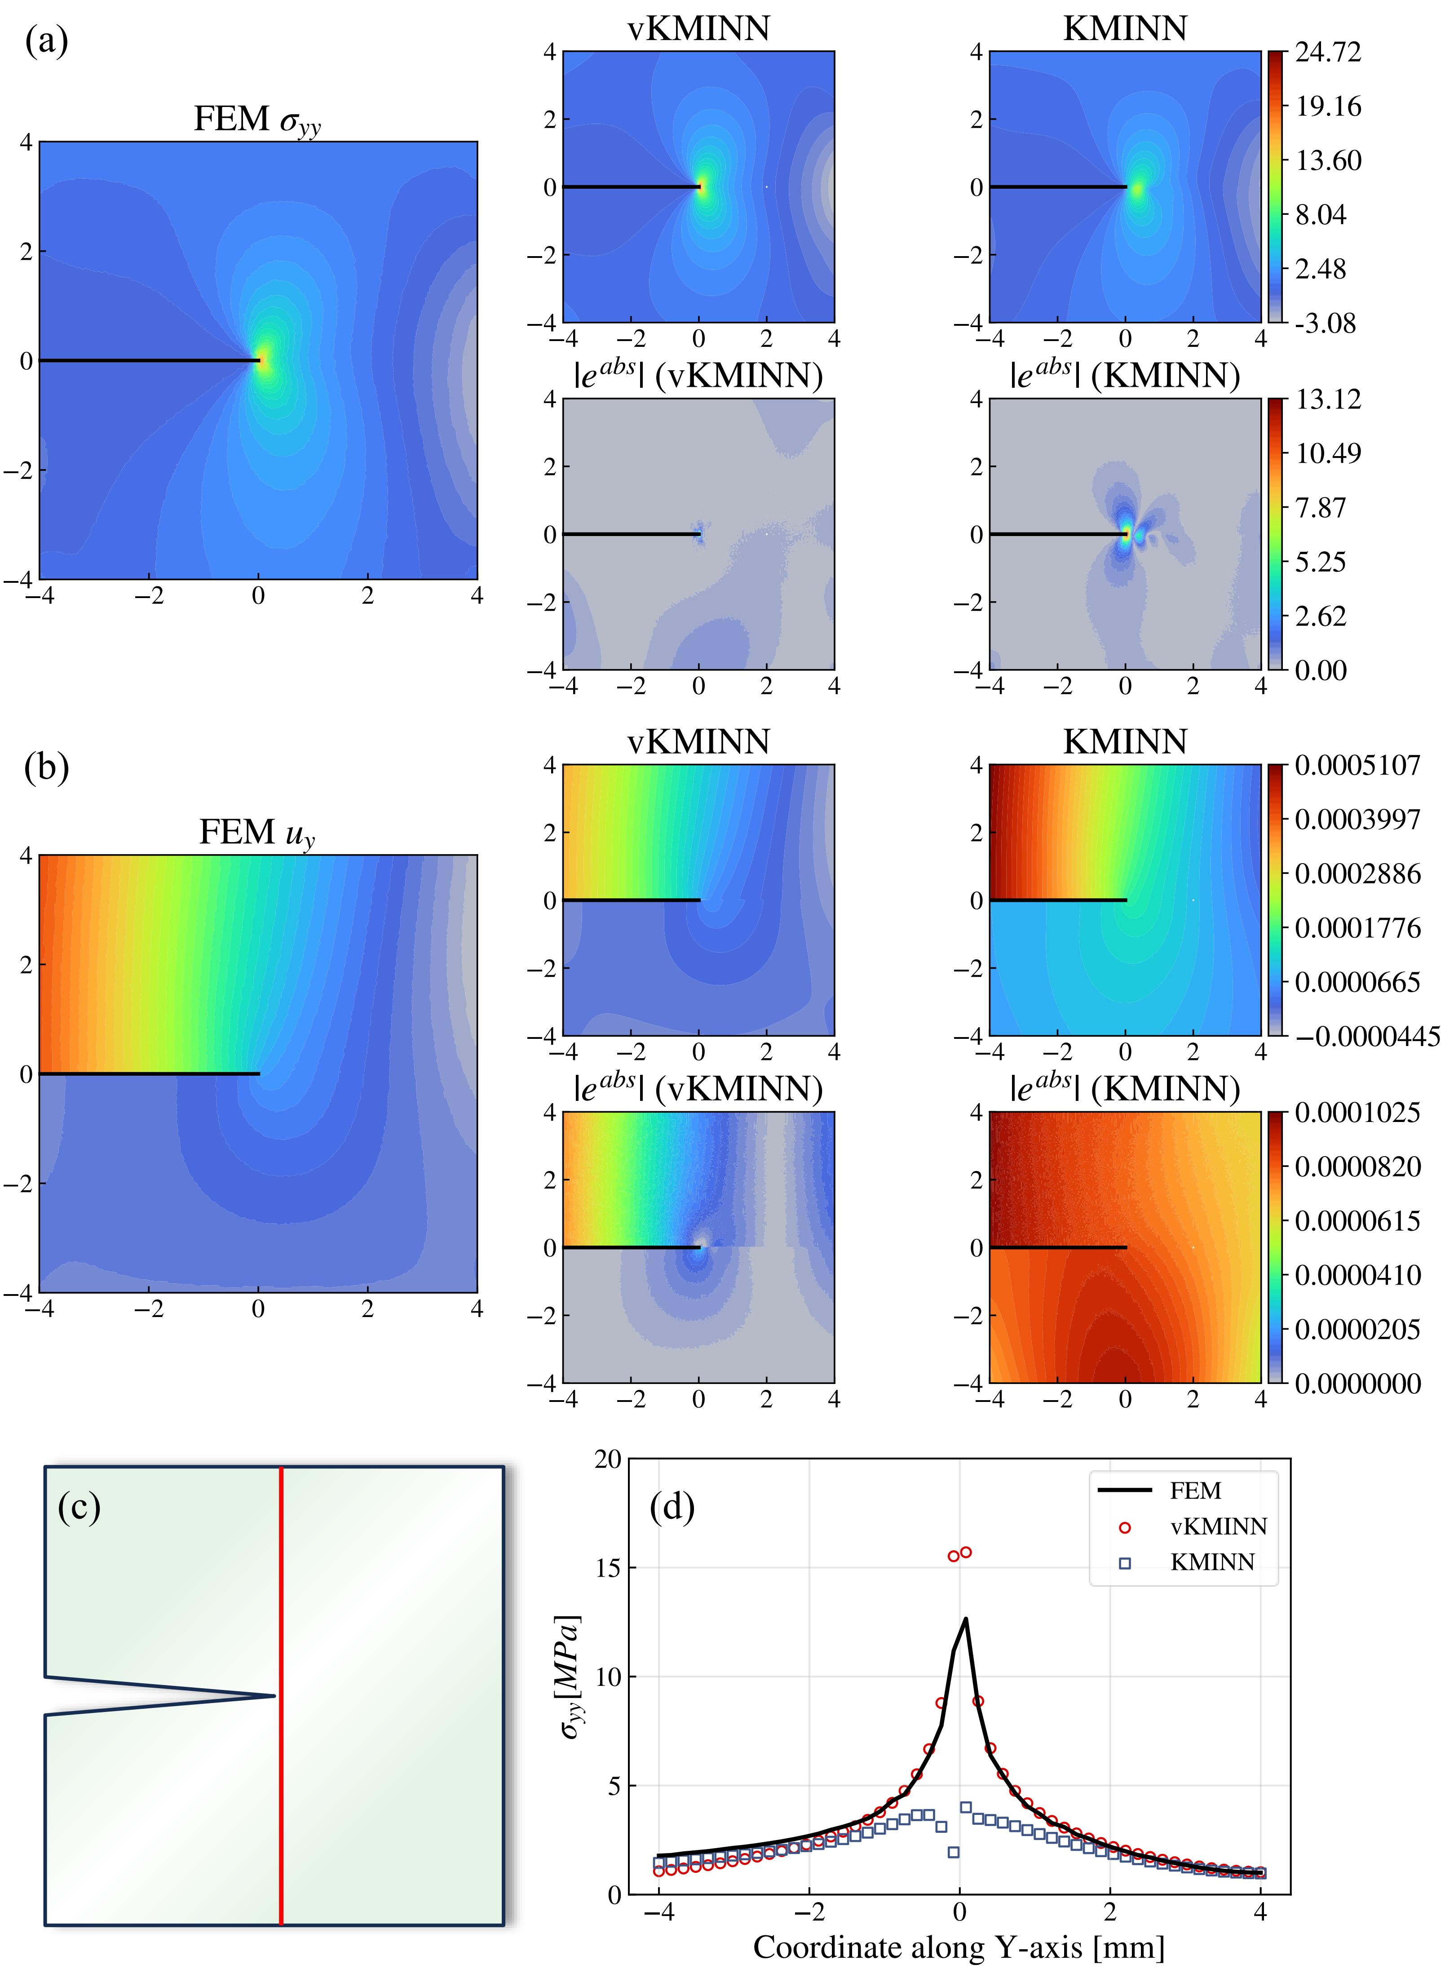
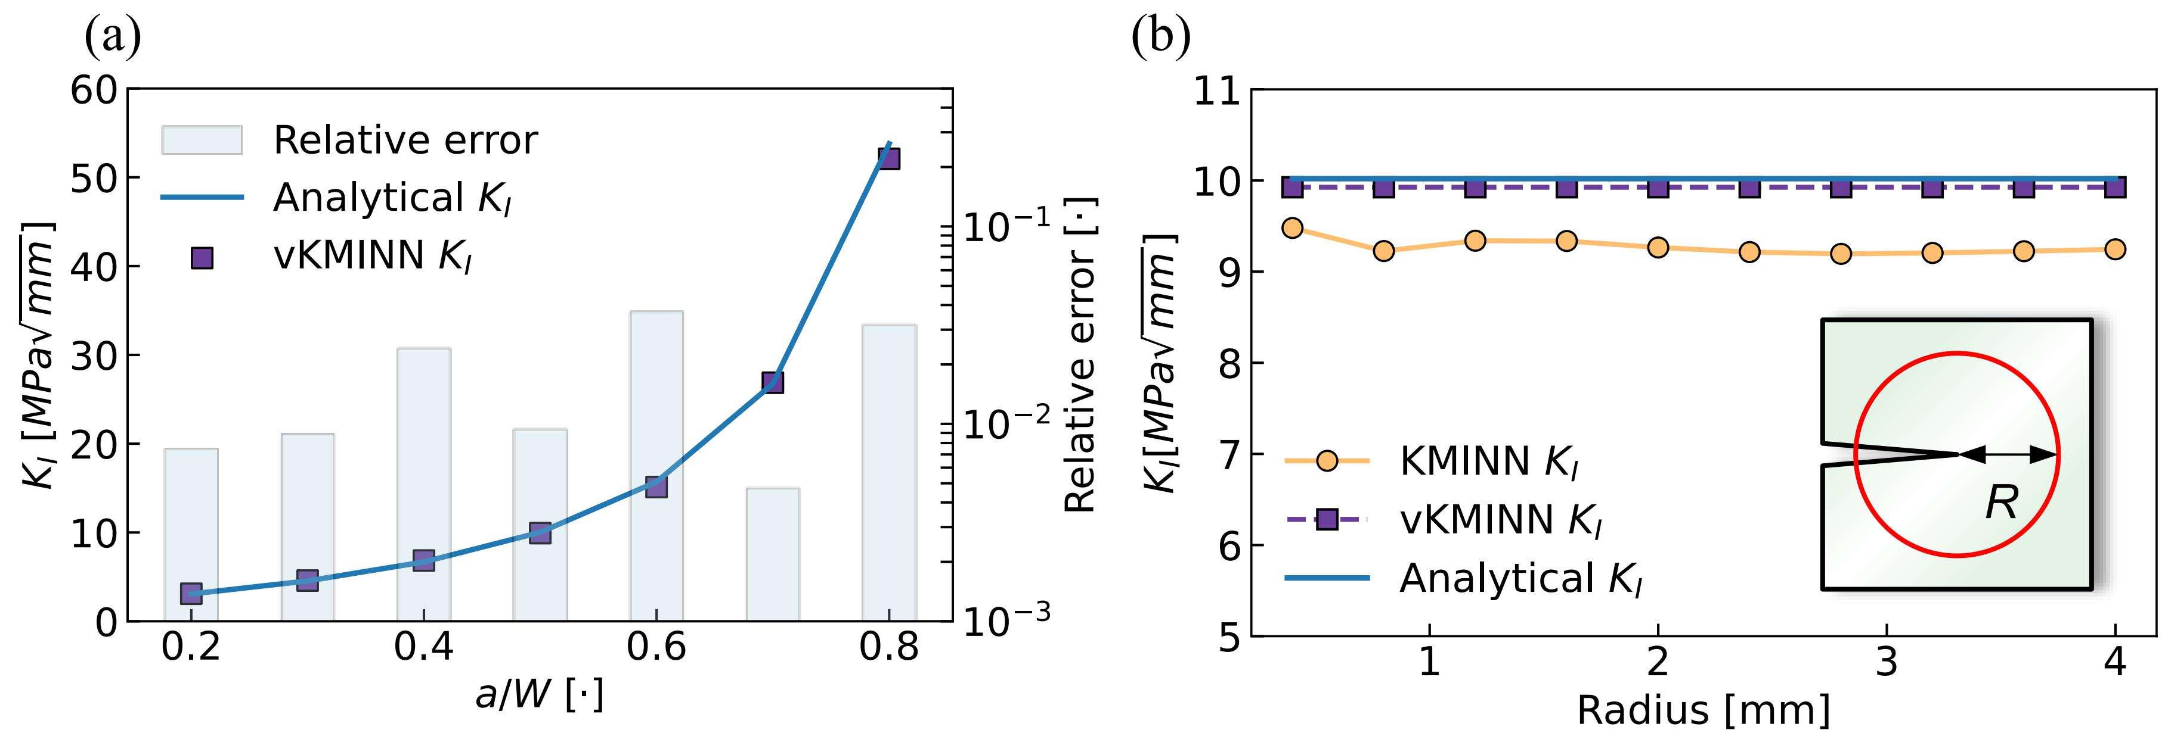
3.3 Case Studies — vKMINN
Single Edge Notch Tension (SENT)

Slide 10
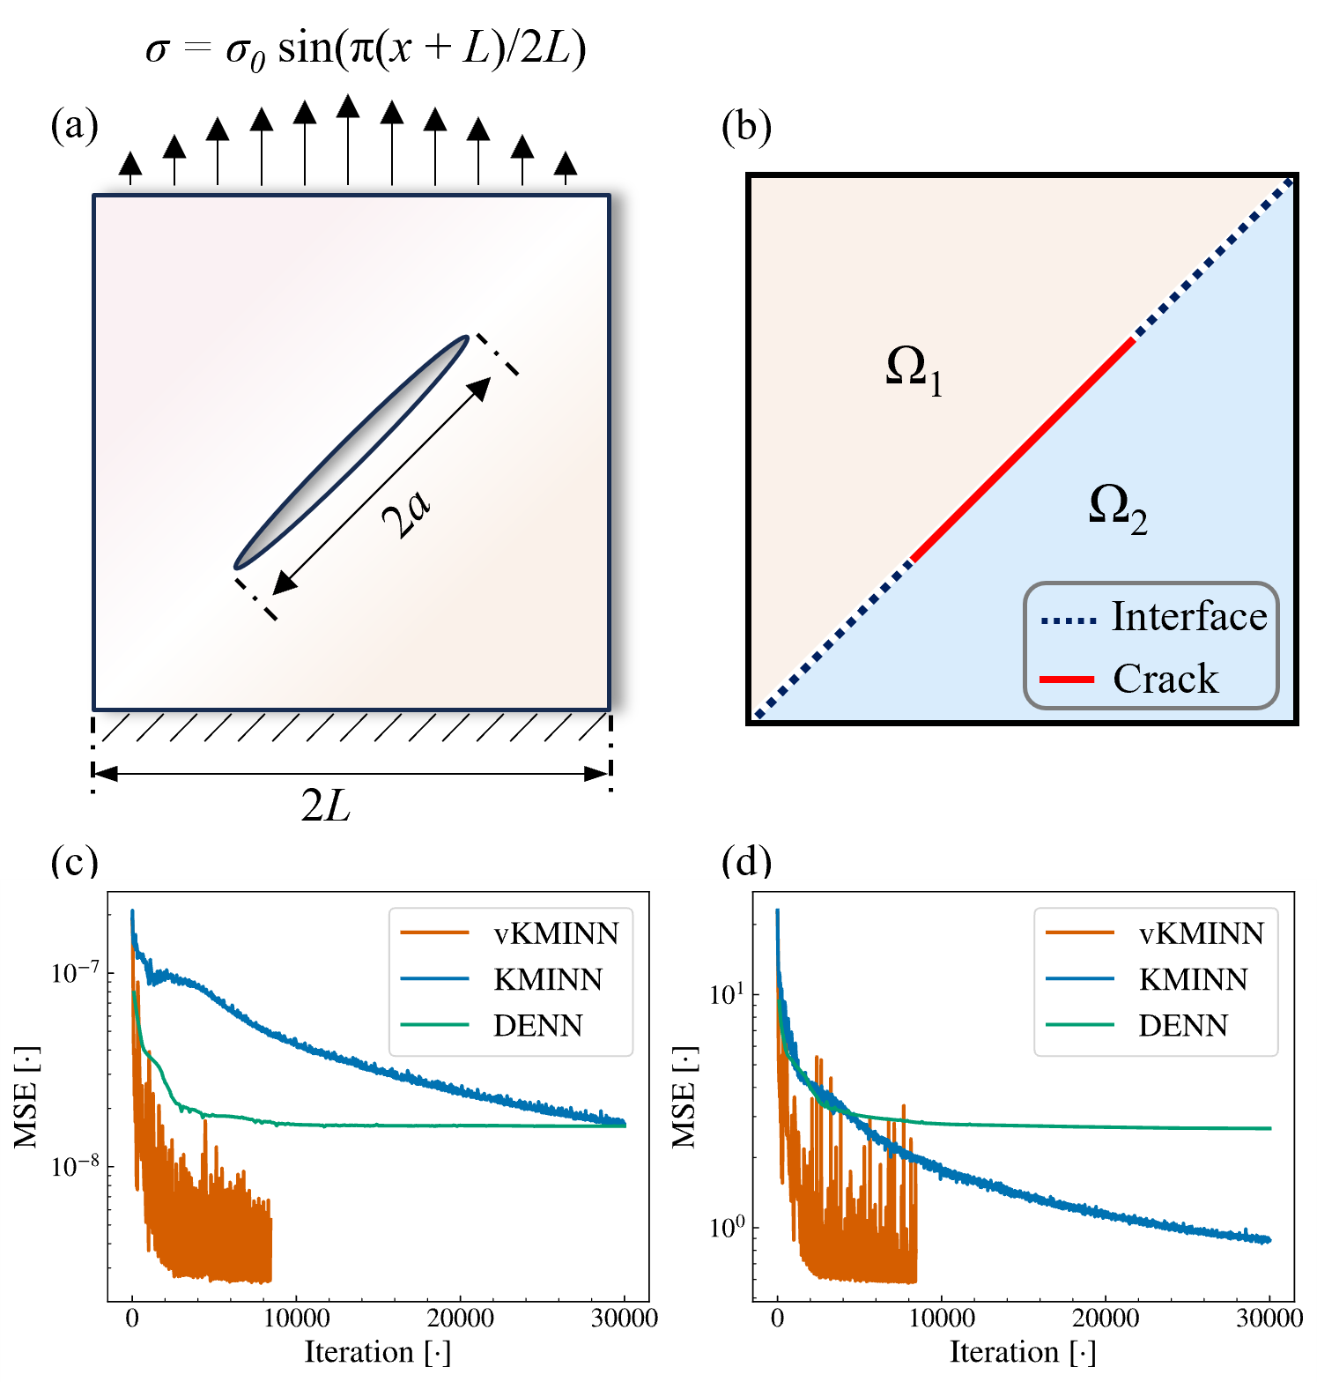
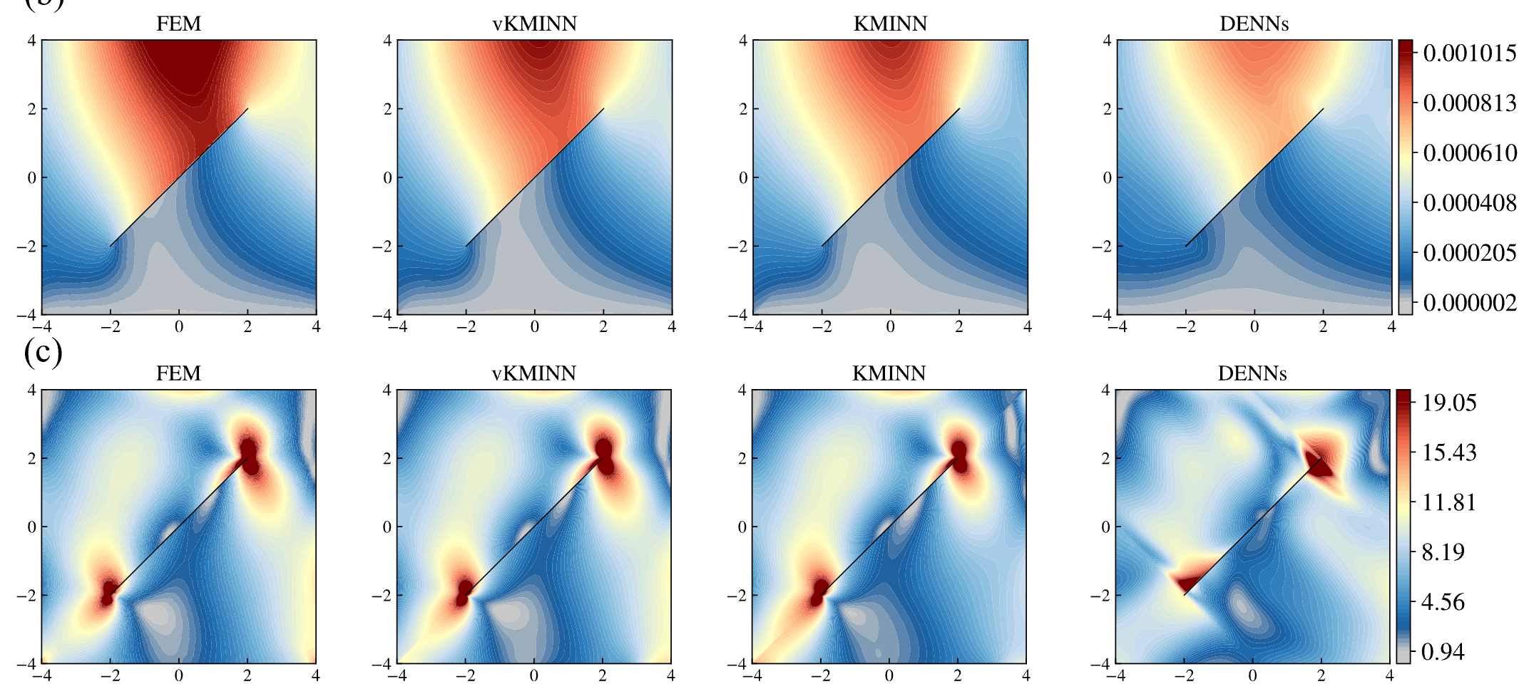
3.3 Case Studies — variational KMINN
Oblique Center Crack Tension (OCCT)
Cut Interface for KMINN
| u_{x} + u_{y} |
σ_{vm}
| u_{x} + u_{y} |
σ_{vm}

Slide 11
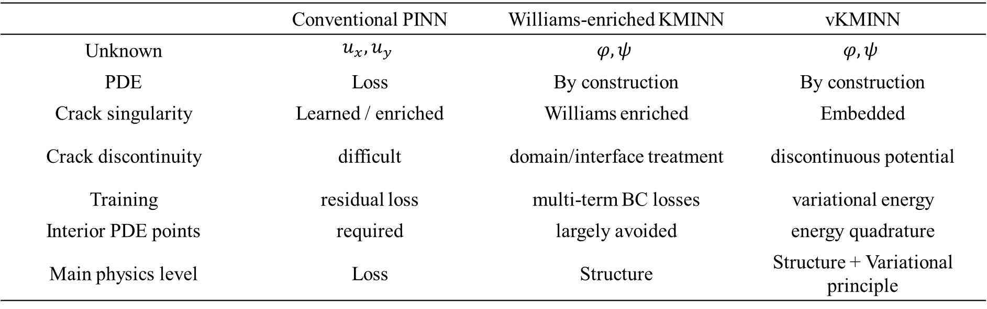
4 Conclusions
 | Conventional PINN | Williams-enriched KMINN | vKMINN
Unknown | $$\begin{aligned}u_{x},u_{y}\end{aligned}$$ | $$\begin{aligned}φ,ψ\end{aligned}$$ | $$\begin{aligned}φ,ψ\end{aligned}$$
PDE | Loss | By construction | By construction
Crack singularity | Learned / enriched | Williams enriched | Embedded
Crack discontinuity | difficult | domain/interface treatment | discontinuous potential
Training | residual loss | multi-term BC losses | variational energy
Interior PDE points | required | largely avoided | energy quadrature
Main physics level | Loss | Structure | Structure + Variational principle
KM potentials embed the analytical structure of 2D elasticity.
Crack-tip singularity and discontinuity can be embedded into the solution representation.
vKMINN replaces multi-term residual balancing with a unified variational energy formulation.
$$\begin{aligned}\boxed{\text{Elastic fracture}→\text{plasticity}→\text{fatigue crack evolution}}\end{aligned}$$

Slide 12
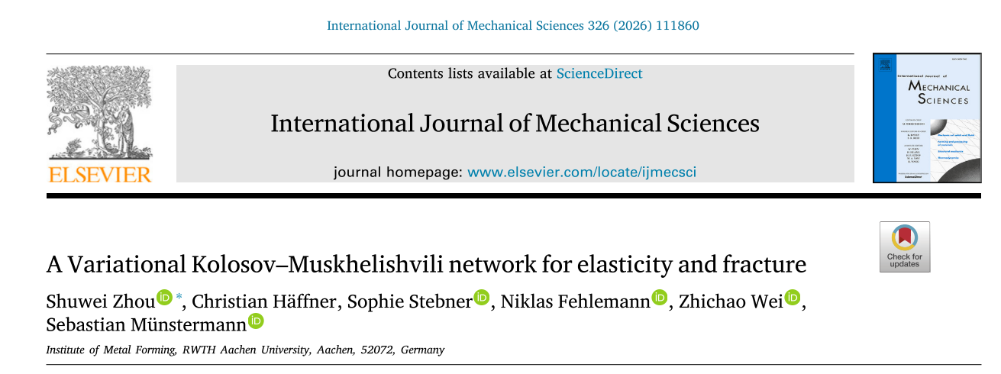
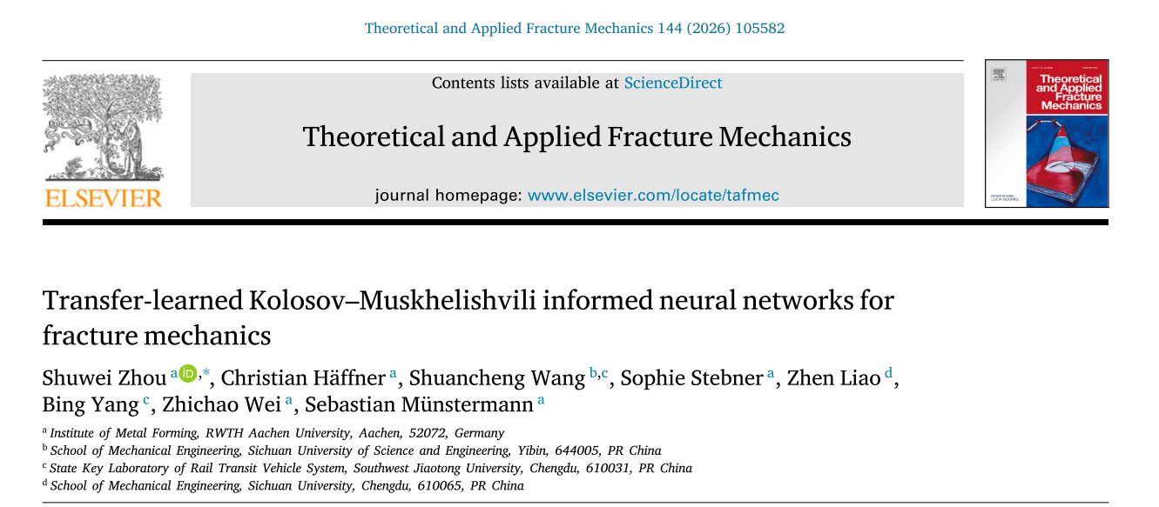
My Website
Scan the QR-code for the slides and the details of the publication

