Slide 1
Few Shot Learning
*cs330-deep-multi-task-and-meta-learning

Slide 2
What will I cover?
What is it? Why is it useful?
Overview of three approaches
Black box approach
Optimisation based
Non-parametric approach

Slide 3
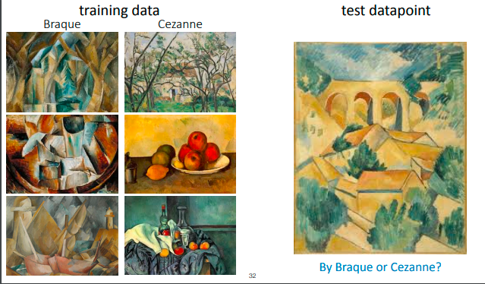
What is it? Why is it useful?
Notes:
Test data point is: Braque
This is an example of few shot learning. You can take a task with a few data points and generalise it to a new example.
How you knew what to look for (assuming not all of you are art experts) is based on past experience and context of painting and images that you have experienced in the past. In this case what gives it away is the way the edges are designed.

Slide 4
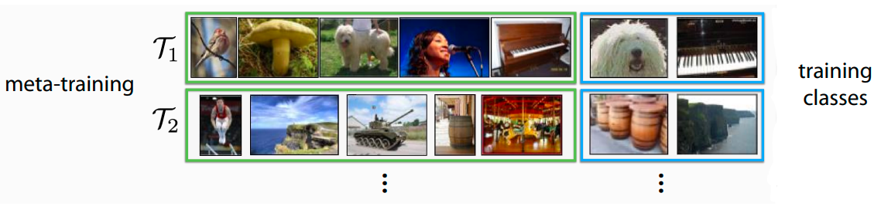
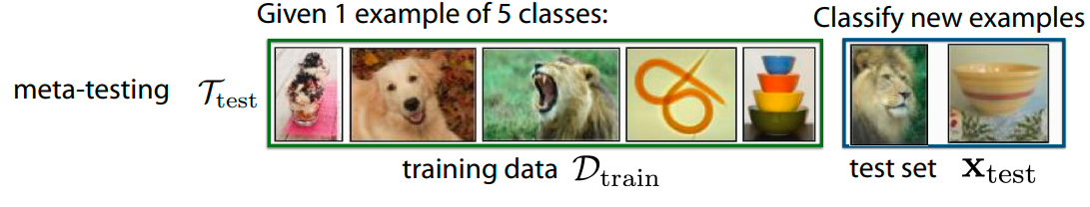
What is it? Why is it useful?
Notes:
So given the previous example, it should be a little easier to explain what few shot learning is:
It is similar to regular learning, but instead of having many examples all helping a model train for one task, you have only a few examples for many tasks.
You are then trying to create a model which can generalise to new tasks with little data.
In this example now of image detection, each task would be to detect something different in the image. E.g. a bird, mushroom, dog, singer or piano.
You train the model on the 5 different tasks all with a random label. Then test the model on the training classes on the top right. Then backpropagate through both the testing and training.
Then when you want to see how good your model is, you have a holdout tasks to test how good your model is at generalising to the new tasks.

Slide 5
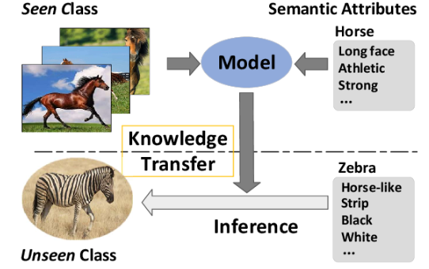
What is it? Why is it useful?
Creating a more general purpose system to be able to learn new tasks more quickly without an abundance of training data
Aiming for model transferability
It is analogous to learning how to learn, or to understand the context of a domain (Often can create a better representation of the data)
Notes:
So if we are creating a successful few shot learning model, we are attempting to create a model which better understands the underlying data and the context of the shared similarity between tasks which is what allows the model to be transferred easily to new tasks.
In a nutshell then, we are attempting the base model for easy and quick transfer learning.

Slide 6
What is it? Why is it useful?
K - Shot Learning
Few shot
There is >1 training examples
One shot
There is one example
Zero shot
There are no training examples *
*Some auxiliary information is necessary to solve the Zero-Shot Learning problem. Such auxiliary information should contain information about all of the unseen classes, which can be descriptions, semantic information, or word embeddings.
Notes:
The is something to mention as well – You will often see the “shot learning” topics come up as three different names. Essentially one and few shot learning essentially work in the same way, but zero shot learning is slightly different.
Unfortunately zero shot learning isn’t this magic technique that can be good at and perform tasks without any training data. It requires some additional information to be provided.

Slide 7
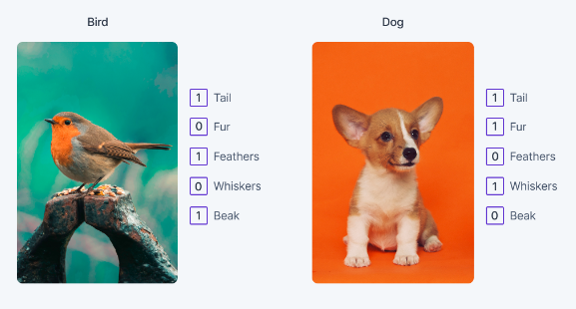
What is it? Why is it useful?
Notes:
So in the case of image detection, zero shot learning could be detecting features of an image, with these features determining what the prediction is.
But there are lots of ways to frame this problem, so it’s just down to your imagination to how you do it.

Slide 8
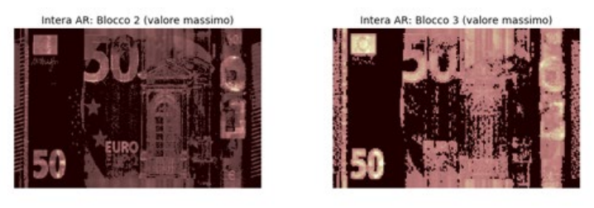
Where might this be useful in Lloyds?
Verification & classification systems
E.g. Voice, handwriting, image, language
Representing large and complex data
Reduces need for training models if you can create a model that can represent the underlying data well
Anomaly detection
Different data will have different anomalies type
*bank-of-italy-siamese-neural-networks-detecting-banknote-printing-defects
*FewSOME: One-Class Few Shot Anomaly Detection
Notes:
Voice recognition is the most obvious place where this could be really useful. Particularly given that techniques such as LoRA can mean that the transfer learning part can be done with very minimal storage overhead. It wouldn’t surprise me at all if this is the way that the bank does it currently.
Maybe more relevant to us working with data in a bank full of unstructured and complex data is the second point here. Having something like a general representation of some of this data could be really useful as a starting place for many projects and could reduce the faff of data mining to extract usefulness out of the complex data.

Slide 9
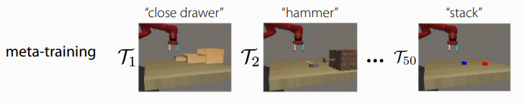
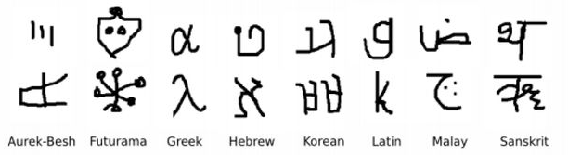
Challenges
Need to have lots of tasks rather than lots of data
Tasks have to have a similar structure
Training takes time if no GPUs
How do we tell the model what task we want it to do?
Notes:
There are a few difficulties of this type of modelling though.
The first and foremost is that you need a lot of tasks. And that is generally a lot of tasks on the same or very similar data, all predicting tasks which use the data in a somewhat similar way. For example, predicting attributes of a customer. Not impossible but typically in the bank we have the complete opposite for the problems we are looking at because the data tends not to be as easily labelled. I’m sure there are ways around this for our data but would require a bit of thought.
The second big problem is that training can take a lot of time if you do not have a GPU, particularly on complex tasks. I don’t think I need to say any more on why this is a problem.
In other problems not quite as relevant at the moment to us, you can also have the problem of how do we tell the model what task we want it to do. This is more prevalent in reinforcement learning such as in the picture here.

Slide 10
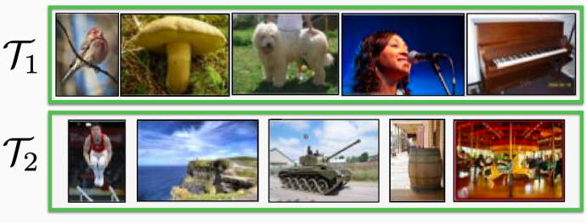
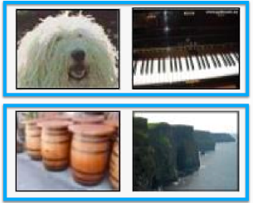
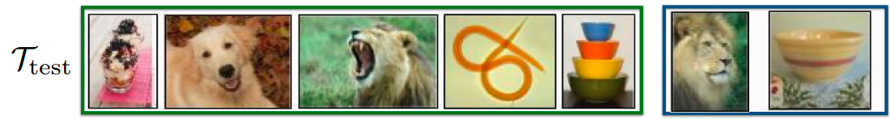
Terminology
Meta training support set Data with labels to use as the k-shots of each batch when training the model | Meta training query set Data with unseen labels to use in testing the meta trained model
Meta testing support set Data with labels to use as the k-shots of each batch when optimising the model to the unseen task | Meta testing query set Data without labels to make inference on
Notes:
So before I go onto how to actually do some of this magic generalizable learning I wanted to quickly explain some terminology to hopefully avoid confusing everyone and myself about what is going on.
In meta learning, typically you have data split differently. Instead of split by the data points, you split by tasks. This means that you have a meta training set which is what you train the model on, and the meta testing sets which you test your model with.
Each set comes with a series of tasks with the number of shot examples (in this object detection example it would be one-shot learning), and you test the models ability to quickly learn the new task with the query set.
So when it comes to the meta testing set, you are testing the model on a completely new set of tasks that the model wasn’t previously trained on to find out how well the model can learn these new tasks.

Slide 11
Method 1: Black Box Approach
Creating a network that, given a new task, can quickly produce something to pass to a second NN model such that it can make a prediction
So there are two networks:
Sequential network 1 (eg RNN) with parameters Ѳ
Network 2 with parameters or state ф which are the output of network 1

Slide 12

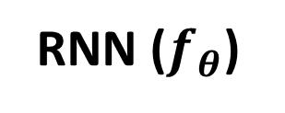
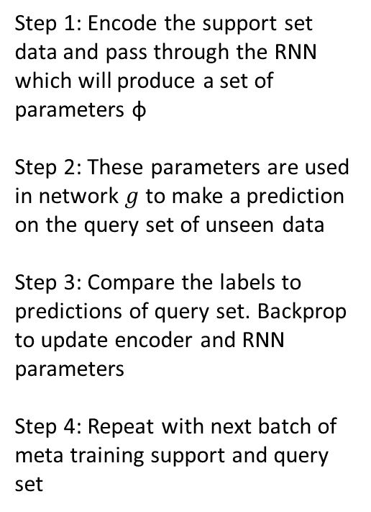
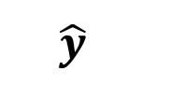
Method 1: Black Box Approach
Step 1: Encode the support set data and pass through the RNN which will produce a set of parameters ф
Step 2: These parameters are used in network $g$ to make a prediction on the query set of unseen data
Step 3: Compare the labels to predictions of query set. Backprop to update encoder and RNN parameters
Step 4: Repeat with next batch of meta training support and query set
RNN ($f_{θ}$)
*or could be any NN that can take in sequences
$$\hat{y}$$
ф
$$g_{\text{ф} }$$
a
b
c
ɑ,ɓ,ʗ
Labels: 0 1 2
Meta training query set
Meta training support set
Notes:
3 – Way, 1 – shot problem
The task here would be to distinguish between different written letters of alphabets. In this case I’ve started with the English alphabet but other examples would be other languages.
The overall model itself if comprised of two separate models which make up the whole system
How this works is:
The images of the letters are encoded and then passed into an RNN (This could also be a bi-directional LSTM or transformer or anything that can take in sequential data)
This first model is trained to output the set of parameters of the second model, which can be whatever you want it to be.
Query set examples are then encoded and passed through this second model on the right here to make a prediction.
The prediction is then compared to the label, allowing you to backpropgate through the whole system to update parameters.
Typically the encoder to transform data to input into the RNN is the same in both support and query and for all inputs.
Difficulty of this technique is that there may be potentially millions of parameters of the neural network that you have to output and that will take a lot of memory and time to compute.

Slide 13
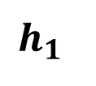
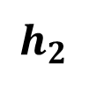

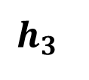
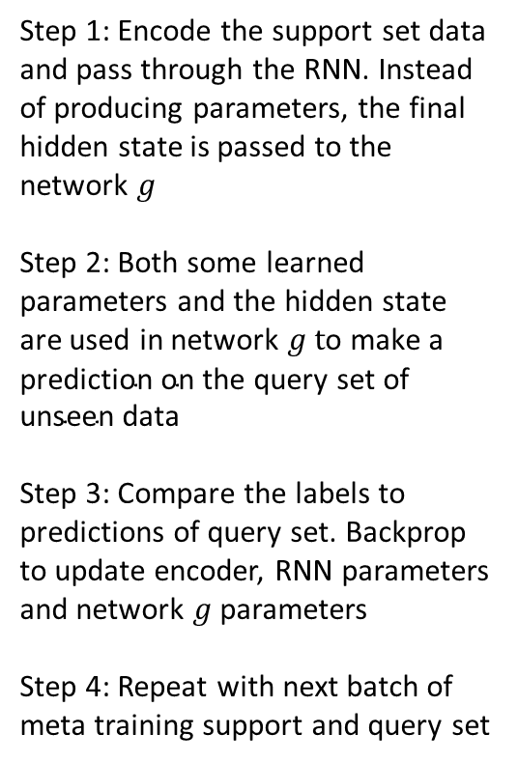
Method 1: Black Box Approach
Step 1: Encode the support set data and pass through the RNN. Instead of producing parameters, the final hidden state is passed to the network $g$
Step 2: Both some learned parameters and the hidden state are used in network $g t\text{o} \text{make} \text{a} \text{prediction} \text{on} \text{the} \text{query} \text{set} \text{of} \text{unseen} \text{data}$
Step 3: Compare the labels to predictions of query set. Backprop to update encoder, RNN parameters and network $g$parameters
Step 4: Repeat with next batch of meta training support and query set
RNN ($f_{θ}$)
*or could be any NN that can take in sequences
$$\hat{y}$$
$$h_{1}$$
$$h_{2}$$
$$h_{3}$$
$$g_{\left(h_{3},{ \text{ф}}_{g}\right)}$$
a
b
c
b
c
ɑ,ɓ,ʗ
Labels: 0 1 2
Meta training query set
Meta training support set
Notes:
Luckily there is an alternative which is more commonly used in practise because you transfer less data. Instead of outputting the parameters of the second model, you can output the hidden state of a RNN as an input parameter to the second model, as well as the regular inputs ${ \text{ф}}_{g}$.
Hidden state $h_{3}$ will typically be much smaller than the parameters of the model like in the previous version.
Now it’s frames like this, unfortunately this does just look like one long RNN now, so doesn’t look particularly exciting when implimenting.
If not trained properly, the network g can simply learn to classify without using the hidden state h3 and therefore would not be able to generalise to new tasks well. This problem also applies to all the other few-shot learning methods as well. There are ways to get around it such as restricting the amount of information that can flow from the data points of tasks into the function forcing the model to learn more information about from the support set to pass to the second function of the model. One way you can do this by adding Gaussian noise to the input data, or if you have more data, adding different versions of the same data point such as a different image of the same type.

Slide 14
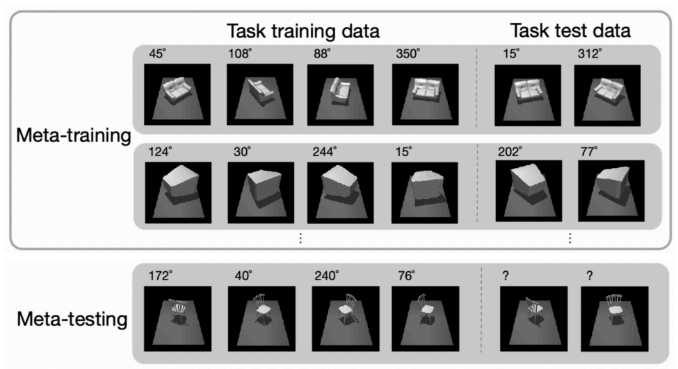
Notes:
Just an example of this is trying to learn the orientation of different objects. In this objective the second part of the network could learn something about the images which gives away the starting position but you could get around this by setting different points of the image as the forward facing point. Alternatively adding different gaussian noise to the images could also have the same effect.
In the Gaussian noise case it is therefore very similar to something like dropout, but dropout works on the activations of a neural network, whereas adding Gaussian noise regularises the actual layers which is the important part of these networks.

Slide 15
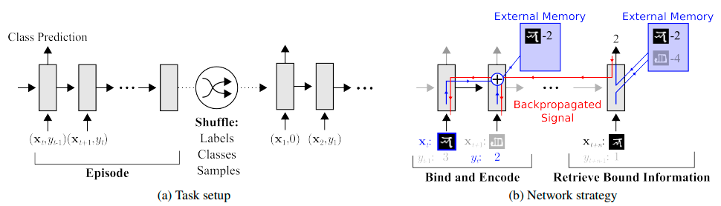
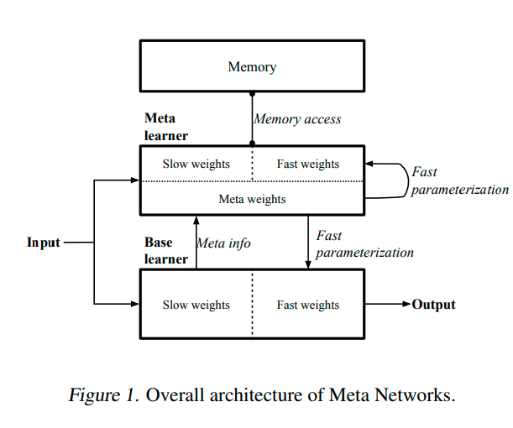
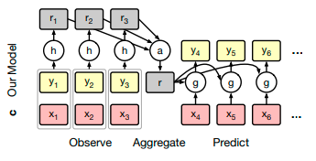
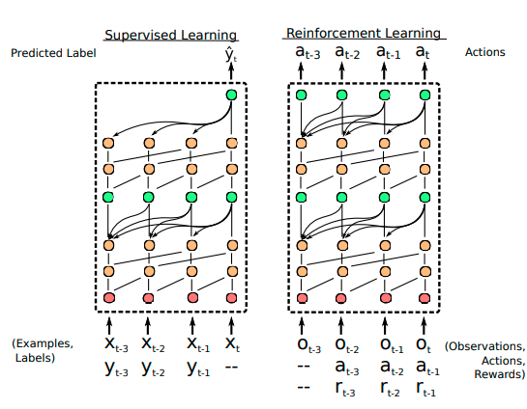
Method 1: Black Box Approach
Meta-Learning with Memory-Augmented Neural Networks Santoro, Bartunov, Botvinick, Wierstra, Lillicrap. ICML ‘16
Meta Networks Munkhdalai, Yu. ICML ‘17
Conditional Neural Processes. Garnelo, Rosenbaum, Maddison, Ramalho, Saxton, Shanahan, Teh, Rezende, Eslami. ICML ‘18
A Simple Neural Attentive Meta-Learner Mishra, Rohaninejad, Chen, Abbeel. ICLR ‘18
Notes:
I’ve got a few papers here of more famous examples of black box few shot learning which you can look over if you’d like, but I won’t go over them.

Slide 16
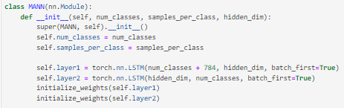
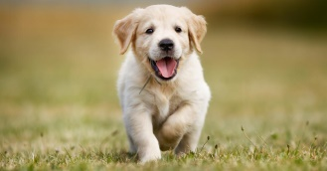
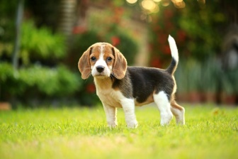
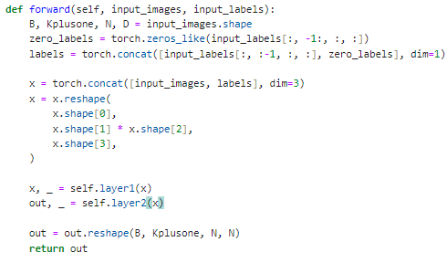
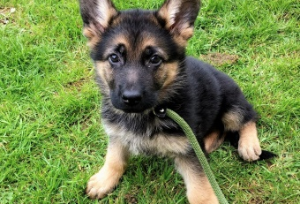
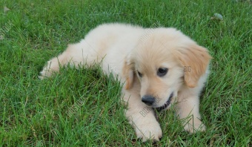
Method 1: Black Box Approach
0
1
2
empty
Notes:
So how does this look in practise?
The task I am doing here, although you can’t see it because I’ve not included most of the code, is to distinguish between different characters of different alphabets. The dataset used is called the omniglot dataset if you are interested
The data here is in a sequence of the first labelled images which are concatenated the label, and then at the end of the sequence there is the final unlabelled images which the model makers a prediction for.
Unfortunately, because the LSTM contains the whole architecture for the code, it’s not very exciting here.

Slide 17
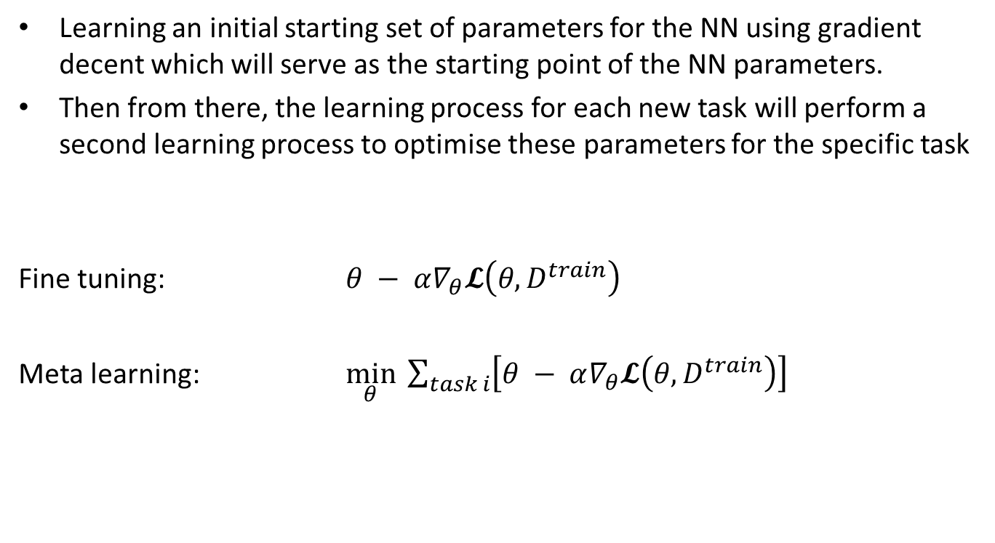
Optimisation Based Approach
Learning an initial starting set of parameters for the NN using gradient decent which will serve as the starting point of the NN parameters.
Then from there, the learning process for each new task will perform a second learning process to optimise these parameters for the specific task
Fine tuning: $θ − α∇_{θ}𝓛\left(θ, D^{train}\right)$
Meta learning: $\min_{θ}{ \sum_{task i}{\left[θ − α∇_{θ}𝓛\left(θ, D^{train}\right)\right] }}$
Notes:
The second method for creating a good few-shot learning model is using gradient decent. Essentially here we are using gradient decent to create a good starting point which will work for other models. It’s therefore basically just creating a pre-trained model which will transfer to a new task easily.

Slide 18

Optimisation Based Approach
It is very similar to pre-training except that we are optimising the model parameters to work on several tasks.
It is not a problem to have different loss functions for different tasks. You can use any the architecture for the NN model.
This is often called model-agnostic meta learning (MAML)
Because of the second-order optimisation, this technique can often be expensive to train leading to high memory and compute usage.
$$∇_{θ}𝓛$$
ф
a
b
c
Labels: 0 1 2
Meta training support set
Notes:
There are two major advantages of this technique:
You can have different loss functions for different tasks (requiring the tasks have similar objectives and have the same structure)
You can use any architecture for the model – hence the name model-agnostic.

Slide 19
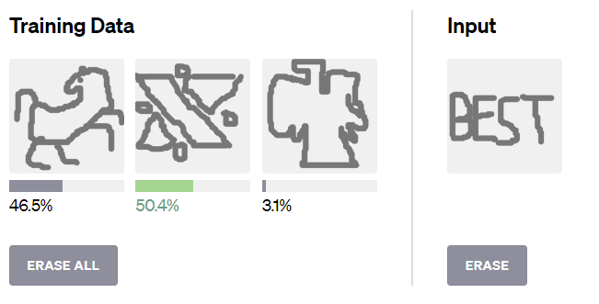
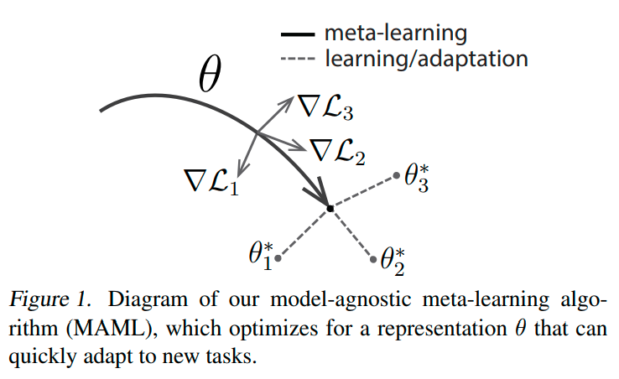
Optimisation Based Approach
https://openai.com/research/reptile
https://arxiv.org/pdf/1703.03400.pdf
Notes:
MAML is the general approach to optimisation based few-shot learning, it does pretty much everything I’ve described so far. There are a few extensions which tackle some of the downsides of the high computation needed for MAML, one such example is reptile which was made by openai
On the link here you can use a model they have made using the technique to compare images you draw. I’ve done…

Slide 20
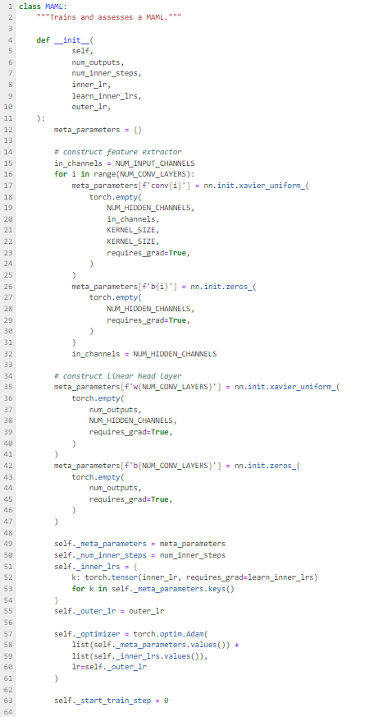
Initialising the parameters of the meta parameters

Slide 21
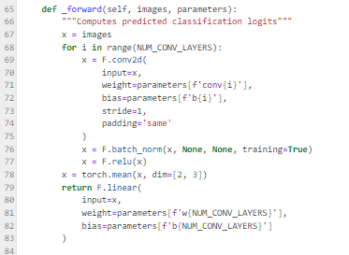
Function to take in parameters from the inner or outer loop and make a prediction

Slide 22
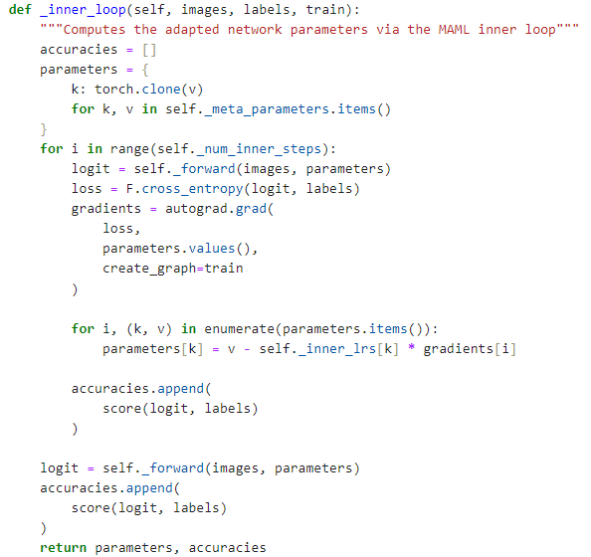
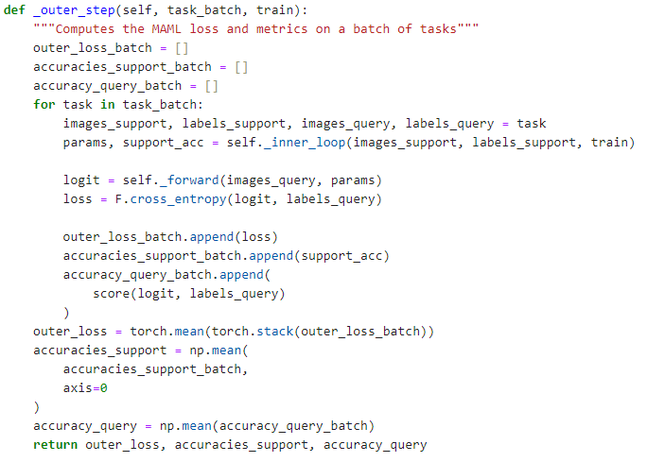
Fine tuning of the meta-parameters on the new task by manually running backprop
Calculating the support accuracy
Running through many tasks
Calling the inner loop to get the fine tuned parameters
Using the outputted parameters for the model to test each task
Calculating the query accuracy

Slide 23
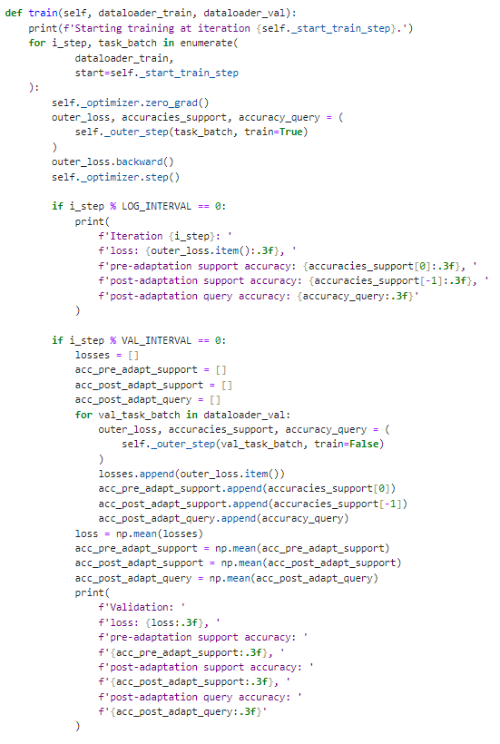
Training

Slide 24
Set initial random meta-parameters
Task 1
Inner loop –fine tunes meta-parameters to the new task
Optimised parameters
New task
Outer loop – Used optimised parameters to test new tasks
Perform backprop to update meta-parameters so that the model can learn quicker and better
Useful meta-parameters for the tasks

Slide 25
Non-Parametric Approach
Anything without gradient descent
Notes:
The final approach to building a few-shot learning model is via non-parametric approaches which essentially means anything that doesn’t use gradient descent in the second step.
There are a whole variety of these but I’ll just quickly go over a few of the more popular ones.

Slide 26
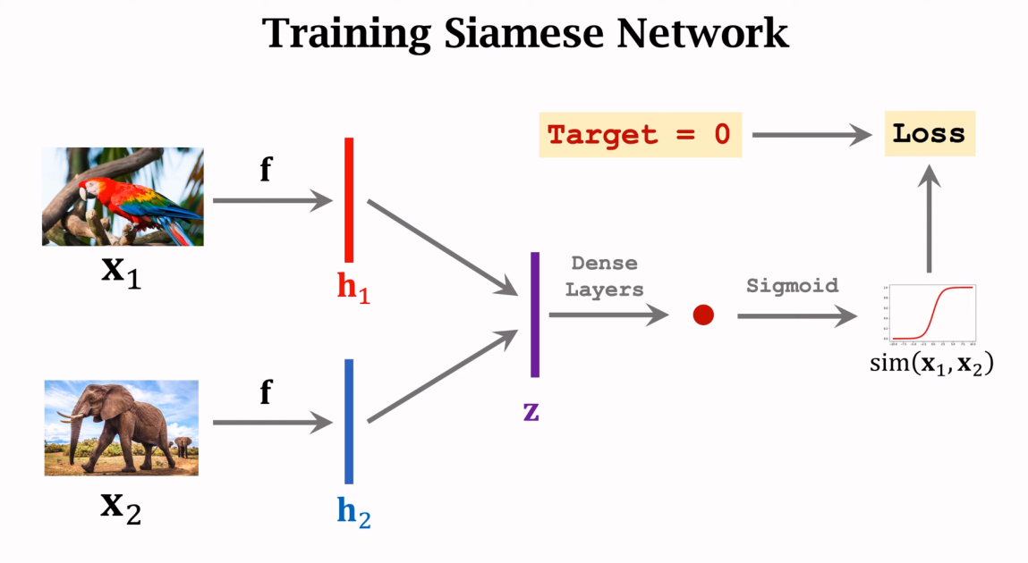
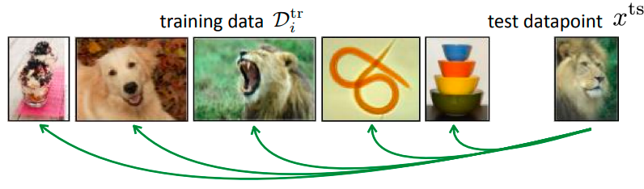
Non-Parametric Approach
https://arxiv.org/abs/2302.03507
Siamese network:
You train a model to become good at n-way classification, choosing the label with the highest probability
The input is compared against known labelled examples
Notes:
The first is Siamese networks, so a network which is comparing two data points using the same underlying function. Here you are essentially outputting a probability of the images being of the same class, and doing n-way classification by picking the highest probability.

Slide 27
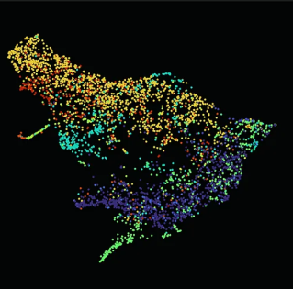
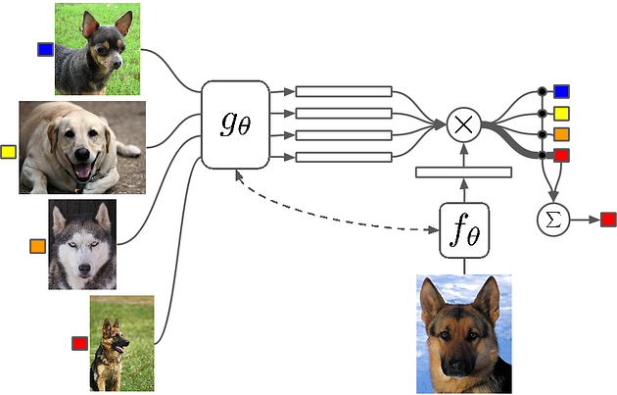
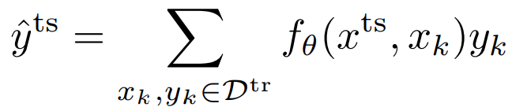
Non-Parametric Approach
https://papers.nips.cc/paper_files/paper/2016/file/90e1357833654983612fb05e3ec9148c-Paper.pdf
Matching network:
An improvement over Siamese networks
Softmax function with outputs for each input class
Notes:
A bit more expressive than Siamese networks is matching networks. This again will do n-way classification, but is framed as a multi-class network where the comparison in the embedding space is done simultaneously for each of the images.
$g_{θ} and f_{θ}$ are often the same network – often something like a bi-directional lstm
You are teaching the wider model to learn to distinguish between features of the support data to be able to discriminate in the query sets.

Slide 28
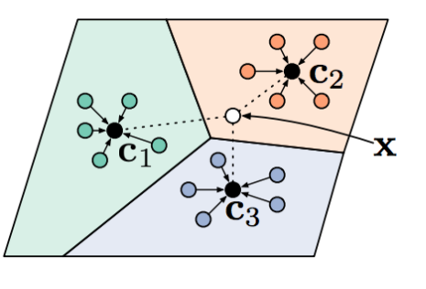
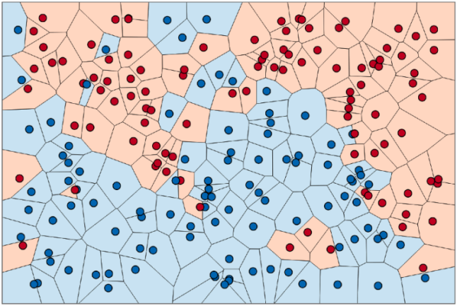
Non-Parametric Approach
https://arxiv.org/pdf/1703.05175.pdf
Prototypical network
Produce a set of embeddings for each item passing through a network.
Then perform a nearest neighbours or other comparison algorithm. Classify with Euclidean or cosine distance.
Notes:
A final one is a prototypical network which does something reasonably similar again, but will use a nearest neighbours algorithm in an embedding space which is output by the network.
You use the few support shots to create new prototypes for which you can make a quick comparison.
The whole network is trained to efficiently learn how to represent data into the embedding space.
I won’t show any of the code because it’s already been code heavy but I’ll send out some notebooks at the end if you are interested.

Slide 29
Comparison of Approaches
Black box approach | Optimisation based approach | Non-parametric approach
Complete expressive power Easy to combine with a lot of other learning problems Not consistent Challenging optimisation Data inefficient | Expressive in deep models Positive inductive bias at the start of learning Handles varying and large k-shots well Consistent Compute and memory intensive | Expressive for most architectures Consistent if the embeddings don’t compress too much Computationally fast and easy to optimise Hard to generalise to varying k-shots Hard to scale to large k-shots Limited to classification
Notes:
Just to finish off here, I’ve got a few pros and cons of the different approaches.
I won’t read them out because that would be boring, and they are fairly similar to what you would expect for almost all ML models.
The only one that is slightly unique to few shot learning is whether the model is consistent which is whether the learned learning procedure will monotonically improve with more data

