Slide 1

Fall Kickoff
Notes:
Studying abroad
Send the mcneese – added to the ICU channel, and the send the caskey paper – sed other powerpoitn and this one add to zotereo

Slide 2
House Keeping Items
1. Paid Positions
2. Supply Chain Research (Dr. Zac Rogers – CSU)
3. Increased Involvement (running studies)
4. New Research Direction
Notes:
door is open
For the GE healthcare - there is an intership -

Slide 3
Orchestra ICU (Caskey et al.,)
Collaboration with Dr. Majid Afshar in the Department of Medicine
A system integrating AI into rounds in the ICU
  Active data collection – ongoing
  Planned data collection from us (IRB)
They are handling the development + medicine side of things
  Want us to handle the HAI side of things

Slide 4
Orchestra ICU (Caskey et al.,)
Human AI teaming in during ICU rounds:
  Rounds are a multidisciplinary presentation of all patients admitted to the ICU within the past 24 hours
  Occurs daily
  Led by the fellow/resident/medical student who is primarily caring for the patient
  Includes:
    Respiratory therapists, nurses, dieticians, physicians (attending, resident, fellow), pharmacists, etc.
  Serves as a way to:
    Generate action items in relation to the care plan
    Teach

Slide 5
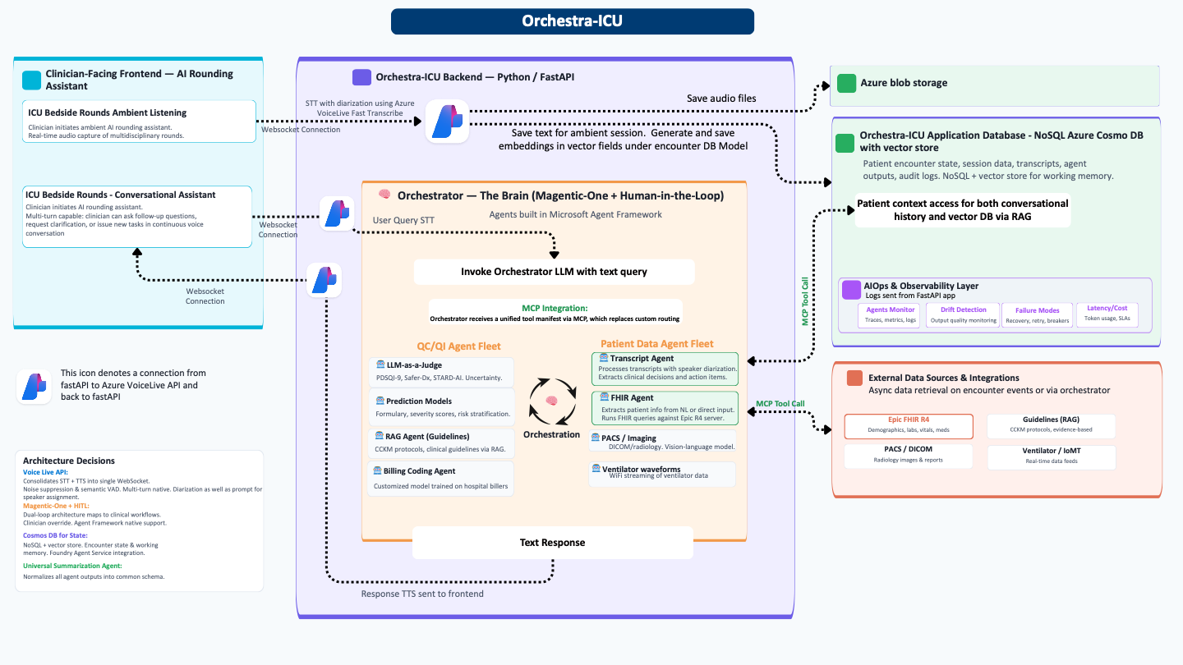
Their Current System (Caskey et al.,)
Relies on the idea of decomposition:
  Breaking down a large task into smaller tasks that different AI agents can accomplish
  Then having an overall agent assess quality and implement
Overall goal is to improve diagnostic accuracy, reduce load on clinicians, and improve accuracy.

Slide 6
Their Current System – Collecting Data
Right now, in more of a feasibility / POC stage
  Clinicians wear microphones when they are rounding, then the audio is transcribed using Whisper.
  Then data it fed in from Epic’s electronic health records (EHR) through FHIR
  No interaction between patient and AI
We have been tasked with adding non-verbal behavior of clinicians into the loop (will share in another ppt)
  “Color” the audio data by coding non-verbal in real time
Notes:
FHIR is basically just an API that allows data to be sent and received securely.

Slide 7
What are we doing (for them)
Developed a coding app, where we record non-verbal behavior in real time, and test how well it can predict teamwork, heuristic use, etc:
  Gaze (Individual + Collective)
  Pointing
  Vertical + Horizontal Nods
  Self Adaptors
  Inward + Outward team movement
  Gesticulation
  Object Movement
Ultimately providing guidance on how they should be designing the AI to interact with clinicians

Slide 8
Action Items for the ICU
Eventually need to do some training and calibration for the coding too:
  Watching videos and calculating inter-rater reliability
Waiting for IRB approval, then collection in the ICU

Slide 9
What does that mean for our own research?
Shifting towards Human-AI teaming:
What role should an AI agent play?
How should it interact with procedures, tell people they are wrong, change thinking, etc
How should an AI agent interact with the team?
What modalities should the AI agent use to communicate with human members, how can we avoid bias in the way information is presented, etc
How should the AI agent be calibrated to human members?
How can we make sure that trust is calibrated to clinicians, how do we account for expertise, etc

Slide 10
Some Cognitive Psych Terms to Know Along the Way
Heuristics: mental “shortcuts” we use to arrive at solutions quicker, but sometimes with less accuracy (rule of thumb thinking; Tversky & Khaneman, 1974)
  In a maze:
    Heuristic way of solving would be picking a direction that moves towards the exit
    Algorithmic way of solving would be putting your hand on the wall until you are out.
Cognitive Biases to Know (Wang et al., 2019):
  Anchoring (Tversky & Khaneman, 1974)
  Automation Bias: Following (Parasuraman et al., 2000)
  Base Rate Neglect
  Confirmation
Dual Process Model of Cognition (See Caskey et al., Preprint):
  System 1: Fast + automatic, relies on heuristics, more susceptible to bias
  System 2: Deliberate + slower, more “algorithmic” thinking, less susceptible to bias <- evidence that you want to point people here
Notes:
Parasuraman et al., https://ieeexplore.ieee.org/document/844354

