Slide 1


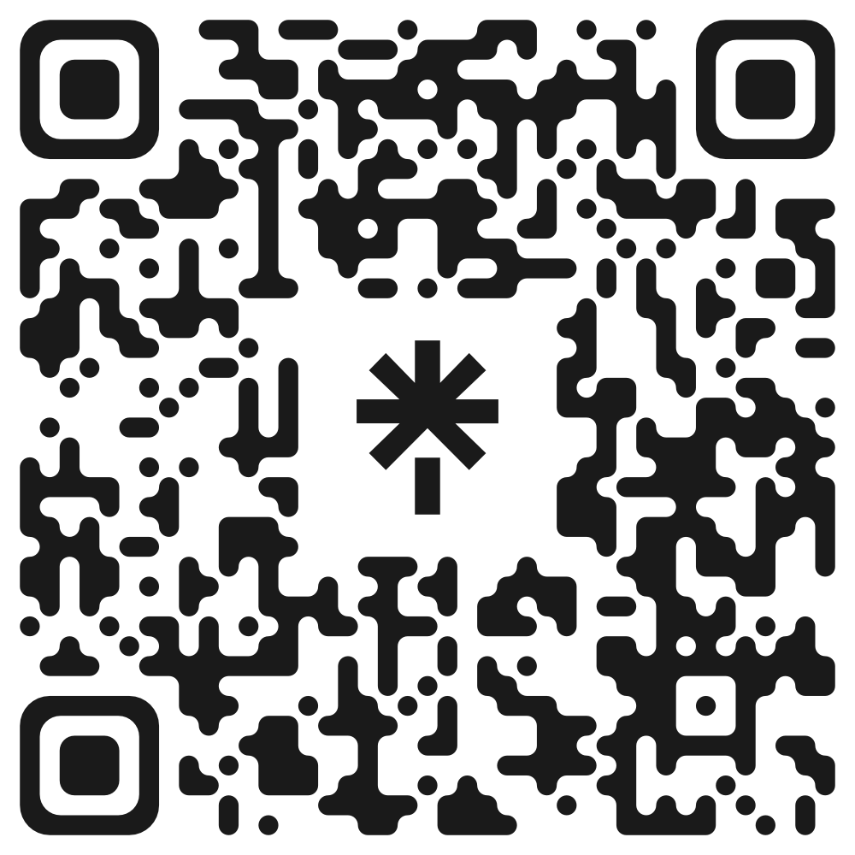


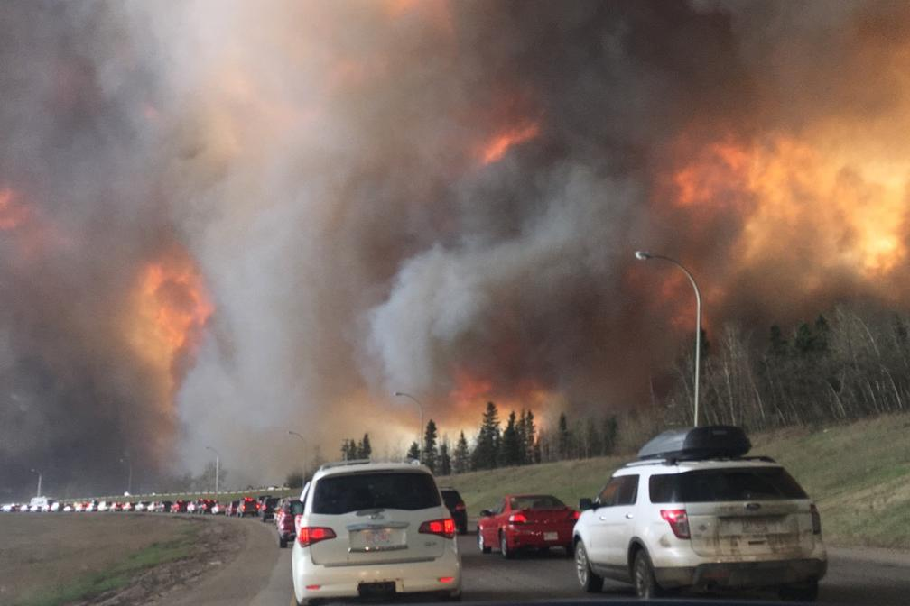
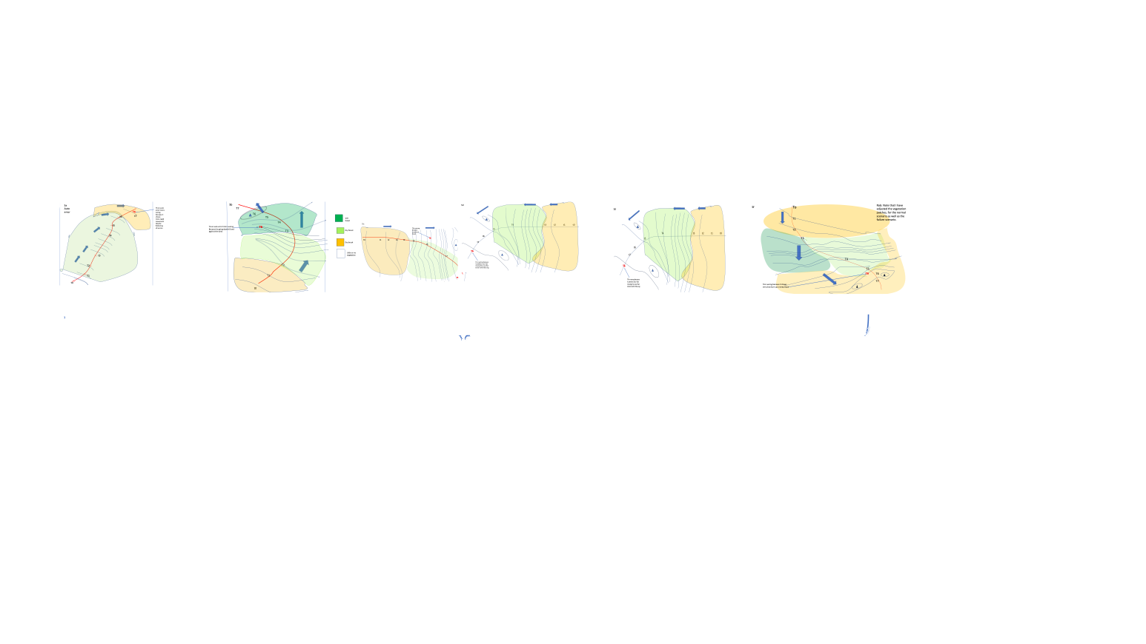
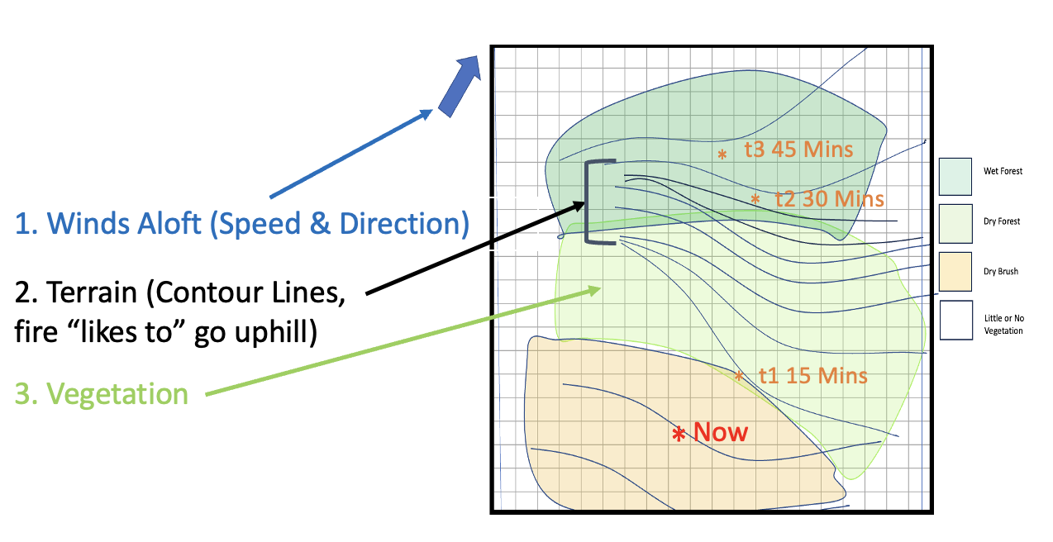

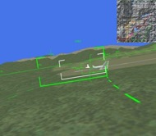
FIPRED: A study of predictive automated displays for wildfire fighting management.
Robert J. Spenceley¹, Christopher D. Wickens², Bianca de Toledo Piza²
1
2
Full Paper
Linktree
Introduction
Training
Results
Mega wildfires such as the Los Angeles fires in the spring, the Hawaii Lahaina Fire in 2023, and the 2016 Fort McMurray Fire in Canada impose a devastating toll, destroying cities and taking lives.
Fort McMurray Fire (2016) Flatiron Fire (2012)
Slide 4
Results – H_{1:} Predictor Benefit – Confirmed
We measured what the error would be if participants predicted using a simple straight-line extrapolation and compared that with their actual error. This was the benefit of the predictor display.
Fires often follow unexpected paths.
Need for graphics-based AI assistance for on-scene fire suppression supervisor: A fire predictor display system we call FIPRED.
Screen 1 Screen 2 Screen 3 Screen 4
Participant sees.
Participant receives feedback.
Display updates.
Participant predicts.
Scenarios
Experimental Design
6 Scenarios, each assessing 4 predictions (t1, t2, t3, t4)
Predictor displays are valuable in several other domains.
Predictor displays based on an AI model of the process.
For FIPRED, we use a simplified Fire Model (e.g., Koen, 2023).
AI is imperfect: what happens when the user becomes totally dependent upon the AI and it makes a mistake: The AI fails. The user follows its erroneous guidance.
This is automation bias.
A B C D E F
3D Flight Path Predictor
Cone of Uncertainty Hurricane Predictor.
4 cycles with feedback for each fire scenario.
Six different fire scenarios: counterbalanced order.
Across these scenarios, participants can learn to predict (internalize the fire model).
Automation fails on the final scenario.
Results – H₂ Automation Bias – Confirmed
Significantly larger error score when automation fails for scenarios A, B, C, & E.
* p < .05
** p < .01
*** p < .001
To be useful, the predictor look-ahead time (LAT) must be greater than the required action time (RAT) of responding personnel (e.g., evacuation time): LAT>RAT.
**
***
*
Automation Failure
**
The automation error on the final scenario
The automation error:
The fire accelerates against the prevailing headwind and after entering wet forest.
t3
Winds aloft
Results – H₃ Dependence Does NOT Influence Automation Bias – Not Confirmed
Participants who relied more upon the automation did NOT have a significantly larger error when it failed (p = .24).
The location that should have been t3 for correct automation
(not actually displayed).
Methods
t2
The FIPRED Display
Simple Fire Model predicts the trajectory.
3 points into the future, (t1,t2,t3) based on our 3 factor Fire Model:
Winds aloft (speed and direction)
Vegetation
Terrain (contours): fires ”like to” go uphill
Participants
t1
Discussion & Conclusions
22 participants: Undergraduates at CSU received course credit for 1 hour of participation. The experiment proceeded with a brief tutorial on the fire model and 4 training scenario trials.
Hypotheses
H₁: The display will be useful to participants.
H₂: When the display fails, automation bias will be observed.
H₃: Larger dependence on automation will result in a significantly larger automation bias when automation fails.
We developed and evaluated a novel predictor display concept for wildfire suppression management.
Participants experienced a prediction performance boost from using the display.
This improvement led them to automation bias, performing worse when the automation unexpectedly failed on the final trial.
However, no indication of automation bias was observed between groups.
Certain scenarios may have had failure and correct points too close to each other.
Failure points may have been too obvious.
Next steps: evaluate the benefits of presenting the raw data behind the prediction.
To what extent did participants depend on the raw data (terrain, winds, vegetation) to make their own predictions, rather than the predictive display?
We do not know from the current data because raw data was always displayed.
Next experiment: same paradigm, but raw data of terrain, winds, and vegetation are removed.
Participants need to predict the forward point of the fire boundary at the next time point based on:
What the prediction says.
What the raw data (winds, vegetation, terrain) are telling them.
Sponsored by Smokey Bear.

