Slide 1

Home Credit Default Risk Kaggle Competition:
How to make a loan
Spencer Owens, University of Utah

Slide 2

Ask the machines…
This presentation contains my findings about how best to predict who will default on loans using machine learning algorithms.
Although the competition is over this algorithm was able to predict loan default 76% of the time.

Slide 3
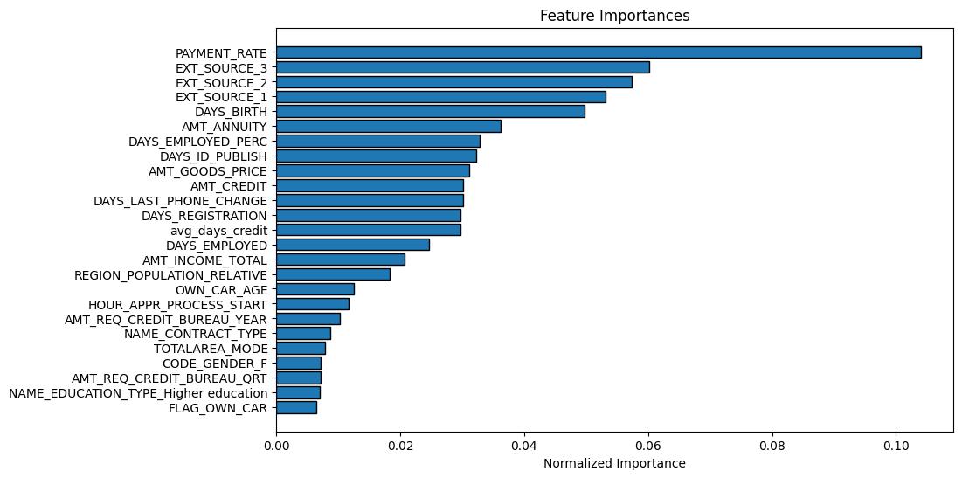
In short, you want to make loans where the payments are not too big, made to reliable borrowers and, if you want the best results, borrowers who older and who have been employed longer.

Slide 4
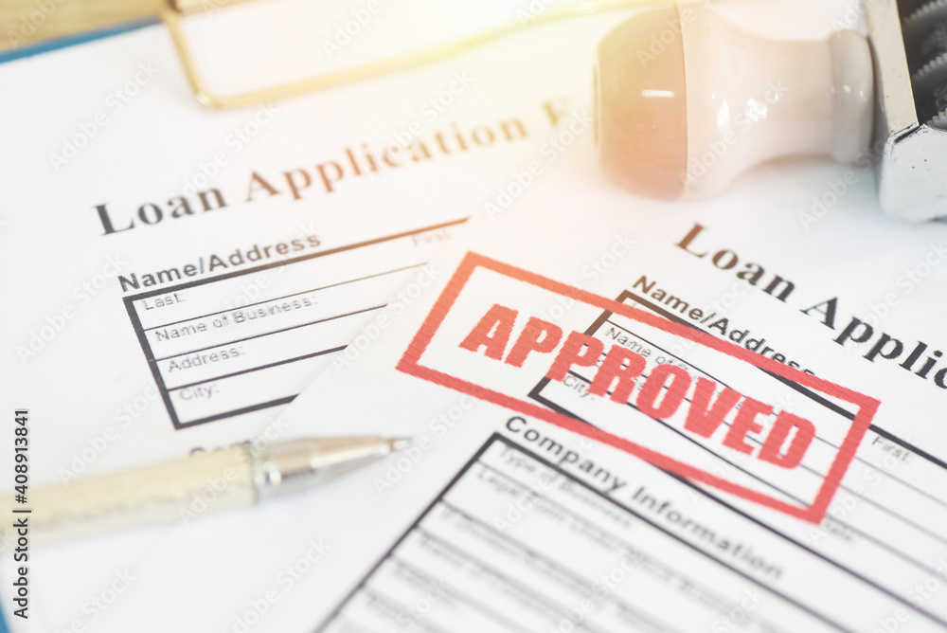
How did we get here?
- Home Credit is
hoping to mitigate the risk of default by using statistical methods.
- We have been provided with application information as well as historical data on clients’ applications, financial information,
and repayment histories.
- We’ll measure our success by our ability to predict when borrowers will default.

Slide 5
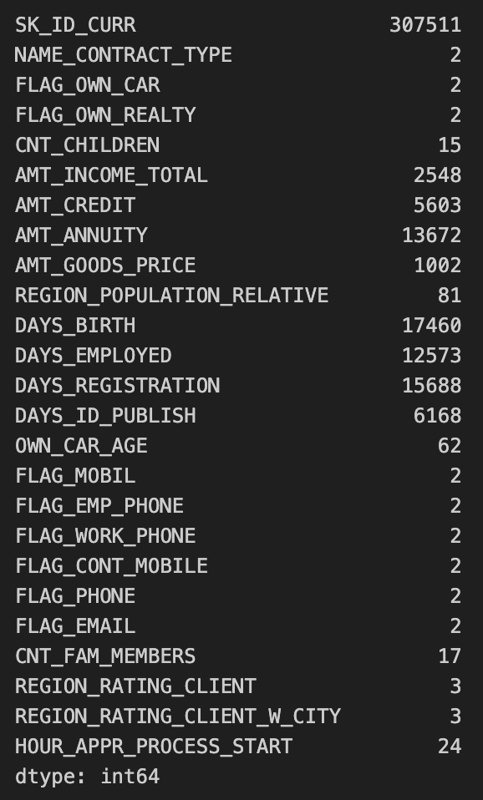
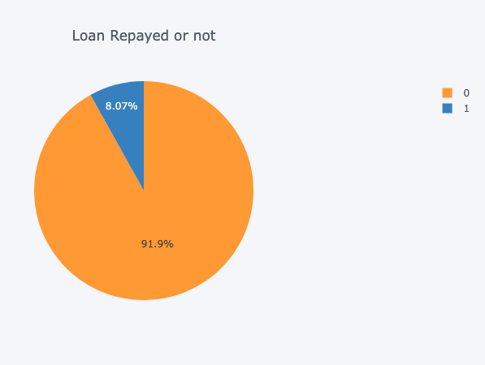
What we have…

Slide 6
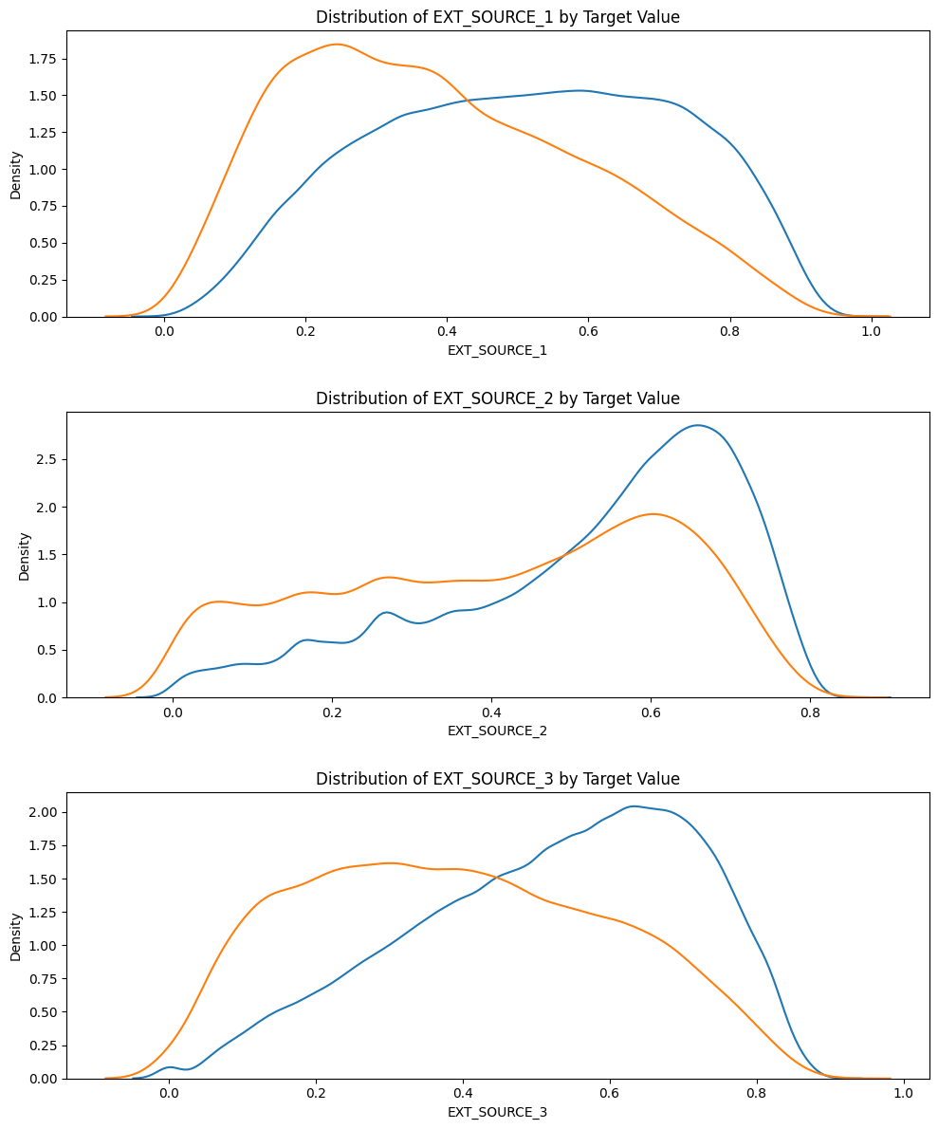
Distribution of credit scores amoung those who defaulted on loans (red) and those who did not (blue).
Creditworthiness is obviously a major factor.

Slide 7
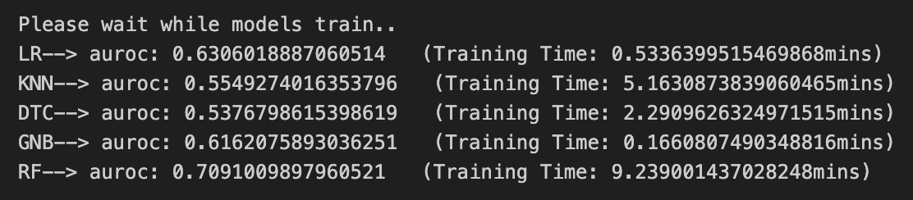
Ranking Test Methods…
We use AUROC to rank the accuracy of these models primarily because that is what
Kaggle does. But, additionally,
AUROC is useful when
ranking models strengths
one against another.
In testing
Logistic Regression,
K Neighbors Classifier, Decision
Tree Classifier, Gaussian NB, Random
Forest Classifier against our data it appear that
a Random Forest Classifier would be most effective.

Slide 8


Slide 9
PAYMENT_RATE: What % of the loan is being paid back each month–the higher the amount, the more likely the borrower is to default.

Slide 10
EXT_SOURCE: These are sources external to Home Credit, presumably normalized credit scores from the major credit bureaus

Slide 11
DAYS_BIRTH: This a measure of a borrower’s age in days.
DAYS_EMPLOYED_PERC: This is the amount of days a borrower has been employed divided by the days since the borrower’s birth.

Slide 12
Final Thoughts…
When it comes to modeling, gradient boosted machines are extremely impressive. I spent much of my time engineering features for the random forest model with limited payoff. And the the LightGBM model blew it away.
In terms of risk, minimize loan making where the rate of payment is especially high and where borrowers have less-than-ideal credit, limited employment history, and are relatively young…
So me. Avoid making loans to someone like me.

