Slide 1
Tableau Guest Lecture
Spencer Shadley
5/29/29
sshadley@tableau.com | LinkedIn
Notes:
Title Slide

Slide 2
About Me

Slide 3

Notes:
https://www.utexas.edu/

Slide 4


Slide 5

Notes:
https://www.amazon.co.uk/Seeds-Varieties-TRINIDAD-MORUGA-SCORPION/dp/B01M4LAHG7

Slide 6


Slide 7
Notes:
Tableau Logo

Slide 8

Move to the Web Team
Notes:
Table

Slide 9
Agenda
Growth of Data
Why Data Matters – Three Examples
Career Opportunities
Interactive Tableau Tutorial
Tableau Resources
Notes:
Table of Contents

Slide 10
What is Big Data?
Notes:
Section Header

Slide 11
The Three Vs
Volume – the amount of data captured often exceeds traditional storage and has required platforms like data lakes and Hadoop. The world now contains zettabytes of data.
Velocity – Speed of collecting and processing data. Some data must be handled in near-real time. For example, traffic and weather conditions.
Variety – Data has many formats. Videos, emails, stock ticker data, etc. Structured (relational) data plays well with MySQL databases and unstructured (non-relational) data plays well with NoSQL databases such as MongoDB.
Notes:
Tera > peta > exa > zetta > yotta
variability (data continues to change)
veracity (data quality)
Visualization
Value

Slide 12
What is Big Data used for?
Notes:
Section Header

Slide 13
A Lot
Measure failure rates
Understand customer behaviors to adjust to their needs
Inform customers (ex. traffic and weather)
Empower machine learning
More…
Notes:
Also variability (data continues to change) and veracity (data quality)

Slide 14
Growth of Data
Notes:
Section Header

Slide 15
“Healthcare data will experience a compound annual growth rate (CAGR) of 36 percent through 2025.”
Jessica Kent, Health IT Analytics, 2018
Notes:
https://healthitanalytics.com/news/big-data-to-see-explosive-growth-challenging-healthcare-organizations

Slide 16
“…data in the manufacturing industry is projected to see a CAGR of 30 percent, financial services data is expected to grow at a rate of 26 percent, and data in the media and entertainment industry will increase at a compound rate of 25 percent.”
Jessica Kent, Health IT Analytics, 2018
Notes:
https://healthitanalytics.com/news/big-data-to-see-explosive-growth-challenging-healthcare-organizations

Slide 17
“Worldwide Big Data market revenues for software and services are projected to increase from $42B in 2018 to $103B in 2027, attaining a Compound Annual Growth Rate (CAGR) of 10.48% according to Wikibon.”
Louis Columbus, Forbes, 2018
Notes:
https://www.forbes.com/sites/louiscolumbus/2018/05/23/10-charts-that-will-change-your-perspective-of-big-datas-growth/#6743ec3d2926

Slide 18
“According to an Accenture study, 79% of enterprise executives agree that companies that do not embrace Big Data will lose their competitive position and could face extinction. Even more, 83%, have pursued Big Data projects to seize a competitive edge.”
Louis Columbus, Forbes, 2018
Notes:
https://www.forbes.com/sites/louiscolumbus/2018/05/23/10-charts-that-will-change-your-perspective-of-big-datas-growth/#6743ec3d2926

Slide 19
“The Hadoop and Big Data Market are projected to grow from $17.1B in 2017 to $99.31B in 2022 attaining a 28.5% CAGR. The greatest period of projected growth is in 2021 and 2022 when the market is projected to jump $30B in value in one year. Source: StrategyMRC and reported by Statista.”
Louis Columbus, Forbes, 2018
Notes:
https://www.forbes.com/sites/louiscolumbus/2018/05/23/10-charts-that-will-change-your-perspective-of-big-datas-growth/#6743ec3d2926

Slide 20
“90% of the data in the world today has been created in the last two years.”
Ralph Jacobson, IBM, 2013
Notes:
https://www.ibm.com/blogs/insights-on-business/consumer-products/2-5-quintillion-bytes-of-data-created-every-day-how-does-cpg-retail-manage-it/

Slide 21
Amount of data per second
40,000 average Google searches as of 5/27/19 (Internet Live Stats)
57,870 YouTube videos watched on average in 2018 (YouTube)
11,574 hours of YouTube video watched on average in 2018 (YouTube)
34,722 Snapchat photos shared on average in 2018 (Snapchat)
1,157 Instagram photos and videos uploaded as of 9/17/18 (Omnicore)
6,000 tweets sent as of 5/17/19 (Internet Live Stats)
Record second was 143,199 on August 3, 2013 when Castle in the Sky aired in Japan (Twitter)
Previous record was set on June 25, 2009 at 456 tweets after Michael Jackson’s death (Twitter)

Slide 22
Why is there more data?
More opportunities to collect data
Virtual Assistants, chatbots
More “smart” devices (50 billion collecting data by 2020, according to Attunity)
Consumers are sharing more information (social media, photo sharing, purchase transactions, etc.)
More people to collect data from (increasing world population, increasing percent of digital users)
Telemetry (feature usage, performance, etc.)
Data is increasingly utilizable
Modern tools such as machine learning and modern visual analytics
Applicable to more scenarios such as machine learning (autonomous cars, image recognition)
It’s new (see Technology Adoption Over Time workbook)
Notes:
Earthquakes are difficult to predict – one of the best predictors is just a twitter scraper looking at people talking about earthquakes
improves many metrics (increases sales, decreases costs, reduces response times, etc.)

Slide 23
Why Data Matters
Notes:
Section Header

Slide 24
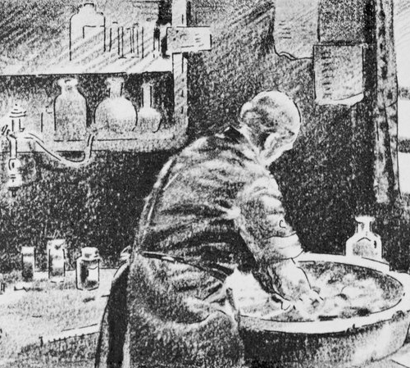
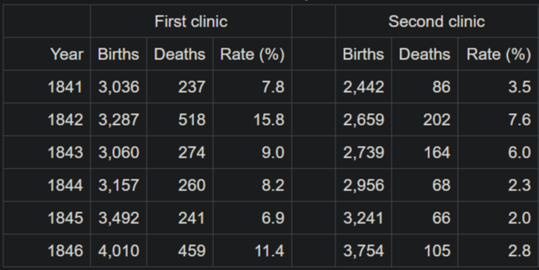
Ignaz Semmelweis
Wrote down mortality rates in a table
Births assisted by doctors had higher mortality rates than those assisted by midwives
Theorized something invisible to the eye must be transferring from previous surgeries
Asked doctors to wash their hands before examining pregnant women
Mortality rate decreased from 18% to 2.2%
Notes:
Picture credit: https://www.npr.org/sections/health-shots/2015/01/12/375663920/the-doctor-who-championed-hand-washing-and-saved-women-s-lives
Table credit: https://en.wikipedia.org/wiki/Ignaz_Semmelweis
Hungarian physician
Pioneer of antiseptic prcedures
Wash hands with chlorinated lime water
Simple Table from 1847
- Microscopic germs, invisible to the eye, can make us sick!
- A doctor who doesn’t wash his hands can spread his disease from one person to another
- Discovery made with data by Ignaz Semmelweis
- In his first year, in fact in his first six months, using this data right here, after being turned down from a more prestigious job he discovered the Germ Theory of Disease
- He noticed that doctors coming from autopsies who then delivered babies had dramatically higher maternal mortality rates due to puerperal fever.
- After asking doctors to wash their hands before examining pregnant women he documented a reduction in mortality rate from 18% to 2.2% over a year
- He, originally, was mocked for this. He had no explanation but from the data he knew that when doctors washed their hands it saved lives.
- He died in an insane asylum at age 47 before his theory was ever accepted.
- A few years after his death in 1865, Louis Pasteur confirmed germ theory and Joseph Lister used their research to practice and operate with hygienic methods with great success.
- John Snow also contributed to this replacement of miasma theory (disease spread through bad air, even caused by things like bad breath).
- Game of Thrones!
- Wrote essay called On the Mode of Communication of Cholera in 1849

Slide 25

Ignaz Semmelweis (cont.)
Germ Theory of Disease
Replaced Miasma theory
Saved many lives
Community did not accept it
Semmelweis died in an insane asylum
John Snow!
With research from Louis Pasteur, Joseph Lister and others confirmed the theory
Wrote persuasive essay called On the Mode of Communication of Cholera (1849)
Notes:
Picture credit: https://www.npr.org/sections/health-shots/2015/01/12/375663920/the-doctor-who-championed-hand-washing-and-saved-women-s-lives
- Simple Table from 1847
- Microscopic germs, invisible to the eye, can make us sick!
- A doctor who doesn’t wash his hands can spread his disease from one person to another
- Discovery made with data by Ignaz Semmelweis
- In his first year, in fact in his first six months, using this data right here, after being turned down from a more prestigious job he discovered the Germ Theory of Disease
- He noticed that doctors coming from autopsies who then delivered babies had dramatically higher maternal mortality rates due to puerperal fever.
- After asking doctors to wash their hands before examining pregnant women he documented a reduction in mortality rate from 18% to 2.2% over a year
- He, originally, was mocked for this. He had no explanation but from the data he knew that when doctors washed their hands it saved lives.
- He died in an insane asylum at age 47 before his theory was ever accepted.
- A few years after his death in 1865, Louis Pasteur confirmed germ theory and Joseph Lister used their research to practice and operate with hygienic methods with great success.
- John Snow also contributed to this replacement of miasma theory (disease spread through bad air, even caused by things like bad breath).
- Game of Thrones!
- Wrote essay called On the Mode of Communication of Cholera in 1849

Slide 26
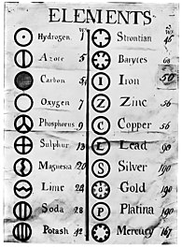
Dmitri Mendeleev
Russian chemist and inventor
Became teacher in 1867 and made a great discovery while writing his textbook – Principles of Chemistry
Viewed elements from a different perspective, playing with how to visualize them
Notes:
Great minds are constantly changing the way they look at a problem. Dmitri Mendeleev is a great example of this.
He took this collection of data and looked at it like this, then this, then this.
In an involved thinking process looked at this way then this way then this way. And finally in this way.
There is no difference between the data stored in that first table and the last one. Not any difference at all.
Here’s the power of perspective shifting. The first table is virtually useless. The last table is one of the most impactful tables of data ever created. You can predict the behavior of elements and even predict new elements.

Slide 27
“I saw in a dream a table where all the elements fell into place as required. Awakening, I immediately wrote it down on a piece of paper.”
Dmitri Mendeleev
Notes:
Quote

Slide 28
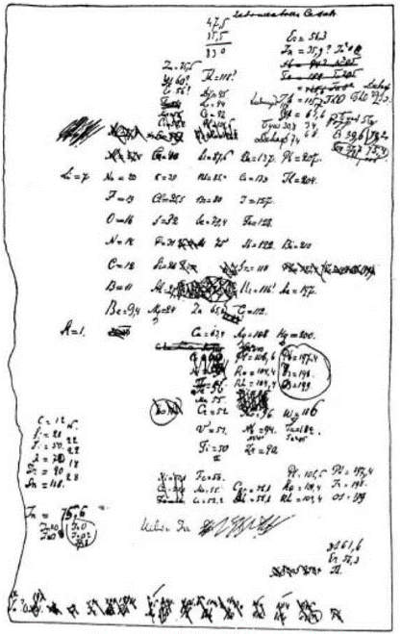
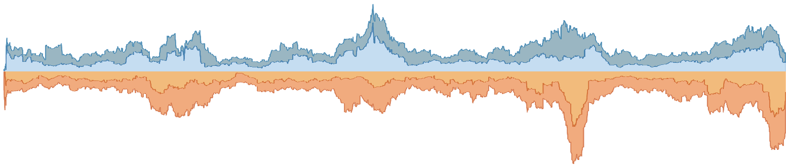
1868
First
Draft
Notes:
https://www.meta-synthesis.com/webbook/35_pt/pt_database.php?Button=pre-1900+Formulations

Slide 29
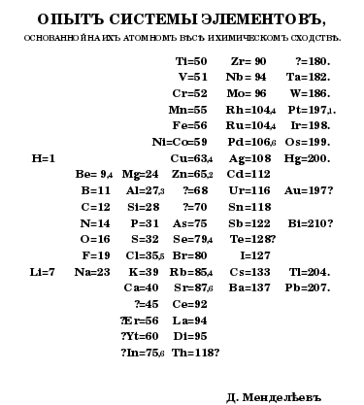
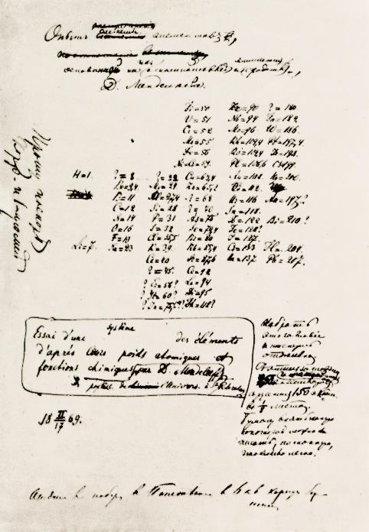
1869
Mendeleev’s
Tabelle I
Notes:
https://www.meta-synthesis.com/webbook/35_pt/pt_database.php?Button=pre-1900+Formulations

Slide 30
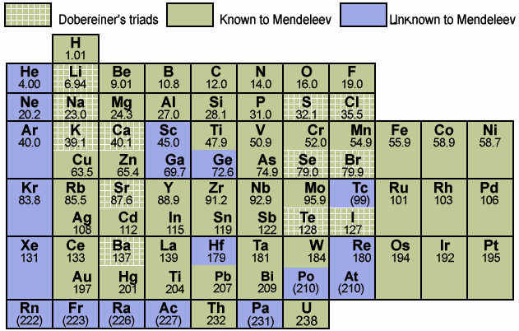
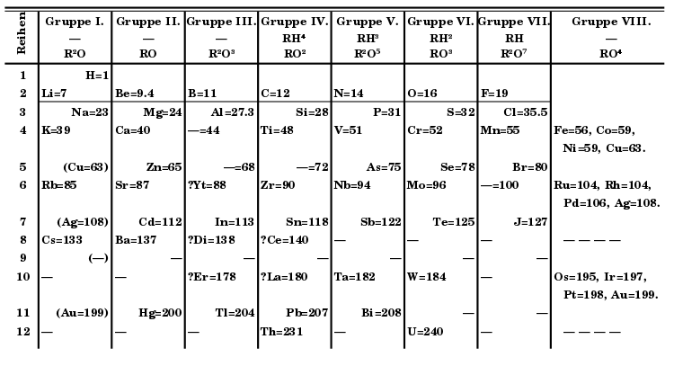
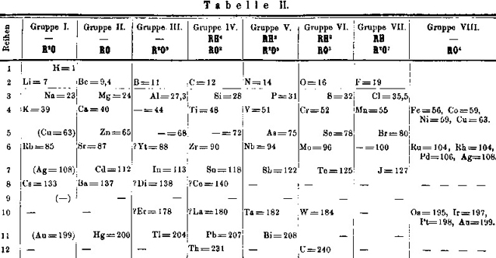
1871
Mendeleev’s
Tabelle II
Notes:
https://www.meta-synthesis.com/webbook/35_pt/pt_database.php?Button=pre-1900+Formulations

Slide 31

Notes:
https://saylordotorg.github.io/text_introductory-chemistry/s12-04-electronic-structure-and-the-p.html

Slide 32

Steven Levitt
Economist, author of Freakonomics
Chicago Public School System switched to new testing criterium
Introduced potential penalties and restrictions on teachers and schools
Grades improved, substantially
Released test scores publicly
Letter == correct answer; number == incorrect
700,000 tests, organized by classroom
1993 – 2000
400,000 students per year
100 million individual answers
Notes:
Steven Levitt, author of Freakonomics
This shows test answers for students in different classrooms
A letter indicates a correct answer and a number indicates an incorrect answer
This data is trying to tell us that over 200 teachers in the Chicago public school system are cheating
They’re changing the answers that students are filling out on tests to make themselves look better
You’ll see it if you just look at it the right way
The Chicago Public Schools teaches more than 400,00 students a year. In 1996 The Chicago Public School system adopted “high-stakes” testing. This enacted minimum scores required on a number of tests in the 3rd, 6th and 8th grade. What was unique here was that it held the school accountable for these scores. For example, a school could be shut down entirely if it didn’t meet minimum reading scores or staff members could have a raise withheld, a promotion cancelled or even be dismissed if they did not meet certain thresholds.
Chicago Public Schools made available a database of the test answers for every CPS student from third grade through seventh grade from 1993 to 2000. This amounts to roughly 30,000 students per grade per year, more than 700,000 sets of test answers, and nearly 100 million individual answers. The data, organized by classroom, included each student’s question-by-question answer strings for reading and math tests
https://medium.com/bloombench/how-data-analysis-helped-uncover-the-cheating-teachers-in-chicago-public-schools-ff1a52d3e00a

Slide 33



What’s Different Here?
Notes:
These questions,coming near the end of the test, were harder than the earlier questions.
This was a group of average students and very few of them have got 6 consecutive correct answers anywhere else on the test, making it even more unlikely that they would get 6 continuous answers right in the harder part of the test.
Upto this point in the test, the fifteen students’ answers were virtually uncorrelated.
Three of the students (row numbers 1, 9, and 12) left more than one answer blank before the suspicious string and then ended the test with another string of blanks. This suggests that a long, unbroken string of blank answers was broken not by the student but by the teacher.

Slide 34
Career Opportunities
Data Scientist
“AI’s impact on marketing is growing, predicted to reach nearly $40 billion by 2025.” (Attunity, 2018)
“The salaries of data scientists are rapidly increasing with demand.” (Attunity, 2018)
“83% of data scientists polled feel that there is shortage of data scientists today” (CrowdFlower, 2016)
“80% of data scientists feel really positive about their current gig” (CrowdFlower, 2016)
“[b]y 2020 the number of Data Science and Analytics job listings is projected to grow by nearly 364,000 listings to approximately 2,720,000.” (Forbes, 2017)
Data Analyst
“Most companies only analyze 12% of the data they have.” (Attunity, 2018)
“But here’s another number: $3.1 trillion, IBM’s estimate of the yearly cost of poor quality data, in the US alone, in 2016. While most people who deal in data every day know that bad data is costly, this figure stuns.” (Harvard Business Review, 2016)

Slide 35
Tableau
Notes:
Technology Adoption Over Time
Germ Theory of Disease (two clinics)
Germ Theory of Disease
Tableau Public
Anime

Slide 36
Technology Adoption Over Time
Notes:
https://github.com/spencer-shadley/data-lecture/blob/master/workbooks%20and%20datasources/Completed%20Workbooks/Technology%20Adoption%20Over%20Time.twbx

Slide 37
Germ Theory of Disease (two clinics)
Open Template/Germ Theory of Disease (two clinics)
Drag “Clinic” to Columns
Drag “Mortality Rate” to Rows
Right click “Mortality Rate” > Measure > Average
“Year” to “Columns”
Move the existing “Clinic” pill to “Color”
“Births” to “Tooltip”
“Deaths” to “Tooltip”
Open “Tooltip”
Add custom Tooltip message

Slide 38
Germ Theory of Disease – Basic Viz
Open Template/Germ Theory of Disease
Right click the empty area in “Measures” > “Create Calculated Field…”
Name the Calculated Field “Mortality Rate (%)”
Type “[Deaths] / [Births] * 100” as the contents of the Calculated Field
Double click your new Calculated Field “Mortality Rate (%)”
Right click “SUM(Rate (%))” > “Measure” > “Average”
Double click “Date”
Switch view to “Entire View”
Right click “YEAR(Date)” > Select “Exact Date”
(notice there is a null row for December 1841)
Click “1 null” > “Filter data” from the bottom right

Slide 39
Germ Theory of Disease – Simple Viz
Select “Show Me” from the top right
Select “area chart”
(notice the date was automatically switched to “YEAR(Date)”)
Click the “+” on the left side of the “YEAR(Date)” pill twice to get it to “MONTH(Date)” again
(NOTE: alternatively instead of steps 1-4 we could change the mark type to “Area”)
Double click the sheet tab (“Sheet 1”) and rename to “Mortality Rate over Time”
Right click “Mortality Rate over Time” and select “Duplicate”
Right click “Date” and select “Month”
Go to the “Analytics” pane
Drag out a “Trend Line” onto “Polynomial”
Drag “Date” to “Color”
Rename the sheet
Notes:
Can add stuff to pages if desired (date or deaths might be interesting)

Slide 40
Germ Theory of Disease – (slightly) Advanced Viz
Duplicate “Mortality Rate over Time”
Drag “Date” to “Pages”
Right click “Date” pill from the “Pages” card and select “Month (May 2015)”
Switch the “Marks” type to “Bar”
Try clicking the “Play” button in the Pages card
Check “Show history” in the Pages card
Select the dropdown and choose “All”
Try playing it again
Rename the sheet “Mortality Rate through Time”
Duplicate “Mortality Rate through Time”
Replace the Pages “Date” with “Mortality Rate (%)” (drag it on top of the existing pill)

Slide 41
Germ Theory of Disease – Dashboard
Create a new dashboard (the grid icon to the right of the tabs)
Switch “Size” to “Automatic”
Drag out “Mortality Rate over Time”
Drag out “Mortality By Month” (below “Mortality Rate over Time)
Select “Mortality By Month” and click the “Use as Filter” button
Try clicking a mark in the “Mortality By Month” sheet
Click “Dashboard” in the top level menu > “Actions…”
Click your filter > “Edit…”
Select “Hover” > “OK” > “OK”
Hover on a mark!
Rename the dashboard (I called it “Mortality Rate Dashboard”)

Slide 42
Germ Theory of Disease – Dashboard 2
Create a new dashboard (the grid icon to the right of the tabs)
Switch “Size” to “Automatic”
Drag out a “Vertical” Object
Drag a “Text” Object into the “Vertical” Object and enter “Try the page controls!”
Drag out a “Horizontal” Object into the “Vertical” Object, below the “Text” Object
Drop “Mortality Rate Through Time” in
Drop “Mortality Rate Through Time (2)” in (on the right)
Name the dashboard (I called it “Mortality Rate Through Time Dashboard”)
Can you get the page controls to be inlined above each sheet?

Slide 43
Germ Theory of Disease – Make it Public!
Click the “Server” top level menu
Click “Sign In…”
Use “https://public.tableau.com” as the URL
Click “Connect”
Sign in with your Tableau Public account (or make one if you haven’t already)
Click the “Server” top level menu
Click “Publish Workbook…”
Note: You might need to switch the datasource to be an extract in the “Data Source” tab if it’s set to “Live”
Change the title to something unique
Click “Save”
It’s published!
Note: to show all sheets you need to “Edit Details” > check “Show workbook sheets as tabs” > “Save”

Slide 44
Featured Tableau Public Vizzes
Notes:
https://public.tableau.com/en-us/s/gallery
https://public.tableau.com/profile/spencer.shadley#!/vizhome/Anime/UndiscoveredAnime

Slide 45
Tableau Resources
Community Forums (Web Data Connector)
Tableau Help
Getting Started with Tableau
Dashboard Best Practices (Google for additional resources on “Tableau Dashboard Design”)
Using the Web Data Connector
Web Data Connector Tutorial
Tableau Web Data Connector Home
Web Data Connector Examples
Featured Tableau Public Vizzes

Slide 46
Make your own viz! (use any data, here’s an anime template and complete anime workbook on Tableau Public)
Notes:
Tableau Public Anime Viz: https://public.tableau.com/profile/spencer.shadley#!/vizhome/Anime/UndiscoveredAnime
Anime Template twb: https://github.com/spencer-shadley/data-lecture/blob/master/workbooks%20and%20datasources/Template%20Workbooks/Anime.twbx
Anime Complete Workbook (same as on public): https://github.com/spencer-shadley/data-lecture/blob/master/workbooks%20and%20datasources/Completed%20Workbooks/Anime.twbx

Slide 47
Any Questions?
Slides, workbooks and assets are available at
https://github.com/spencer-shadley/data-lecture
Notes:
Title Slide

