Slide 1
State Management with the Store
Lesson 20.3
Notes:
- What were some of the pain points of working with context and hooks?
- Managing many different contexts and hooks can gets complex very quickly.
- What is the difference between mutability and immutability, and what are the advantages of each?
- **Mutable** objects can have their properties changed or _mutated_, whereas **Immutable objects** can not. Typically immutable objects help prevent your application from getting over-complicated. They often make it easy to identify _why_ the state changed, since every time an object needs to change, a new object has to be explicitly created. This also tends to make testing your components significantly easier.
- How might we manage state when if there are several different objects to keep track of, and several components that have the ability to update them?
- We can create a single global state that contains all of the states needed throughout our application.

Slide 2

Let’s Talk About Pure Functions
And why they’re better than impure functions.
Pure Functions Impure Functions
Pure functions are straightforward with singular purposes.
No side effects inside the function.
Whenever data is modified, it is stored in a new variable.
Include side effects like database and network calls.
Often modify the values that are passed in.
Redux
Notes:
Pure functions are straightforward with singular purposes.
They do not have any side effects within them. Whenever data needs to be modified, it is not mutated. Impure functions tend to have multiple purposes. The might contain database or network calls.

Slide 3
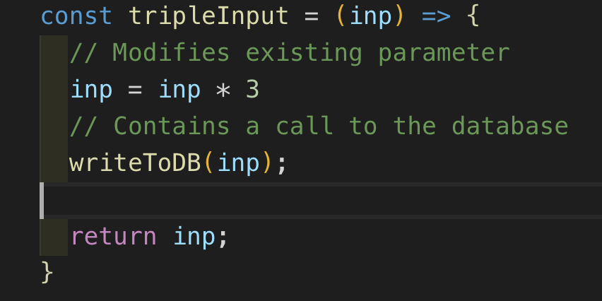
Here’s an Impure Function
Pure vs. Impure functions
Notes:
here modifies its argument instead of creating a new argument.

Slide 4
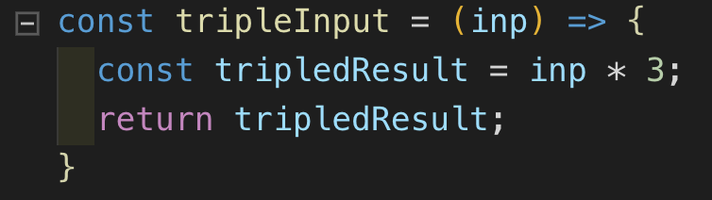
Here’s a Pure Function
Pure vs. Impure functions
Notes:
has a singular purpose, making it more developer-friendly.

Slide 5
Creating pure functions is an effective technique to apply to all of your JavaScript, but it is especially useful when creating React components.
Redux

Slide 6

Redux
Redux is a state management library that helps organize the state of complex applications. Redux requires a lot of boilerplate code, but its utility skyrockets as applications get more complex.
Instead of learning about the Redux library, we will focus on the concepts and design patterns that Redux uses. After learning how to create each function from scratch, we will implement a Redux-like state management system in a small CMS app.
Notes:
is a state management library that helps organize the state of complex applications. While Redux requires a lot of boilerplate code, its utility skyrockets as applications get more complex.

Slide 7
Actions, Reducers, and Store
Today, we will cover three core Redux topics
Action
A declarative object that defines what the store should do to the state.
Reducer
Handles all actions by taking in the previous state and returning a new state.
Store
Grants the entire application access to the reducer function and the global state.

Slide 8
The Principles of Redux
Notes:
-

Slide 9
Principle 1: State Tree
The first premise of Redux is that every stateful aspect of your application can be represented by a single JavaScript object known as the state tree.
console.log(store.getState())
/* Prints
{
visibilityFilter: 'SHOW_ALL',
todos: [
{
text: 'Consider using Redux',
completed: true,
},
{
text: 'Keep all state in a single tree',
completed: false
}
]
}
*/
Notes:
The first premise of Redux is that every stateful aspect of your application can be represented by a single JavaScript object known as the state tree.

Slide 10
Principle 2: Read Only
The second principle of Redux is that the state tree is read-only. This means that in order to change the state tree, you need to dispatch an action. The action describes the change that the state will undergo in a declarative manner.
store.dispatch({
type: 'COMPLETE_TODO',
index: 1
})
store.dispatch({
type: 'SET_VISIBILITY_FILTER',
filter: 'SHOW_COMPLETED'
})
Notes:
- The second principle of Redux is that the state tree is read only. This means that in order to change the state tree, you need to dispatch an action. The action describes the change that the state will undergo in a declarative manner.

Slide 11
Principle 3: Changes are made with pure functions
Try to make your reducers pure functions. It is considered bad practice to use side effects inside reducer functions.
function visibilityFilter(state = 'SHOW_ALL', action) {
switch (action.type) {
case 'SET_VISIBILITY_FILTER':
return action.filter
default:
return state
}
}
case 'COMPLETE_TODO':
return state.map((todo, index) => {
if (index === action.index) {
return Object.assign({}, todo, {
completed: true
})
}
return todo
})
default:
return state
}
}
Notes:
* **Actions, reducers, and store**:
- **Actions** are declarative objects that define what the store should do to the state.
- **The Reducer** takes the previous state and action, then returns a new state. It is important that the reducer is a pure function.
- **The Store** servers as the global state. It gives different pieces of our application access to data held in the state and the reducer function.

Slide 12
Let’s Get Started!

