Slide 1
Predicting Post-Myocardial Infarction Complications Using Machine Learning
A Machine Learning Approach to Clinical Risk and Hospital Resource Optimization
Team 3A: Yuanfei Chen, Han Pham, Neha Kolagatla, Qinyi Ding, Yuqi Zhou, Spencer Cao

Slide 2



Introduction
Achieve early risk prediction, allowing hospitals to efficiently allocate resources
UCI ML Repository / University of Leicester
Goal
Data Source
Notes:
Myocardial infarction (MI) remains a leading cause of morbidity and mortality, and early identification of patients at risk for severe in-hospital complications remains a key challenge in clinical care. When patients arrive at the emergency department with MI, clinicians must rapidly assess their risk of developing severe in-hospital complications such as cardiogenic shock, acute heart failure, pulmonary edema, recurrent MI, or life-threatening arrhythmias. In certain cases, hospital resources such as ICU beds, cardiac monitoring equipment, and specialized staffing are limited, but early and accurate risk classification is vital for optimizing care and preventing major complications. Therefore, with this issue in mind, our project aims to use myocardial-risk patient data to predict whether individuals will experience major complications that could lead to lethal outcomes.
It was originally collected at the Krasnoyarsk Interdistrict Clinical Hospital and compiled by Krasnoyarsk State Medical University for use in research studies headed by S.E. Golonvenkin. We planned to use the data to build a machine learning model that predicts our selected target variable, a binary indicator called “Major_Complication,” which identifies whether a patient is at high risk of experiencing a major in-hospital event based solely on admission-time data. The target variable represents possible events such as cardiogenic shock, acute heart failure, pulmonary edema, recurrent MI, or life-threatening arrhythmias. By doing this, we believe that we’ll be capable of capturing clinically meaningful deterioration, supporting early risk stratification, and directly informing hospital decisions related to ICU monitoring, staffing, and emergency resource allocation.

Slide 3
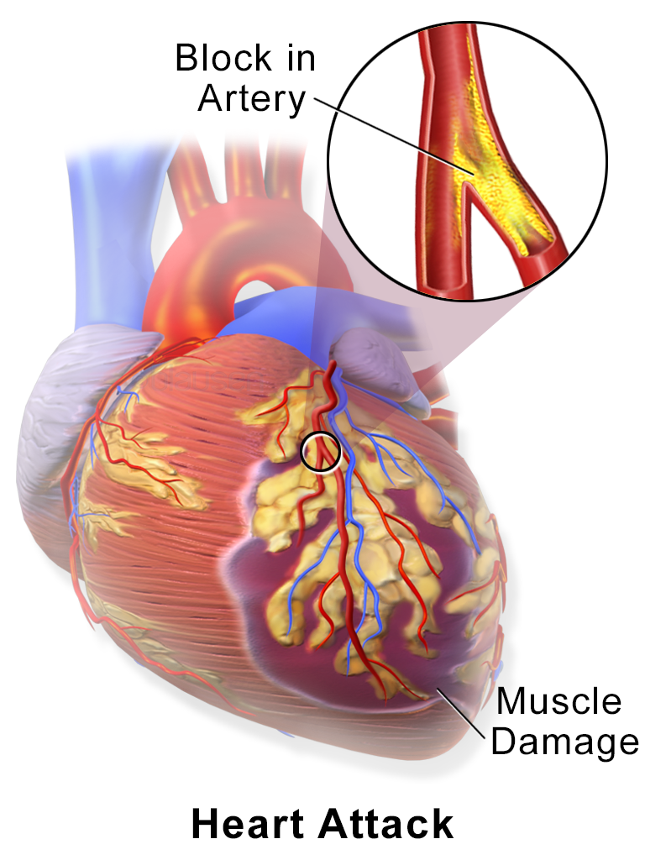
What is MI ?
Myocardial Infarction (heart attack) is a leading global cause of death.
It is a condition when blood flow to the heart is blocked, causing heart muscle tissue to die
When MI patients arrive at the emergency department, clinicians must quickly assess complication risk.
Major Complications: cardiogenic shock, acute heart failure, pulmonary edema, recurrent MI, or deadly arrhythmias.
Notes:
Myocardial Infarction (heart attack) is a leading global cause of death.
It is a condition when blood flow to the heart is blocked, causing heart muscle tissue to die
When MI patients arrive at the emergency department, clinicians must quickly assess complication risk.
Complications include cardiogenic shock, acute heart failure, pulmonary edema, recurrent MI, or deadly arrhythmias.

Slide 4
Project Objective
Predict risk of Major/Lethal Complications using admission-time clinical features.
Achieve early risk prediction, allowing hospitals to allocate ICU beds, monitoring devices, and staff more effectively.
Utilize a dataset of 1,700 patient entries & 124 features.
Compare two modeling pipelines
Identify which ML model performs best clinically.

Slide 5

The Dataset Preprocessing
1,700 patients data entries
Cleaning Steps:
Dropped ID feature
15,974 missing values handled by median imputation for numeric, mode for categorical
Created binary target variable: Major_Complication
Filtering with Mutual Information to handle high dimensionality of the raw data (124 attributes)

Slide 6
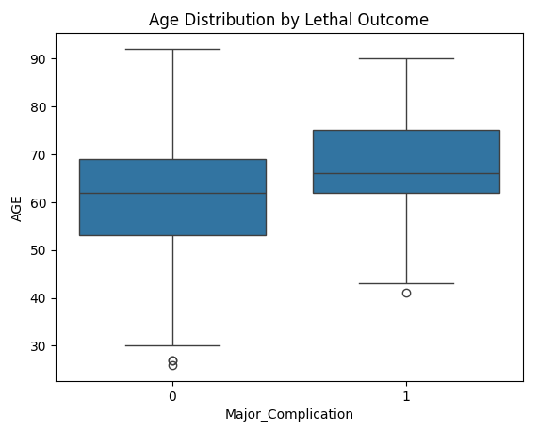
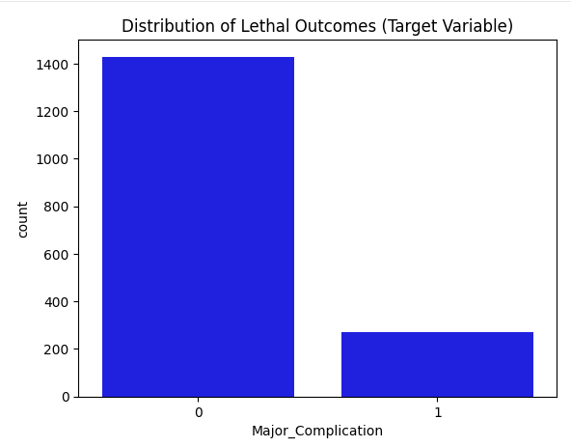
Exploratory Data Analysis
Prior to cleaning:
Age Distribution (Box Plot)
Ages are roughly normal but skewed older (peak: 60–70).
Very young (<40) and very old (>85) patients are underrepresented.
Target Variable (Bar Chart)
Severe class imbalance (~8:1).
Majority: no major / lethal complication; minority: major complication
Imbalance must be addressed for reliable modeling.
Notes:
Our exploratory analysis provides important initial insights into the dataset before building our prediction model, particularly regarding age distribution and target class balance. As shown in the Age Distribution box plot, the patient population follows an approximately normal distribution but is skewed toward an older demographic, with the highest frequency occurring between ages 60 and 70. This suggests that the medical complications being studied are most prevalent among older adults. From the box plot, there is a noticeable drop-off in patients younger than 40 and older than 85, indicating that these extreme age groups are underrepresented in the cohort.

Slide 7
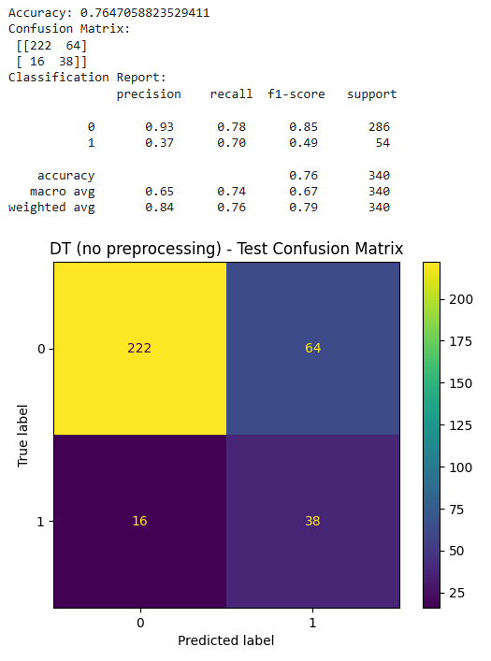
Our 1st Benchmark:
Simple Decision Tree
Only ~16% of patients had major complications; model becomes biased toward predicting “low-risk.”
result of imbalanced dataset (dangerous in a clinical setting)
Accuracy alone becomes misleading.
Approximately 76% overall accuracy
High-risk MI patients reaching only a 37% precision
Key metrics to track: Recall (sensitivity), Precision, F1-score, Confusion matrix

Slide 8

Modeling Approaches
Feature selection → Decision Tree → Post Pruning → SMOTE
Creating Decision Tree with full raw feature set → Random Forest
Approach 1
Approach 2

Slide 9
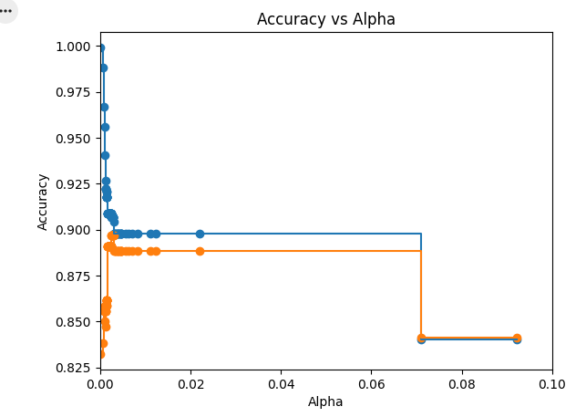
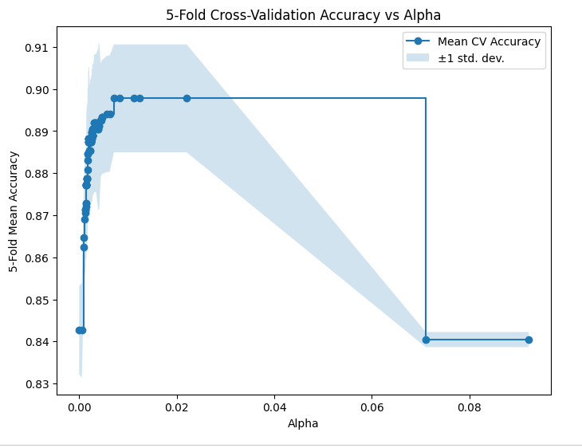
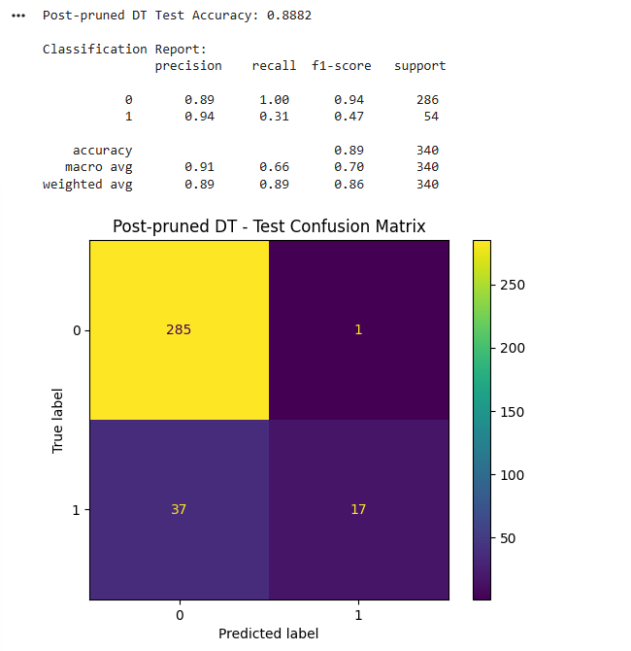
Approach 1: Decision Tree Classification With Post Pruning
Decision tree classification
Mutual Information feature selection - top 15 features
Post-pruning with 5-fold Cross-Validation to increase accuracy and sensitivity.
Accuracy increased from 76% to 88%
Recall for positive High-risk MI Patients is 0.31 (concerning)
Notes:
By comparing the original confusion matrix (without preprocessing) to the post-pruned model shown above, we see a substantial improvement in performance: overall accuracy increased from 76.47% to 88.82%. The class distribution remains the same but, now in the filtered model, Class 0 achieves a strong precision of 89% for identifying low-risk MI patients, while Class 1 reaches an even higher precision of 94% for identifying high-risk patients. However, an important concern persists, as the model continues to exhibit low recall for Class 1 (0.31), indicating that 69% of high-risk patients are missed / misclassified as low-risk despite its high precision.

Slide 10
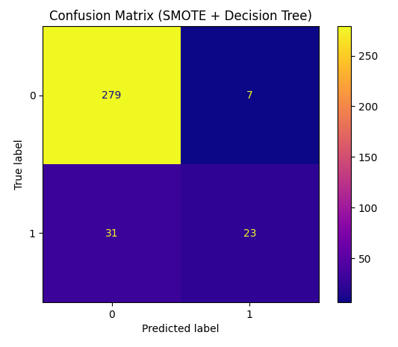
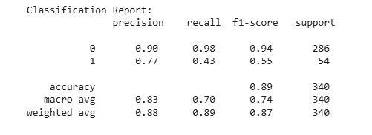
Approach 1 (cont.) :
DTC + SMOTE
Implementing SMOTE to oversample minority class to resolve imbalance:
Changes:
Overall accuracy remains similar (89% vs. 88.82%).
The recall improves from 0.31 to 0.43.
Precision decreases from 0.94 to 0.77.
Performance decreases as precision is now at 0.90
Recall decreased to 0.98.
Notes:
Summary: The Post-pruned Decision Tree has excellent precision but missed a majority of high-risk MI patients. This would be extremely dangerous in a medical context. Once we applied SMOTE, we discovered that it improves on catching high-risk MI patients (higher recall). The accuracies are stable, but there is a small trade-off in precision as more low-risk MI patients are falsely classified as high-risk. In conclusion, SMOTE improves the model’s ability to detect high-risk MI patients, which is an important clinical priority, at the cost of more false alarms.

Slide 11
Approach 2: Decision Tree + Random Forest Classification
No Feature Selection
Decision Tree as Baseline
Random Forest:
300 Trees,
min_samples_leaf = 5,
class_weight = ‘balanced’,
Handles Nonlinear Interactions,
Natural feature selections using tree splits
Random forest performs well on high dimensional medical data and can handle imbalance via class_weight.

Slide 12
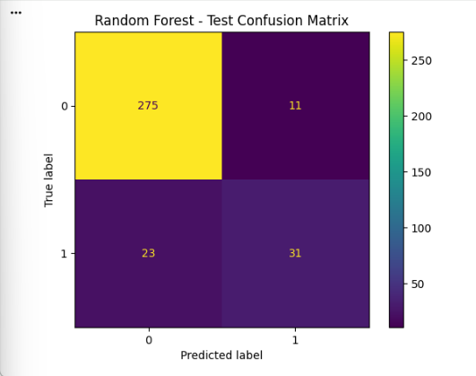
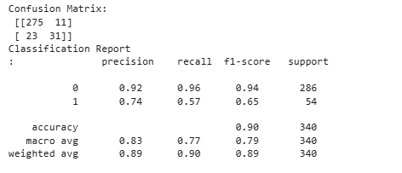
Approach 2 : Results
Overall Accuracy: 90%
Precision (Class 1): 74% of predicted high-risk patients were true high-risk
Recall (Class 1): captured 57% of true Major Complication cases
Best balance between catching true complications & limiting false alarms
Captured the highest % of high-risk patients among all models

Slide 13
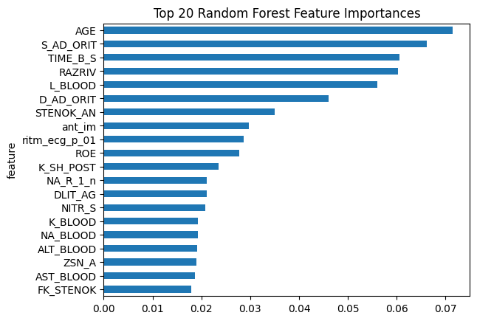
Top Predictors Identified by the Model
Age
ICU systolic/diastolic BP
Cardiogenic shock
Myocardial rupture
Time from pain onset to hospital
ECG rhythm & anterior MI
Hemoglobin & ESR

Slide 14
Conclusion
SMOTE improved recall but lowered precision for identifying positive major complications
Random Forest: 57% recall, balanced performance (90% overall accuracy)
the value of recall is crucial in a clinical setting
Notes:
Conclusion: While the Post-Pruned Decision Tree technically has high precision, it is likely under-fitting the minority class (Class 1) due to aggressive pruning. Ultimately, we determined that for our case of predicting major complications for MI patients, the Random Forest Classifier is the superior model. Out of all the models we generated, the Random Forest Model achieves the highest percentage (57%) in correctly identifying high-risk MI patients, which is crucial within a clinical setting. It provides a much more functional coverage of the dataset, capturing significantly more positive instances while maintaining acceptable accuracy.

Slide 15

Business Interpretation
Identifies high-risk MI patients early, allowing proactive planning.
Enables better allocation of ICU beds, monitoring resources, and specialists —> efficient hospital operations
Helps prevent costly complications and reduces readmission risks.
Lowers false-negative rates, representing an acceptable operational trade-off.
Notes:
Business Interpretation and Managerial Implications
If implemented in a clinical setting, the findings from this project could meaningfully assist hospitals in making operational decisions:
Improved Resource Allocation
Our Random Forest model identifies more than half of high-risk MI cases at admission. This gives hospitals the ability to prioritize ICU beds, continuous cardiac monitoring, and specialist intervention for the right patients. Early identification reduces delays in care and can lower the rate of sudden deterioration.
Reduction of Costly Complications
High-risk MI events often lead to extended ICU stays, emergency interventions, and greater use of staff time. By correctly classifying these patients earlier, hospitals can prevent severe downstream operational complications, which translates into:
lower treatment costs
reduced readmission penalties
improved survival outcomes
Acceptable Rate of False Positives
The Random Forest generated 11 false positives (patients incorrectly identified as high-risk). From a business operations standpoint, this is a manageable cost, particularly compared to the risk of missing true high-risk patients.

Slide 16
Thank You!

